Slide 1




From pQCD to neutron-star cores:
Recent advances in Equation-of-State inference
Aleksi Vuorinen
University of Helsinki and Helsinki Institute of Physics
Compact Stars in the QCD Phase Diagram
Barcelona, 22 May 2026
Main references:
Annala et al. (incl. AV), Nature Comm. 14 (2023), 2303.11356
Navarrete, Paatelainen, Seppänen, PRD 110 (2024), 2403.02180
Kärkkäinen, Navarrete, Nurmela, Paatelainen, Seppänen, AV, PRL 135 (2025), 2501.17921
Notes:
Welcome to Helsinki for the kickoff meeting of our new centre of excellence in…
My name is…

Slide 2
How does baryonic matter behave at the highest densities encountered in Nature?
Notes:
The problem my research addresses is almost childlike in its simplicity: what happens to ordinary matter when it is compressed without limit?

Slide 3
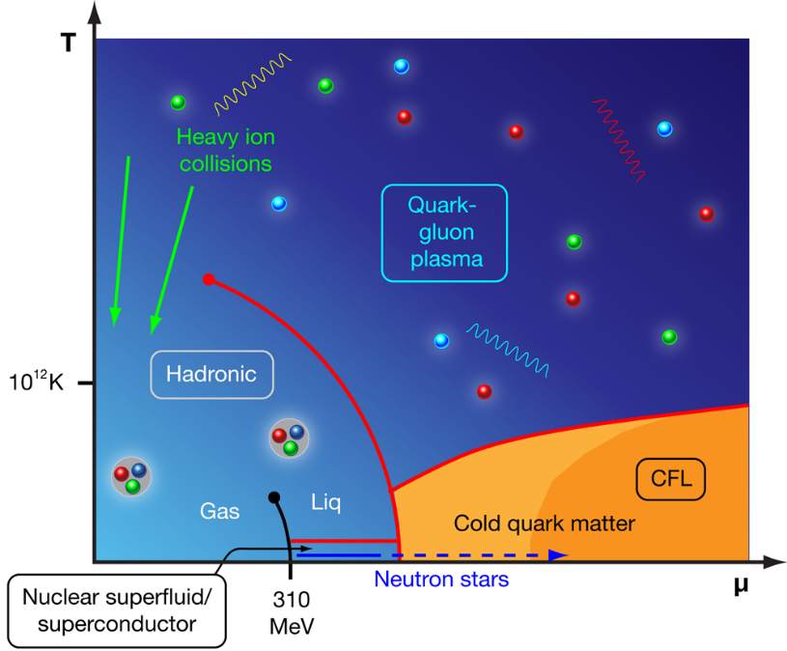
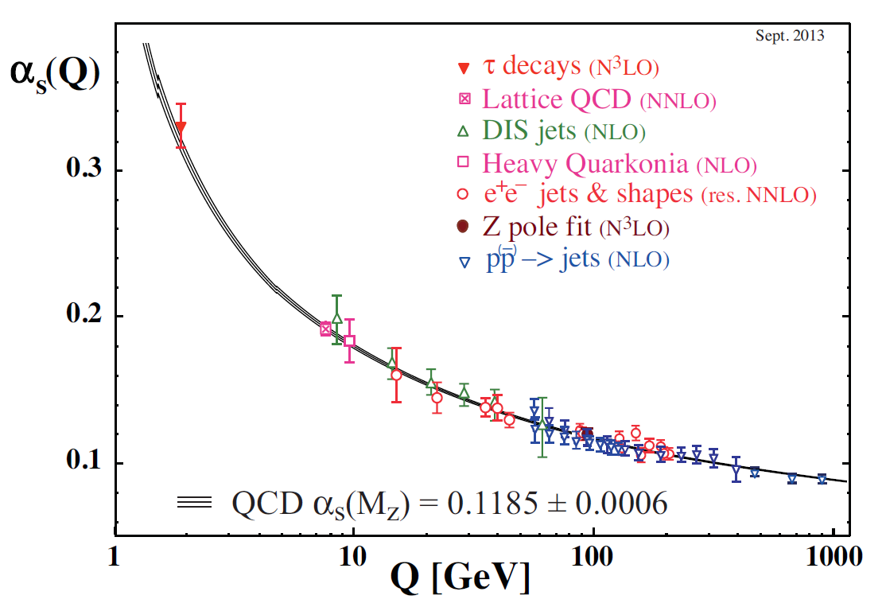
Notes:
The answer to this question is parameterized by the phase diagram of Quantum Chromodynamics, the theory of the strong nuclear interaction.
Unfortunately, however, much of the figure you see here is currently just an educated guess.
This is because we still lack the tools to reliably map the phase structure of QCD especially at high baryon densities.
***CLICK***
Given the strongly coupled nature of QCD, any quantum-field-theory tool up to the task must simultaneously satisfy three requirements: be first-principles, nonperturbative, and remain valid even at high density and low temperature.
***CLICK***
At the moment, this is a classic pick two problem.

Slide 4

’Pick two’ problem:
First principles
Non-perturbative
Applicable at $μ≫T$
Notes:
The answer to this question is parameterized by the phase diagram of Quantum Chromodynamics, the theory of the strong nuclear interaction.
Unfortunately, however, much of the figure you see here is currently just an educated guess.
This is because we still lack the tools to reliably map the phase structure of QCD especially at high baryon densities.
***CLICK***
Given the strongly coupled nature of QCD, any quantum-field-theory tool up to the task must simultaneously satisfy three requirements: be first-principles, nonperturbative, and remain valid even at high density and low temperature.
***CLICK***
At the moment, this is a classic pick two problem.

Slide 5
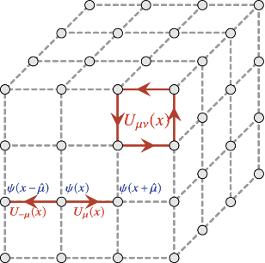
’Pick two’ problem:
Lattice QCD
First principles
Non-perturbative
Applicable at $μ≫T$
Notes:
Lattice QCD is first principles and nonperturbative but confined to small densities because of the famous Sign Problem.

Slide 6
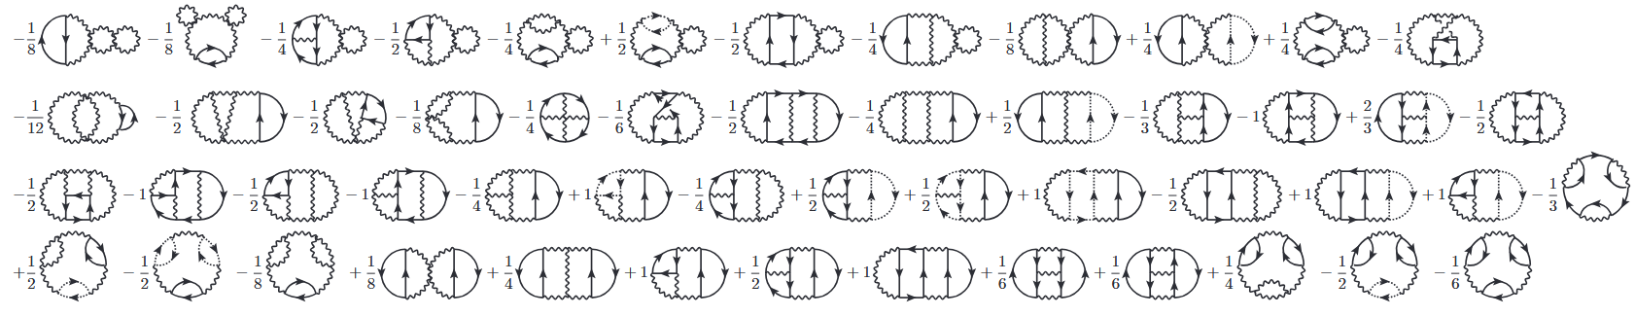
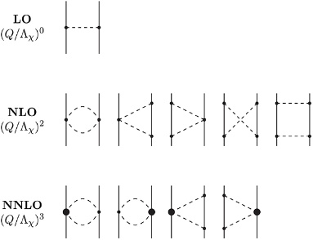
’Pick two’ problem:
First principles
Non-perturbative
pQCD & CEFT
Applicable at $μ≫T$
Notes:
Similarly perturbative QCD and ab-initio nuclear theory tools are first principles and apply all the way to vanishing temperatures but are reliable only at very large or small energy densities.

Slide 7
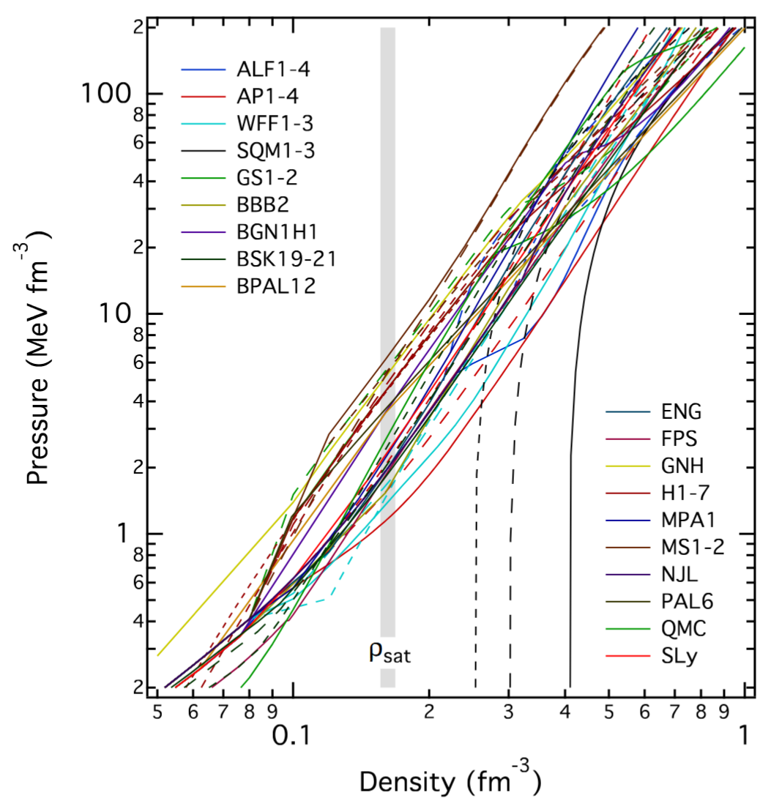
’Pick two’ problem:
First principles
Non-perturbative
Phen. models
Applicable at $μ≫T$
Notes:
And finally, this field has a long history of using simplified models for QCD, represented by the multitude of equation-of-state curves on this plot.
They typically capture some nonperturbative effects and can often be applied across the phase diagram but inevitably come with uncontrolled systematic uncertainties.

Slide 8
Or get all three?
First principles
Non-perturbative
?
Applicable at $μ≫T$
Notes:
A very natural question then emerges: apart from solving the lattice Sign Problem once and for all, is it possible to combine different methods into a framework that satisfies all three constraints at once?

Slide 9
Or get all three?
Our take on dense QCD
Combine established pQCD & EFT tools with a systematic use of neutron-star observations, with NS data supplying the non-perturbative input
First principles
Non-perturbative
?
Applicable at $μ≫T$
Notes:
While I’m not promising a full solution, this is precisely the challenge that my project StellarQCD addresses: obtaining a robust quantitative handle on the physics of dense QCD.
The key concept here is a unique combination of advanced perturbative thermal field theory calculations and a systematic use of astrophysical data in the inference of the neutron-star-matter equation of state.
The timeliness of this research relies on two independent factors: a methodological breakthrough in thermal field theory we have recently achieved here in Helsinki, and the unprecedented flow of observational data on neutron stars we are about to receive.

Slide 10
Rest of the talk:
Role of high-density constraint in NS-matter EoS inference
Case study: Inspecting twin stars with EoS inference
Improving the high-density constraint: Basics of perturbative QCD at nonzero density
Towards full N3LO: Methods and preliminary results
Future directions

Slide 11
Motivation: Role of high-density constraint in EoS inference

Slide 12
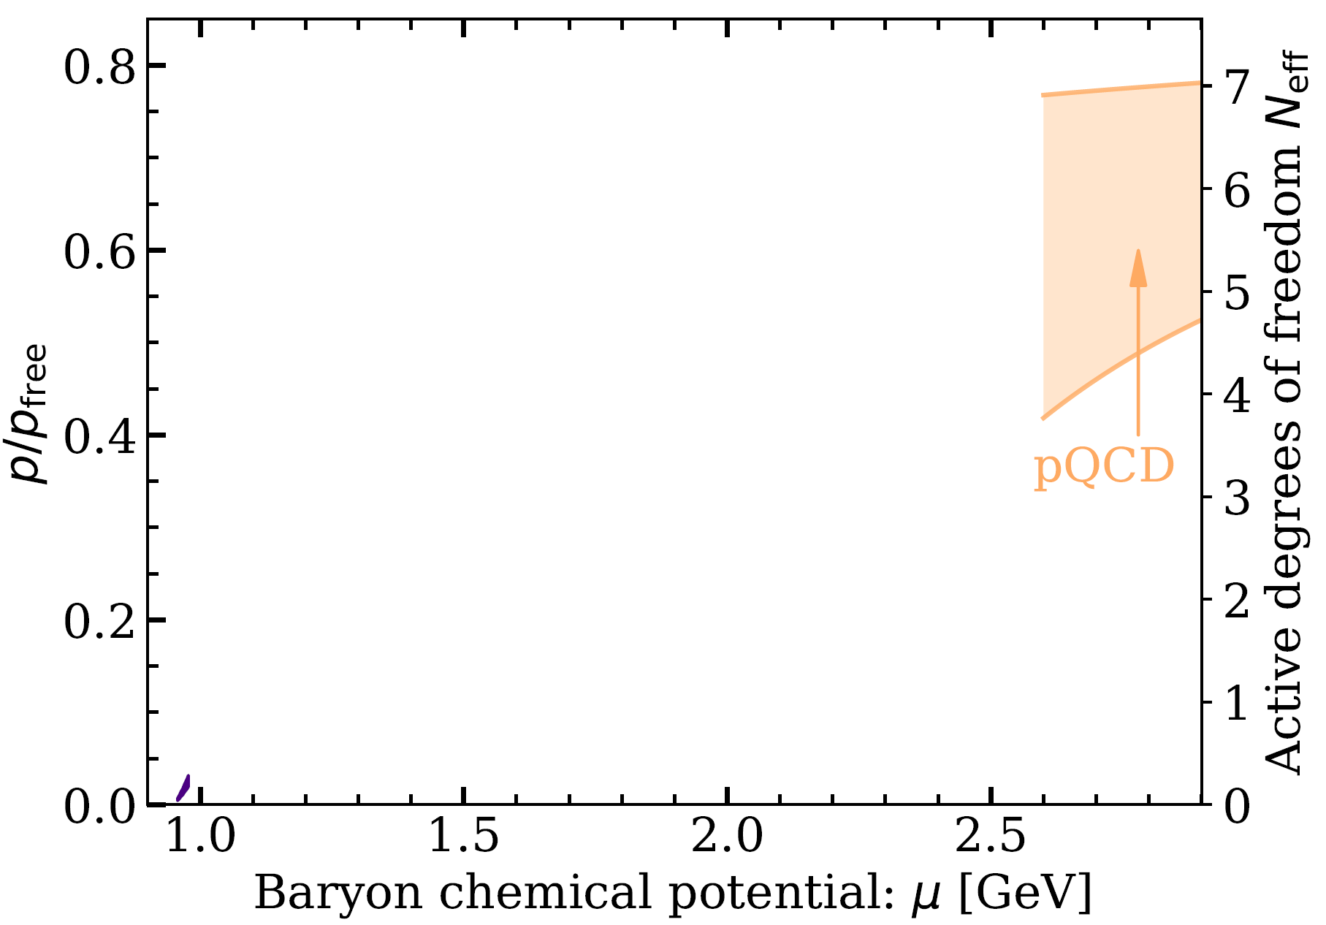
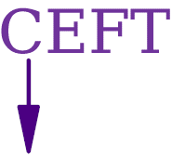
Basic problem: Lack of first-principles tools for dense QCD matter
For the properties of NS matter – controlling stellar structure and composition – only low- and high-density limits under control via Chiral EFT & pQCD

Slide 13

Basic problem: Lack of first-principles tools for dense QCD matter
For the properties of NS matter – controlling stellar structure and composition – only low- and high-density limits under control via Chiral EFT & pQCD
Model-agnostic approach (Gorda, Kurkela, AV,...): Systematic use of robust limits & observational data

Slide 14
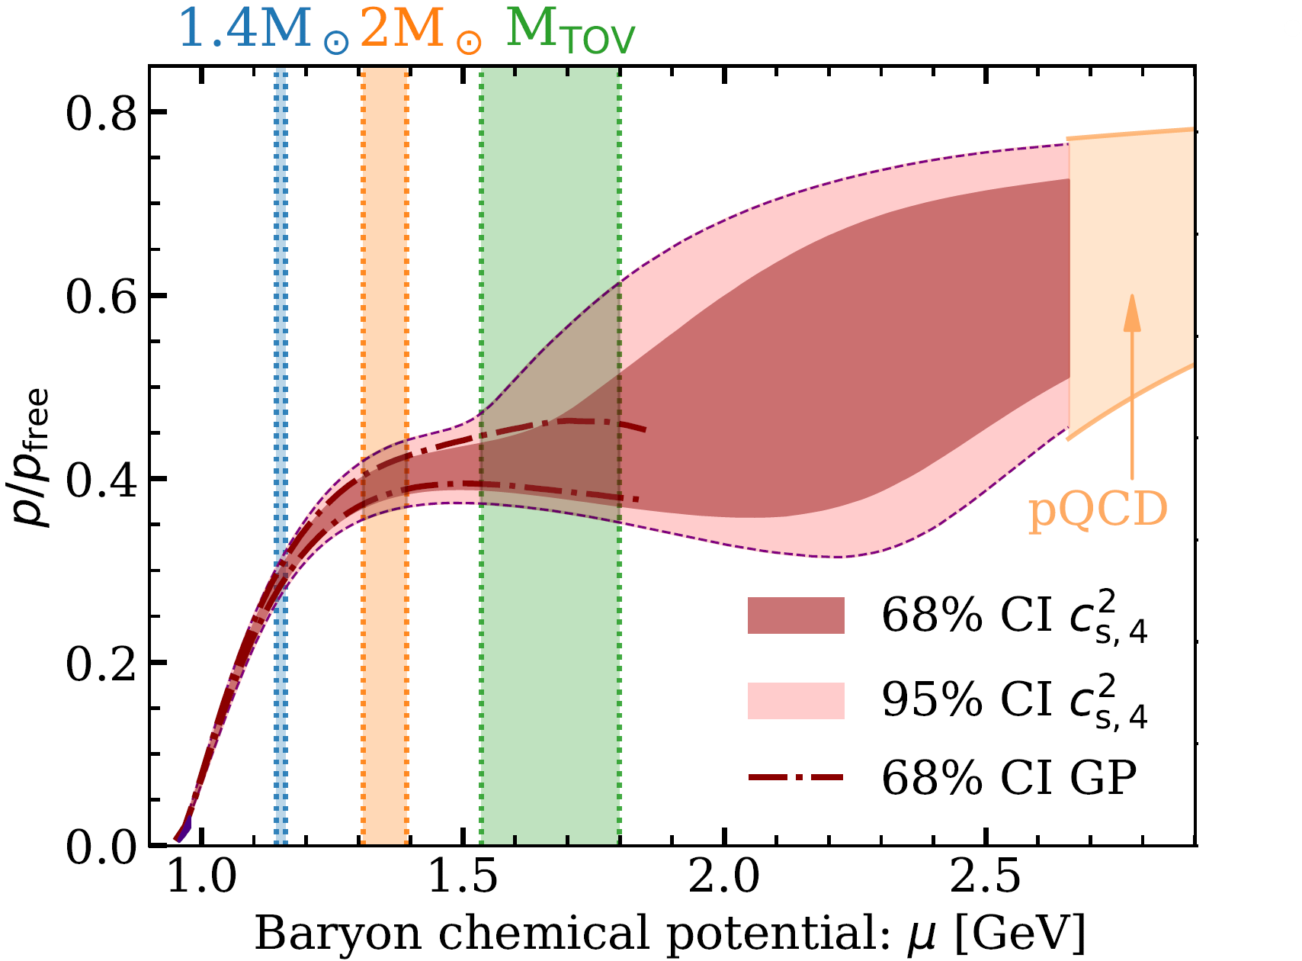
Basic problem: Lack of first-principles tools for dense QCD matter
For the properties of NS matter – controlling stellar structure and composition – only low- and high-density limits under control via Chiral EFT & pQCD
Model-agnostic approach (Gorda, Kurkela, AV,...): Systematic use of robust limits & observational data
Accurate equation of state (EoS) at all densities
Evidence for quark-matter cores in massive NSs
Kurkela, Fraga, Schaffner-Bielich, AV, ApJ 789 (2014)
Annala, Gorda, Kurkela, AV, PRL 120 (2018)
Annala, Gorda, Kurkela, Nättilä, AV, Nature Physics 16 (2020)
Annala et al. (incl. AV), PRX 12 (2022)
Gorda, Komoltsev, Kurkela, ApJ 950 (2023)
Annala et al. (incl. AV), Nature Communications 14 (2023)
Gorda, Komoltsev, Kurkela, Sunde, ApJ 1002 (2026)
…

Slide 15
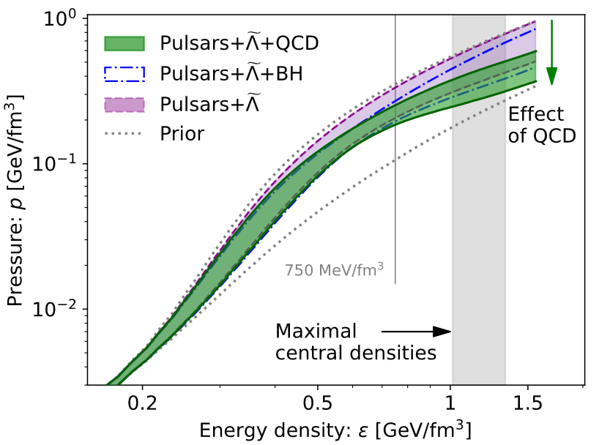
Basic problem: Lack of first-principles tools for dense QCD matter
For the properties of NS matter – controlling stellar structure and composition – only low- and high-density limits under control via Chiral EFT & pQCD
Model-agnostic approach (Gorda, Kurkela, AV,...): Systematic use of robust limits & observational data
Accurate equation of state (EoS) at all densities
Evidence for quark-matter cores in massive NSs
Kurkela, Fraga, Schaffner-Bielich, AV, ApJ 789 (2014)
Annala, Gorda, Kurkela, AV, PRL 120 (2018)
Annala, Gorda, Kurkela, Nättilä, AV, Nature Physics 16 (2020)
Annala et al. (incl. AV), PRX 12 (2022)
Gorda, Komoltsev, Kurkela, ApJ 950 (2023)
Annala et al. (incl. AV), Nature Communications 14 (2023)
Gorda, Komoltsev, Kurkela, Sunde, ApJ 1002 (2026)
…

Slide 16
Basic problem: Lack of first-principles tools for dense QCD matter
For the properties of NS matter – controlling stellar structure and composition – only low- and high-density limits under control via Chiral EFT & pQCD
Model-agnostic approach (Gorda, Kurkela, AV,...): Systematic use of robust limits & observational data
Accurate equation of state (EoS) at all densities
Evidence for quark-matter cores in massive NSs
Challenge: Is it possible to qualitatively improve the situation without new observational breakthroughs?

Slide 17
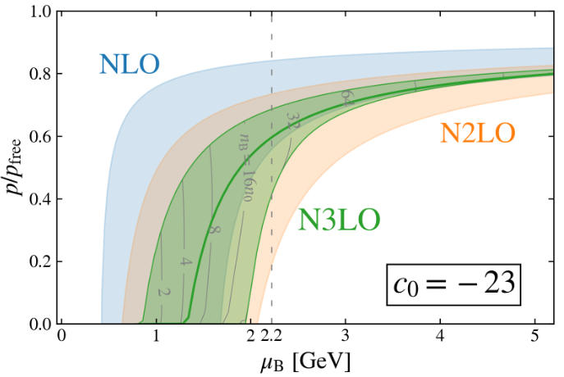
Basic problem: Lack of first-principles tools for dense QCD matter
For the properties of NS matter – controlling stellar structure and composition – only low- and high-density limits under control via Chiral EFT & pQCD
Model-agnostic approach (Gorda, Kurkela, AV,...): Systematic use of robust limits & observational data
Accurate equation of state (EoS) at all densities
Evidence for quark-matter cores in massive NSs
Opportunity: Completion of N3LO QM pressure has potential for qualitative leap (no need for N4LO?)
Easier said than done: determination of missing hard contribution has been an open problem since late 1970s...
Annala et al. (incl. AV), Nature Comm. 14 (2023)
(estimated)
Gorda, Paatelainen, Säppi, Seppänen, PRL 131 (2023)

Slide 18
Basic problem: Lack of first-principles tools for dense QCD matter
For the properties of NS matter – controlling stellar structure and composition – only low- and high-density limits under control via Chiral EFT & pQCD
Model-agnostic approach (Gorda, Kurkela, AV,...): Systematic use of robust limits & observational data
Accurate equation of state (EoS) at all densities
Evidence for quark-matter cores in massive NSs
Opportunity: Completion of N3LO QM pressure has potential for qualitative leap (no need for N4LO?)
Easier said than done: determination of missing hard contribution has been an open problem since late 1970s... but won’t be for much longer!
Annala et al. (incl. AV), Nature Comm. 14 (2023)
(estimated)
Gorda, Paatelainen, Säppi, Seppänen, PRL 131 (2023)

Slide 19
Case study: Inspecting twin stars with EoS inference*
*See also poster by Sofia Blomqvist!

Slide 20
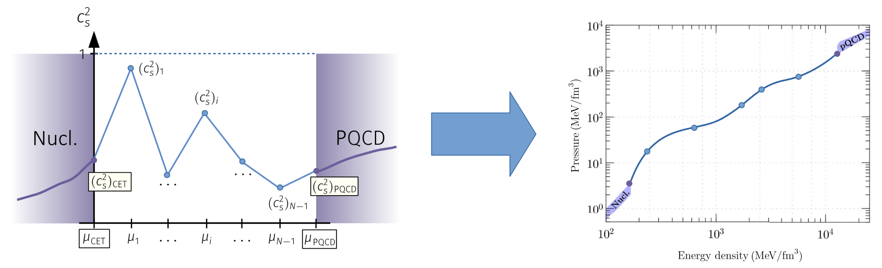
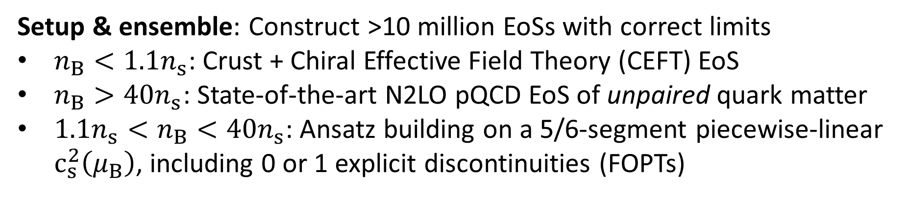
Setup & ensemble: Construct >10 million EoSs with correct limits
$n_{B}<{1.1n}_{s}$: Crust + Chiral Effective Field Theory (CEFT) EoS
$n_{B}>{40n}_{s}$: State-of-the-art N2LO pQCD EoS of unpaired quark matter
${1.1n}_{s}<n_{B}<{40n}_{s}\text{:}$ Ansatz building on a 5/6-segment piecewise-linear $c_{s}^{2}\left(μ_{B}\right)$, including 0 or 1 explicit discontinuities (FOPTs)
Blomqvist, Ecker, Gorda, AV, arXiv:2512.19477

Slide 21
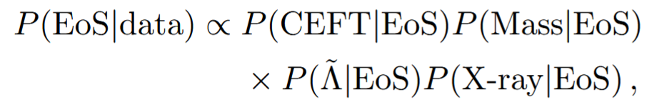
Bayesian analysis: Build stellar models (both twins and ordinary NSs) and successively incorporate observational information
Radio observations: existence of massive pulsars
Tidal-deformability constraints from GW170817
X-ray results from NICER
X-ray results from previous analyses of RXTE data
Blomqvist, Ecker, Gorda, AV, arXiv:2512.19477

Slide 22
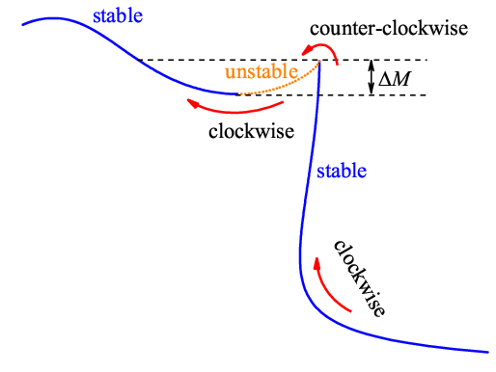
Physics questions to be answered:
Does current data favor or disfavor the existence of twin stars?
What are the observations that constrain twins the most?
If viable solutions exist, what are their physical characteristics?
Zhang, Li, EPJA (2025)
Blomqvist, Ecker, Gorda, AV, arXiv:2512.19477

Slide 23
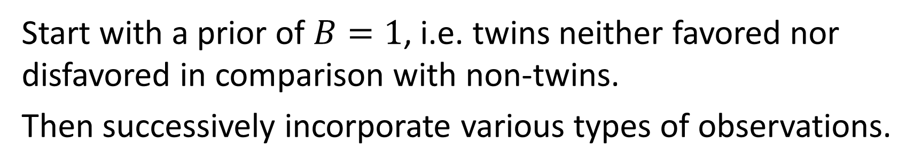
Start with a prior of $B=1$, i.e. twins neither favored nor disfavored in comparison with non-twins.
Then successively incorporate various types of observations.

Slide 24
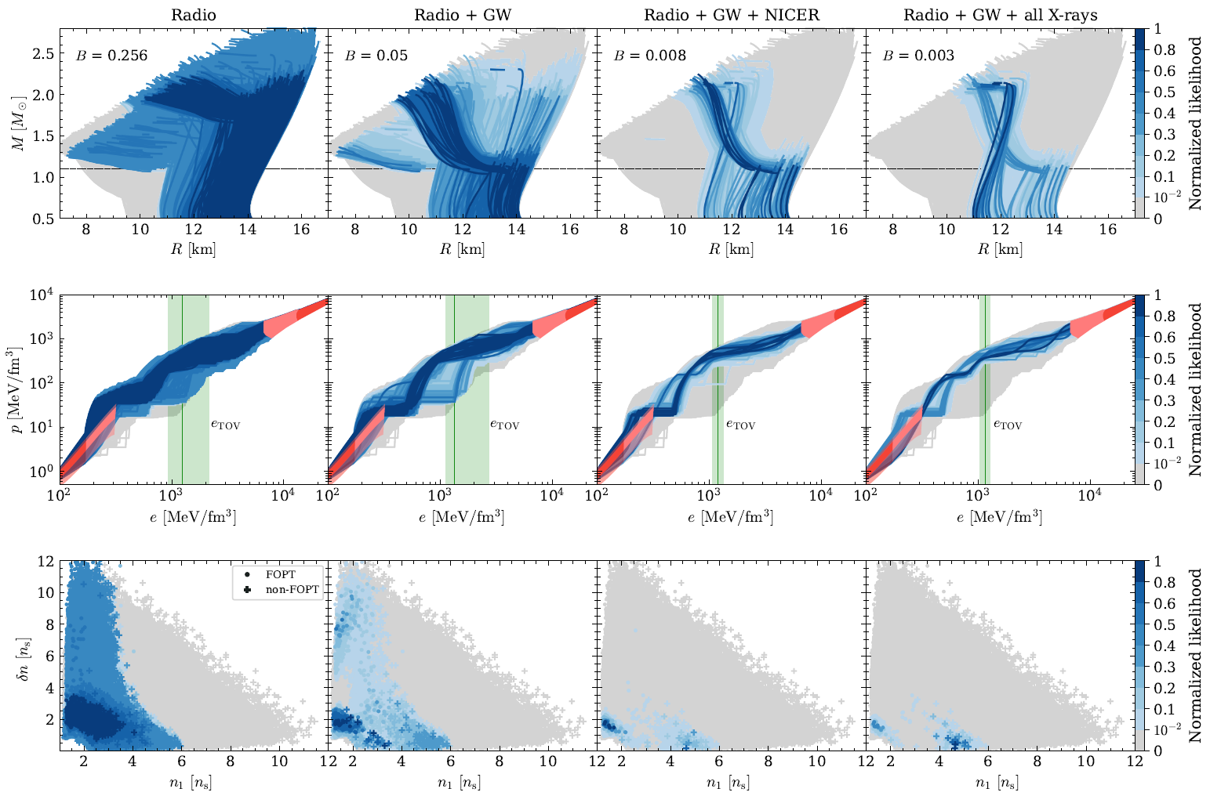

Slide 28
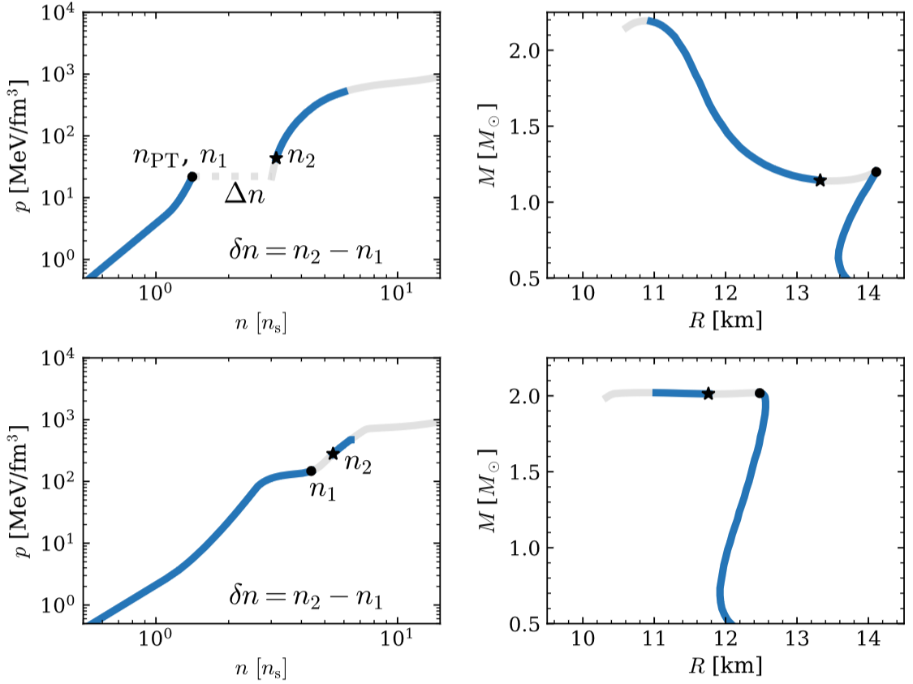
Viable class 1: Early-onset FOPT
Viable class 2: Late crossover

Slide 29
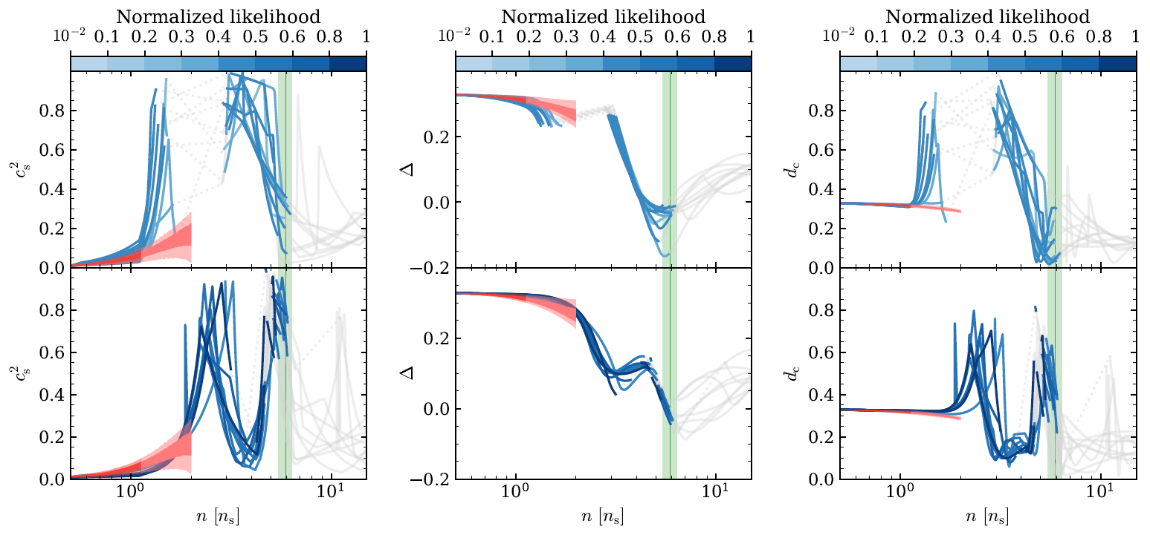
Viable class 1: Early-onset FOPT
Viable class 2: Late crossover

Slide 30
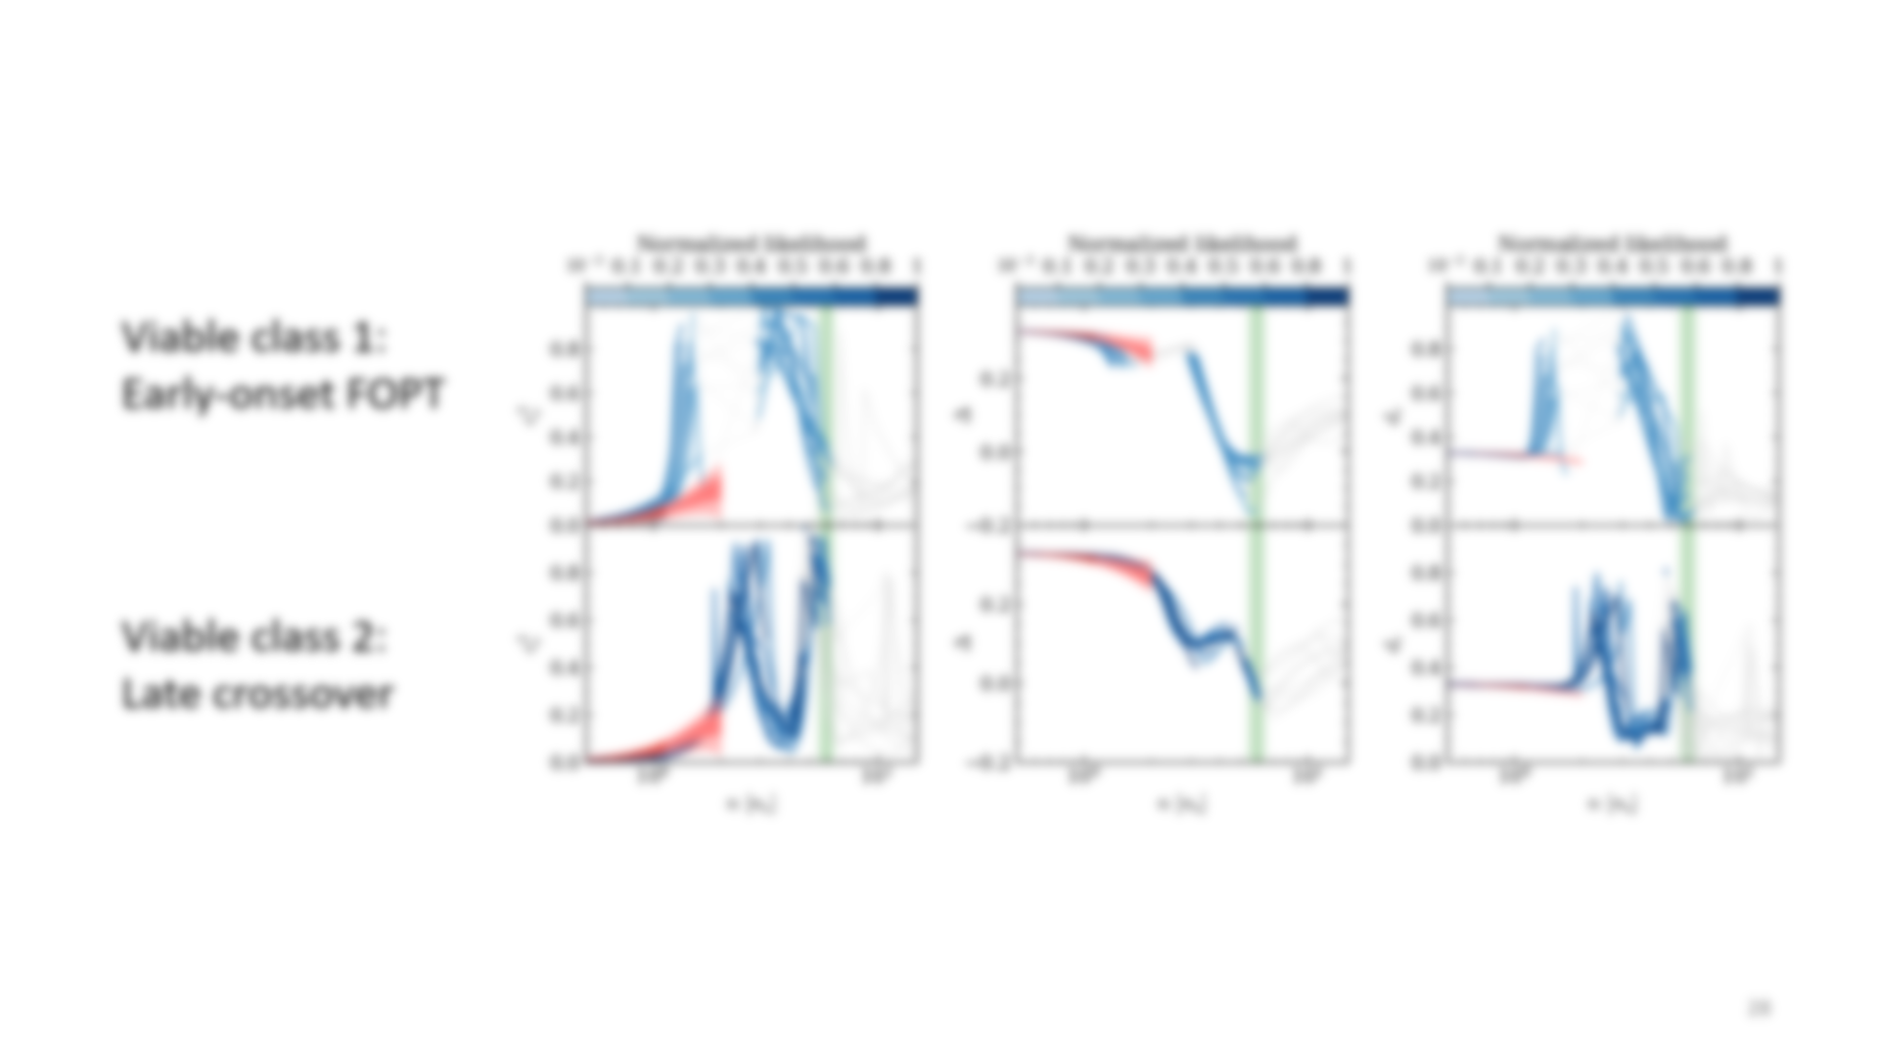
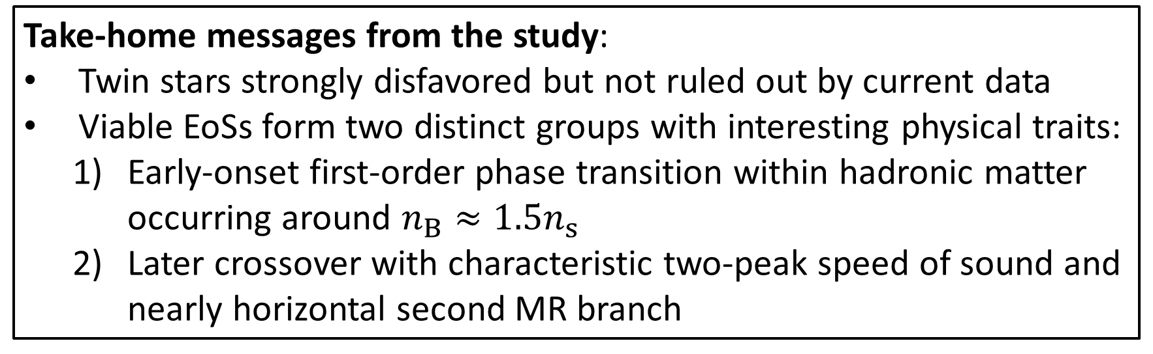
Take-home messages from the study:
Twin stars strongly disfavored but not ruled out by current data
Viable EoSs form two distinct groups with interesting physical traits:
  Early-onset first-order phase transition within hadronic matter occurring around $n_{B}≈{1.5n}_{s}$
  Later crossover with characteristic two-peak speed of sound and nearly horizontal second MR branch

Slide 31
Improving the high-density constraint: Basics of perturbative QCD at nonzero density

Slide 32
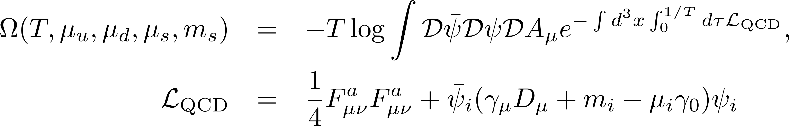

Slide 33
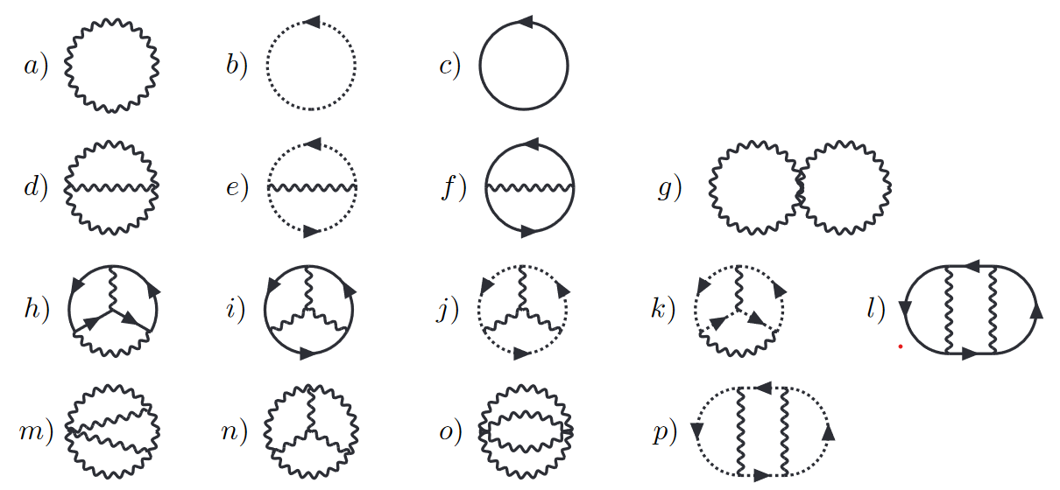
+ resummation of soft bosonic dof’s, typically implemented via dimensionally reduced effective theories

Slide 34
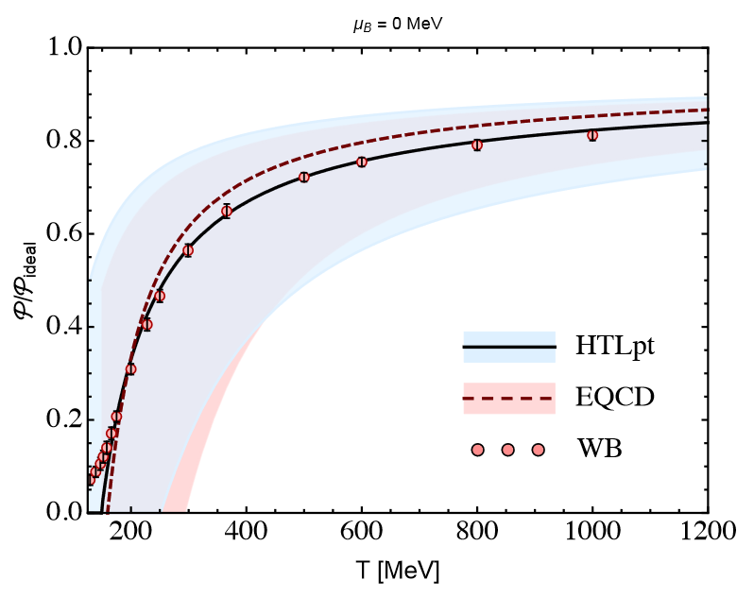
+ resummation of soft bosonic dof’s, typically implemented via dimensionally reduced effective theories
Ghiglieri, Kurkela, Strickland, AV, Phys. Rept. 880 (2020)

Slide 35
But what happens at high $μ$ and $T=0?$

Slide 36
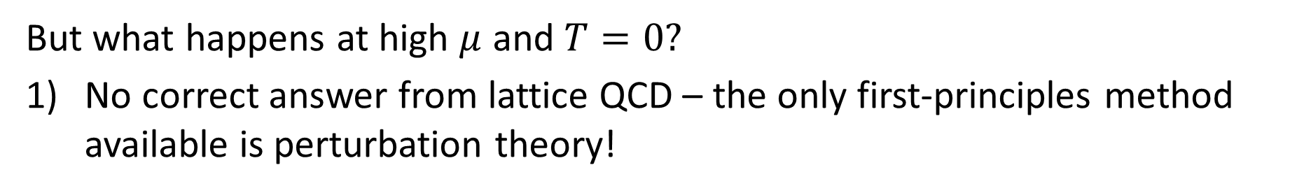
But what happens at high $μ$ and $T=0?$
No correct answer from lattice QCD – the only first-principles method available is perturbation theory!

Slide 37
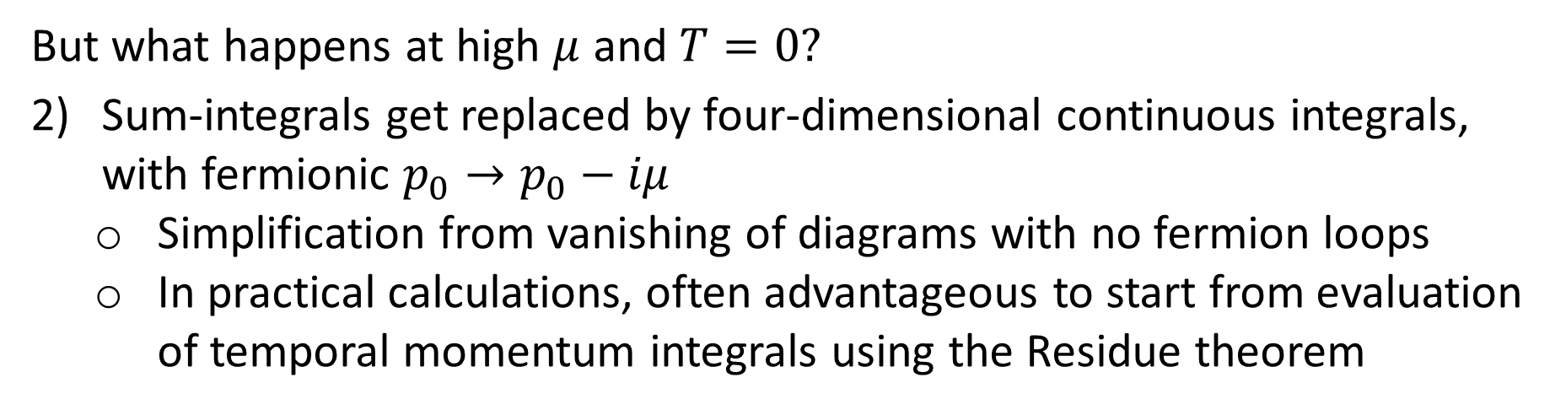
But what happens at high $μ$ and $T=0?$
Sum-integrals get replaced by four-dimensional continuous integrals, with fermionic $p_{0}→p_{0}−iμ$
  Simplification from vanishing of diagrams with no fermion loops
  In practical calculations, often advantageous to start from evaluation of temporal momentum integrals using the Residue theorem

Slide 38







But what happens at high $μ$ and $T=0?$
IR sensitive modes no longer 3d: all bosonic (Euclidean) four-momenta satisfying $\left|P\right|≲m_{E}\sim gμ_{B}$ need special treatment
Correct EFT for soft dof’s: Hard Thermal Loop effective theory
$${ω=ip}_{n}$$
$$m_{D}$$
$$2πnT$$
$$T\sim μ$$
$$T\sim m_{D}$$
$$T=0$$

Slide 39
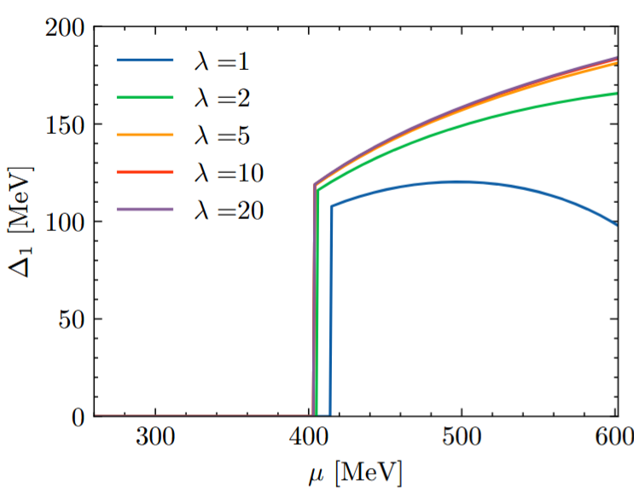
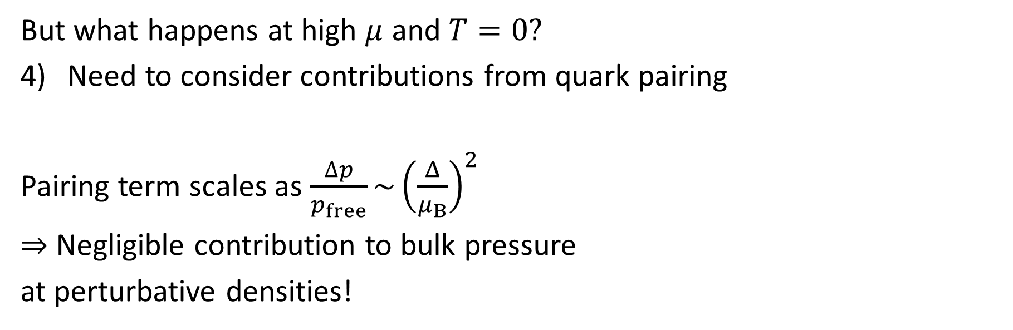
But what happens at high $μ$ and $T=0?$
Need to consider contributions from quark pairing
Pairing term scales as $\frac{∆p}{p_{free}}\sim {\left(\frac{Δ}{μ_{B}}\right)}^{2}$
$⇒$ Negligible contribution to bulk pressure
at perturbative densities!
[Gholami, Hofmann, Buballa, PRD 111 (2025)]

Slide 40
Towards full N3LO: Methods and preliminary results

Slide 41
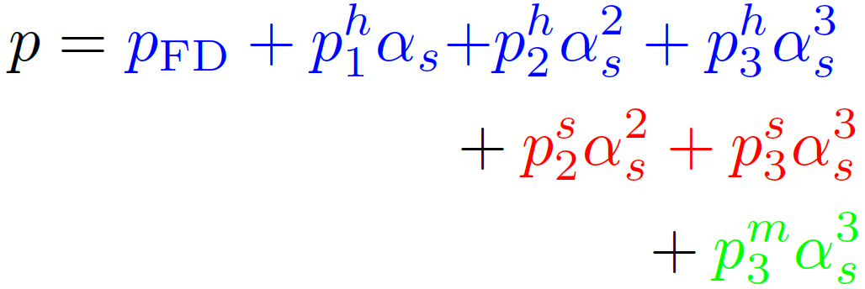
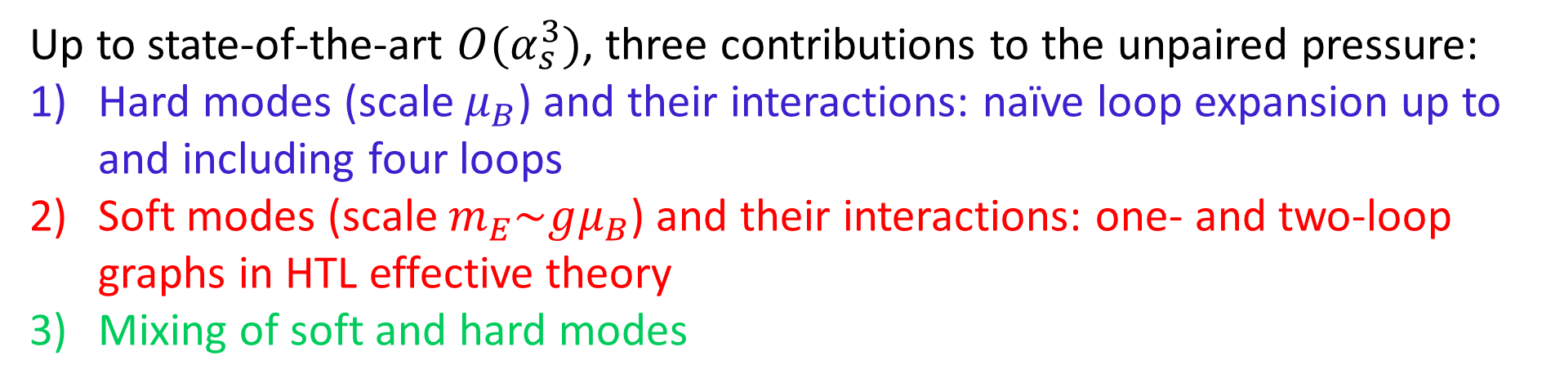
Up to state-of-the-art $O(α_{s}^{3})$, three contributions to the unpaired pressure:
Hard modes (scale $μ_{B}$) and their interactions: naïve loop expansion up to and including four loops
Soft modes (scale $m_{E}\sim gμ_{B}$) and their interactions: one- and two-loop graphs in HTL effective theory
Mixing of soft and hard modes

Slide 42
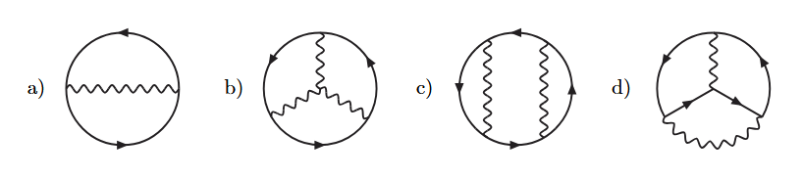
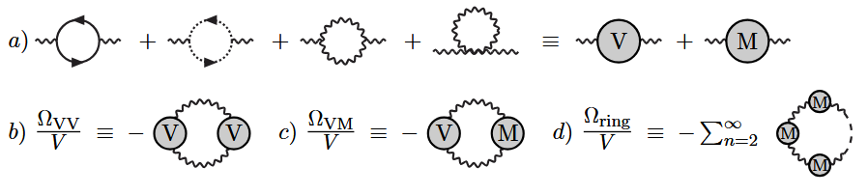
Up to state-of-the-art $O(α_{s}^{3})$, three contributions to the unpaired pressure:
Hard modes (scale $μ_{B}$) and their interactions: naïve loop expansion up to and including four loops
Soft modes (scale $m_{E}\sim gμ_{B}$) and their interactions: one- and two-loop graphs in HTL effective theory
Mixing of soft and hard modes
Known since 1970’s: Freedman, McLerran, PRD 16 (1977)

Slide 43
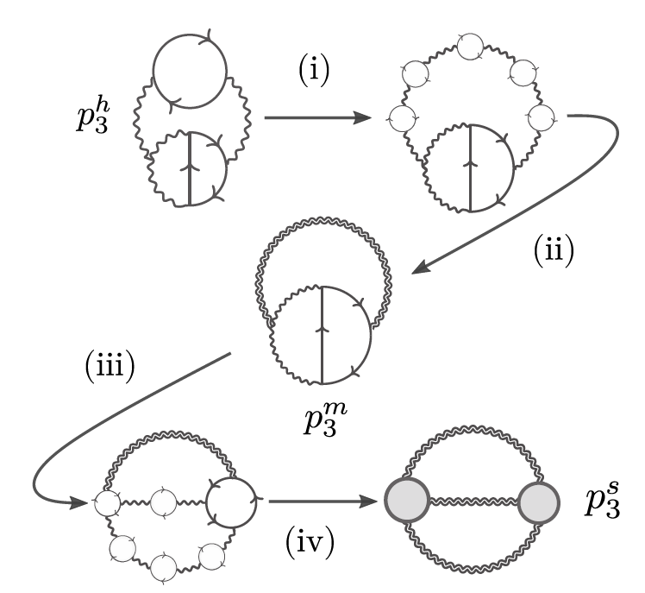
Up to state-of-the-art $O(α_{s}^{3})$, three contributions to the unpaired pressure:
Hard modes (scale $μ_{B}$) and their interactions: naïve loop expansion up to and including four loops
Soft modes (scale $m_{E}\sim gμ_{B}$) and their interactions: one- and two-loop graphs in HTL effective theory
Mixing of soft and hard modes
1
3
2
Leading log from Gorda, Kurkela, Romatschke, Säppi, AV, PRL 121 (2018)

Slide 44
Up to state-of-the-art $O(α_{s}^{3})$, three contributions to the unpaired pressure:
Hard modes (scale $μ_{B}$) and their interactions: naïve loop expansion up to and including four loops
Soft modes (scale $m_{E}\sim gμ_{B}$) and their interactions: one- and two-loop graphs in HTL effective theory
Mixing of soft and hard modes
1
3
2
Gorda, Kurkela, Paatelainen, Säppi, AV, PRL 127 (2021); Fernandez, Kneur, PRL 129 (2022)

Slide 45
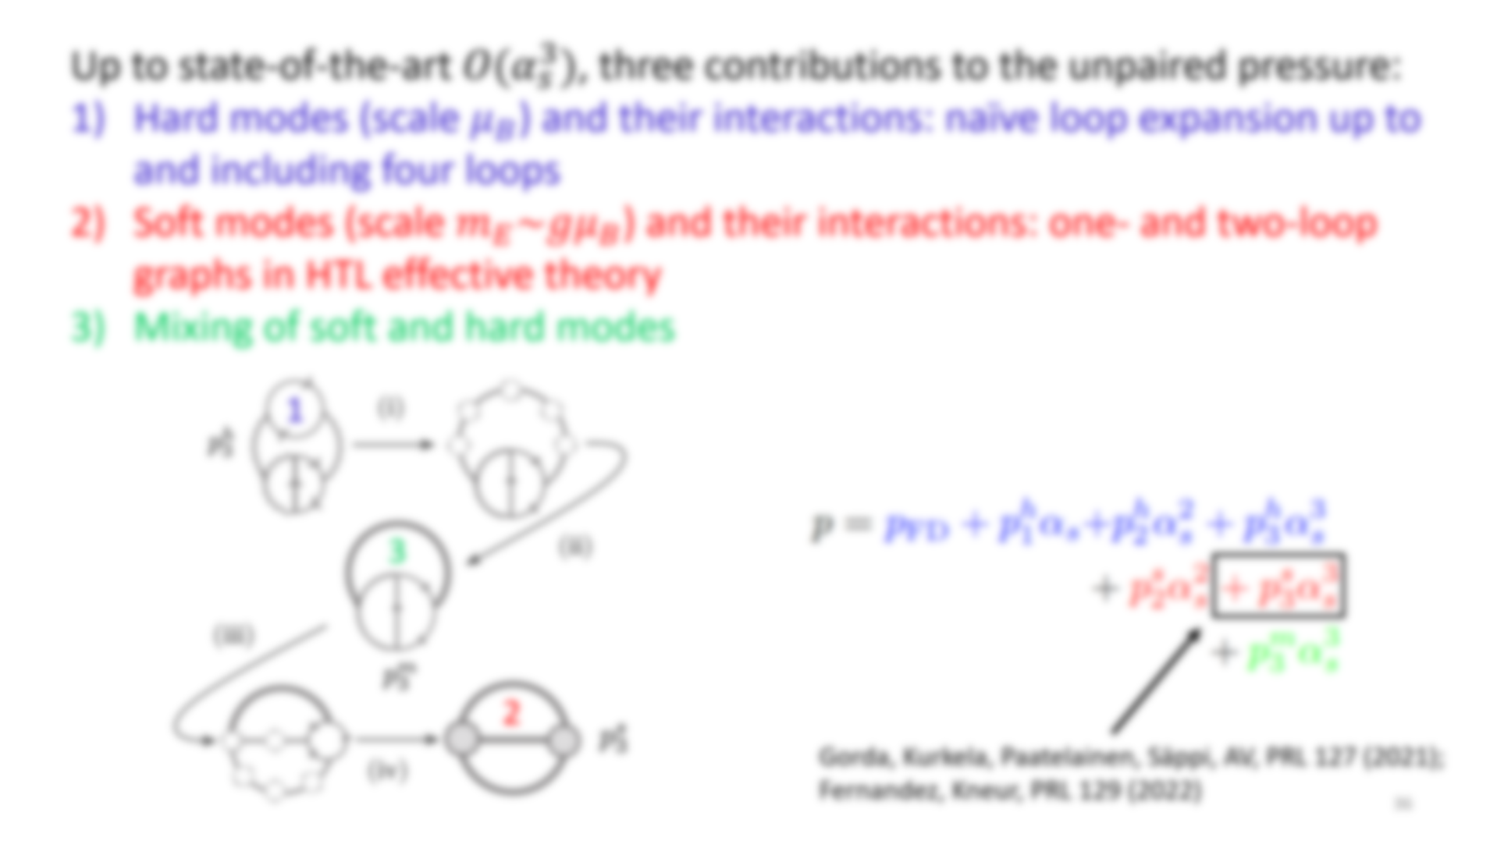
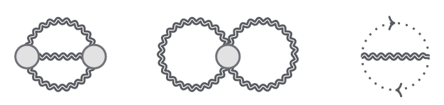

Slide 46
Up to state-of-the-art $O(α_{s}^{3})$, three contributions to the unpaired pressure:
Hard modes (scale $μ_{B}$) and their interactions: naïve loop expansion up to and including four loops
Soft modes (scale $m_{E}\sim gμ_{B}$) and their interactions: one- and two-loop graphs in HTL effective theory
Mixing of soft and hard modes
1
3
2
QED: Gorda, Kurkela, Österman, Paatelainen, Säppi, Seppänen, Schicho, AV, PRD 107 (2023)
QCD: Gorda, Paatelainen, Säppi, Seppänen, PRL 131 (2023)

Slide 47
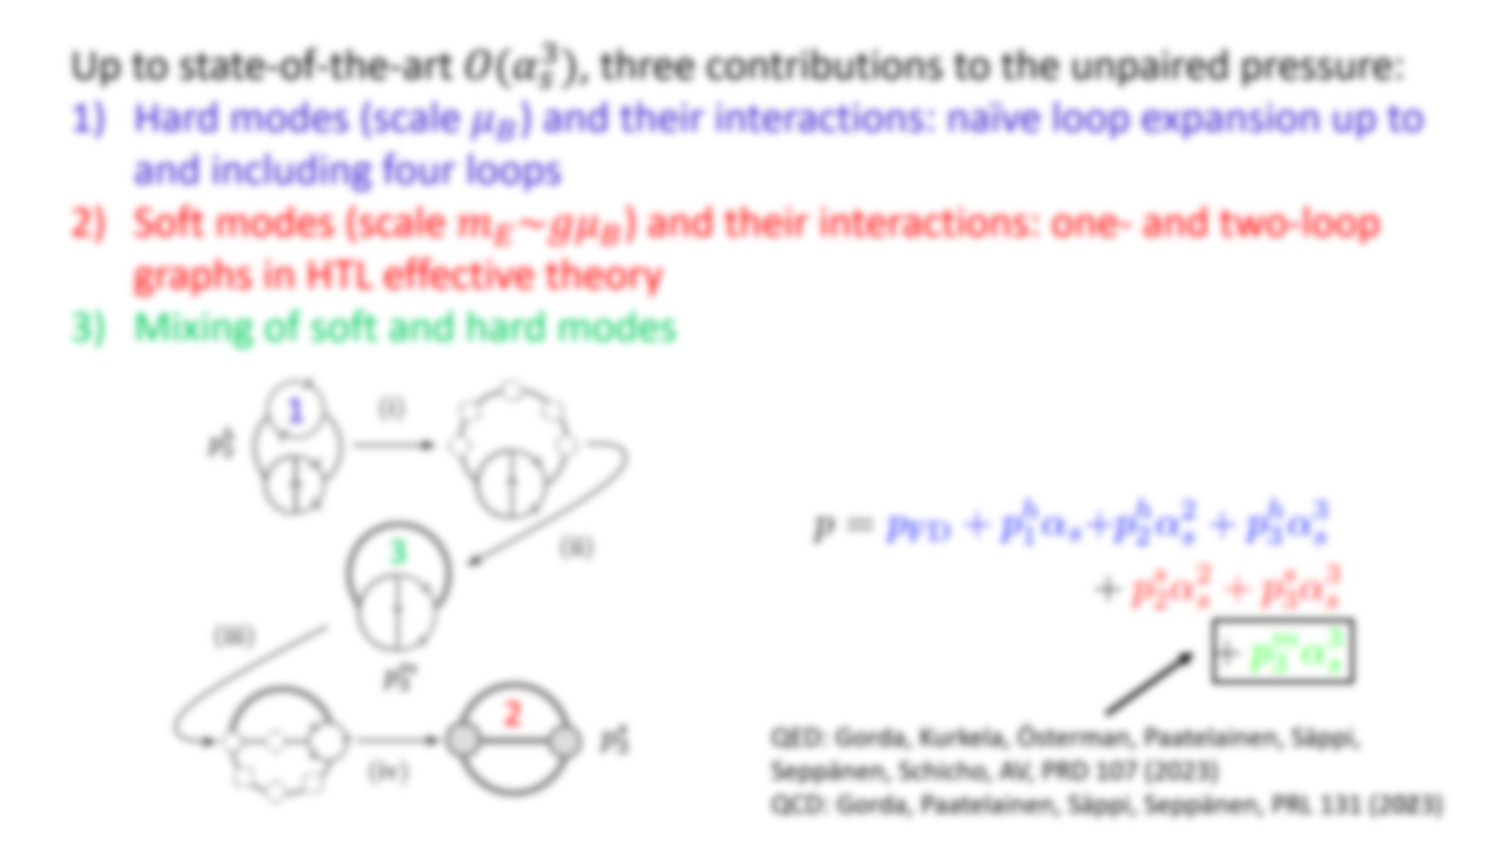
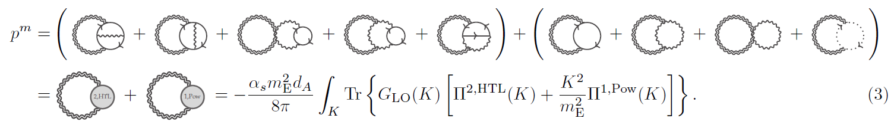

Slide 48
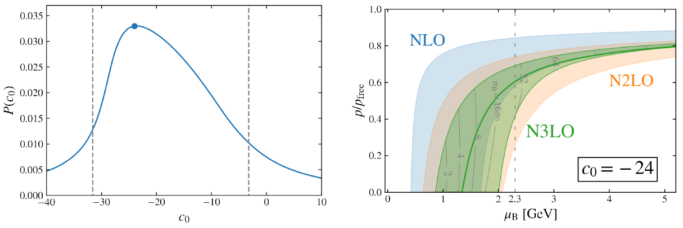

Slide 49
Up to state-of-the-art $O(α_{s}^{3})$, three contributions to the unpaired pressure:
Hard modes (scale $μ_{B}$) and their interactions: naïve loop expansion up to and including four loops
Soft modes (scale $m_{E}\sim gμ_{B}$) and their interactions: one- and two-loop graphs in HTL effective theory
Mixing of soft and hard modes
1
Last unknown part – and by far the most challenging
3
2

Slide 50
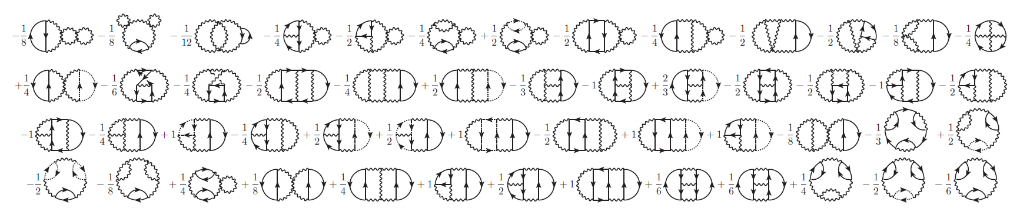
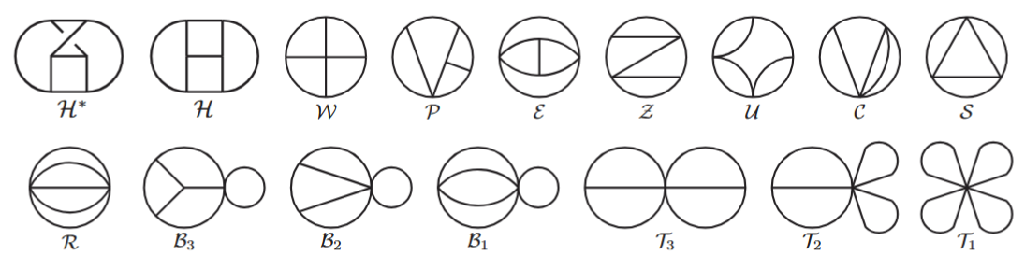
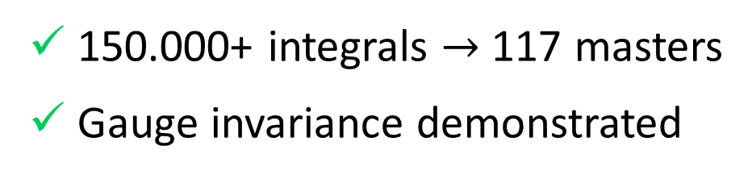
Hard contributions: Setup and traditional evaluation strategy
✓ 150.000+ integrals $→$ 117 masters
✓ Gauge invariance demonstrated
✓ Cancellation of UV and IR poles
against renorm. / EFT contributions
Kärkkäinen et al. (incl. AV), PRL 135 (2025), 2501.17921

Slide 51
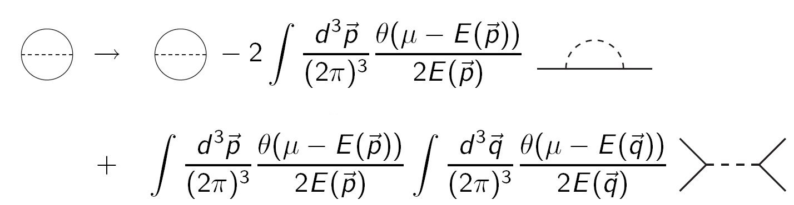
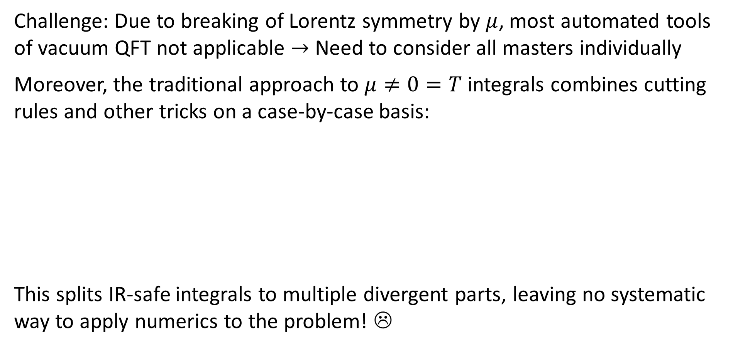
Hard contributions: Setup and traditional evaluation strategy
Challenge: Due to breaking of Lorentz symmetry by $μ$, most automated tools of vacuum QFT not applicable $→$ Need to consider all masters individually
Moreover, the traditional approach to $μ≠0=T$ integrals combines cutting rules and other tricks on a case-by-case basis:
This splits IR-safe integrals to multiple divergent parts, leaving no systematic way to apply numerics to the problem! ☹

Slide 52
Hard contributions: New hope from Loop Tree Duality (LTD)
Resolve IR issues by matching
LTD: Systematic numerical approach building on extensive work within vacuum QFT
Goal: Locally finite 3d representation amenable to numerical treatment
Perform temporal integrals analytically
Systematic removal of UV divs. via vacuum renormalization
Performing the IR- and UV-safe 3d integrals with Monte-Carlo methods
LTD in vacuum QFT:
Capatti, Hirschi, Kermanschah, Ruijl, PRL 123 (2019)

Slide 53

Hard contributions: New hope from Loop Tree Duality (LTD)
Resolve IR issues by matching
LTD: Systematic numerical approach building on extensive work within vacuum QFT
Goal: Locally finite 3d representation amenable to numerical treatment
Crucial insight: With 4d Lorentz invariance broken, directly applicable to thermal settings!
Perform temporal integrals analytically
Systematic removal of UV poles via vacuum renormalization
Performing the IR- and UV-safe 3d integrals with Monte-Carlo methods
LTD in vacuum QFT:
Capatti, Hirschi, Kermanschah, Ruijl, PRL 123 (2019)
LTD at nonzero density:
Navarrete, Paatelainen, Seppänen, PRD 110 (2024)
Kärkkäinen et al. (incl. AV), PRL 135 (2025)

Slide 54
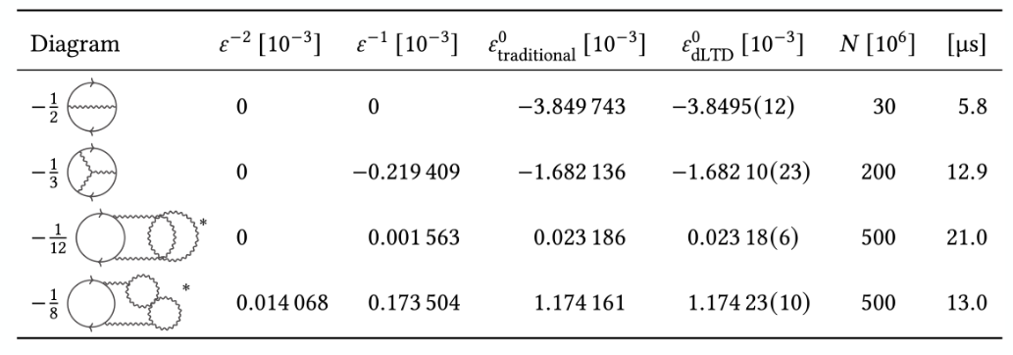
Hard contributions: New hope from Loop Tree Duality (LTD)
Resolve IR issues by matching
LTD: Systematic numerical approach building on extensive work within vacuum QFT
Goal: Locally finite 3d representation amenable to numerical treatment
Crucial insight: With 4d Lorentz invariance broken, directly applicable to thermal settings!
Blind to topology: Over 70 masters evaluated, including ones deemed impossible before
Perform temporal integrals analytically
Systematic removal of UV poles via vacuum renormalization
Performing the IR- and UV-safe 3d integrals with Monte-Carlo methods
LTD in vacuum QFT:
Capatti, Hirschi, Kermanschah, Ruijl, PRL 123 (2019)
LTD at nonzero density:
Navarrete, Paatelainen, Seppänen, PRD 110 (2024)
Kärkkäinen et al. (incl. AV), PRL 135 (2025)

Slide 55
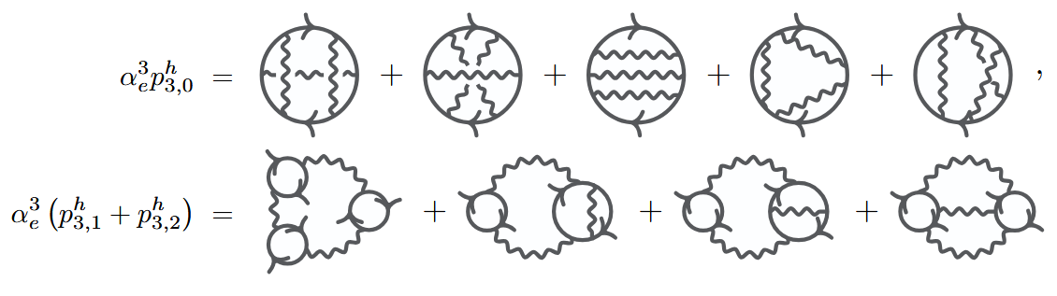
Hard contributions: New hope from Loop Tree Duality (LTD)
First physical test: the N3LO pressure of cold and dense QED

Slide 56
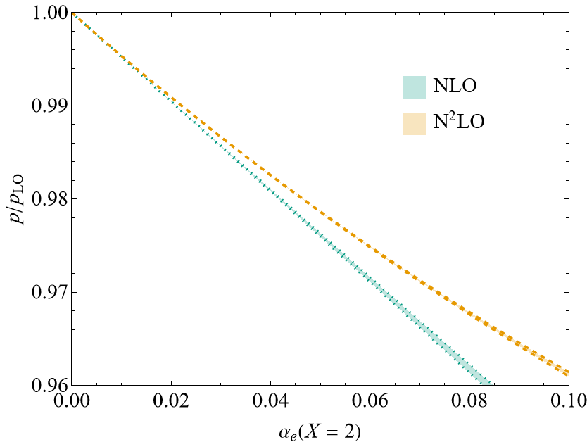
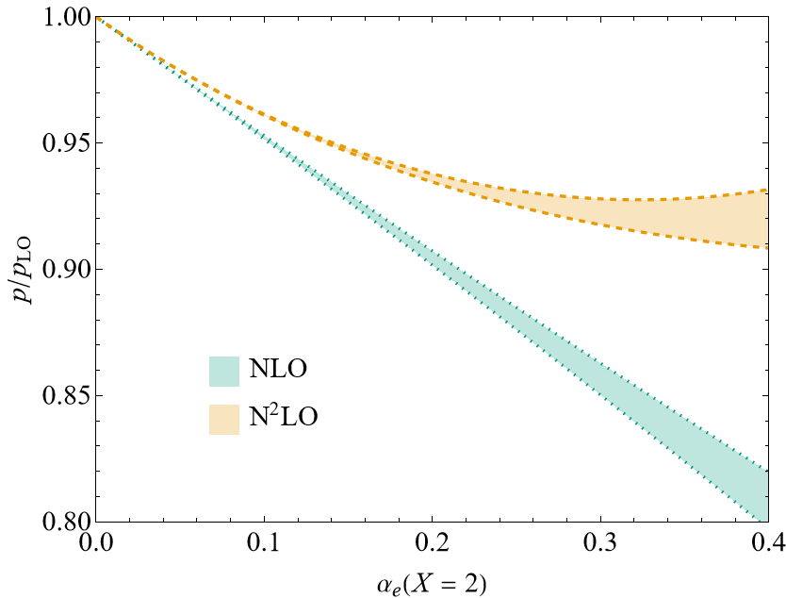
Hard contributions: New hope from Loop Tree Duality (LTD)
First physical test: the N3LO pressure of cold and dense QED

Slide 57
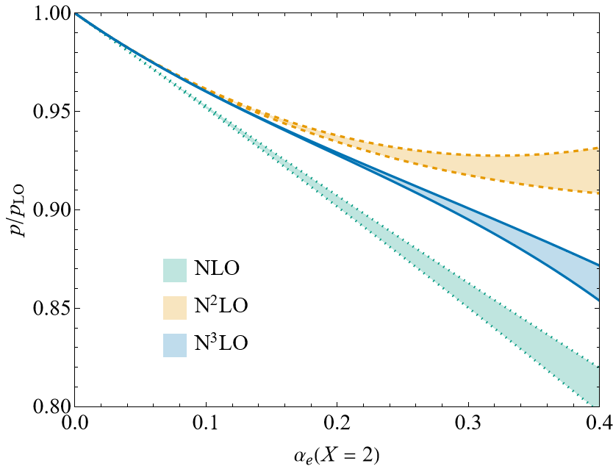


Hard contributions: New hope from Loop Tree Duality (LTD)
First physical test: the N3LO pressure of cold and dense QED

Slide 58

Hard contributions: New hope from Loop Tree Duality (LTD)
Coming up: N3LO quark-matter pressure at $T=0$; N2LO QCD pressure for $T≠0≠μ$ (and $m_{s}≠0$); N3LO pure Yang-Mills pressure; $O\left(α_{s}^{3}\right)$ QM pressure at all $T≠0≠μ$; …

Slide 59
Future directions

Slide 60
Inferring the EoS of NS-matter has become an active topic due to close connection to the phase of matter inside NS cores.
60

Slide 61


Inferring the EoS of NS-matter has become an active topic due to close connection to the phase of matter inside NS cores.
The near future holds great promise on both low-density and observational sides:
NICER and future X-ray observatories (eXTP, etc.) will provide improved radii
LVK (& later ET, CE) will vastly increase # of tidal-deformability measurements
Rapid progress towards $2n_{s}$ in ab-initio Chiral Effective Theory calculations
61

Slide 62

Inferring the EoS of NS-matter has become an active topic due to close connection to the phase of matter inside NS cores.
The near future holds great promise on both low-density and observational sides:
NICER and future X-ray observatories (eXTP, etc.) will provide improved radii
LVK (& later ET, CE) will vastly increase # of tidal-deformability measurements
Rapid progress towards $2n_{s}$ in ab-initio Chiral Effective Theory calculations
But due to recent developments in thermal Loop Tree Duality, we can expect equally dramatic improvements from pQCD!
62

