Slide 1



Binary Neutron Star Merger as a Probe of Hadron-Quark Transition
Yong-Jia Huang
Purple Mountain Observatory / RIKEN
Compact Stars in the QCD phase diagram
19 May 2026

Slide 2
Outline
● Quark matter inside neutron star
● Statistical equation of states from nuclear crust to the asymptotic freedom
● Hadron quark transition in binary neutron star mergerary binary neutron star merger

Slide 3
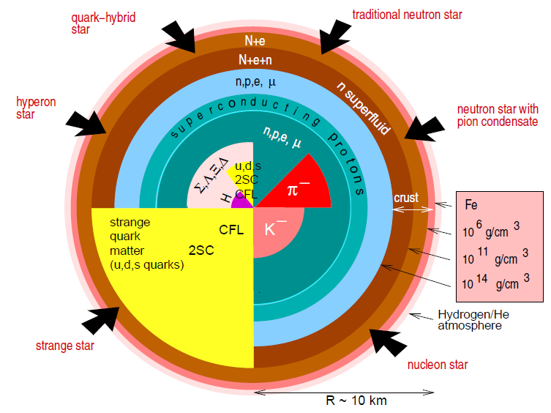
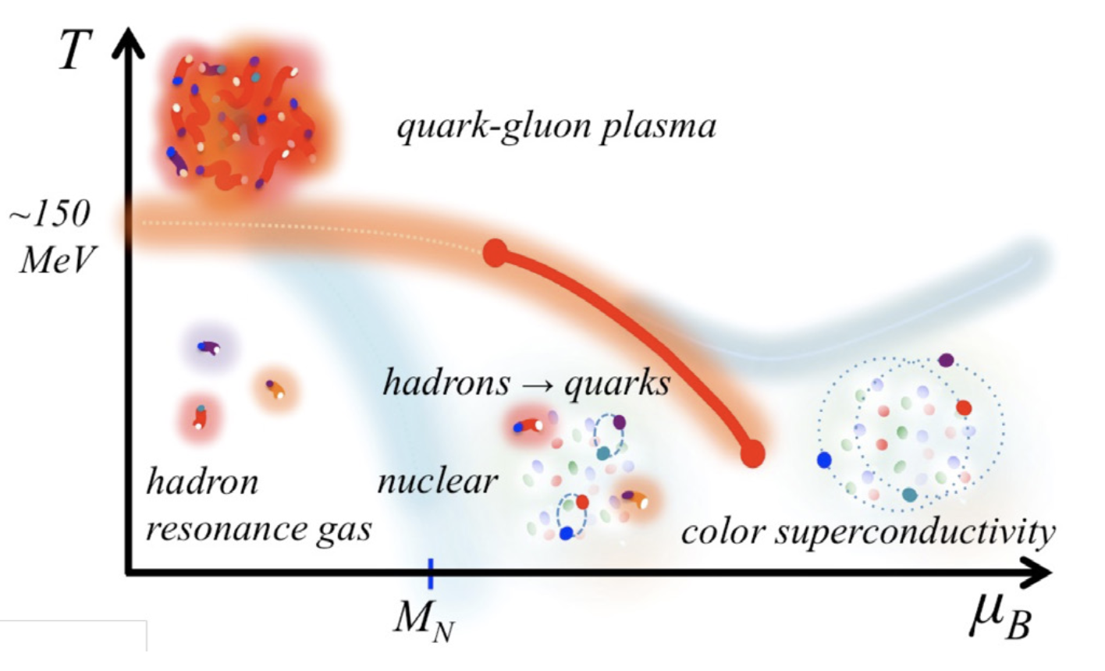
Baym et al. 2018
Neutron star merger
Zero temperature
Neutron star observation (mass, radius, tidal deformability …)
Equation of State
Finite temperature
Binary neutron star merger

Slide 4
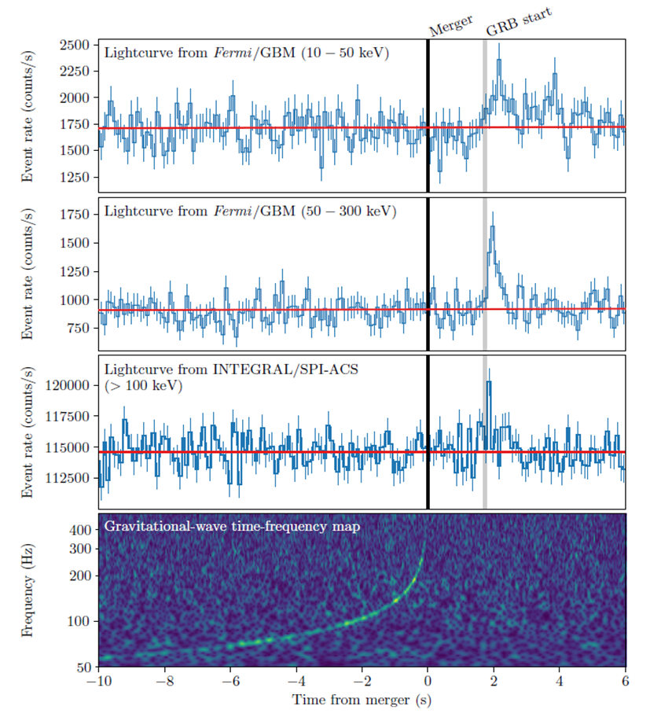

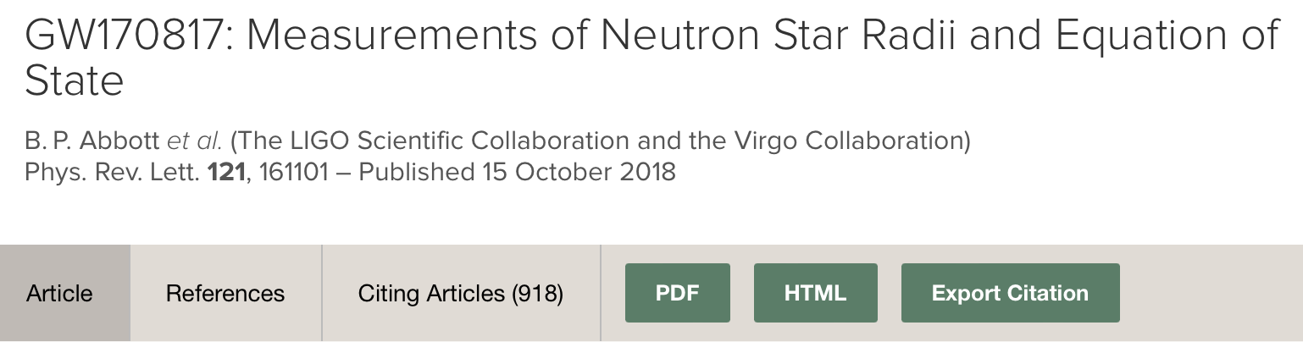
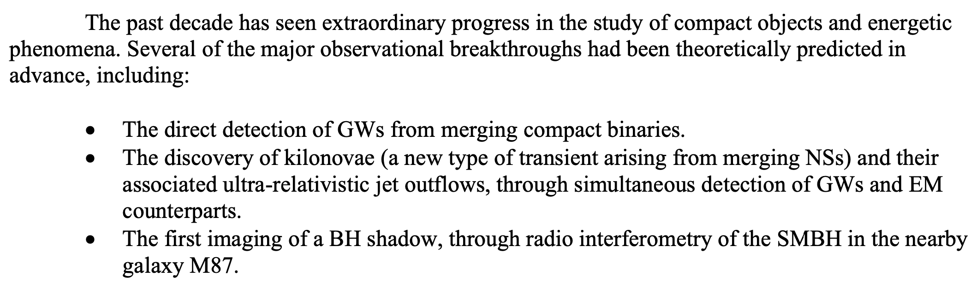

Gravitational wave
DNS mergers: one of great breakthroughs in 2010s

Slide 5
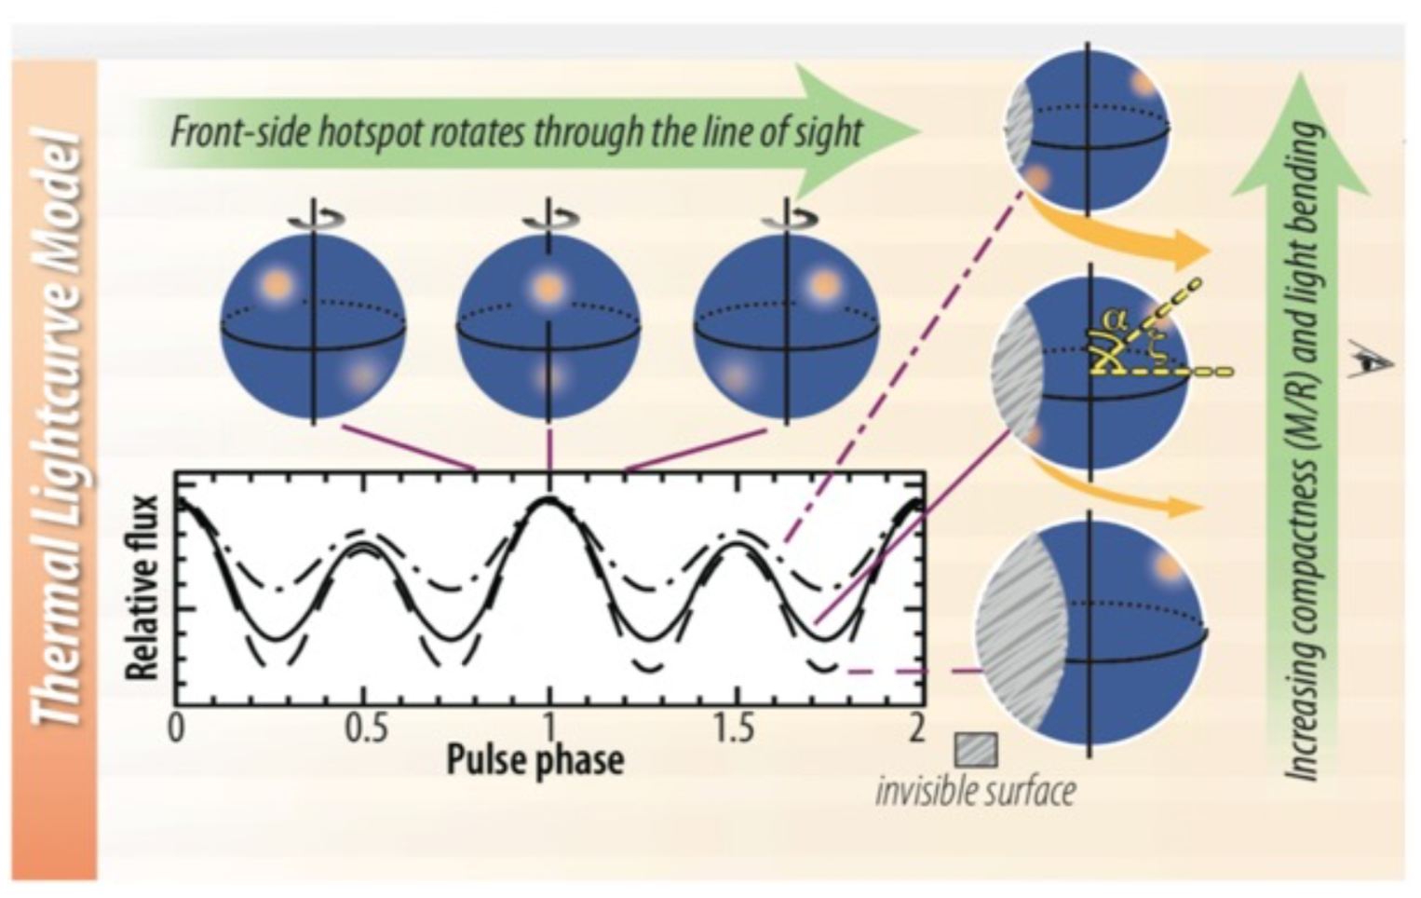
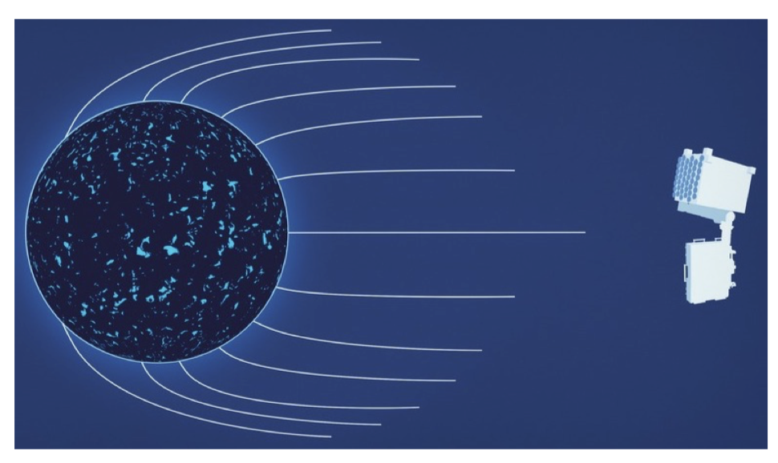
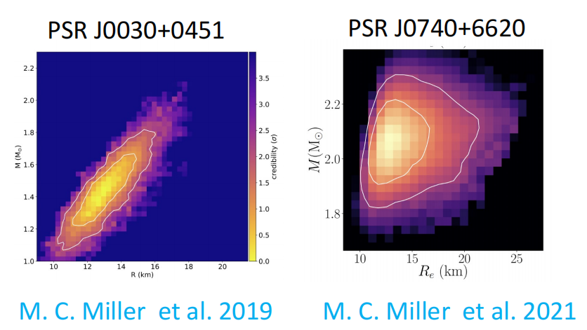
Multi-messenger information
The existence of ~2 solar mass neutron star
J3048+0432 (2.01±0.04 solar mass), J0740+6620 (2.08±0.07 solar mass)
Tidal deformability from gravitational waves
GW170817
Compactness(mass/radius) from NICER observation
J0030+0451, J0740+6620, J0614–3329, J0437–4715

Slide 6
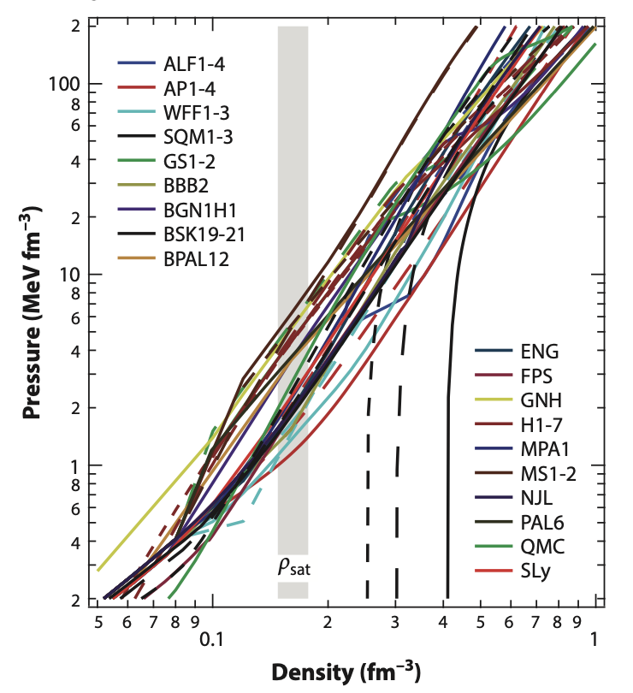
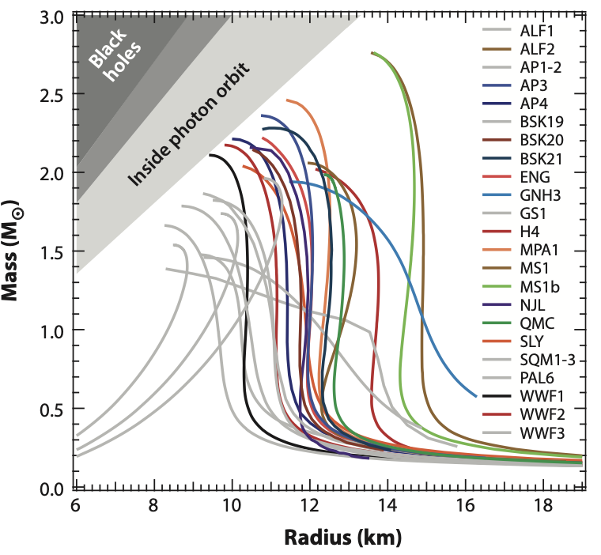
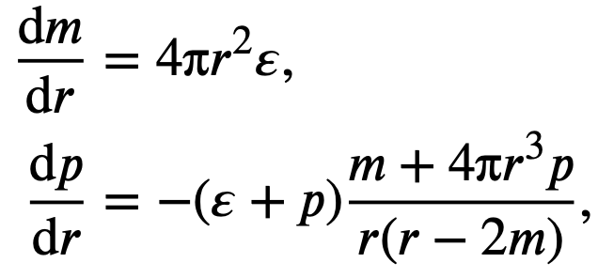
Micro vs. Macro
Equation of state: nuclear physics
Mass-Radius relation: astrophysics
Get M-R with models
Constraining the range of EOS with statistics
（Ozel et al. 2016 ARA&A）

Slide 7
EOS Construction
Model-agnostic method
No nuclear interaction
Flexible representation
Phenomenology method
Effective nuclear interaction
Parameterized
Ab-initio method
Realistic nuclear interaction
Parameter-constrained
Observation Driven
Microscopic
• Too many possible of composition inside the NS, limiting the reliability of ab-initio extrapolations.
• NS observation data can always be fitted with enough parameters.
Non-parametric EOSs + ab-initio calculation as boundary condition
Observations do not determine a few parameters but induce a probability measure on a function space

Slide 8
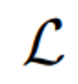
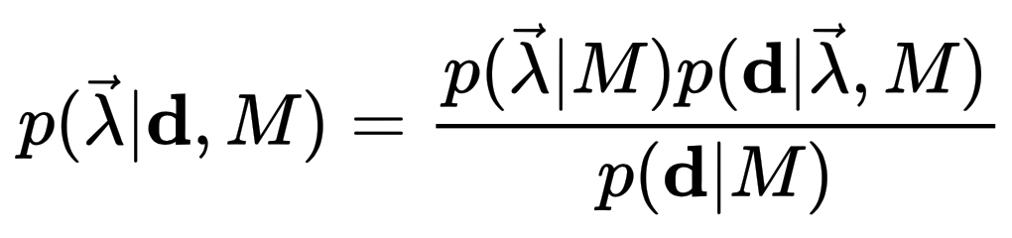

Bayesian Inference
Conditional on a given model 𝑀, the posterior distribution of the parameter vector λ is obtained by combining data d from multiple sources
Probability density of prior
Likelihood
Probability density of posterior

Slide 9
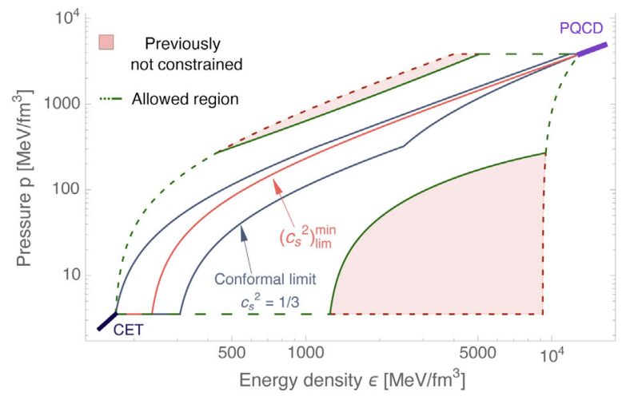
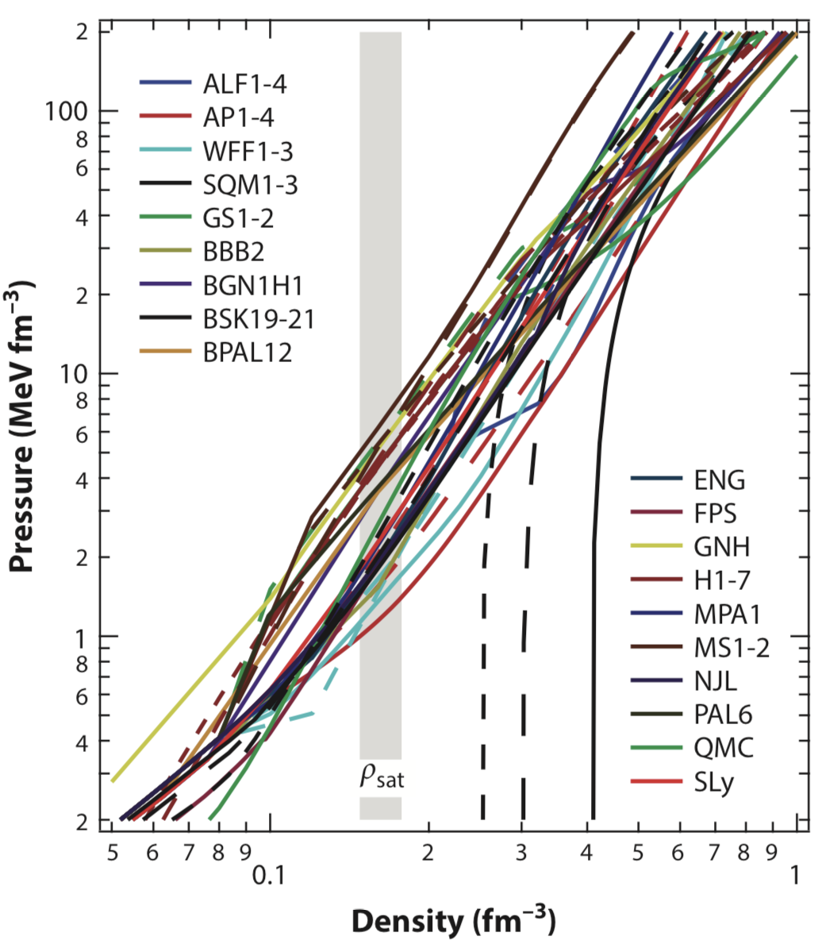
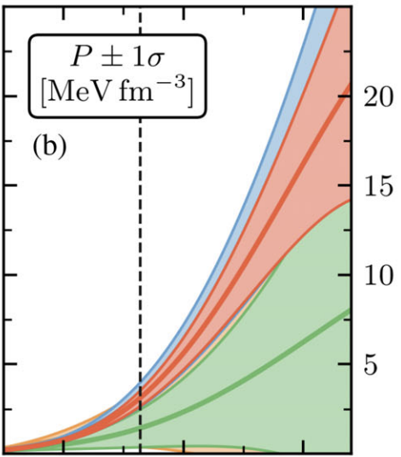
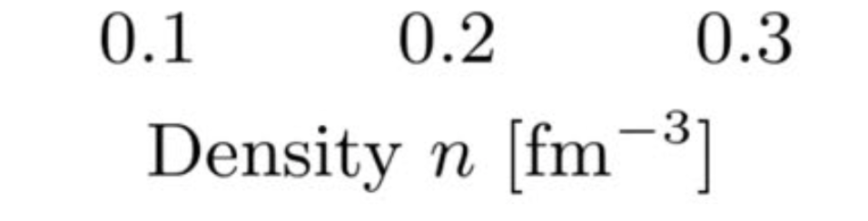
Additional physical information/constraints
NS data
pQCD
χEFT
Chiral effective field theory: yields reliable EoS up to the nuclear saturation density n_{s}
The boundary constraint from pQCD: valid at ultra-high densities, can be reasonably extrapolated to low densities, say 5-10n_{s}, under the conditions of causality and microscopic stability (0≤c_{s}²≤1)
(Drischler et al. 2021 PRL; Gorda et al. 2022 PRL)
Notes:
The mass and radius data of neutron stars mainly govern /ˈɡʌv.ɚn/ the EoS in the middle density regime. In the low density region,
the chiral /ˈkaɪrəl/ effective field theory calculation has reached a high accuracy in recent years, which yields reliable EoS up to the nuclear saturation density. Although dense matter cannot be described with a perturbative theory until ultra-high density (∼ 40n0)，under the conditions of causality [kɔˈzæləti] and microscopic stability, the pQCD constraint can be reasonably extrapolated to the low density region.
In our inference, both the NS mass and radius data and the theoretical information have been taken into account.

Slide 10
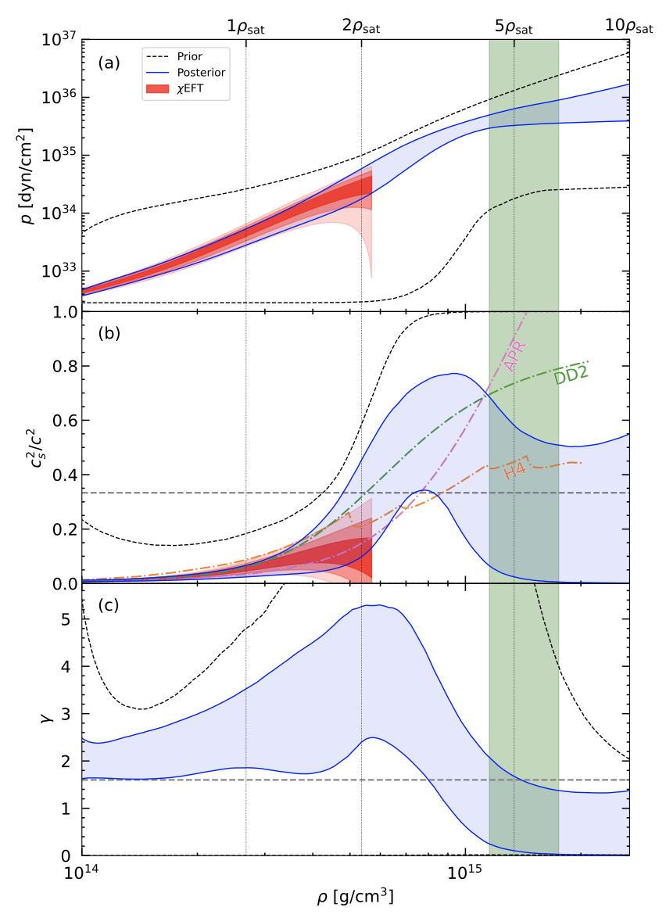
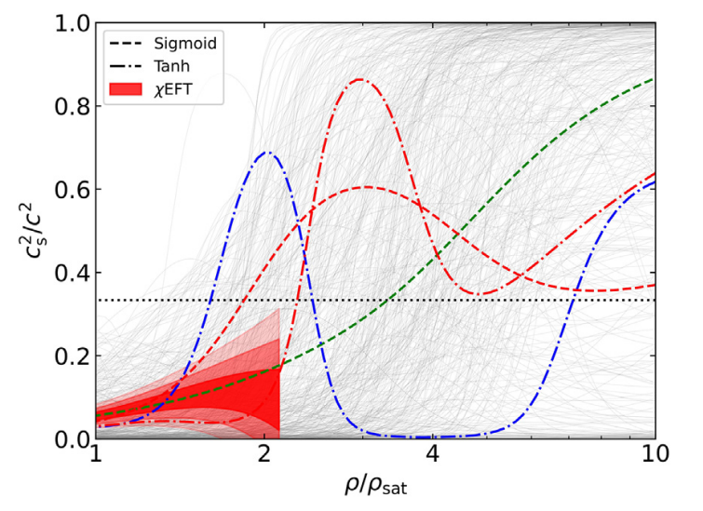
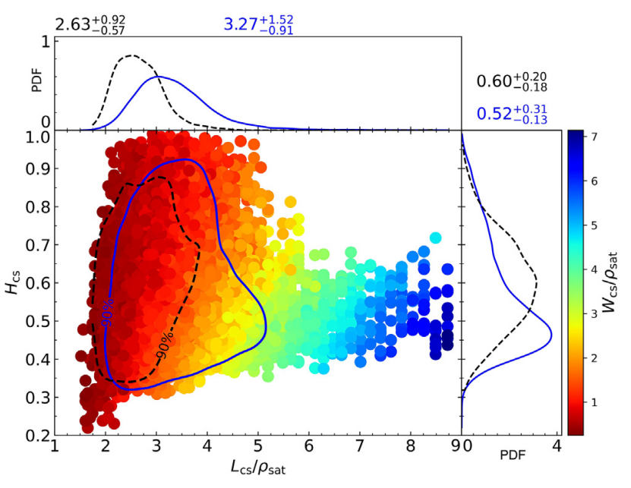
Peak structure in CS2
Prior
Posterior
NS observation
Rapidly stiffening
Chiral EFT, pQCD
EOSs seems stiffer than ChiEFT calculation in 1~2 n0, and peak generally presents in the posterior.
EOS tends to be soft near the center of most massive NS.
Han, Huang, Tang & Fan, Science Bulletin 2023

Slide 11
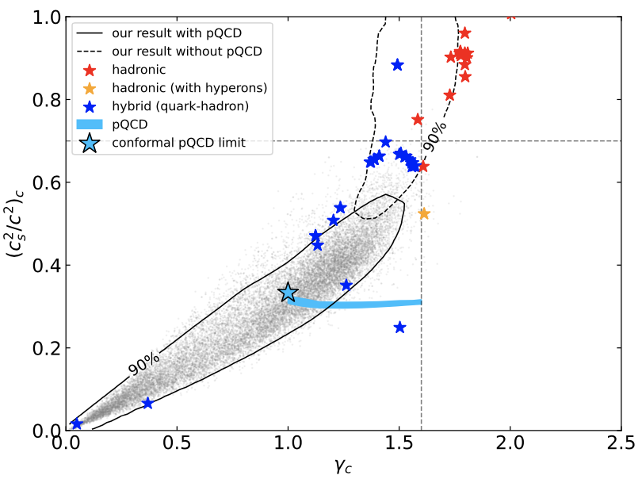
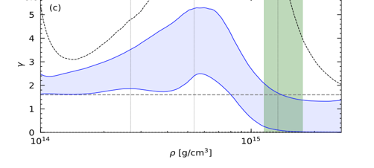
Quark matter inside NS
Han, Huang, Tang & Fan, Science Bulletin 2023

Slide 12
Outline
● Quark matter inside neutron star
● Statistical equation of states from nuclear crust to the asymptotic freedom
● Hadron quark transition in binary neutron star mergeryeutron star merger

Slide 13

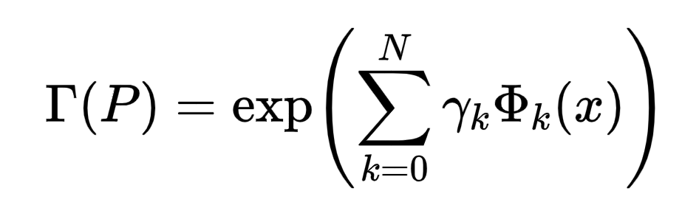
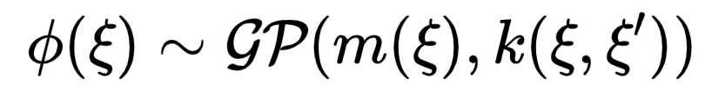
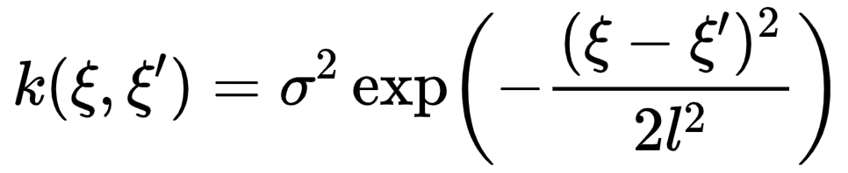

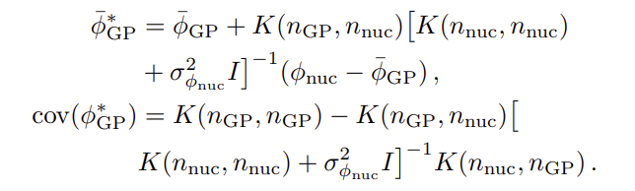
Non-parametric
Parametric: Specific analytical form, characterized by a limited number of parameters, such as
Piecewise Polytrope Spectral method
Non-parametric: No specific functional form, but rather that the function follows a certain probability distribution. The "shape" of the quantity is entirely determined by observed data (such as mass, radius, and tidal deformability)
Gaussian Process
Mean function
Covariance/Kernel
conditioned
NS EOS construction

Slide 14
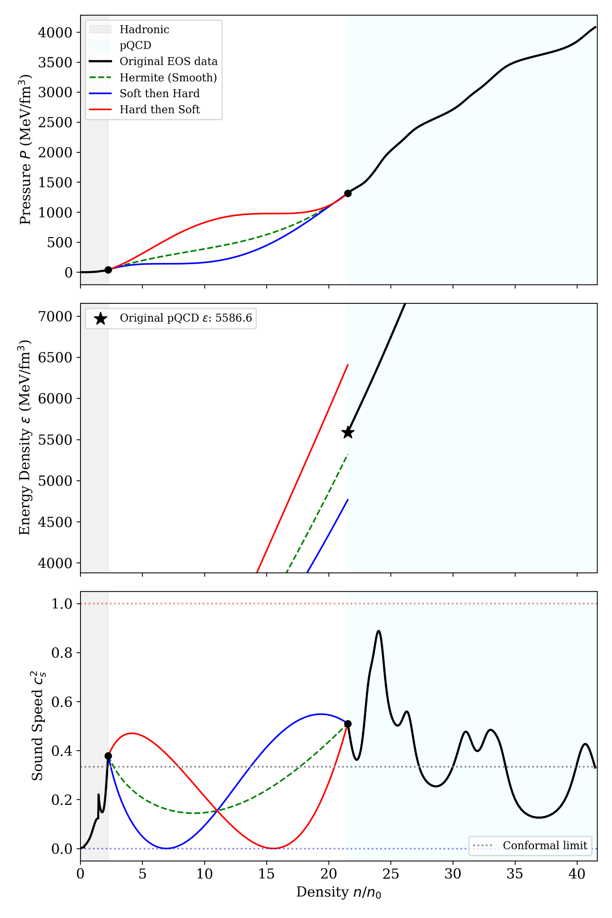
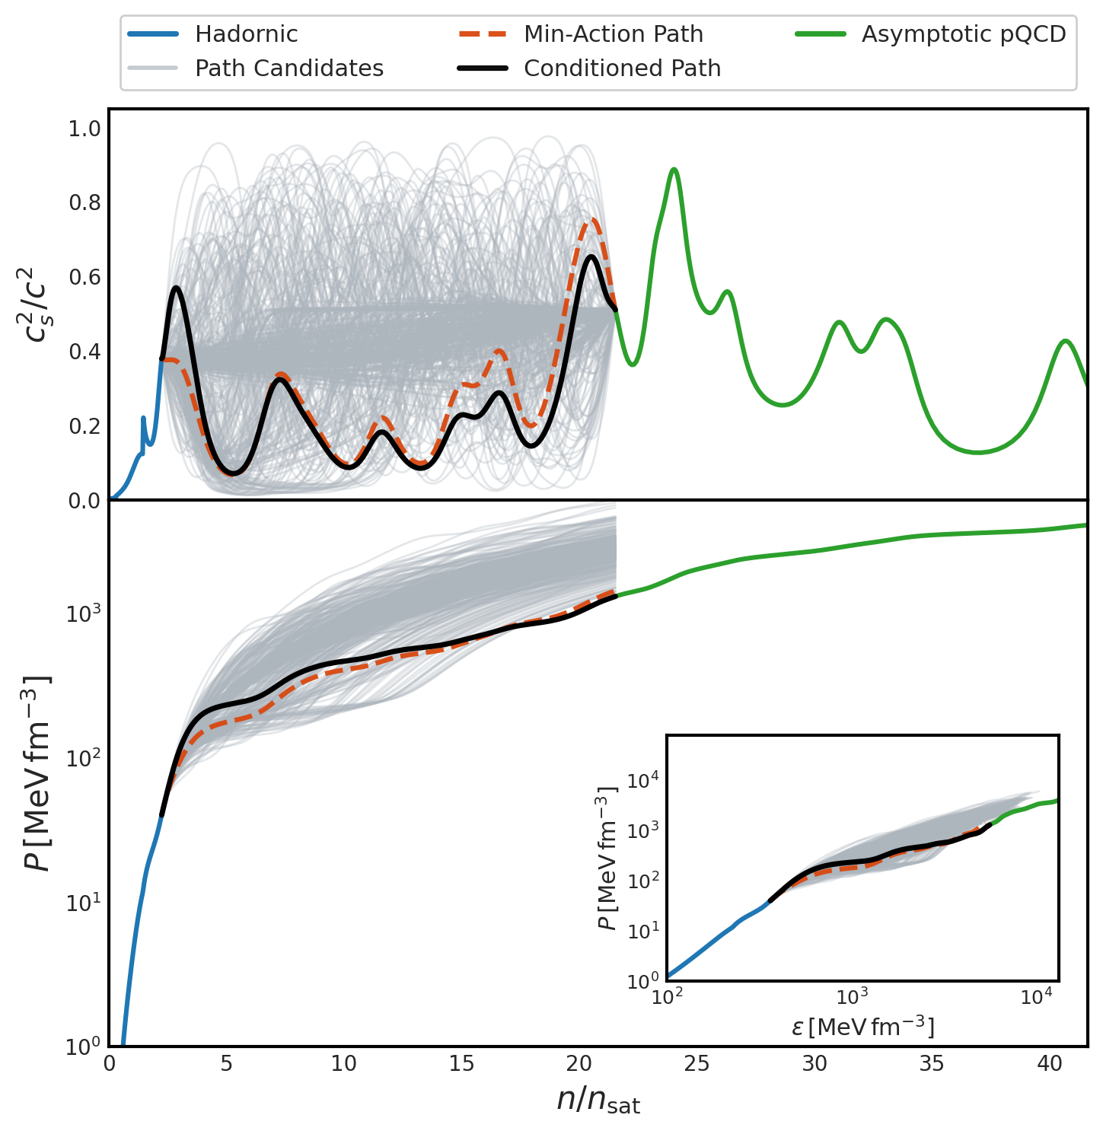
Least-action bridge
From pQCD to lower
From ChiEFT to higher

Slide 15
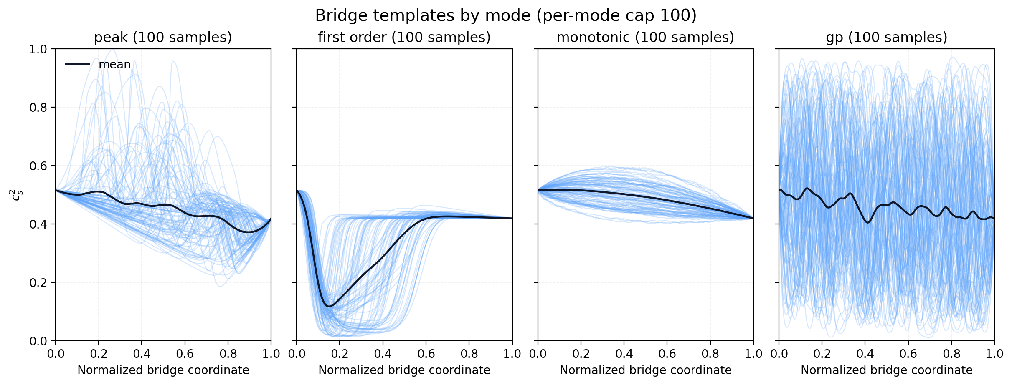
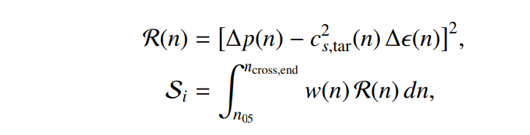
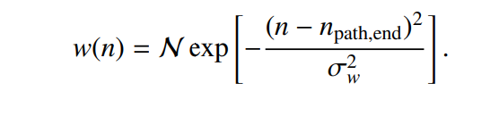
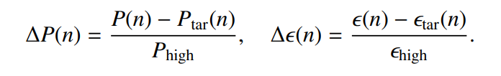
Least-action bridge
From pQCD to lower
From ChiEFT to higher

Slide 16
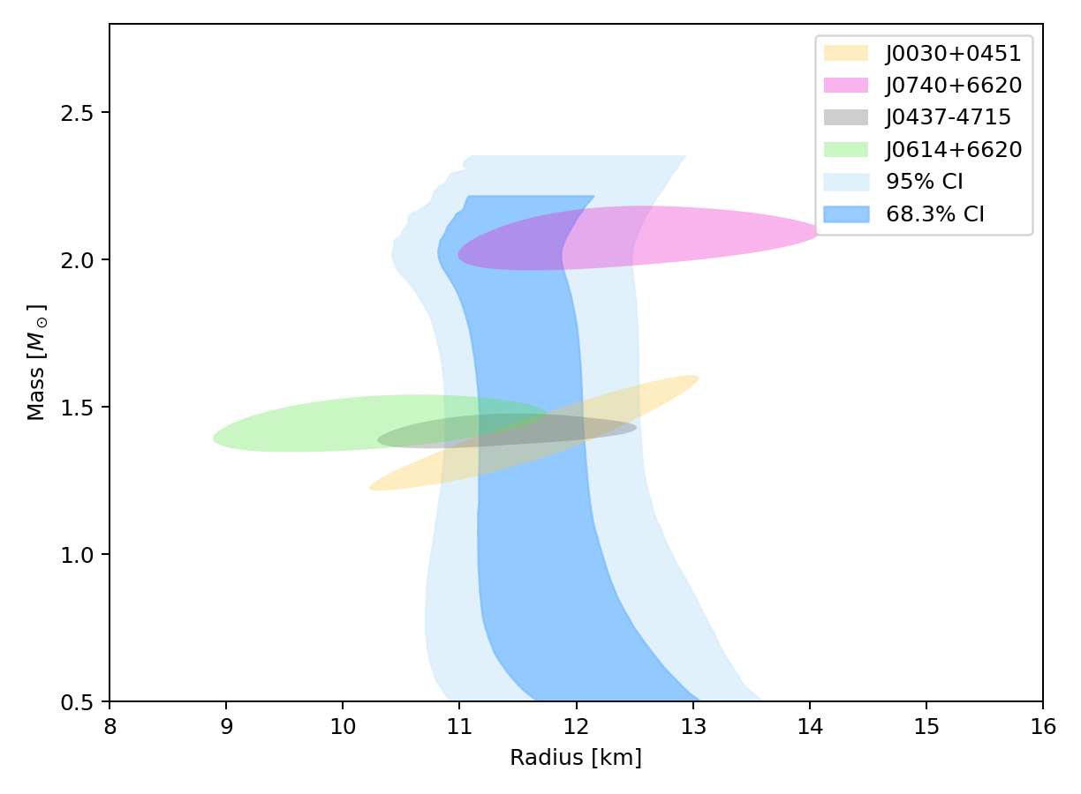
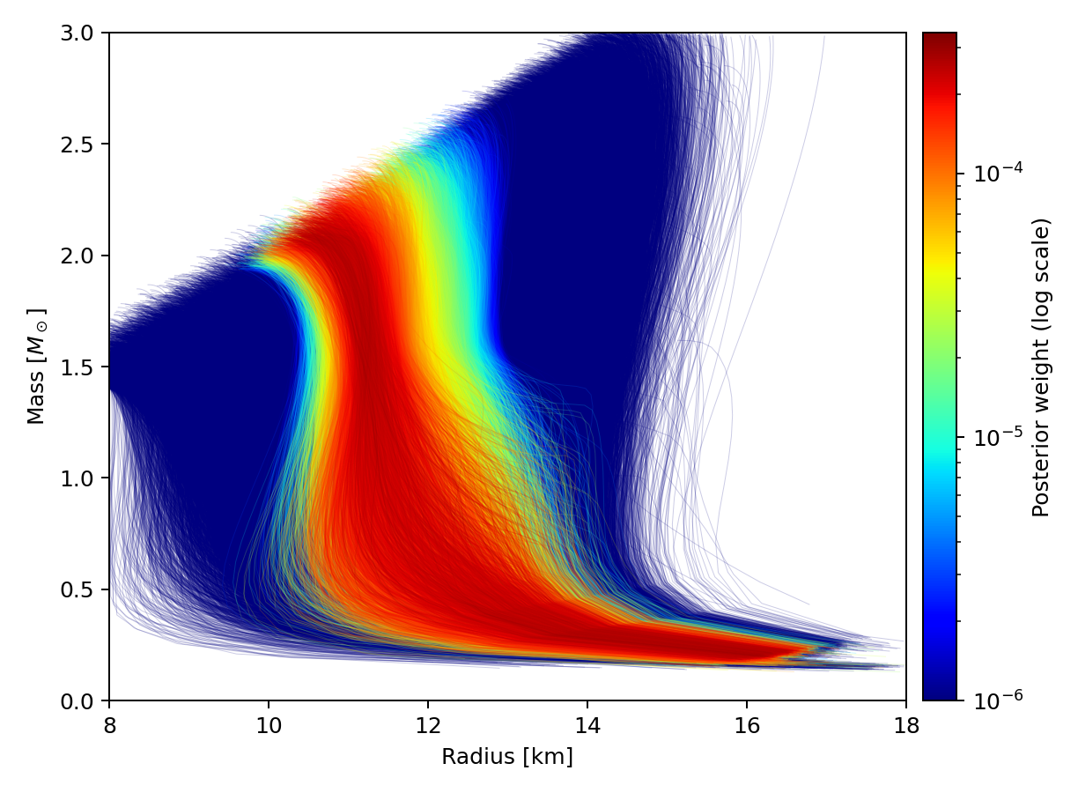
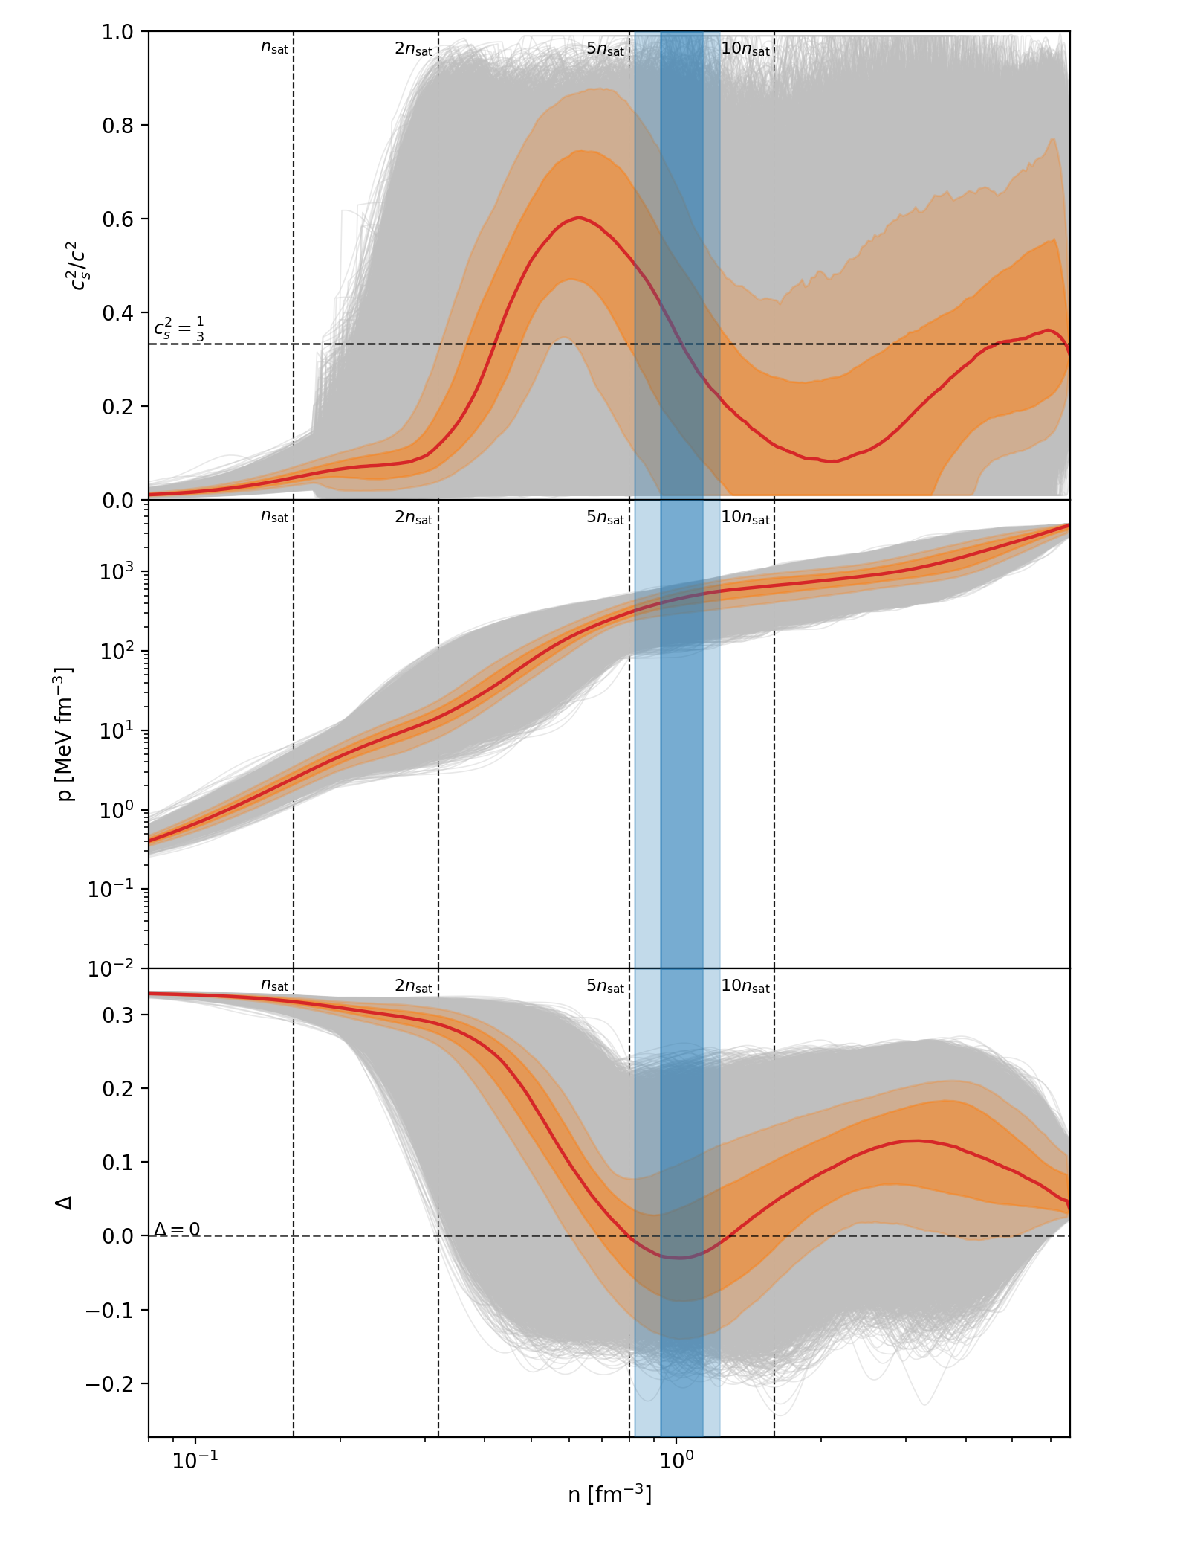
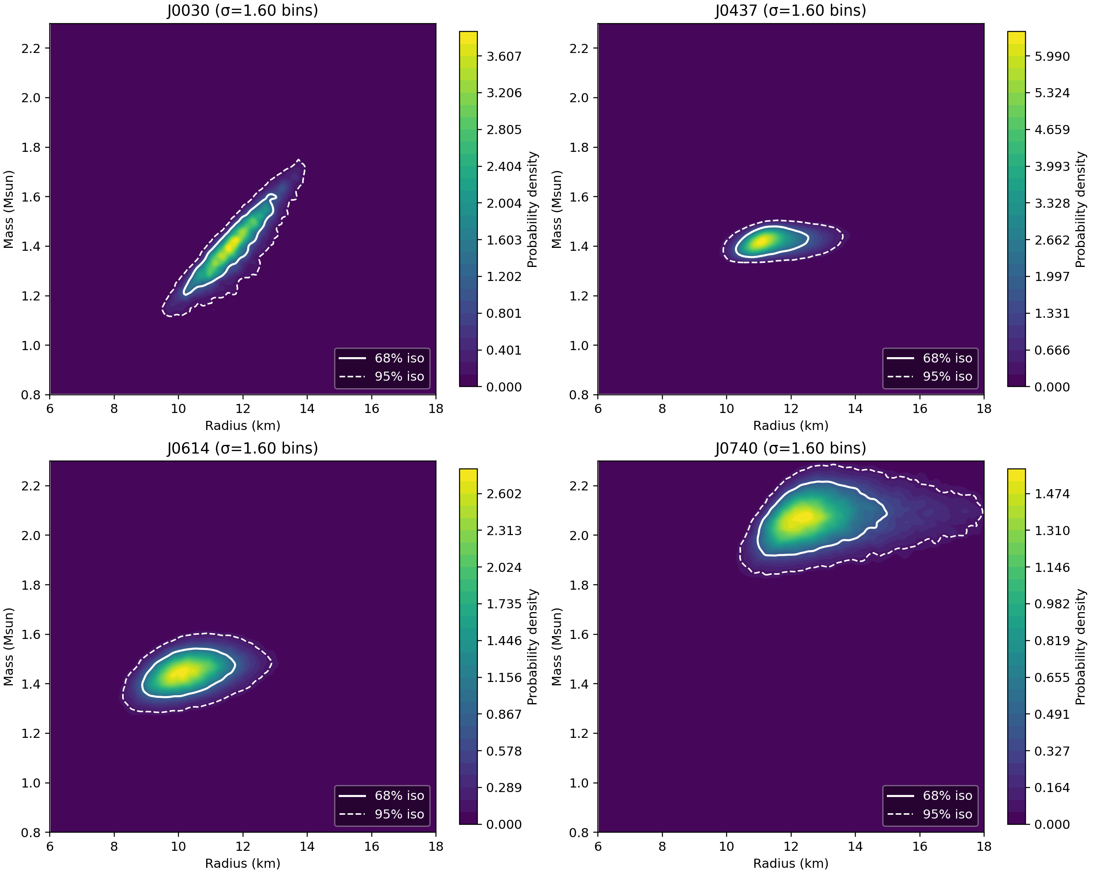
Multi-messenger Constraints
Minimum assumption: causality, thermodynamic stability
μ = 2.6 GeV
~110000 samples
Huang, Tang, Fan (arxiv: 2605.08584)

Slide 17
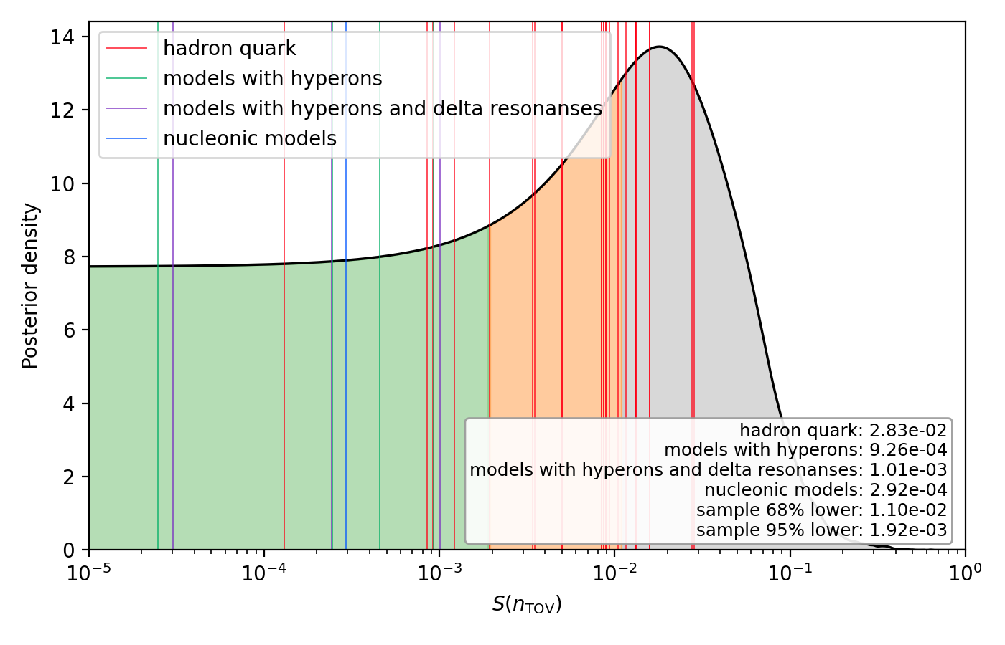
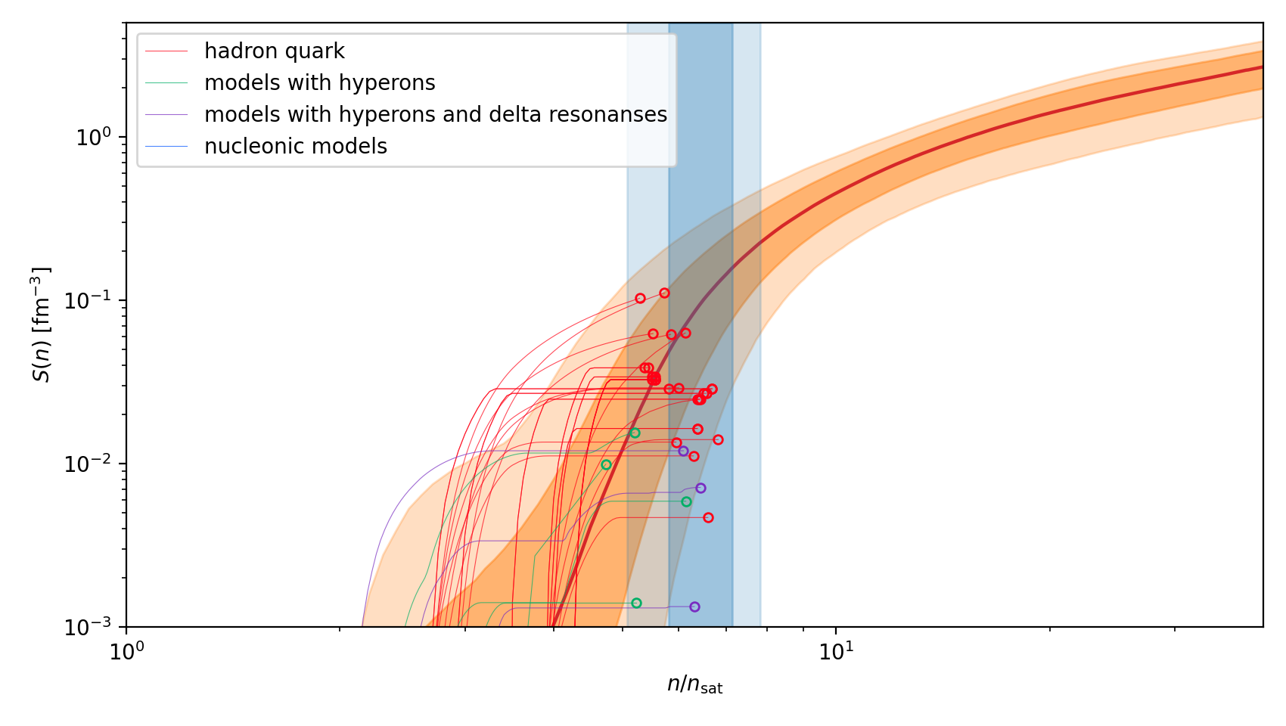
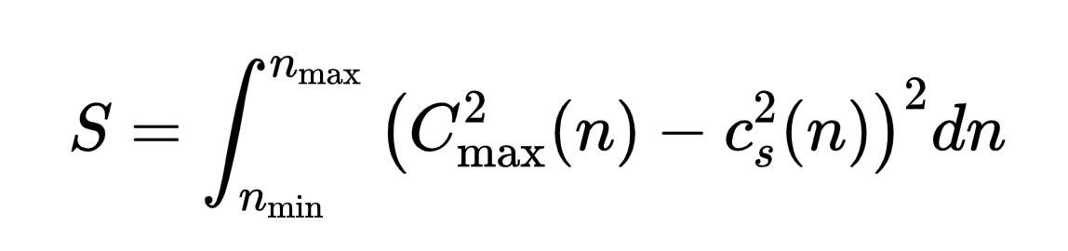
Multi-messenger Constraints
Huang, Tang, Fan (arxiv: 2605.08584)

Slide 18
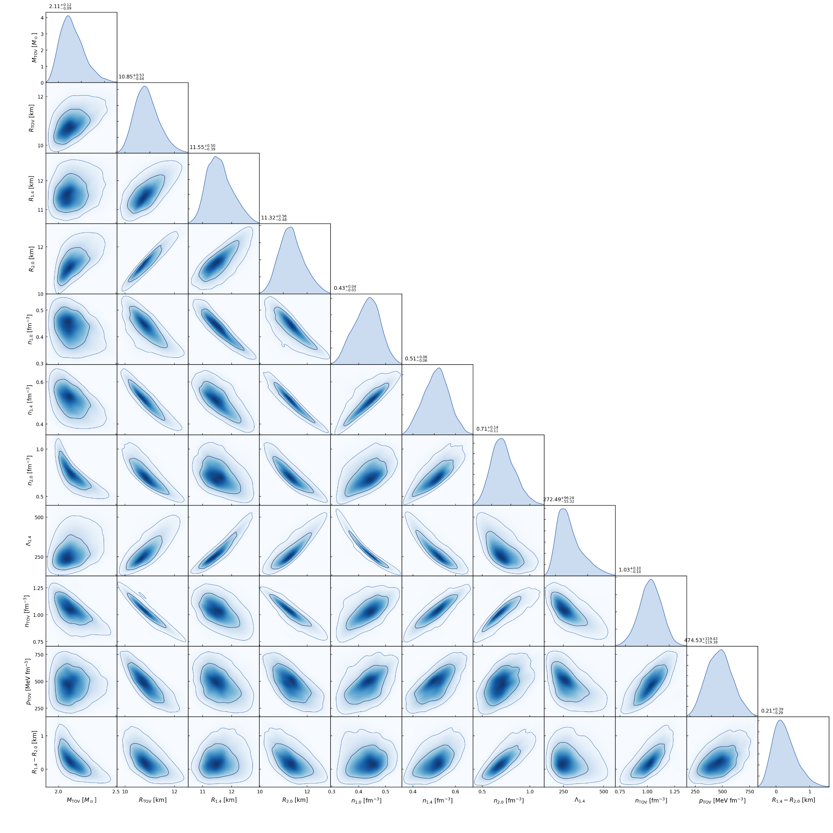
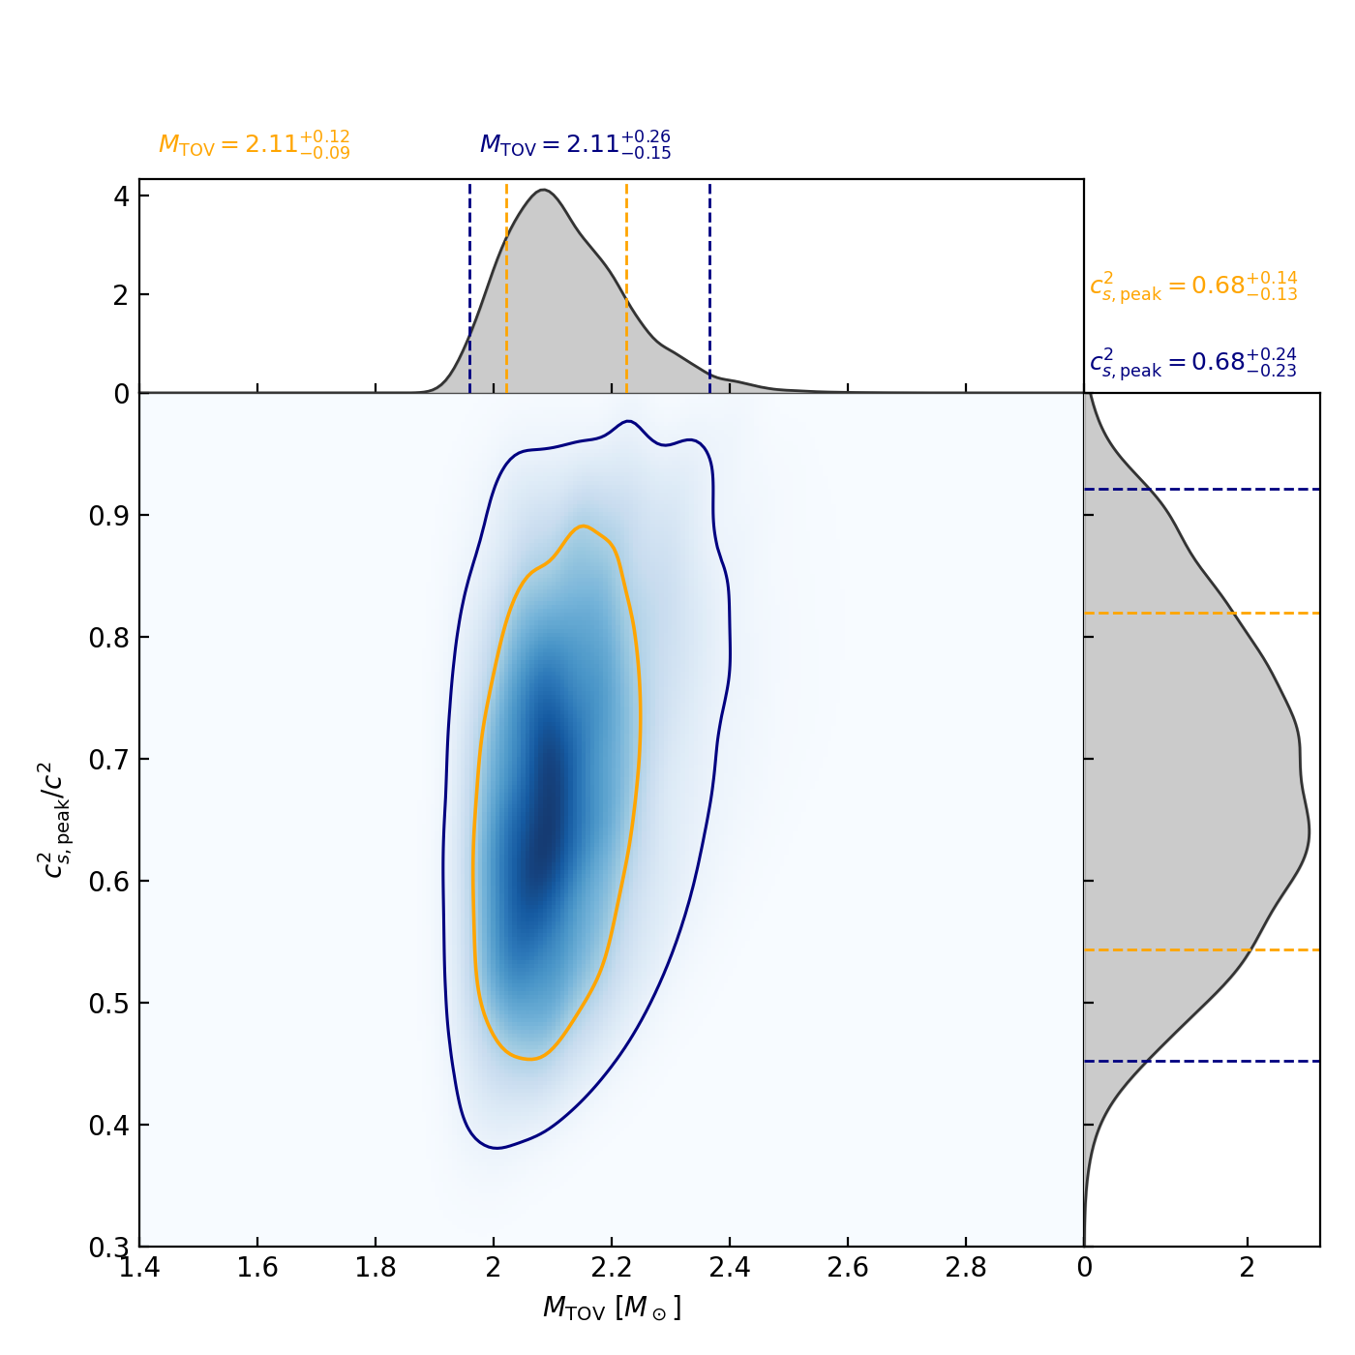
Multi-messenger Constraints
TOV mass is not necessary high for a high sound speed inside NS
Huang, Tang, Fan (arxiv: 2605.08584)

Slide 19
Outline
● Quark matter inside neutron star
● Statistical equation of states from nuclear crust to the asymptotic freedom
● Hadron quark transition in binary neutron star merger neutron star merger

Slide 20
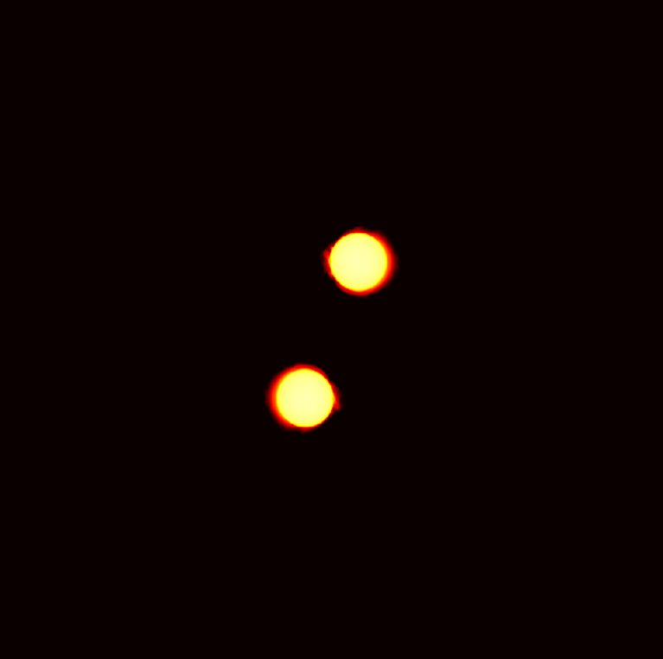
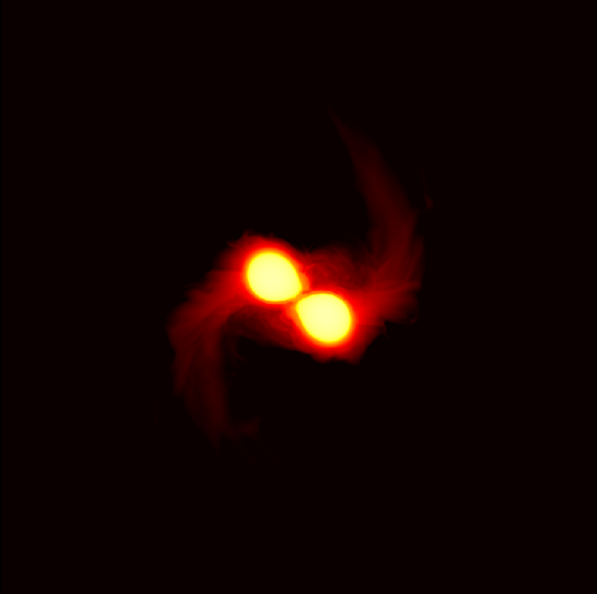
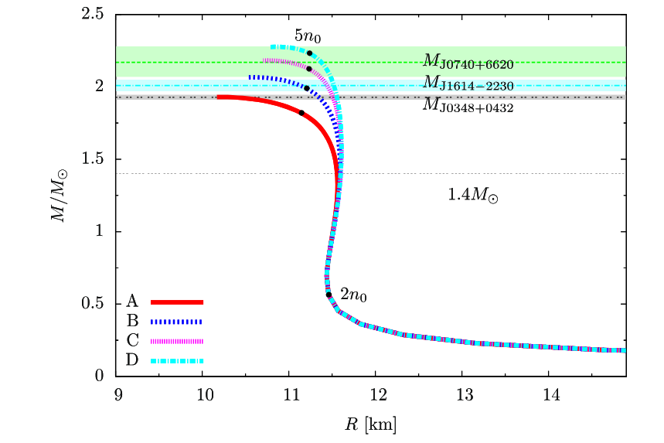
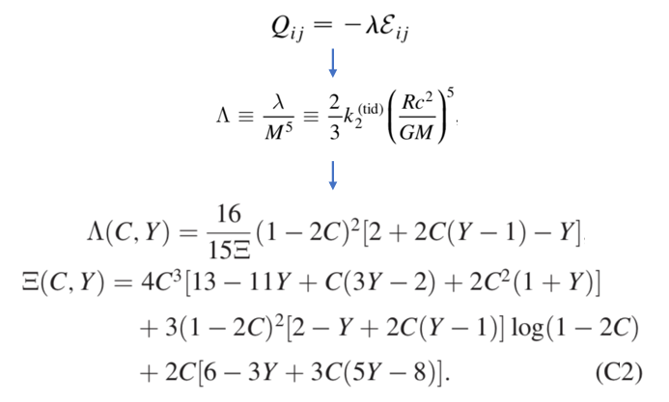
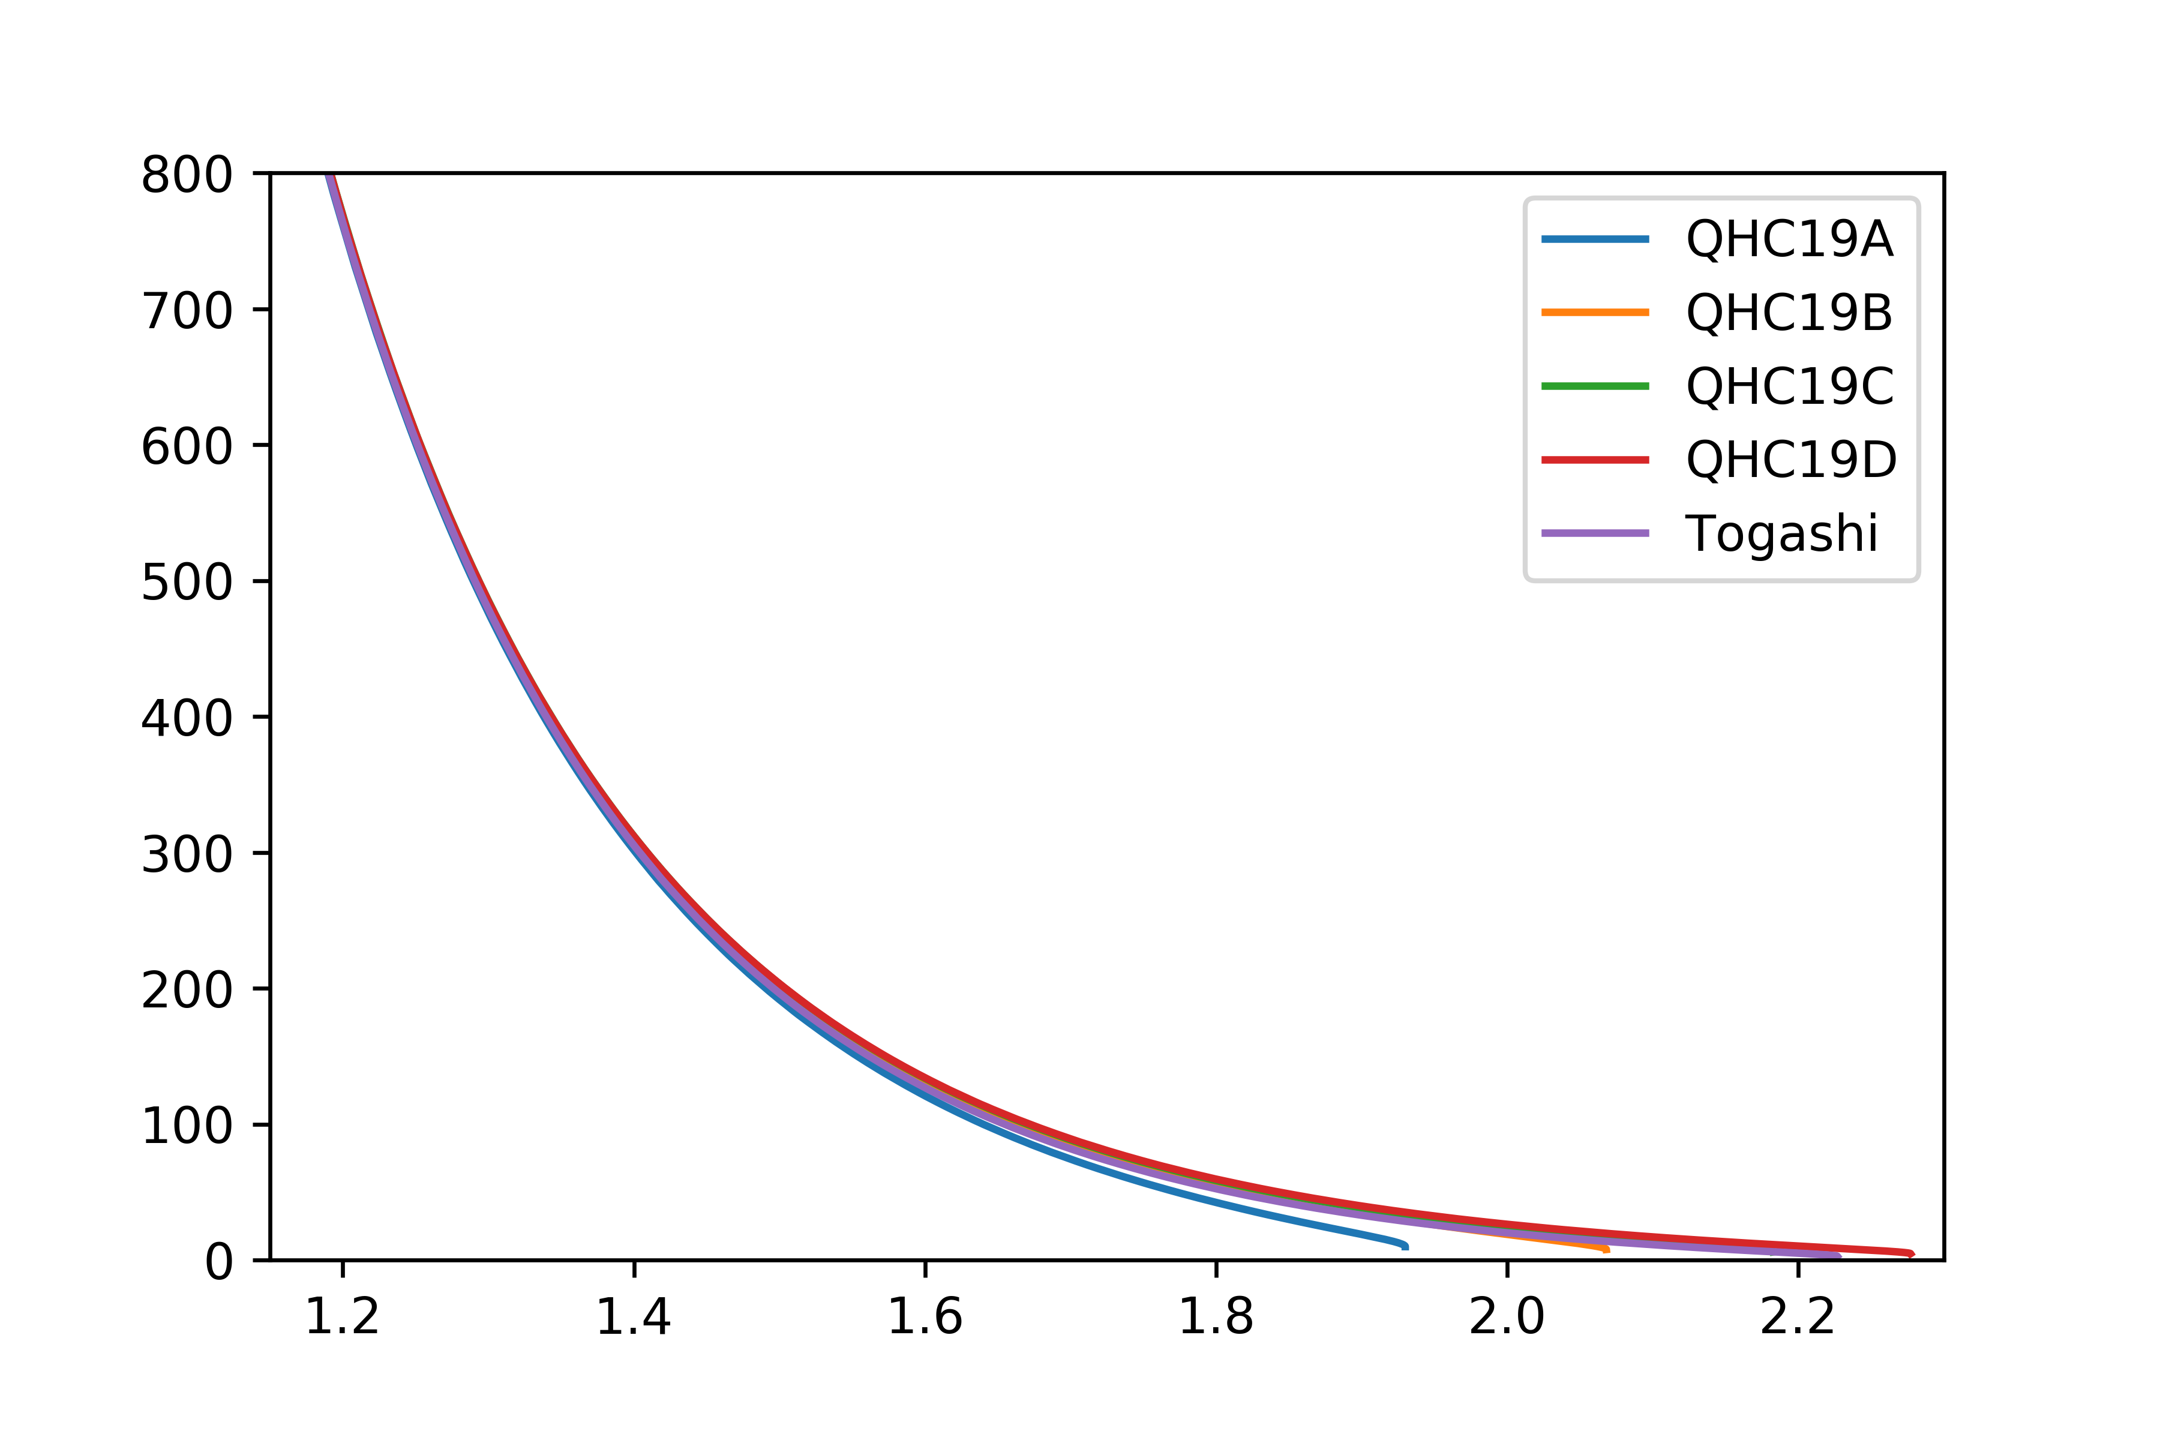
Quadrupolar tidal deformability
∨
Strongly correlated with the compactness(C) of NS
Not sensitive to the state of matter near the center
M
QHC19 EOS (Quark-Hadron crossover)

Slide 21
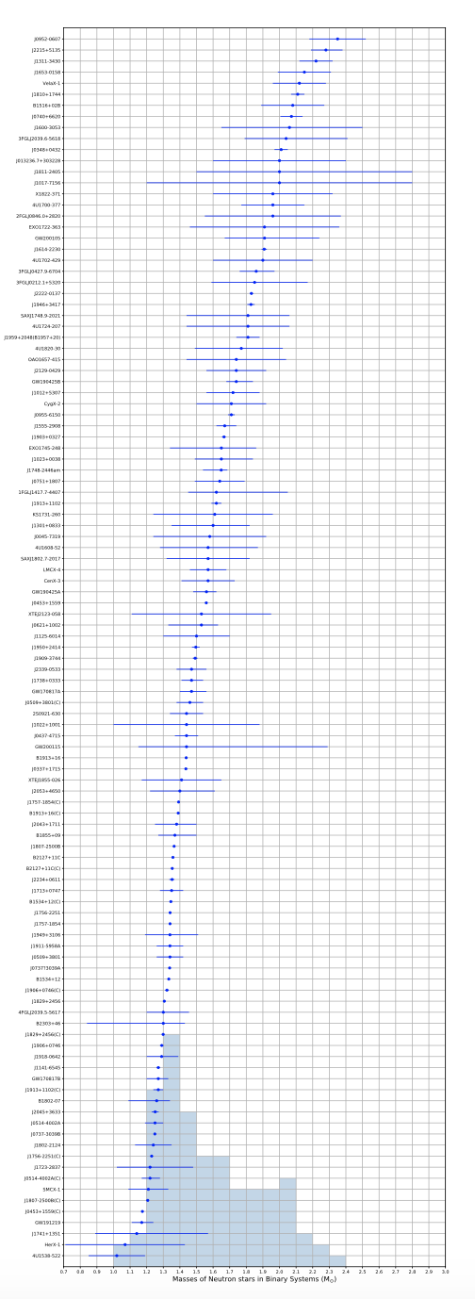
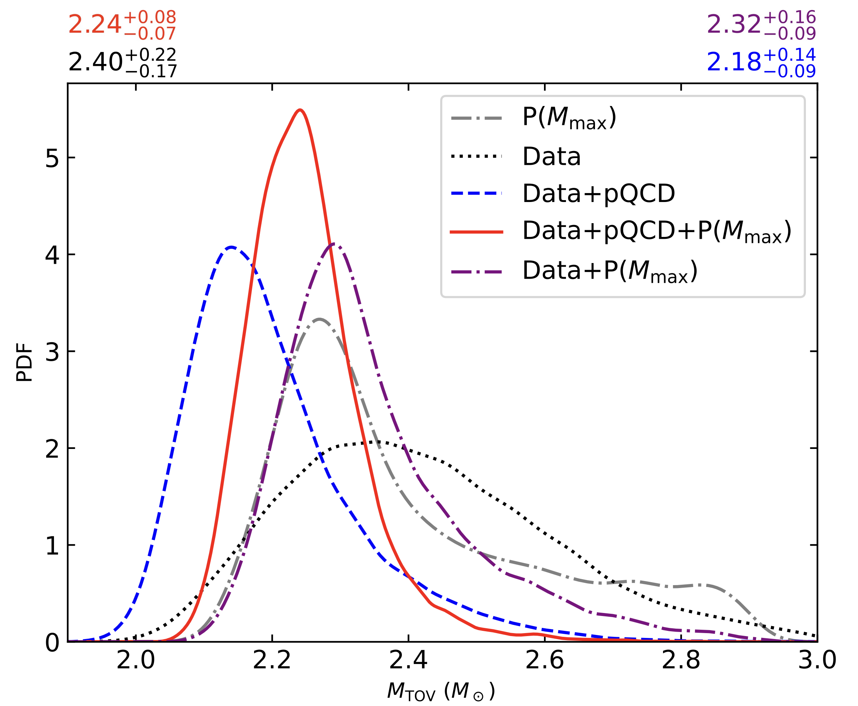
Maximum mass of non-rotating NS
Fan et al. 2024 PRD: GW170817+NICER+χEFT+pQCD+mass function P(Mmax)+Bayesian inference yields a M_{TOV} at a precision of ~3%.

Slide 22
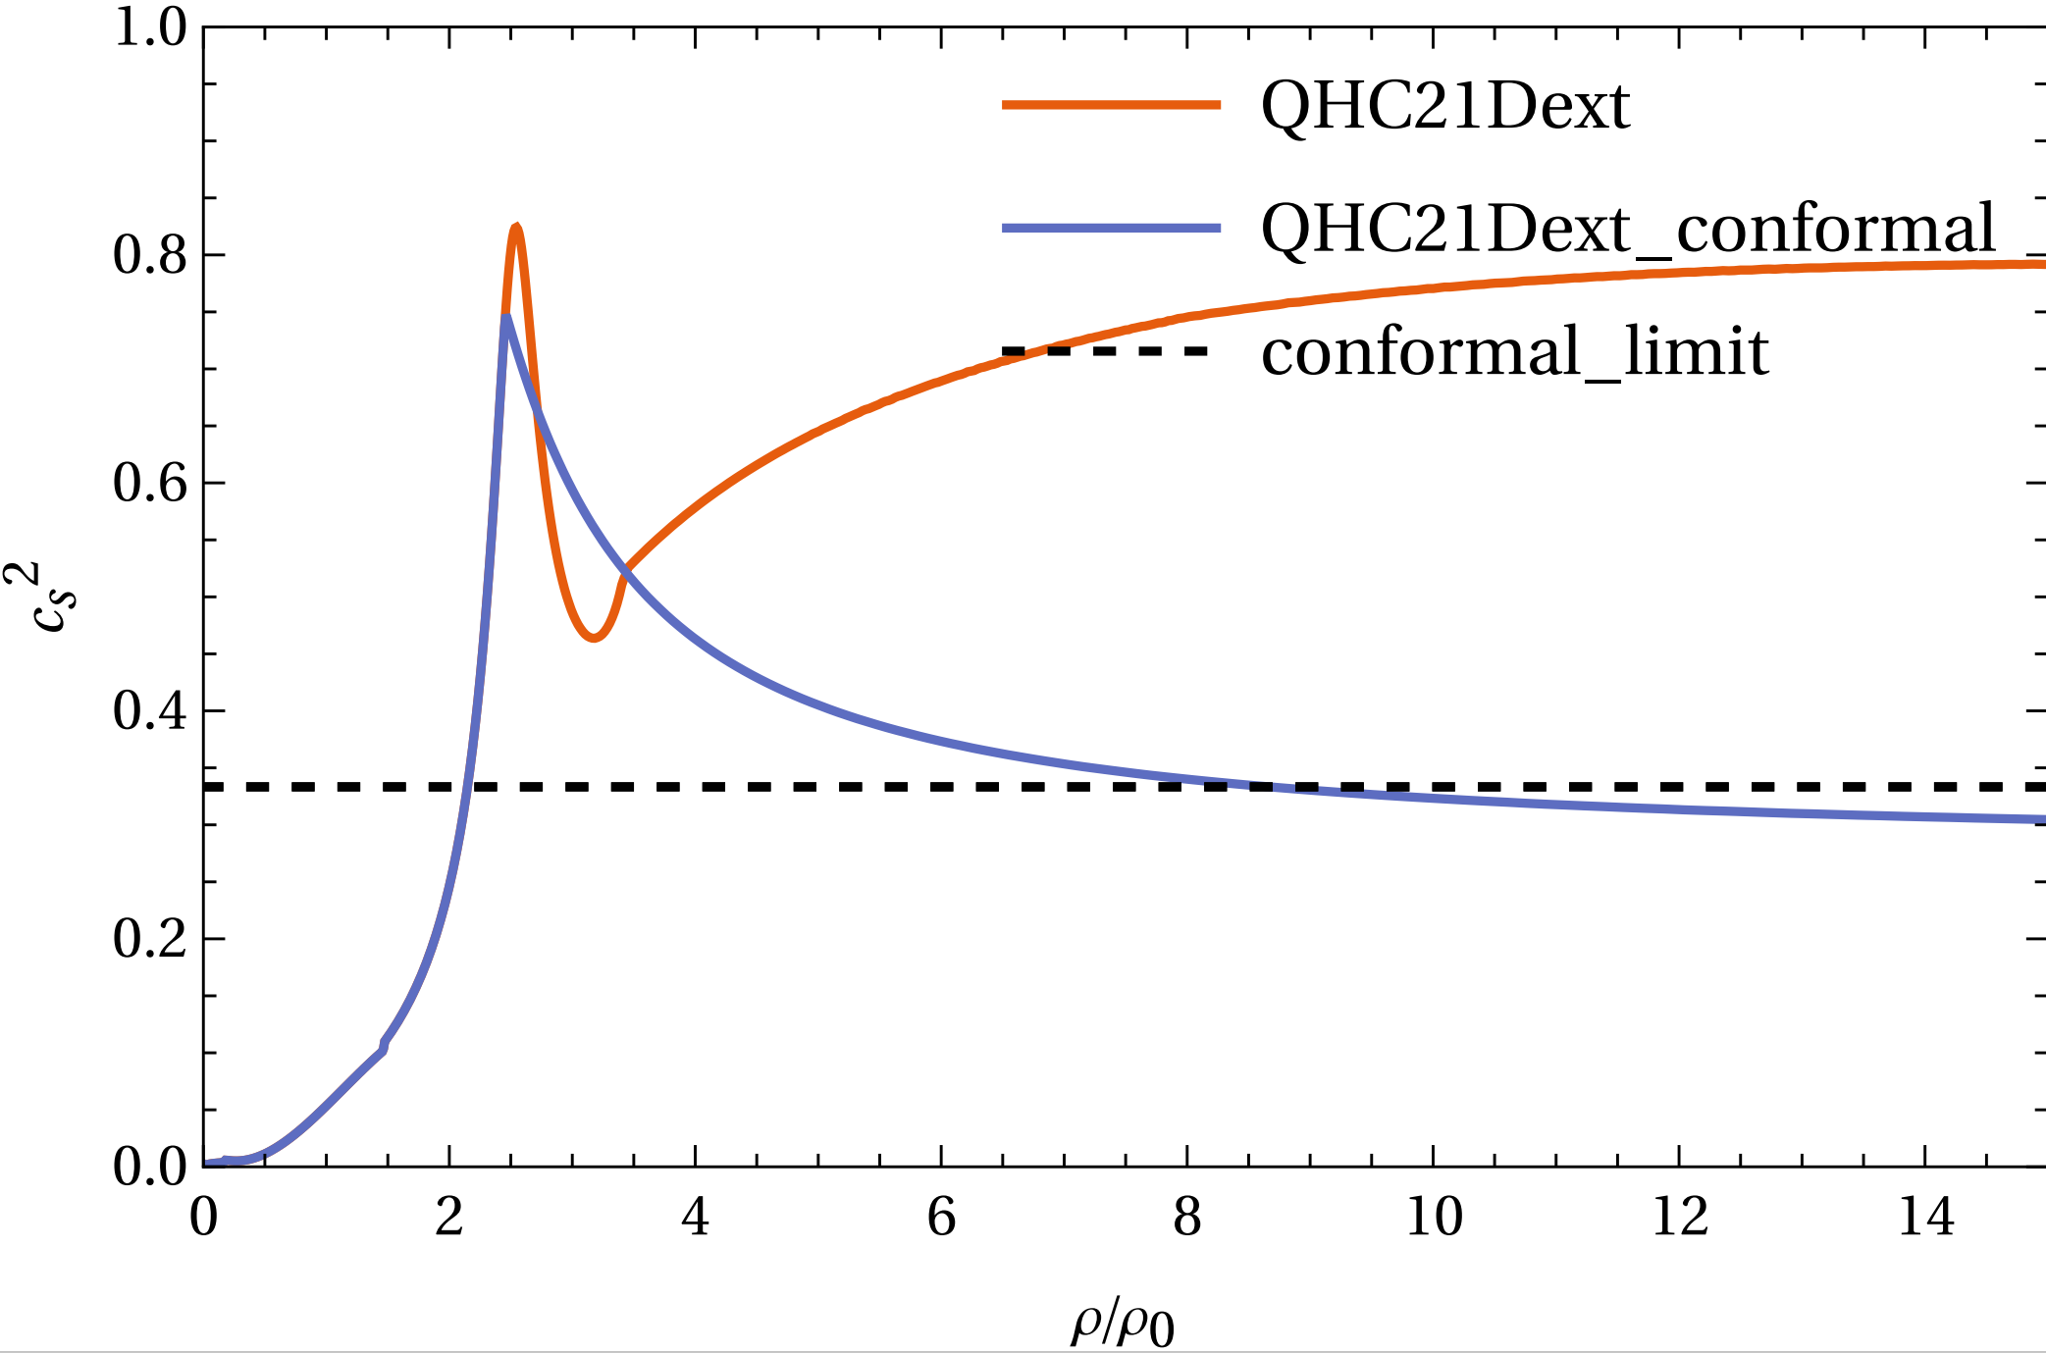
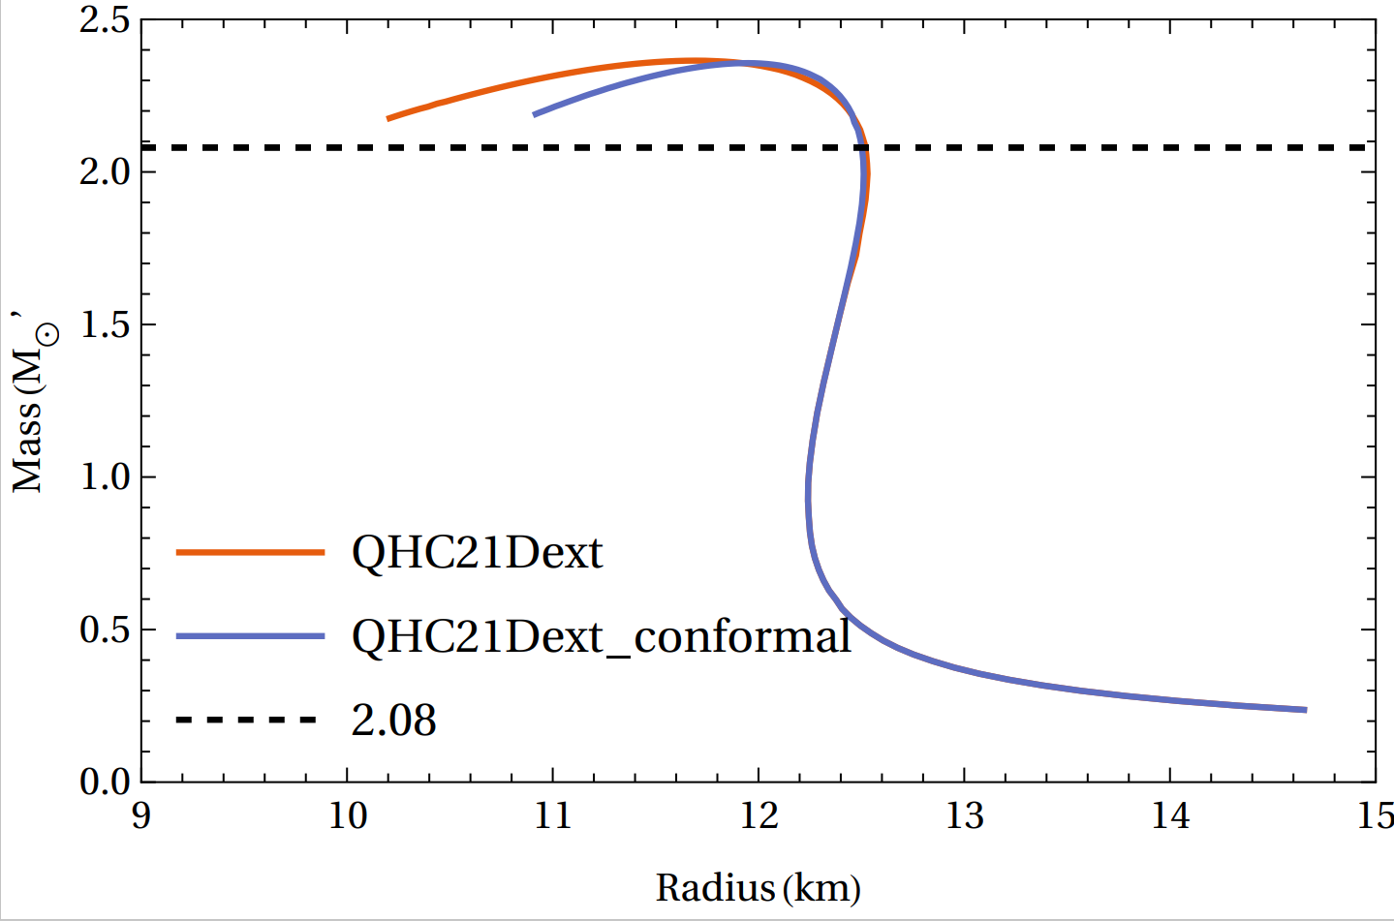
Degeneracy
A very different behavior in cs2​ can correspond to nearly the same mass–radius relation for a neutron star. This is why information from pQCD becomes essential when discussing the state of matter near the core of massive neutron stars.
How can we know more about the state of matter near the center of NS?
NS in equilibrium Dynamical merger

Slide 23

Binary Neutron Star Merger
Neuweiler et al. arxiv:2510.14850
Exotic matter? (hyperon, quark...)
Finite temperature (high temperature and high chemical potential)?
Neutrino effect?
Magnetic fields?

Slide 24

Binary Neutron Star Merger
Baiotti et al. (2017)

Slide 25

Binary Neutron Star Merger

Slide 26


Binary Neutron Star Merger
Inspiral
Post-merger
Numerical simulation(GRHD) result for binary neutron star merger

Slide 27

Gravitational wave
Post-merger
Transient phase
(peaks in GW spectrum)
Post-merger
Quasi-stationary
(instantaneous frequency)
Early inspiral
(mass, spin)
late inspiral
(tidal deformability))
BH (quasi-normal mode)

Slide 28



Post-merger
Rotational curve
NS 1
NS 2
without viscosity
Shibata and Kiuchi (2017) with artificial viscosity
Touched
Not touched, small radius high contact frequency

Slide 29







Post-merger
Toy model
Takami et al. (2015)

Slide 30


GW Spectrum
Hanauske et al. PRD 2017
GW spectrum during the BNS merger, several peaks were present because of the post-merger oscillation. f1 and f3 vanish quickly as they are coupled with radial oscillation. f2 is fully rotation-driven.

Slide 31

QCD phase diagram
Fujimoto et al. 2023; Fukushima and Hatsuda 2011
How the hadron-quark transition takes place in zero temperature but high chemical potential?

Slide 32


QCD phase diagram
· For $n_{B}< 2n_{0}$, the dominant interactions occur via a few (~1-2) meson or quark exchanges, and description of the matter in terms of interacting nucleons is valid.
· For $2n_{0}<n_{B} <(4−7)n_{0}$, many-quark exchanges dominate and the system gradually changes from hadronic to quark matter.
· For $n_{B}> (4−7)n_{0}$, the matter is percolated and quarks no longer belong to specific baryons.

Slide 33


1PT vs. QHC
Crossover: Smoothly connects the boundary for hadron and quark; stiffening when confined quark saturated; support 2 solar mass NS with soft hadronic EOS
1st PT: strong 1st PT only take places on the center of massive NS; or a Gibbs construction, predicts no so much difference with the hadronic baseline in zero temperature
Strong 1st phase transition
Quark-hadron crossover

Slide 34


1PT in BNS merger
Bauswein et al. PRL 2019
Deconfined quark matter arises with an energy density “jump”, which always softens EOS.

Slide 35



1PT in BNS merger
Parash et al. PRD (2021)
A rather similar M-R curve + lower onset density in the finite T ---100 Hz in GW spectrum

Slide 36


QHC in BNS Merger
Two versions of QHC19 EOS based on Togashi EOS:
· Smooth crossover
· Small deviation near quark saturation density(2 n0)
· Peak/bump sturcture (stiffer than the hadronic baseline)
· Same radius for low-mass neutron star
· The stiffening from crossover can support more
massive neutron star

Slide 37



QHC in BNS Merger

Slide 38



QHC in BNS Merger
· The EOS properties are well shown in the f2 frequency.
· Lower $f_{2}$ in low-mass BNS merger, independent of the height of such peak.（on the contrary with the first-order phase transition）

Slide 39





QHC in BNS Merger
Third-generation gravitational wave dectector
2030s
Chatziioannou et al. 2017
SNR~5 Δf2 < 20Hz
Srivastava et al. 2022

Slide 40

Constraint on strong 1PT
Tang, Huang, Fan PRD (2025)

Slide 41


Constraint on strong 1PT
The phase transition (if so) is expected to occur either at densities below the central density of the least massive neutron stars, or near the center of the most massive ones.
Tang, Huang, Fan PRD (2025)

Slide 42


Neutron-quark star
Observationally confirming quark degrees of freedom in stable NSs usually requires signaling a transition from conventional hadronic stars to hybrid stars with quark cores. In other words, the scenarios where quarks are always or never present in NSs cannot be distinguished with observations of stars in equilibrium.
Neutron-quark star: quark effects emerge at masses below the lowest observed neutron-star mass

Slide 43


Neutron-quark star
QHC-stiff
Crossover start
QHC-soft
Deconfined
Not fully Deconfined
No f2-mode GW
M1.25 M1.375 M1.48 M1.55 M1.60 M1.65 M1.70
Mass
>20ms >20ms >20ms >20ms 2.0ms 1.8ms 1.7ms
Lifetime

Slide 44

Neutron-quark star
The rapidly stiffening of EOS could be observed by combining the observation of BNS in inspiral and post-merger

Slide 45




No-f2 mass threshold
Prompt collapse: collapse occurring during the first increase of the maximum density
Prompt-collapse
No f2 observed, but nonnegligible GW energy released
We define the no-f2 mass threshold as the lowest mass of one star in the binary (only for equal-mass cases here) for which no f2-mode GW emission is identified.
Criterion: ~0.3$M_{Θ}$ difference could exist between no-f2 and prompt collapsing mass threshold

Slide 46



Post-merger GW energy vs. frequency

Slide 47




Phase boundary?
How does the onset density of quark matter change with temperature?
Quark matter is denser and has higher entropy (color/flavor d.o.f)
Negligible at high chemical potentials or temperatures
Negative
One critical point? Two critical point? No phase boundary?
Extend the hadron-quark hybrid EOS from zero temperature to finite temperature
Togashi EOS

Slide 48
Conclusion
• Current constraints on the NS EOS have been significantly tightened by combining gravitational-wave data with electromagnetic observations.
• Non-parametric approaches enable us to explore the EOS space without imposing specific functional forms, thereby uncovering potential structures in the EOS. The results show that quark matter is favored to exist inside massive NSs and that quark matter is intrinsically soft within the neutron-star picture.
• Observations of stable neutron stars have inherent limitations, as the global NS structure is insensitive to the emergence of a new phase in the core. Numerical-relativity simulations of binary NS mergers are therefore indispensable for probing hadron-quark transitions.
• Finite-temperature effects in the merger remnant lower the critical density for quark deconfinement, making binary neutron-star mergers unique laboratories for studying the QCD phase diagram at high chemical potential and high temperature.
Multi-messenger Inference --- Numerical Relativity --- Nuclear Physics

Slide 49

Nice to see you in Barcelona!

