Slide 1
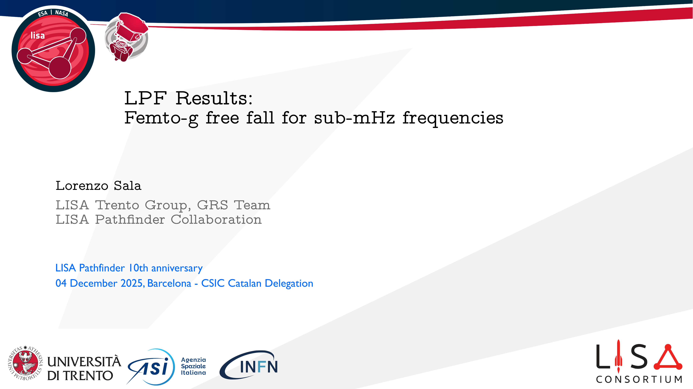
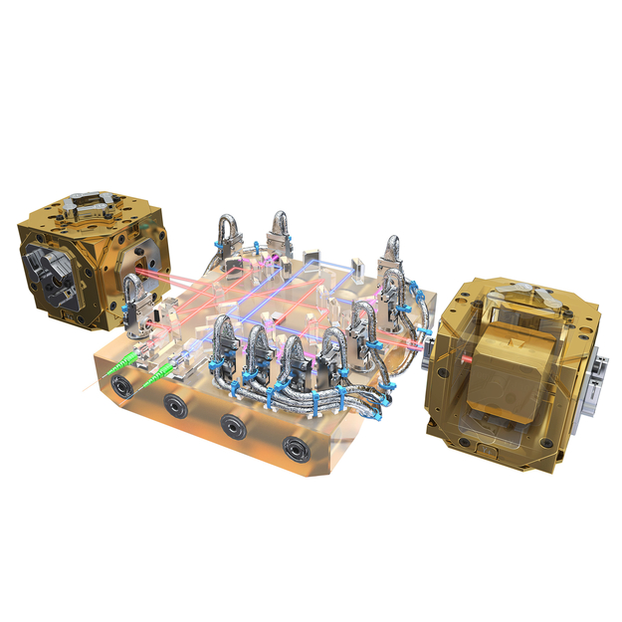
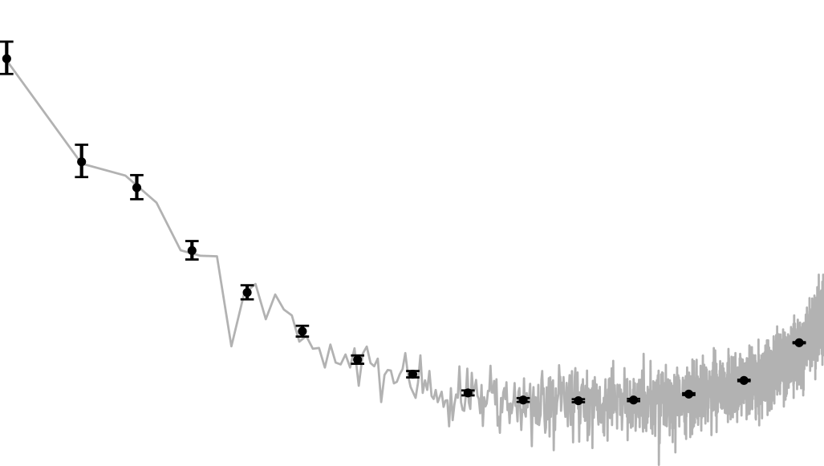

Slide 2

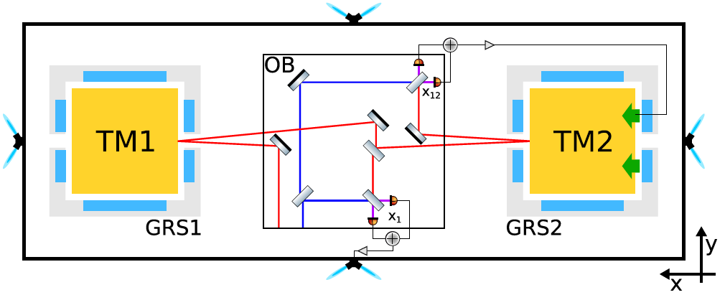
LISA Pathfinder: a window to low frequencies
LPF’s main measurement: the differential acceleration between two LISA-like TMs, along a 38cm arm.
TM1: Drag-free control.
TM2: pN actuation along sensitive axis.
Both: force/torque actuation along all remaining DOFs.
Electrode Housing
Interferometric IFO readout
Optical Bench
Capacitive (GRS) readout, 6 DOF
Suspension loop, pN forces on TM2 w.r.t. TM1
Applied control
forces
Stiffness terms, coupling to S/C motion
Drag-free loop, μN forces on S/C w.r.t. TM1
Inertial forces

Slide 3
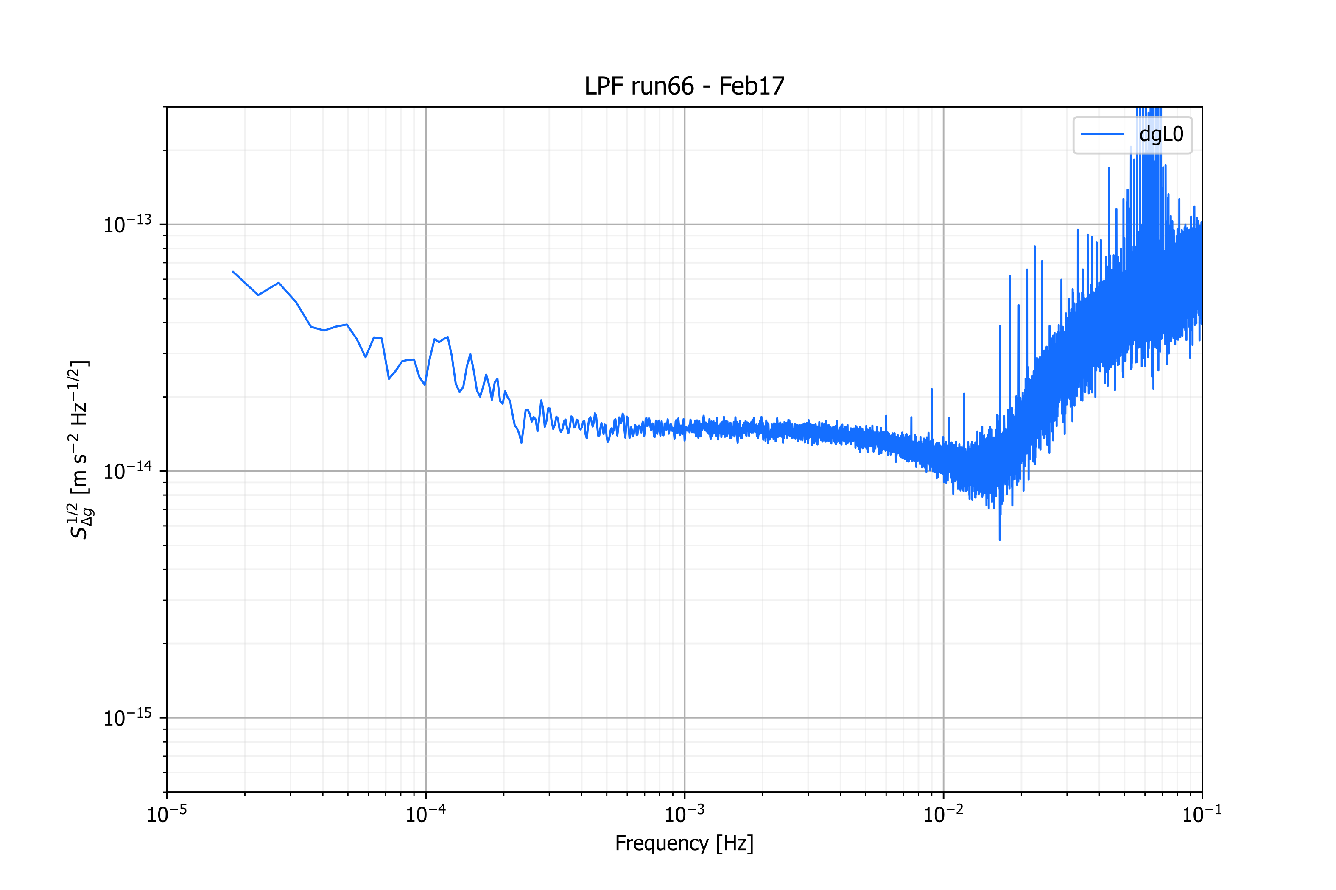
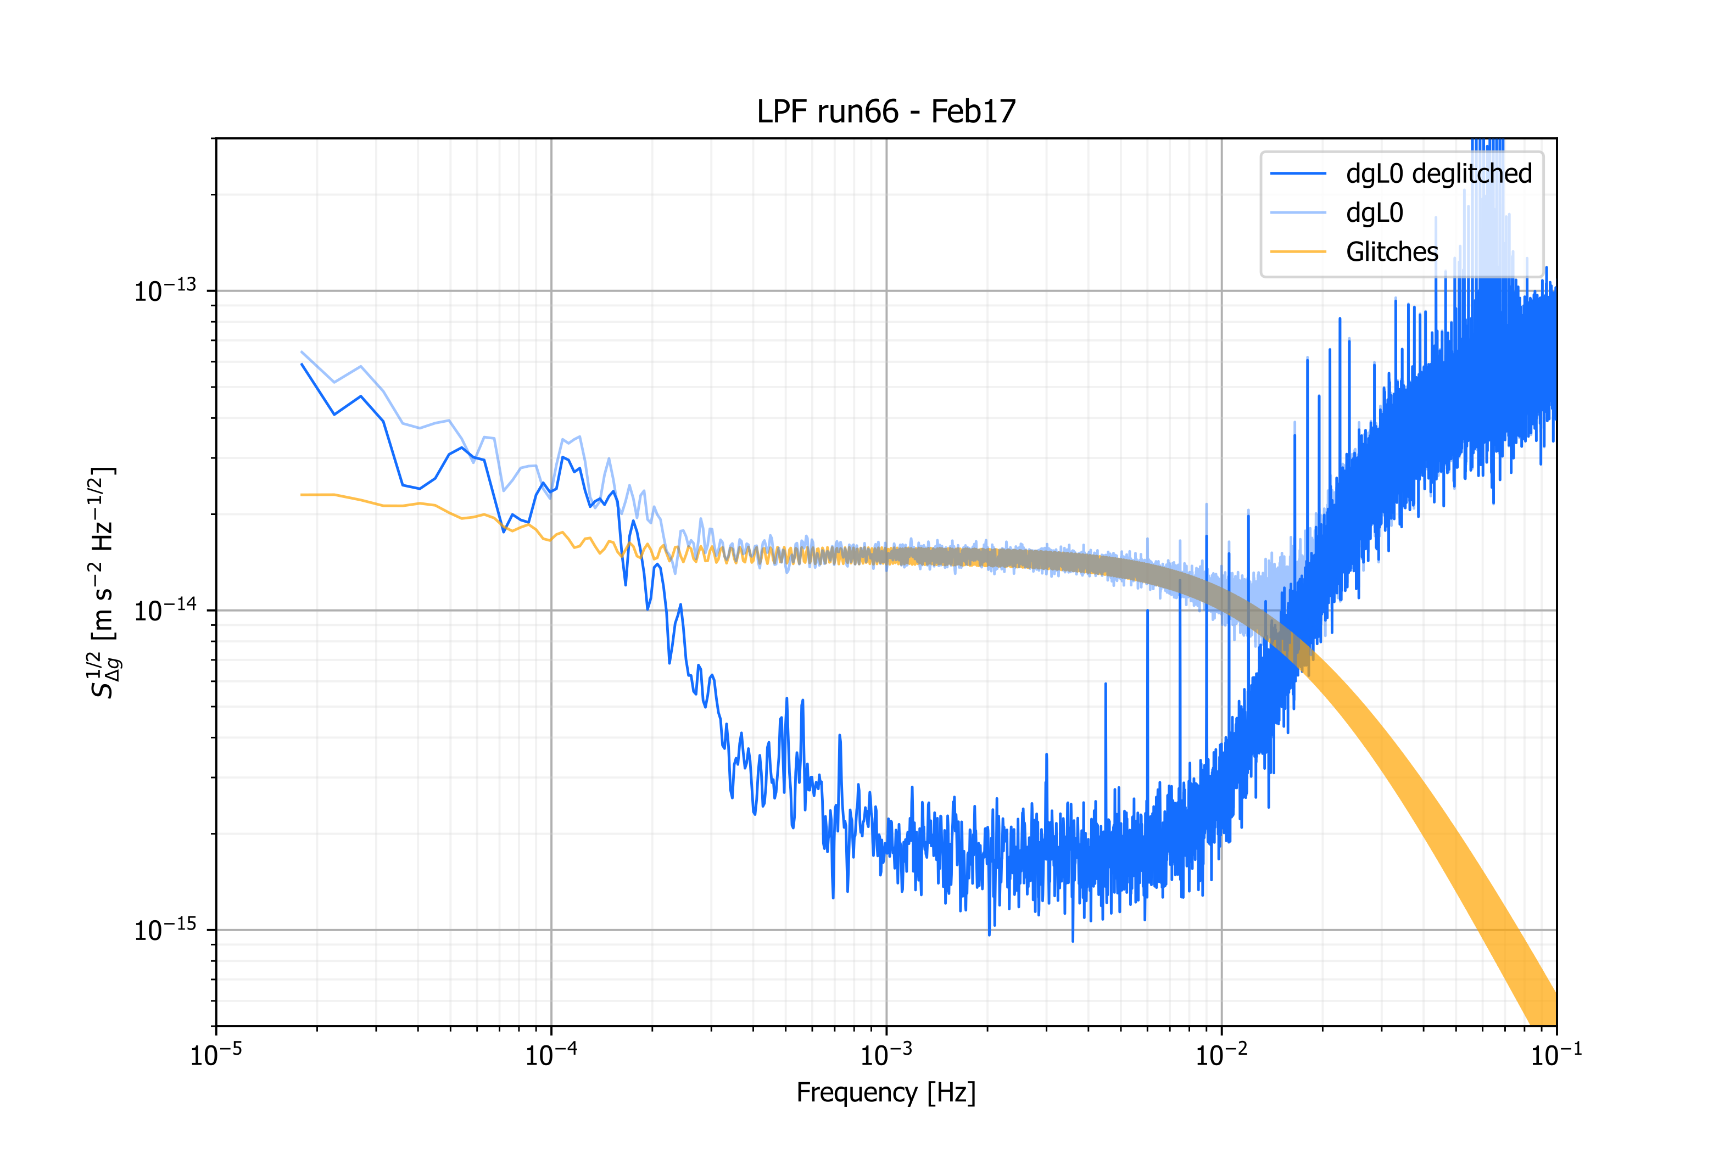
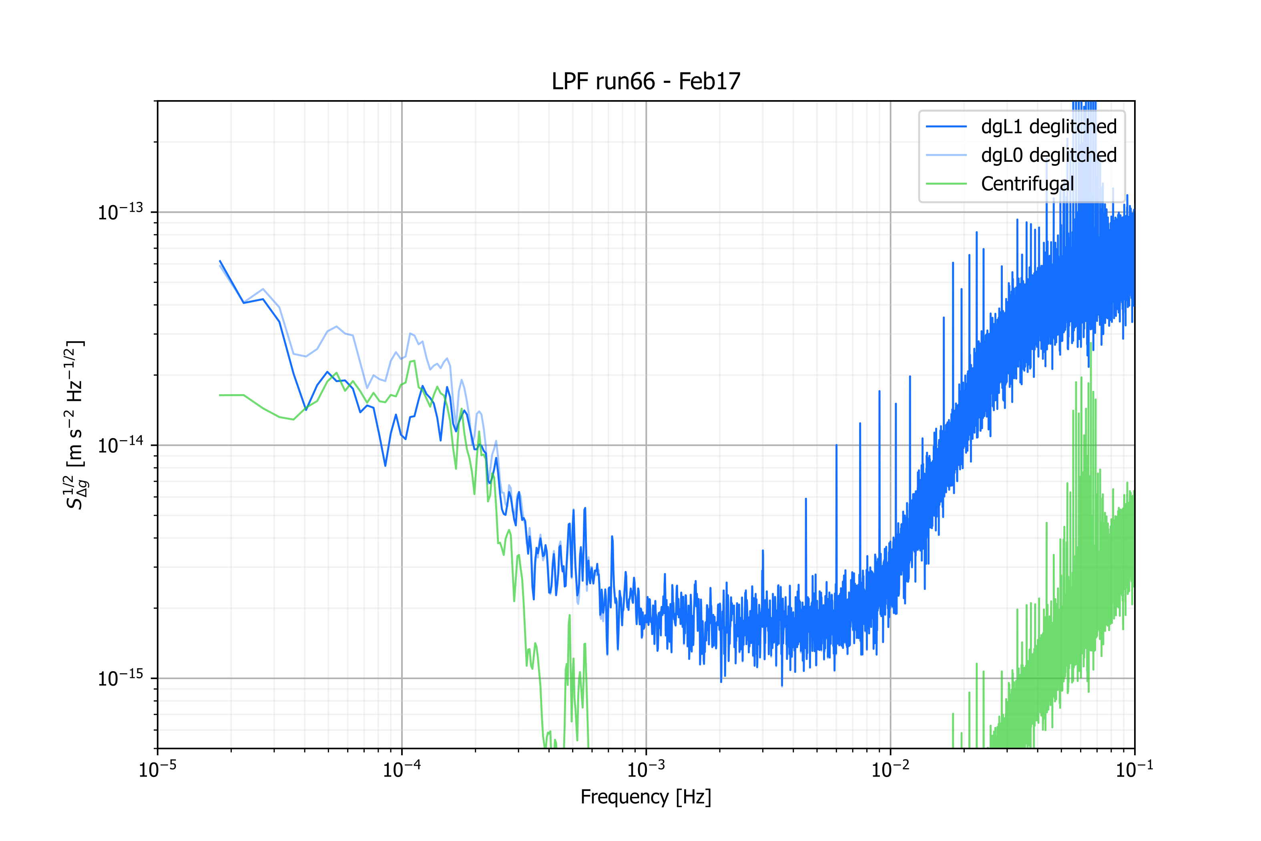
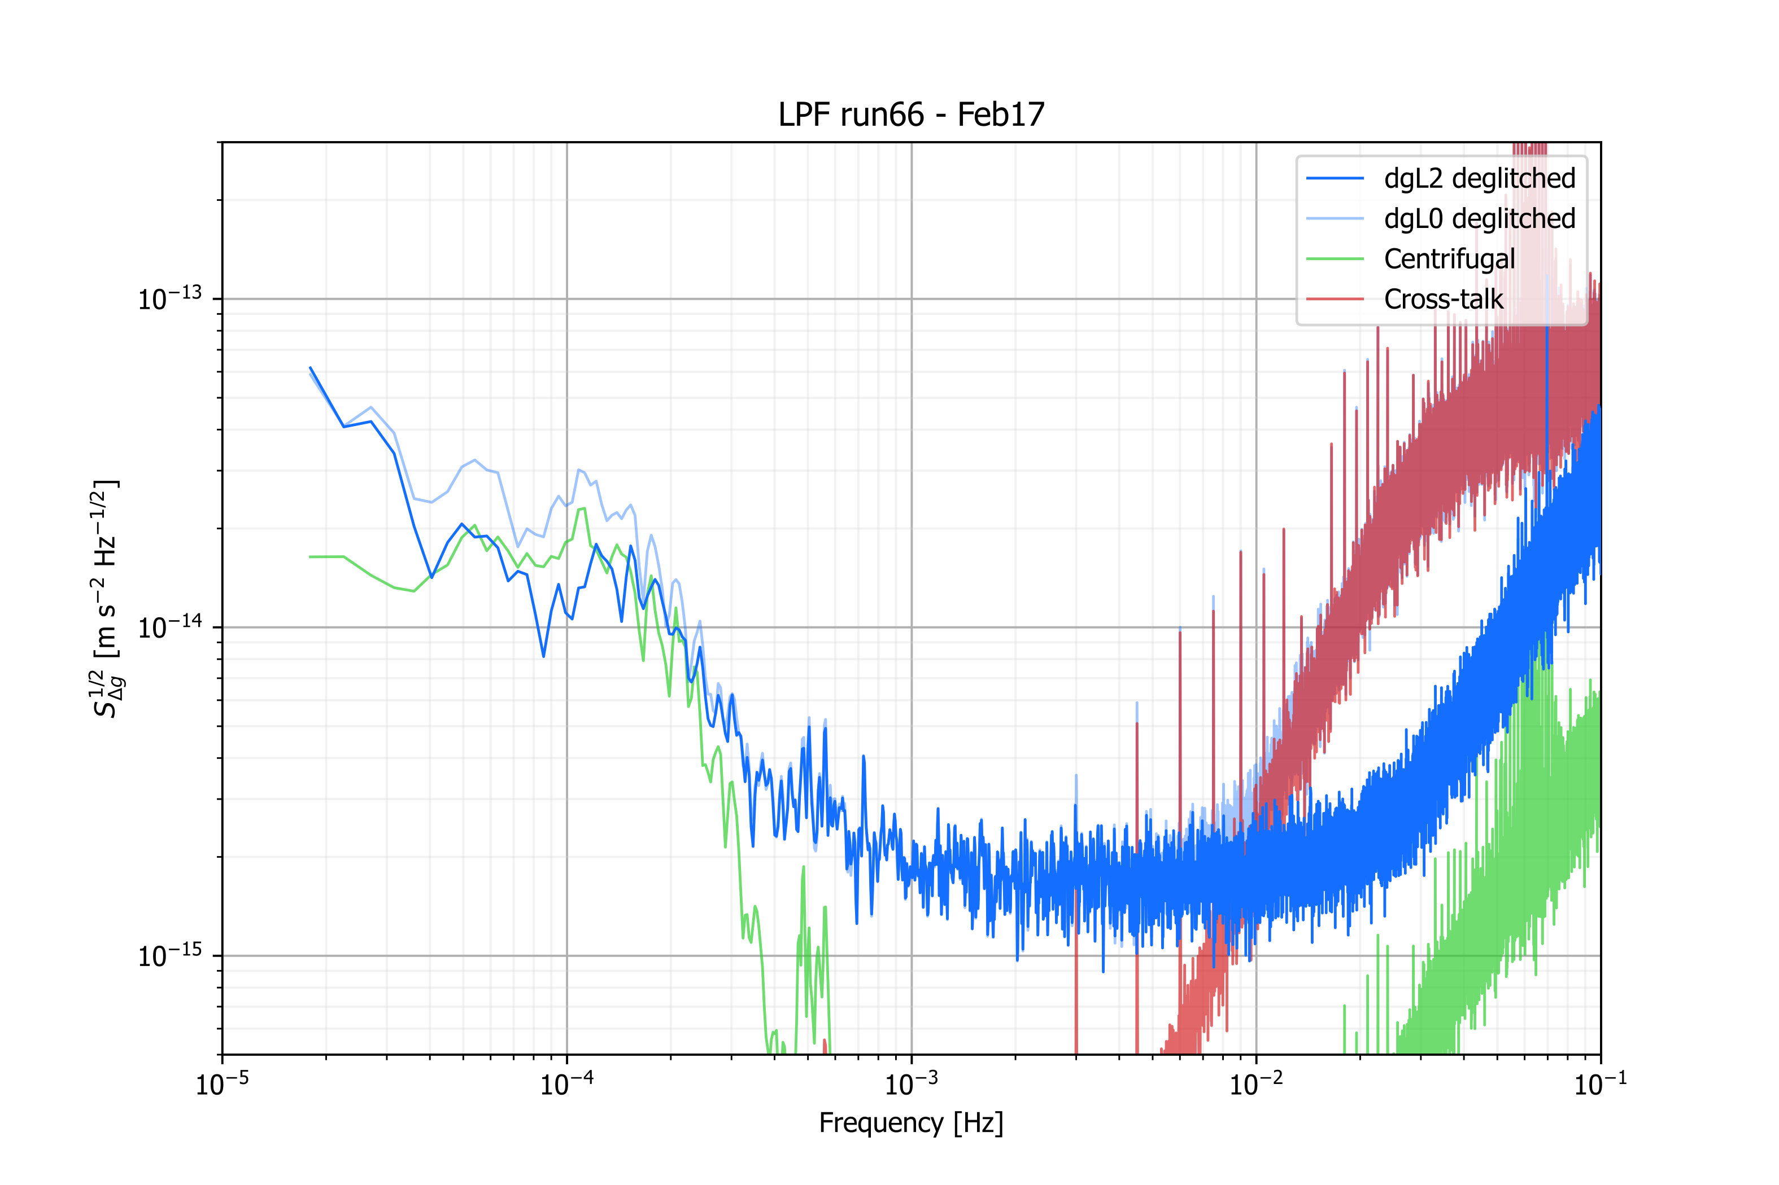
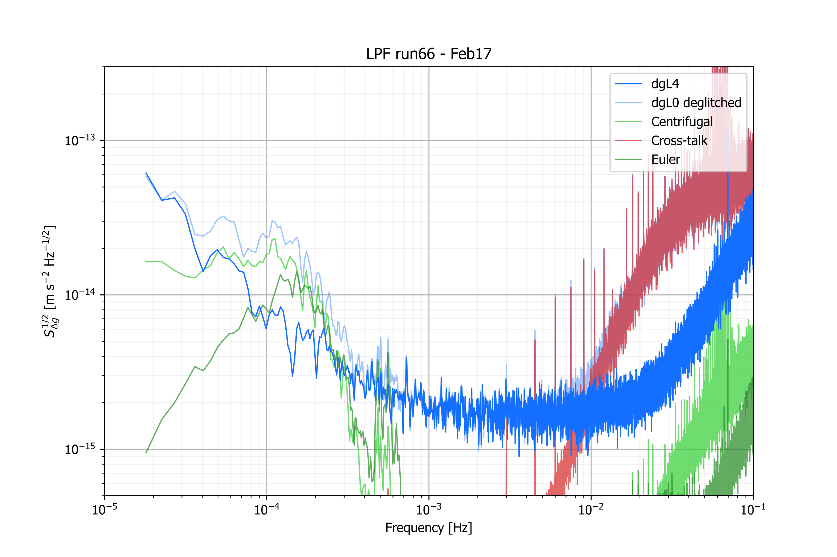
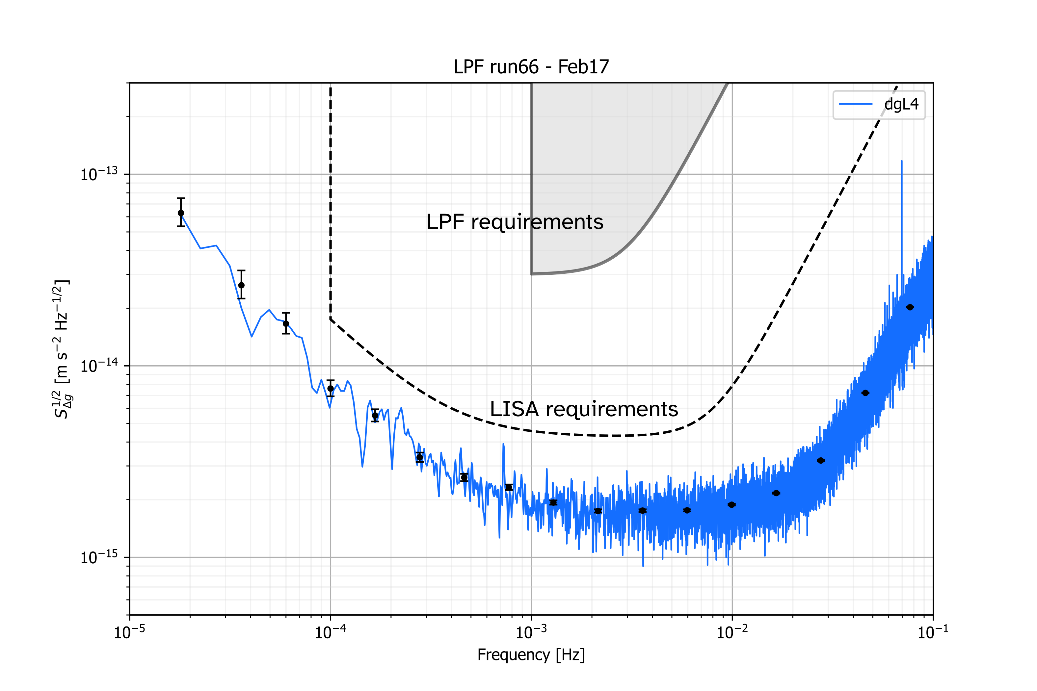
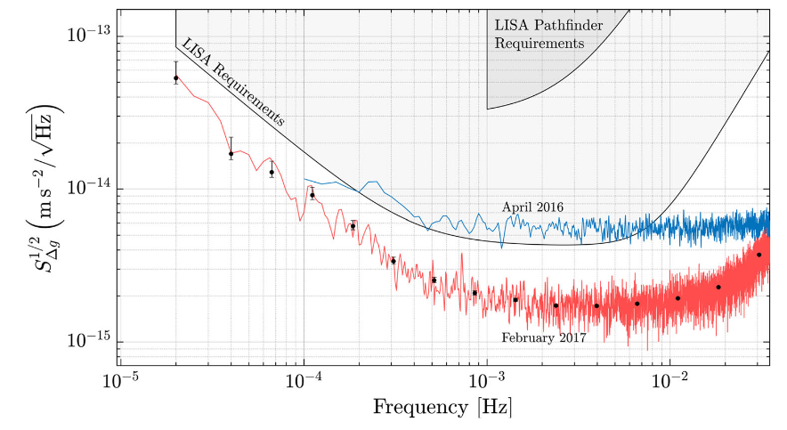
LPF noise down to dgL4
Measured dgL0.
Deglitching.
Subtraction of centrifugal force.
Decorrelation of cross-talk “debumping”
Decorrelation of Euler force

Slide 4
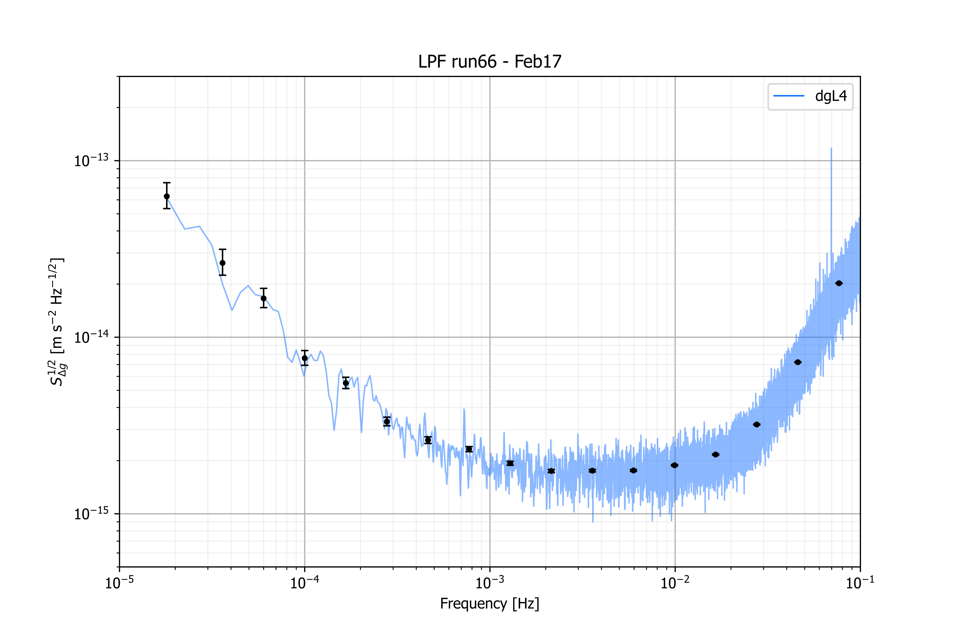
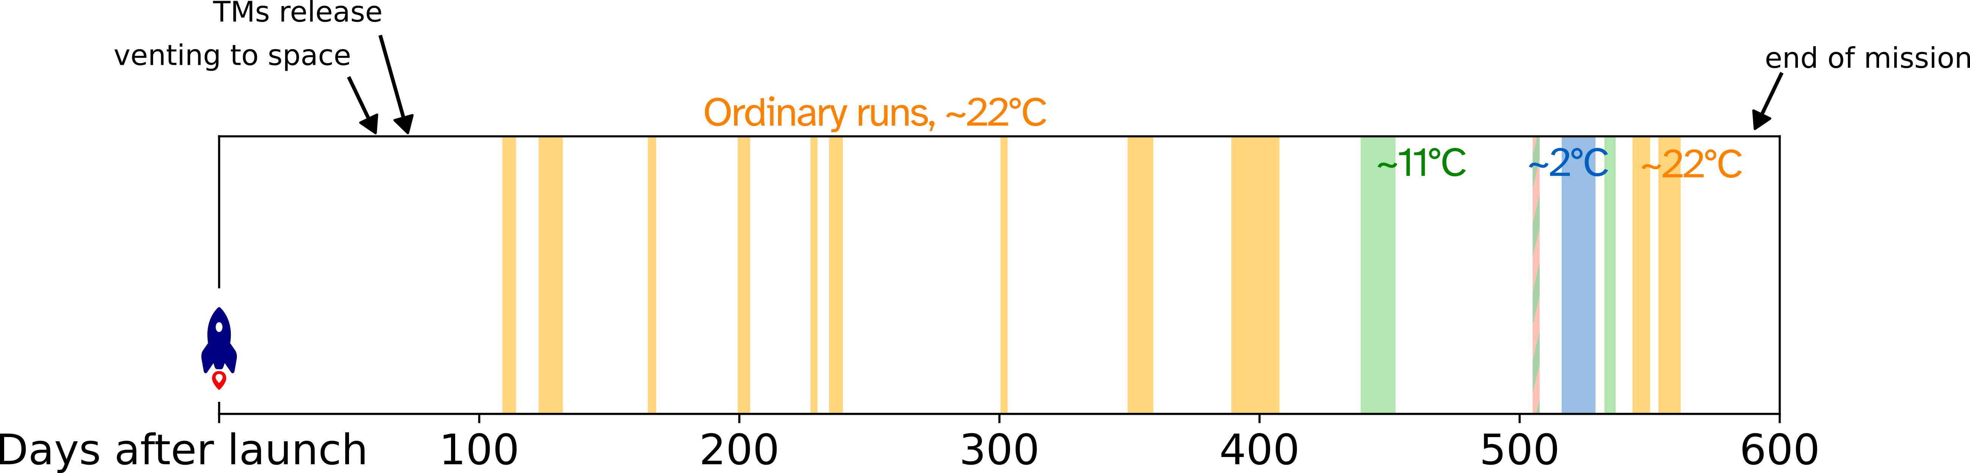

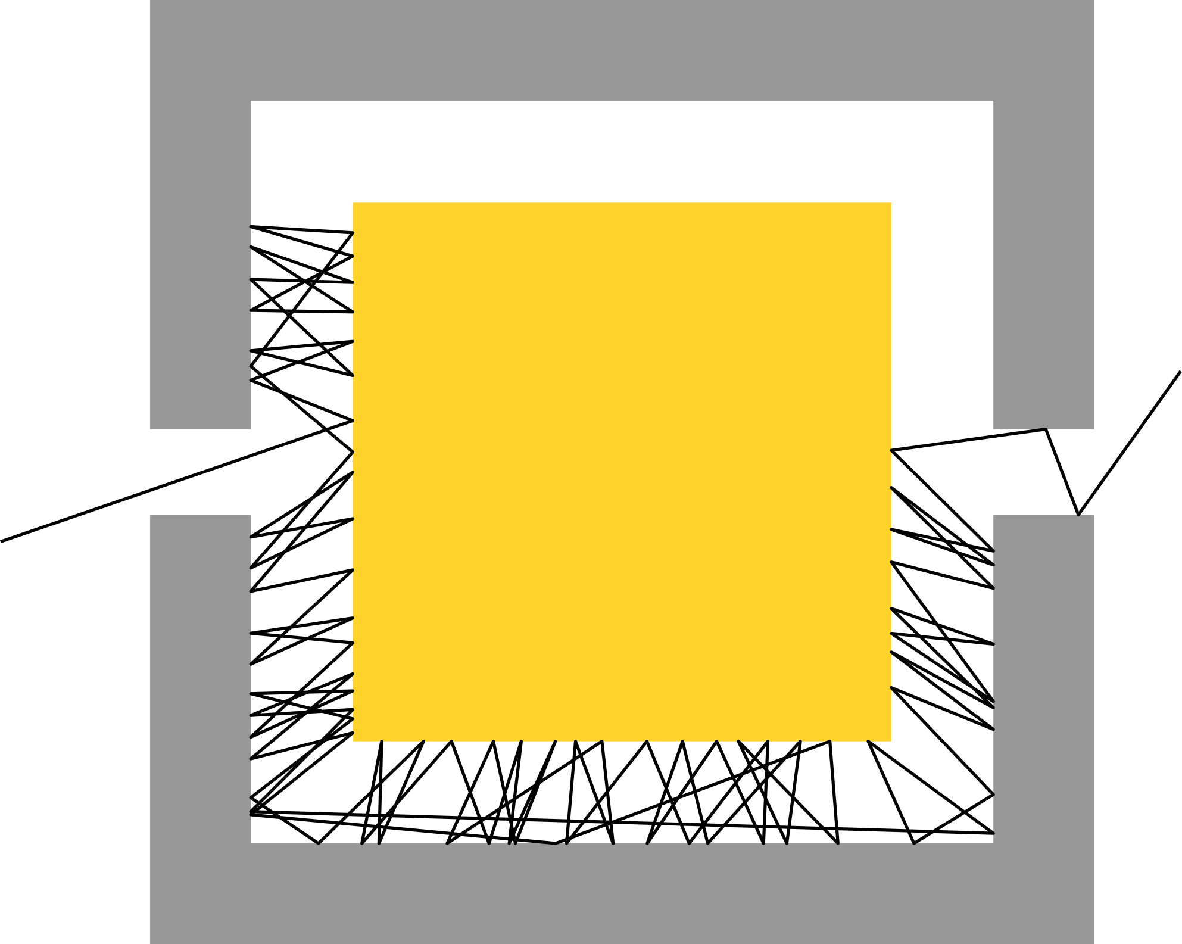

Noise source breakdown
$${32.0}_{−1.7}^{+2.4} fm {Hz}^{−1/2}$$
PRL 120, 061101 (2018)
PRL 126, 131103 (2021)
PRD 106, 082001 (2022)
Forces on TM
Interferometer readout
LPF noise runs 6
9
17
39
42-43 54
59
61
66 69
74
75-76
PRD 110, 042004 (2024)
Brownian force noise

Slide 5
Low-frequency noise

Slide 6
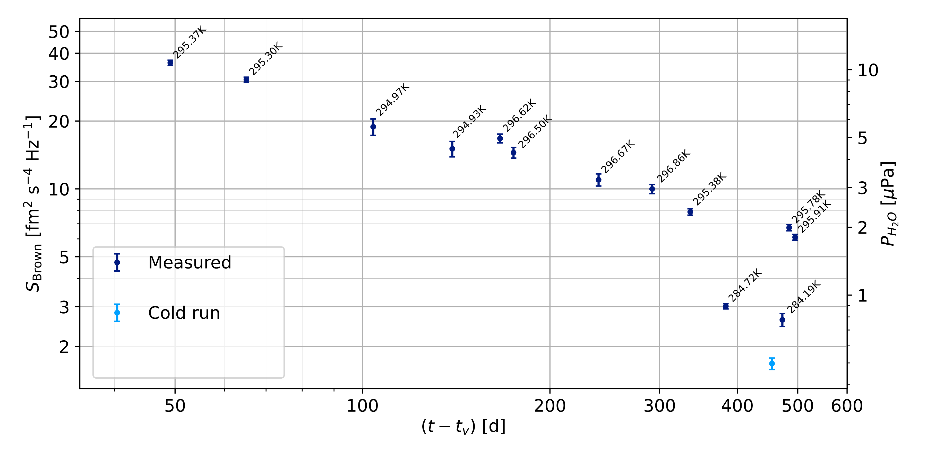
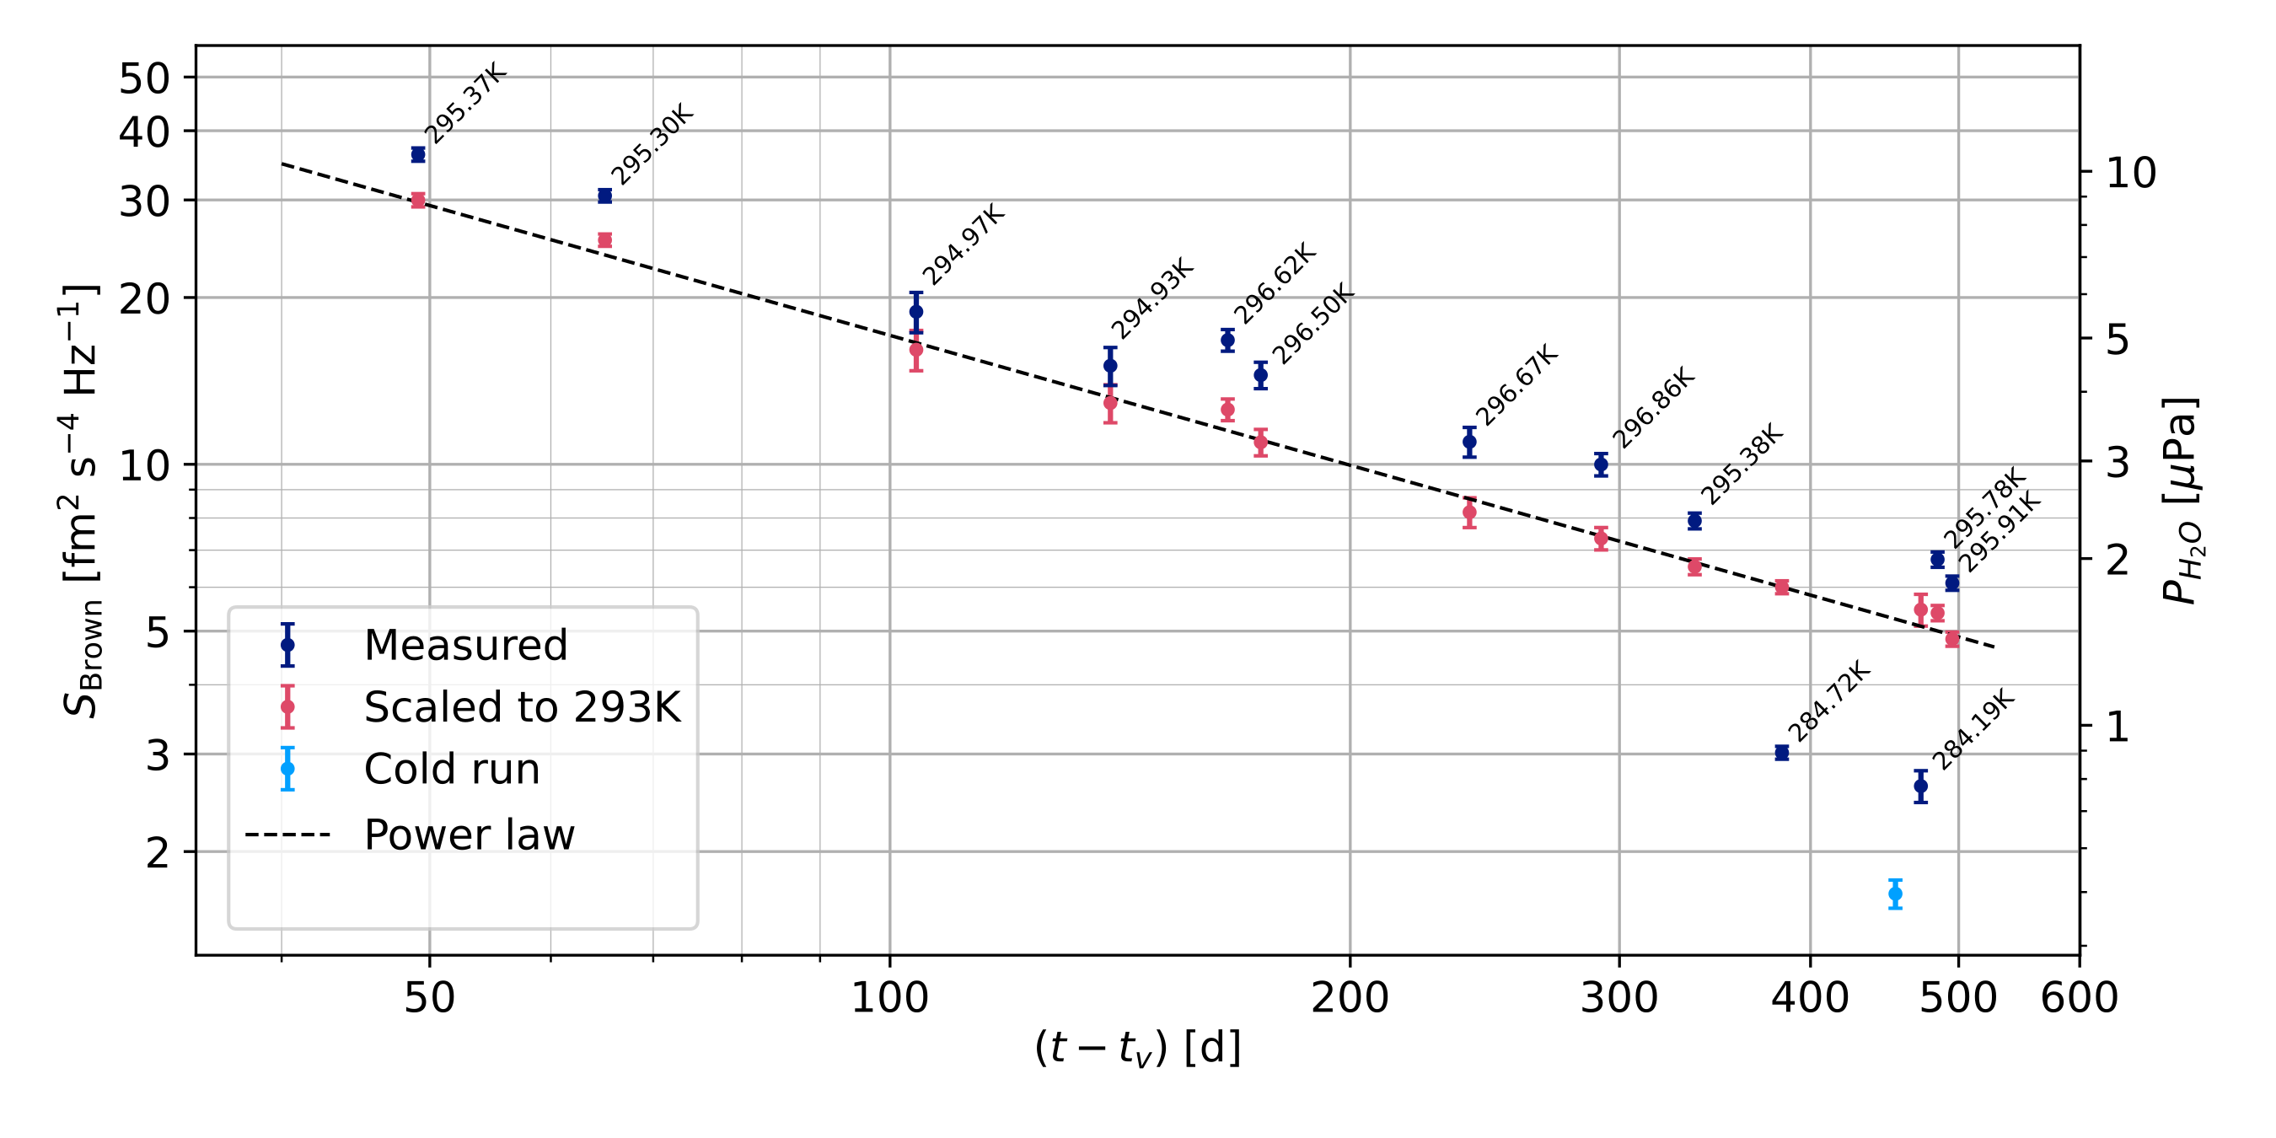
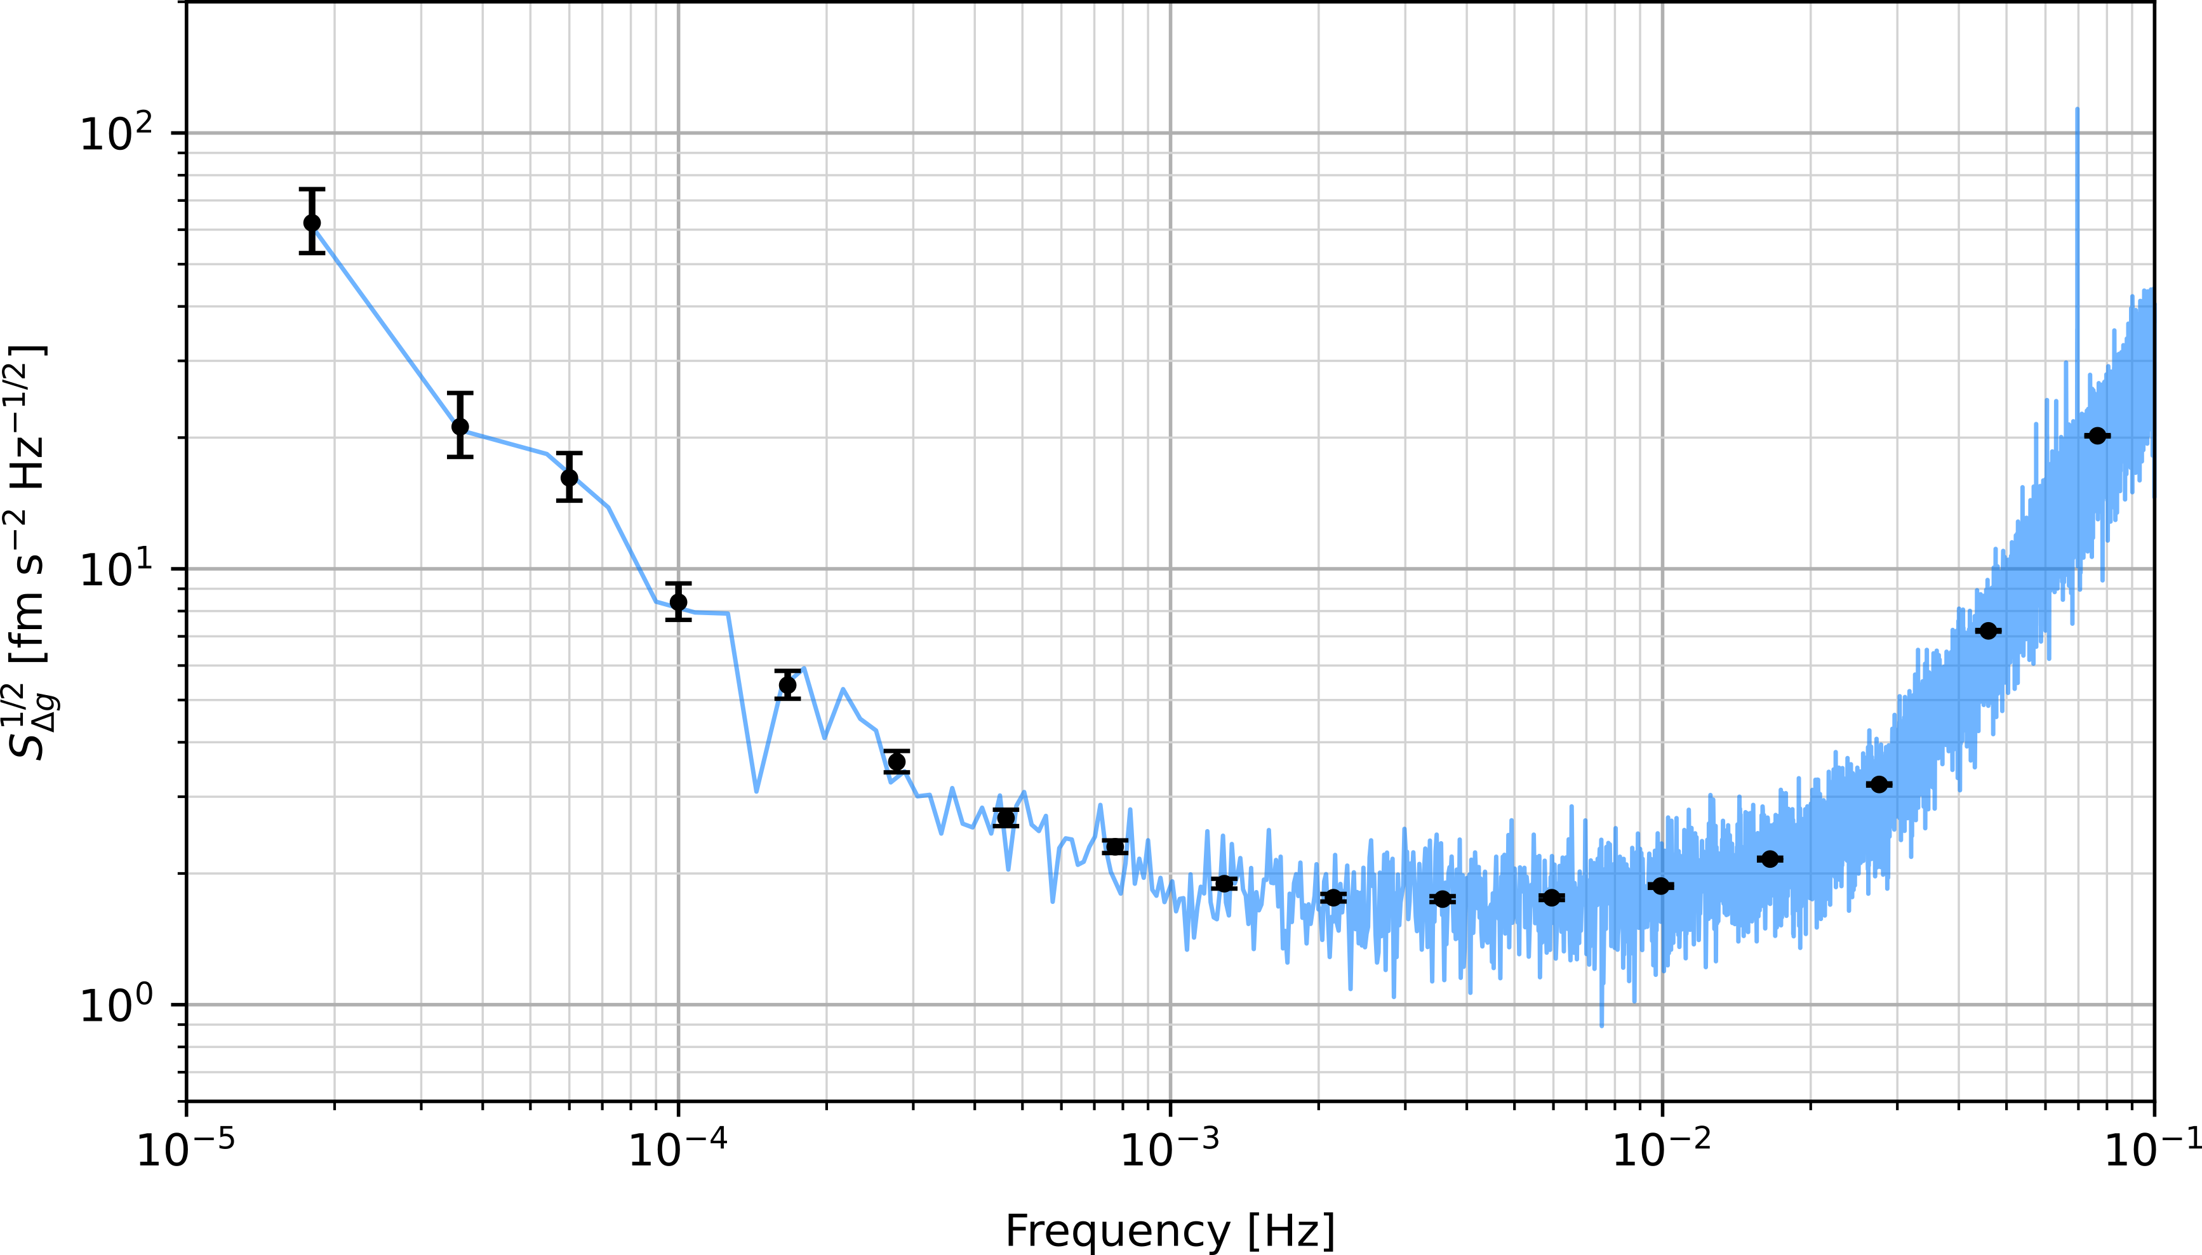
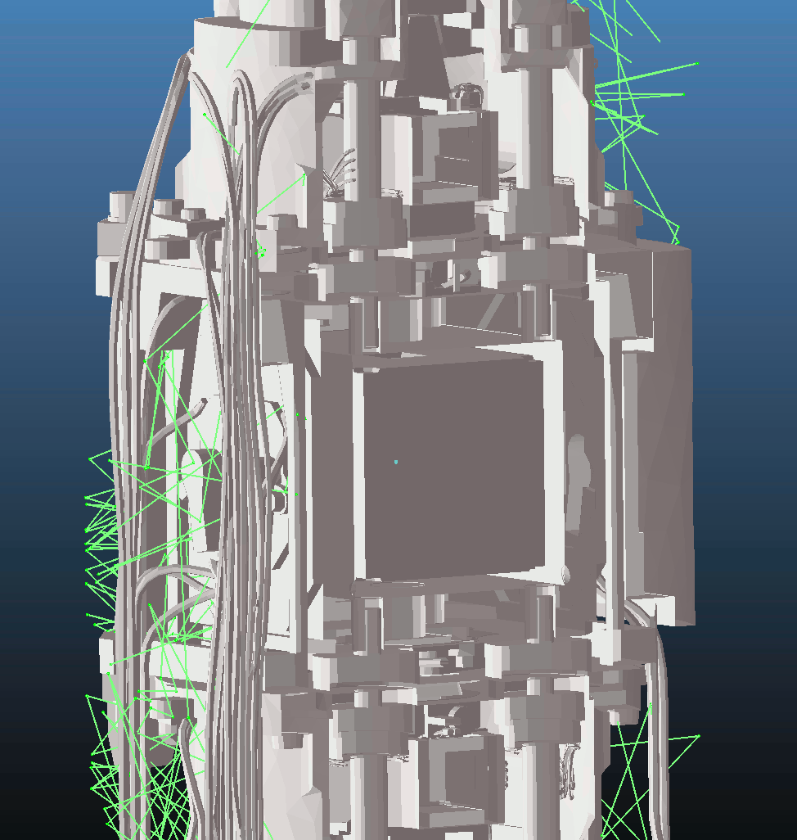
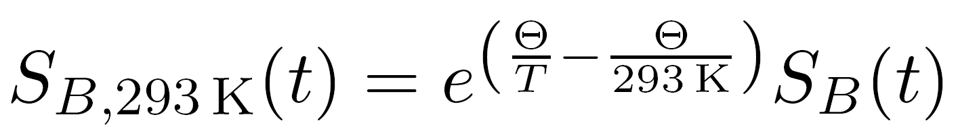
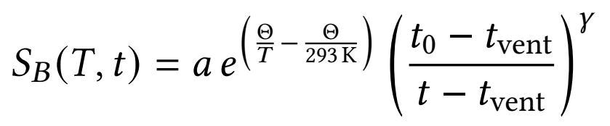
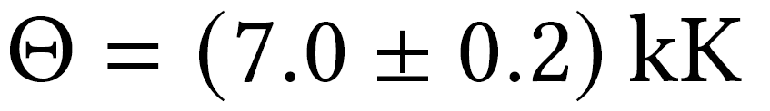
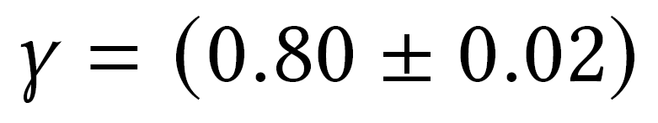
Brownian noise and pressure
Evolution of the Brownian noise PSD in time
Brownian noise decreased consistently over time (about 1.5 yr venting).
Brownian dominates mHz acceleration noise.
Reached “H₂O equiv. pressure” 2 μPa.
Reached LISA pressure spec.
Dependence on T clearly identified.
Consistent with water outgassing. However, incompatible with standard outgassing “water-film on metal”.

Slide 7
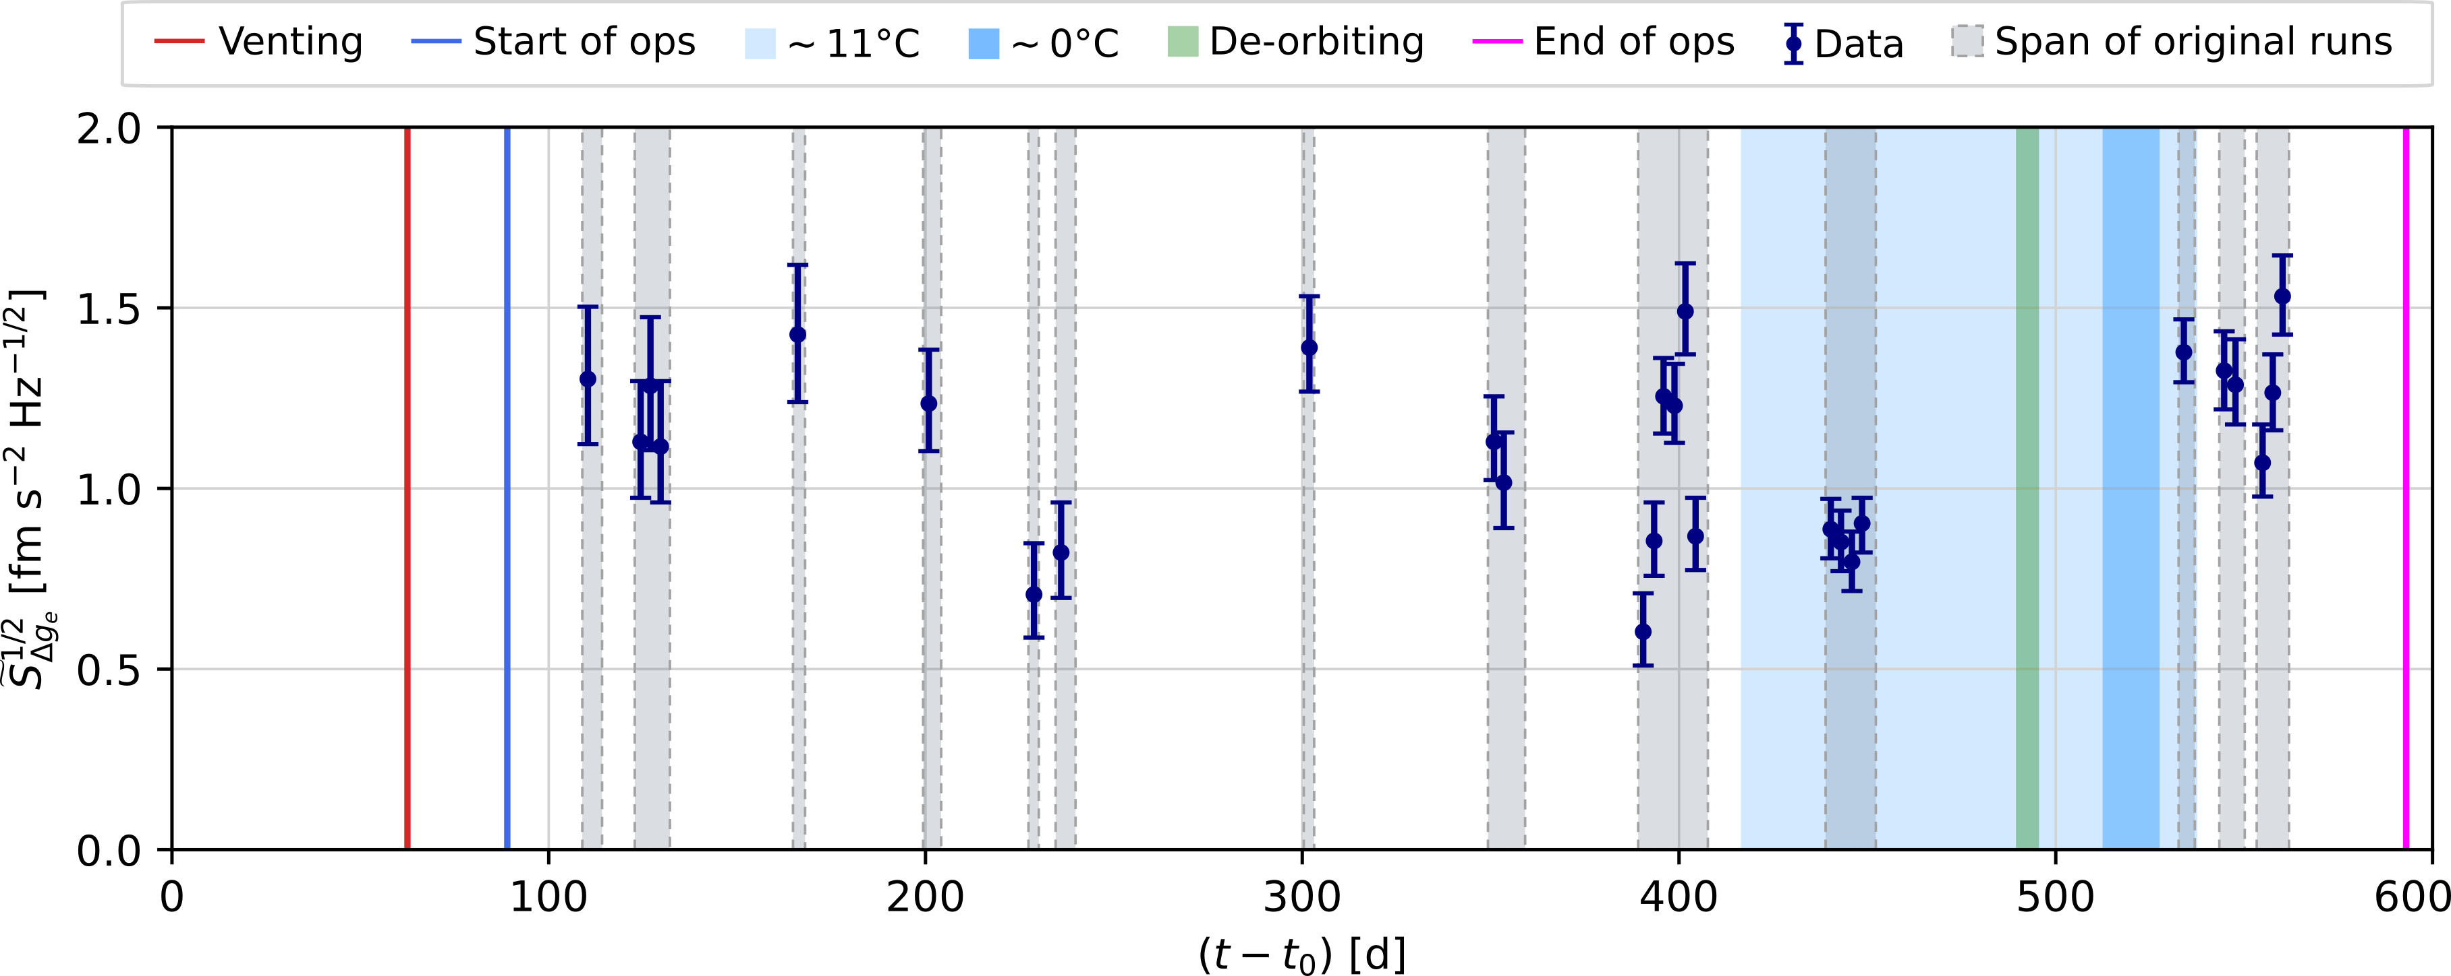
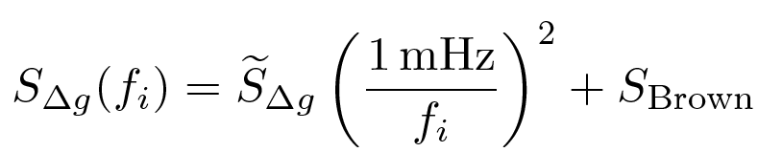
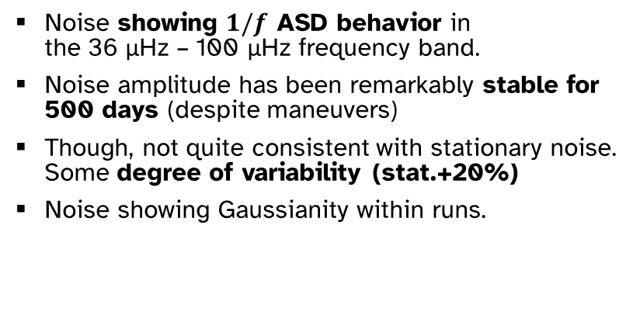
Stability of the sub-mHz noise
Noise showing $1/f$ ASD behavior in the 36 μHz – 100 μHz frequency band.
Noise amplitude has been remarkably stable for 500 days (despite maneuvers)
Though, not quite consistent with stationary noise. Some degree of variability (stat.+20%)
Noise showing Gaussianity within runs.

Slide 8
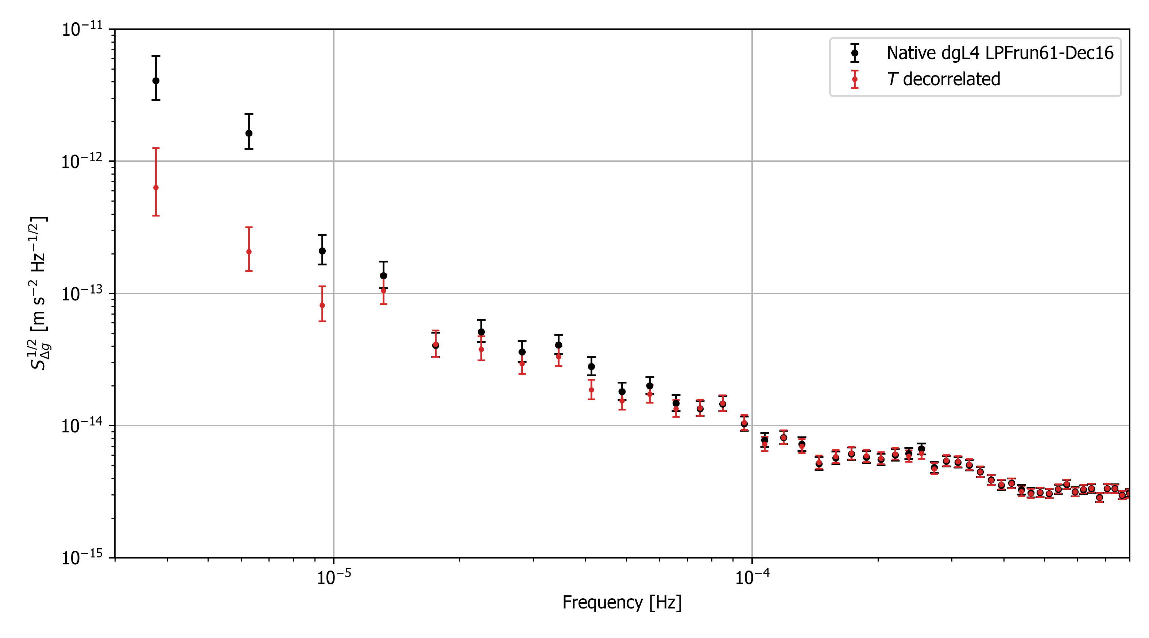
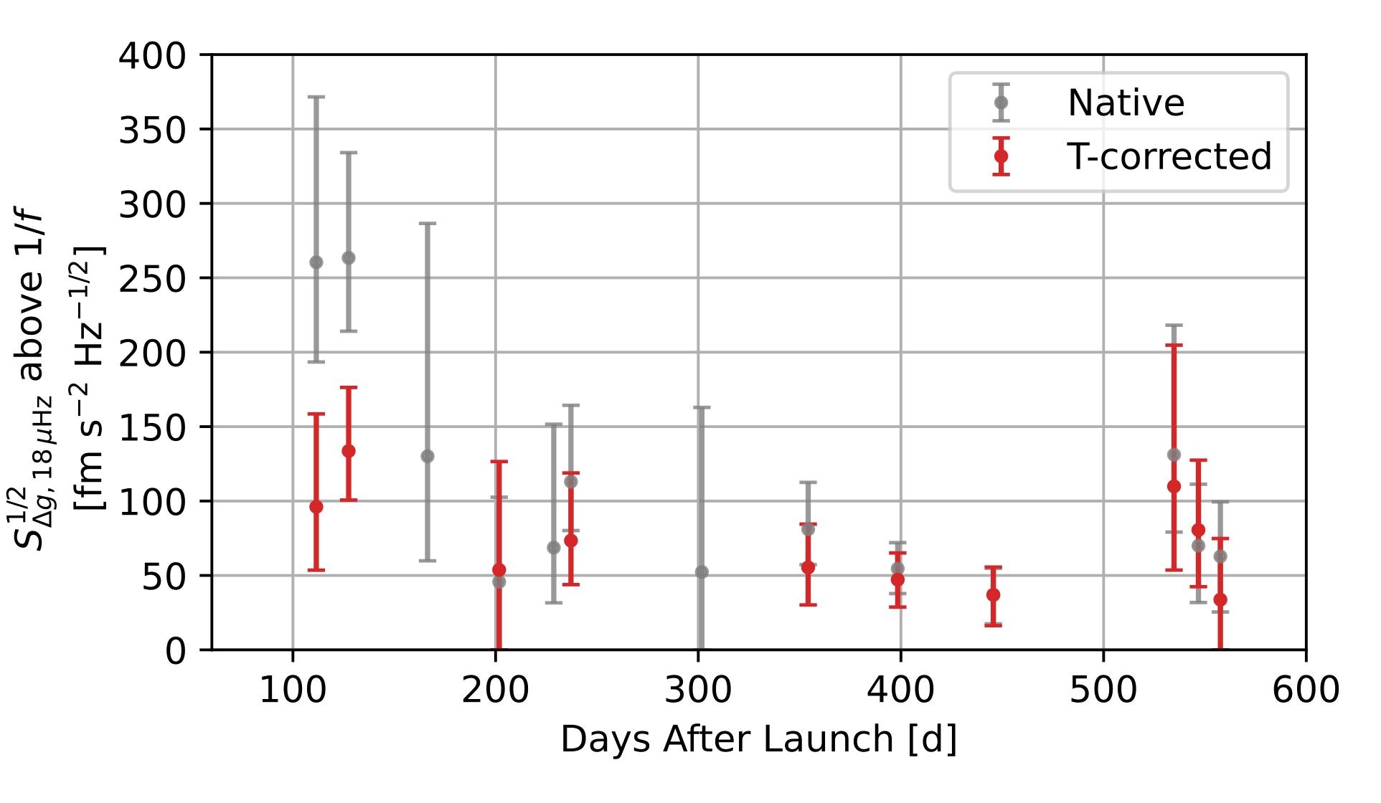
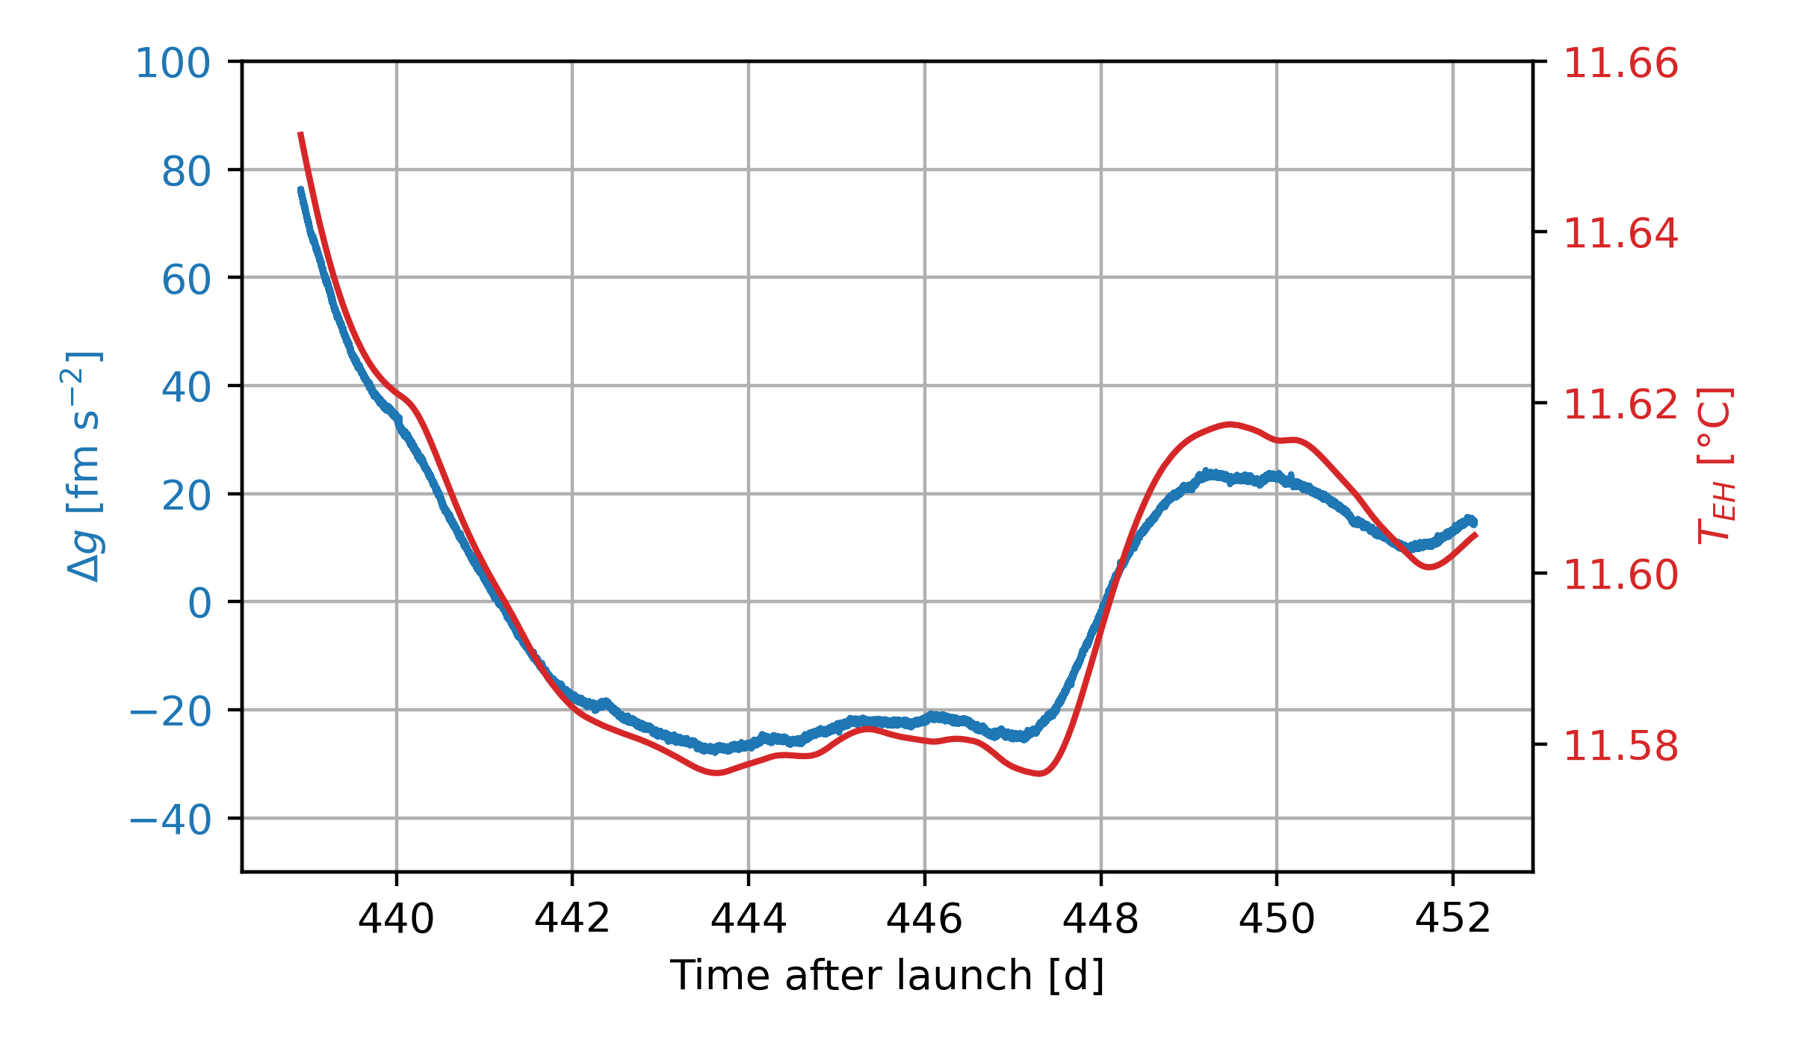

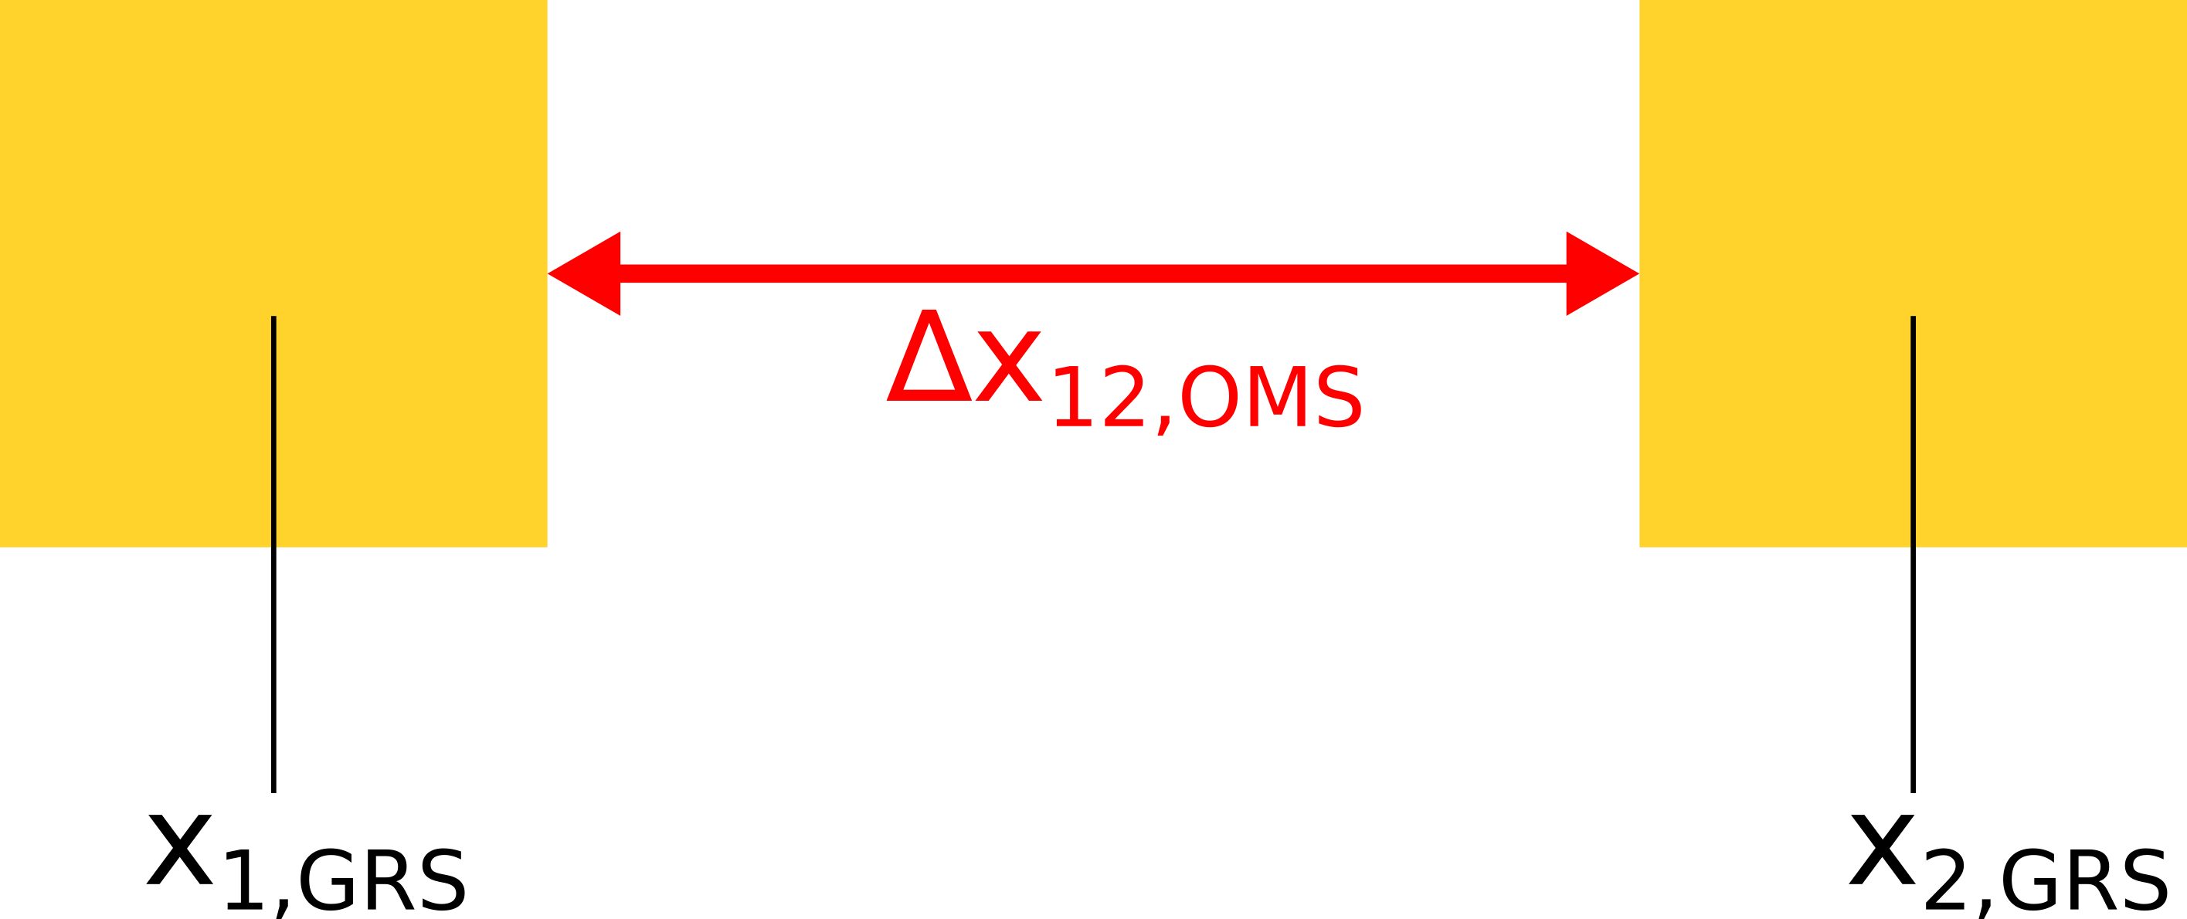
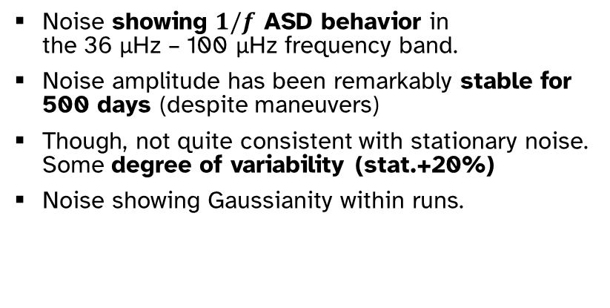
Stability of the sub-mHz noise
12-day periodogram
Noise showing $1/f$ ASD behavior in the 36 μHz – 100 μHz frequency band.
Noise amplitude has been remarkably stable for 500 days (despite maneuvers)
Though, not quite consistent with stationary noise. Some degree of variability (stat.+20%)
Noise showing Gaussianity within runs.
[ unpublished: with new LISA P&O PSD frequency set ]
Extremely-low frequencies (<20 μHz) dominated by drift+thermal+distortion effects

Slide 9
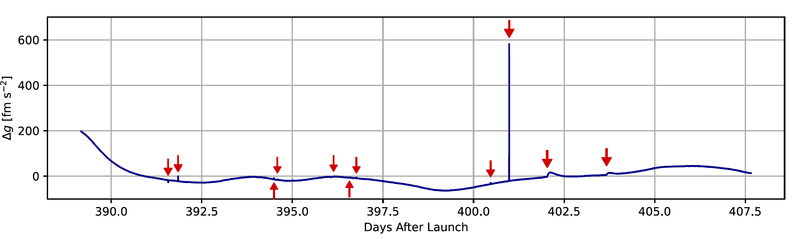
LPF Glitches

Slide 10
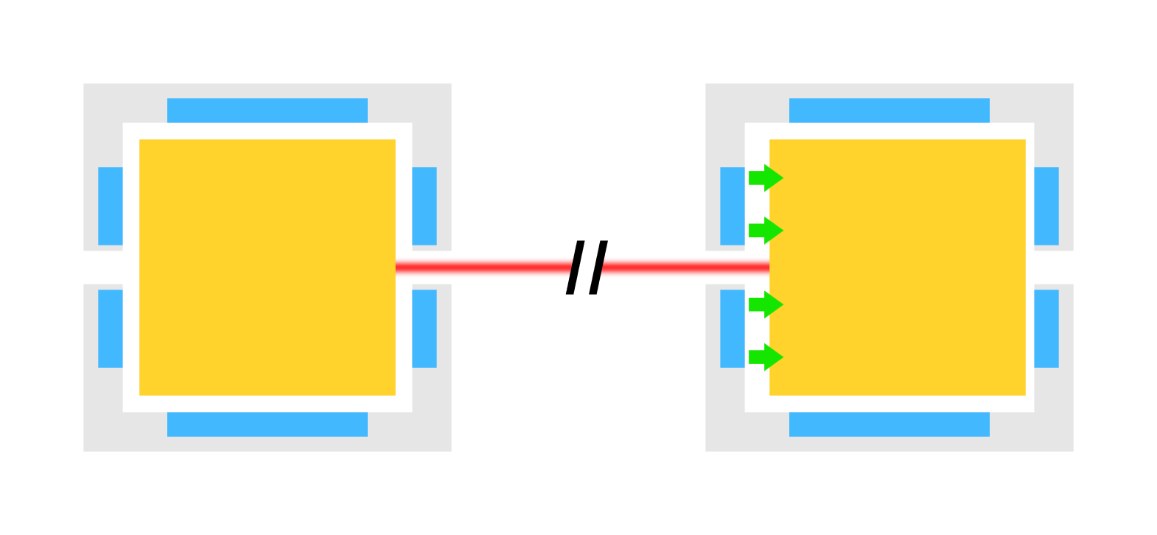
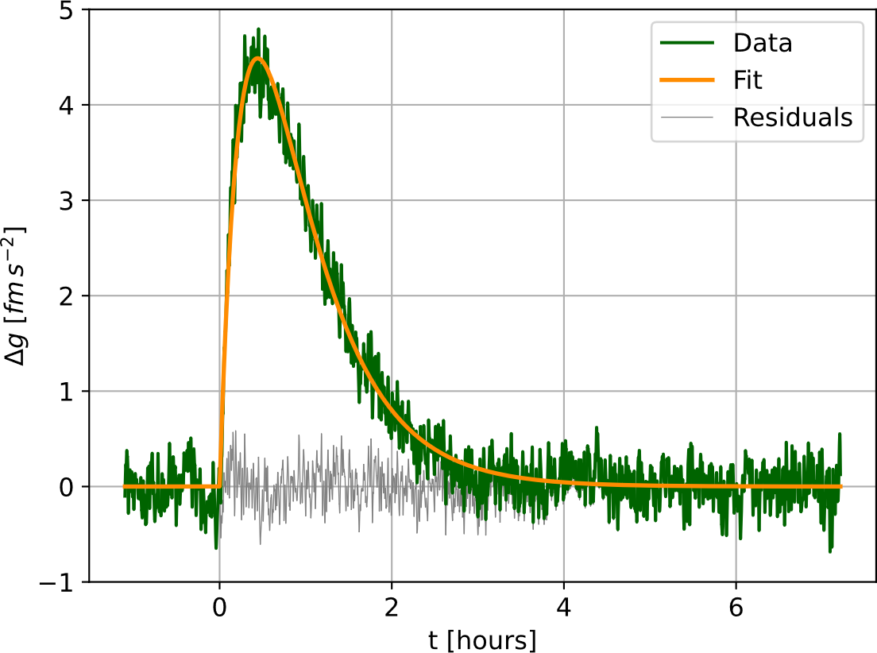
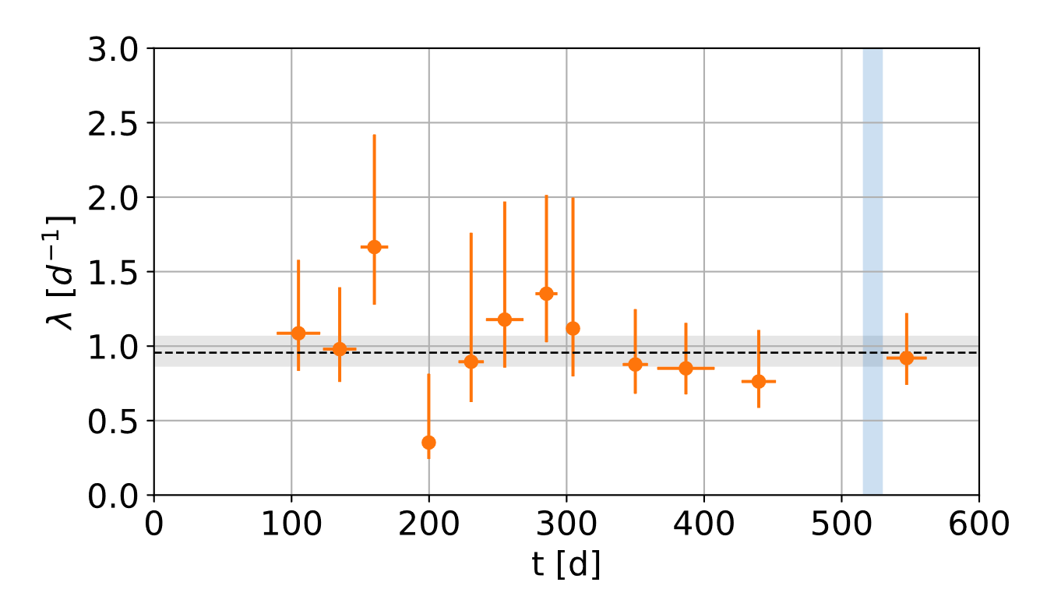
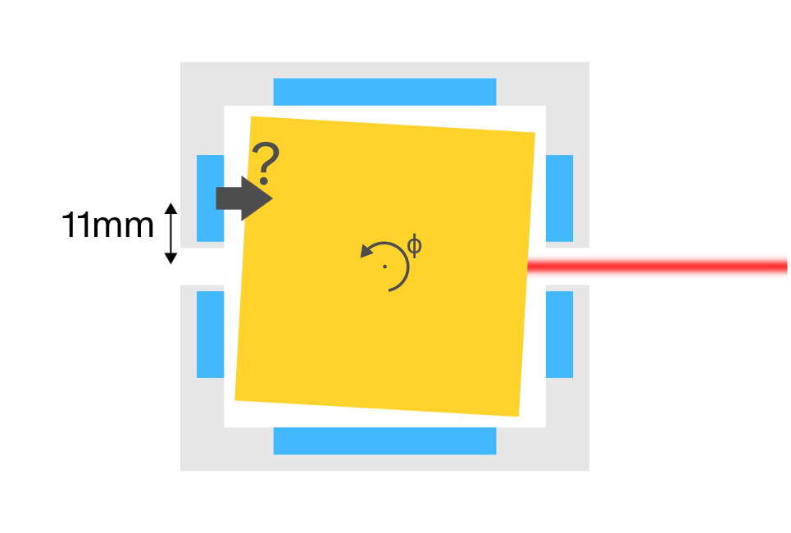
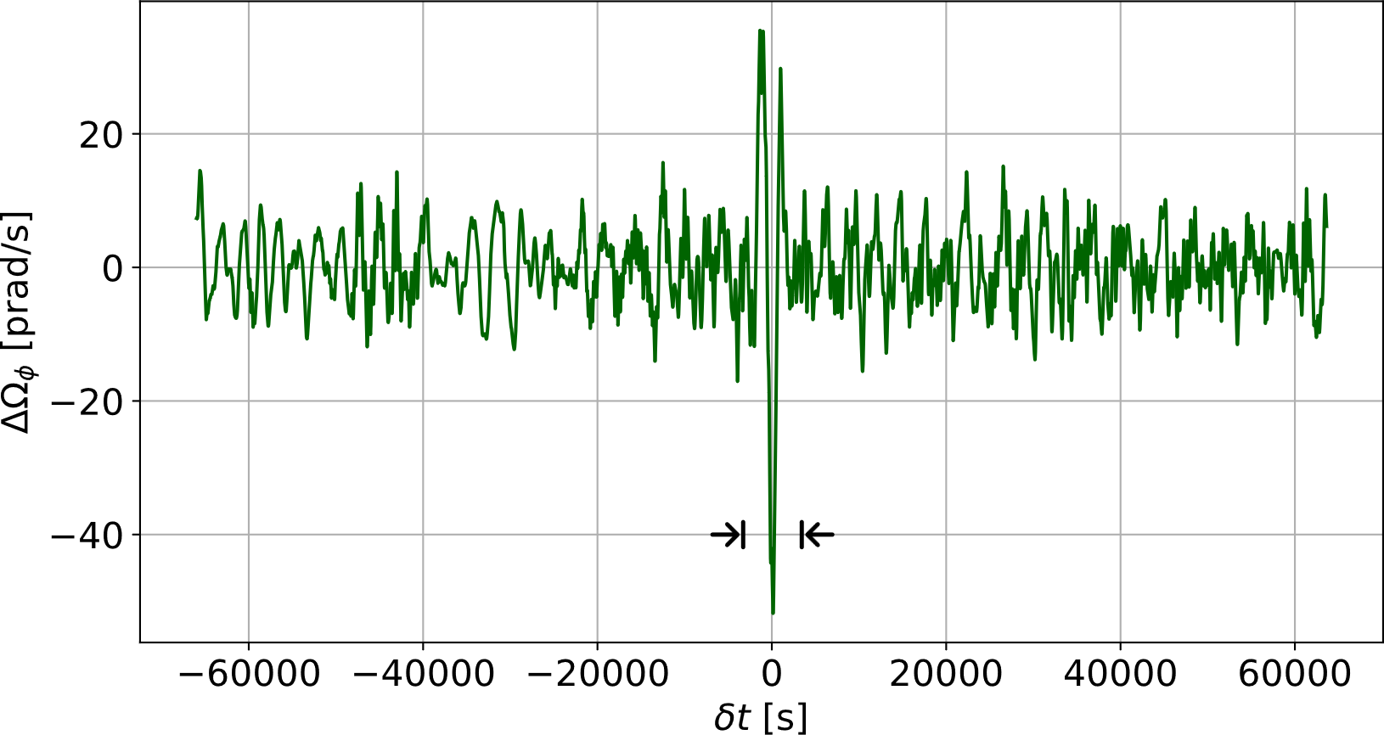
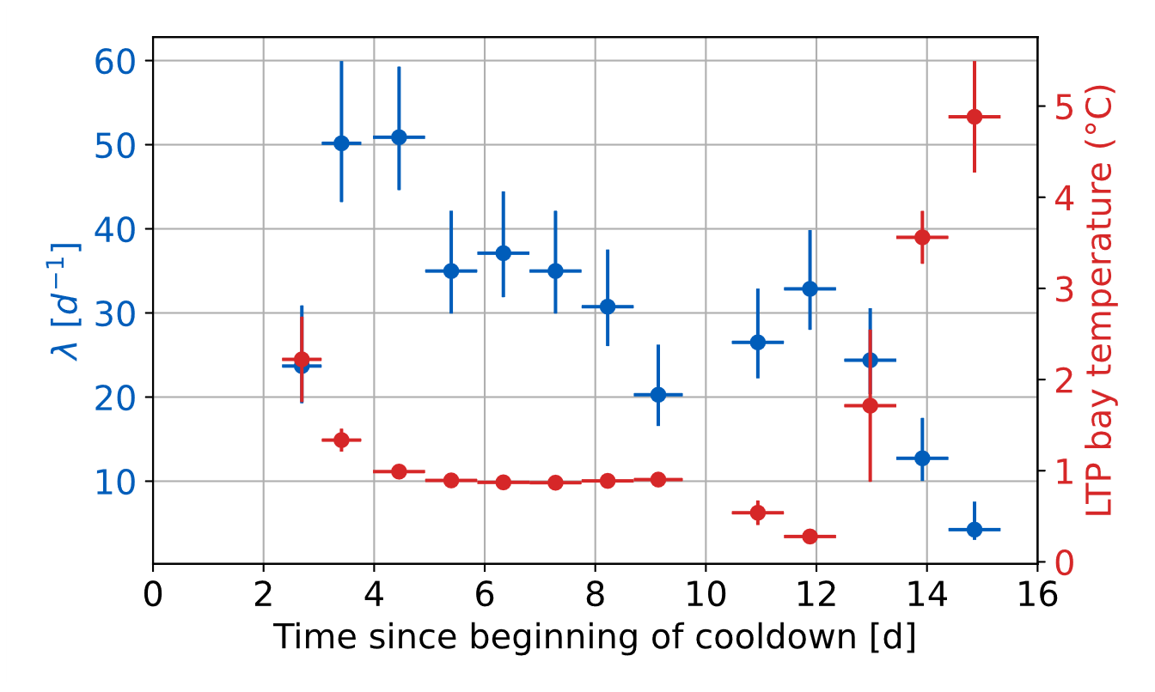
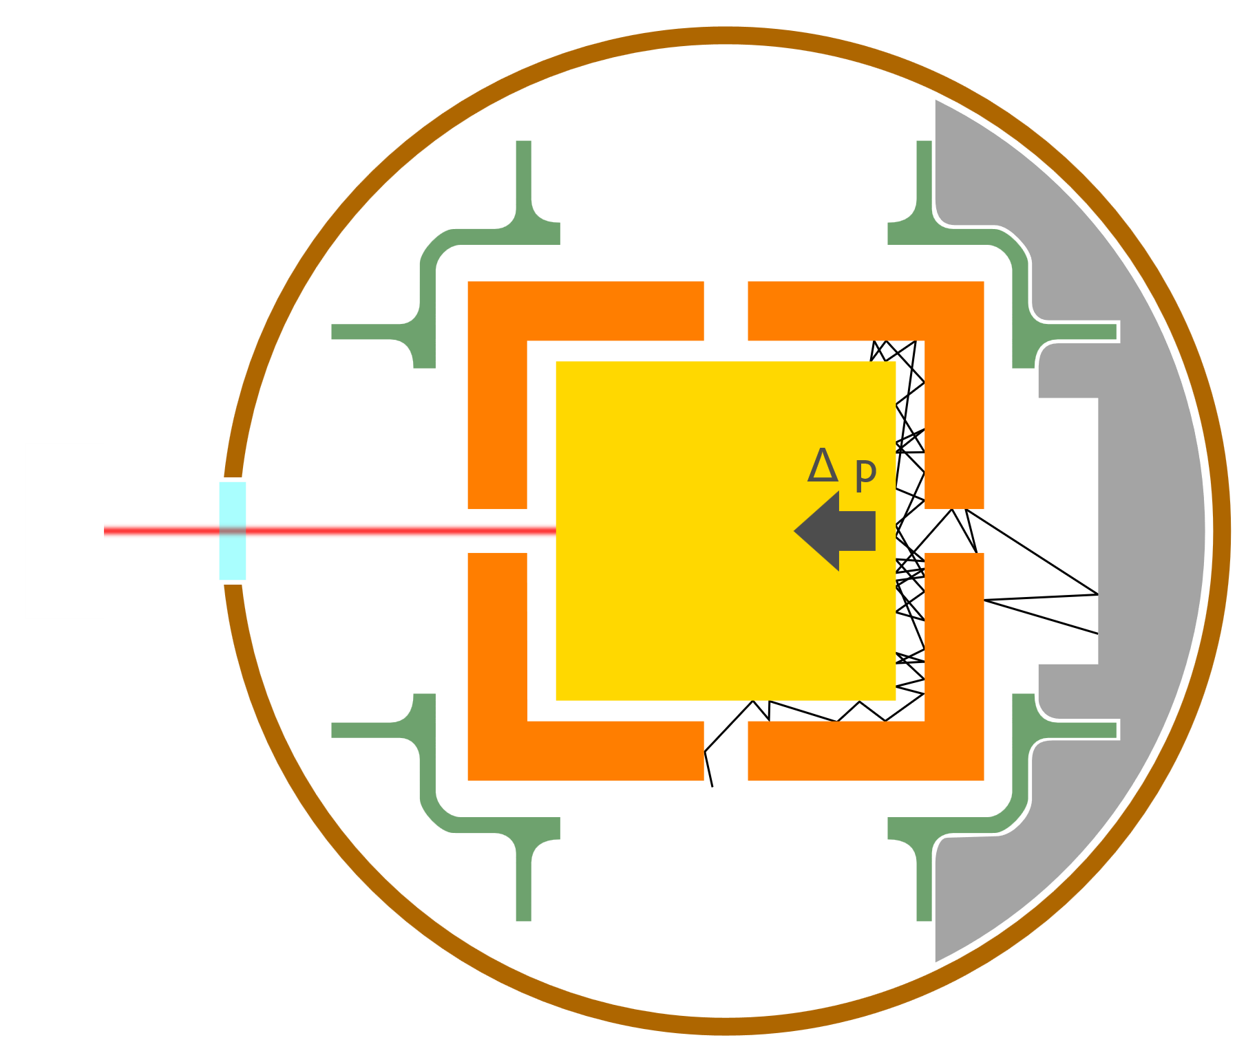

LPF glitches: description
Impulse-carrying events (98 events + 334 cold) detected during the whole mission, rate in ordinary runs: $λ={0.96}_{−0.09}^{+0.11} d^{−1}$
Poisson-distributed, occurrence rate stable for 1.2 yr.
Real forces pushing the TM(s), → Duration between 1s and 5h. → Transferred impulse between 10fm/s and 1nm/s.
No torque associated, except for a few events.
Increased rate during 0°C runs.
Hypotheses:
No clear smoking gun, but some sources excluded: thermal/magnetic/gravitational/ some kind of electrostatics.
A possibility: outgassing
- see PRD 106, 062001 (2022) -

Slide 11
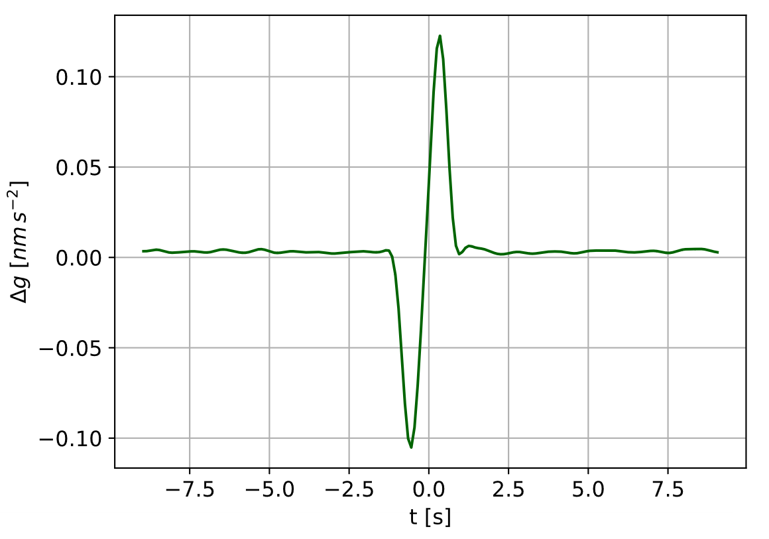
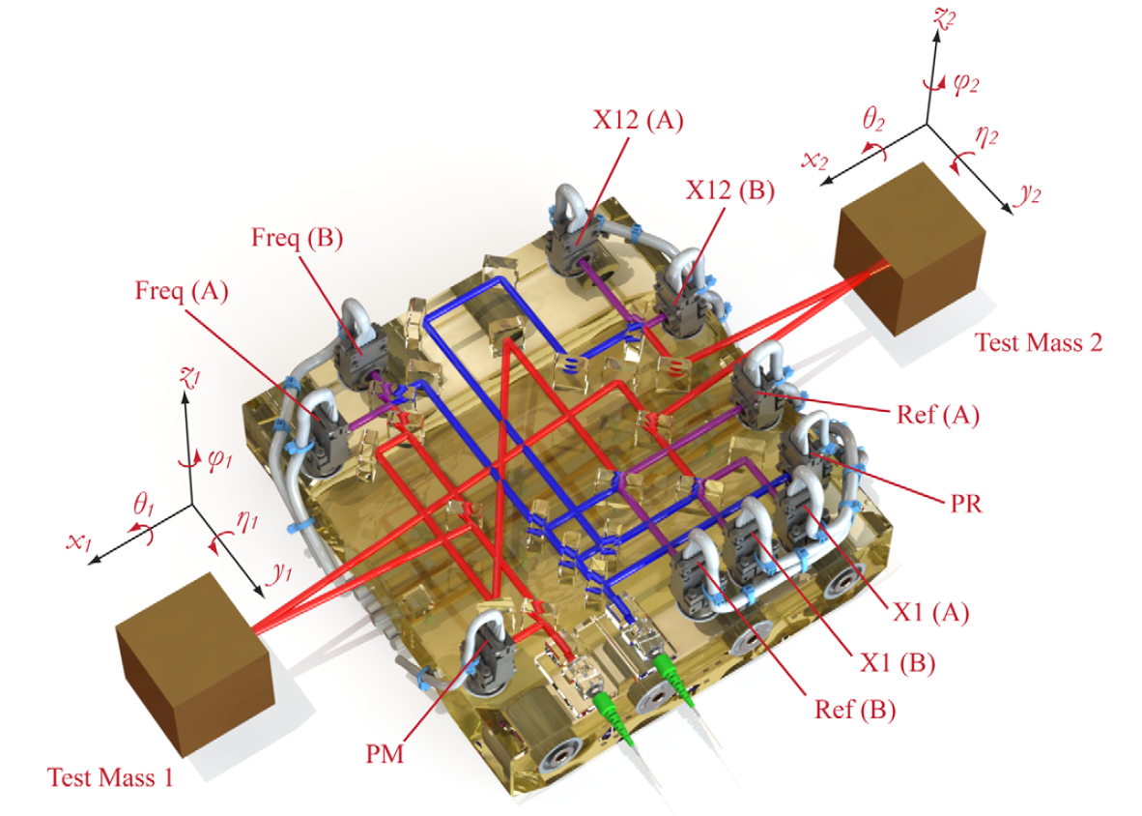
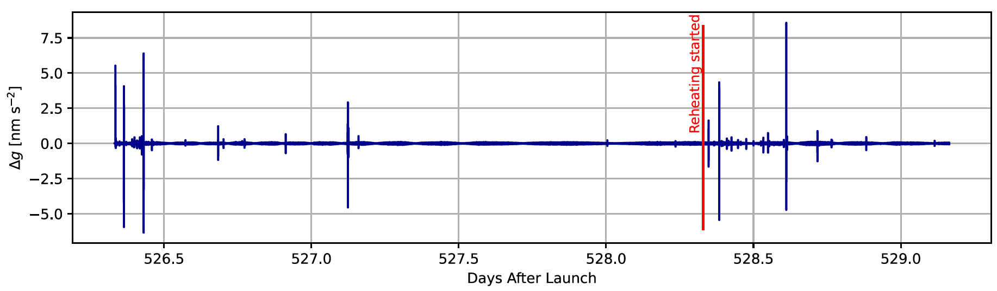
Glitch nature: two-sided
Properties:
Fast time scale, no net impulse
97% in cold runs
Significant coincidences with events in IFO channels:
55/152 Reference Interferometer
4/152 Frequency Interferometer
28/152 x1 Interferometer
→ Very likely due to (rare) interferometer anomalies
Similar events showed up in the interferometer flown on GRACE-Fo, and traced back to mechanical disturbances [ PRL 123 031101, 2019 ]

Slide 12
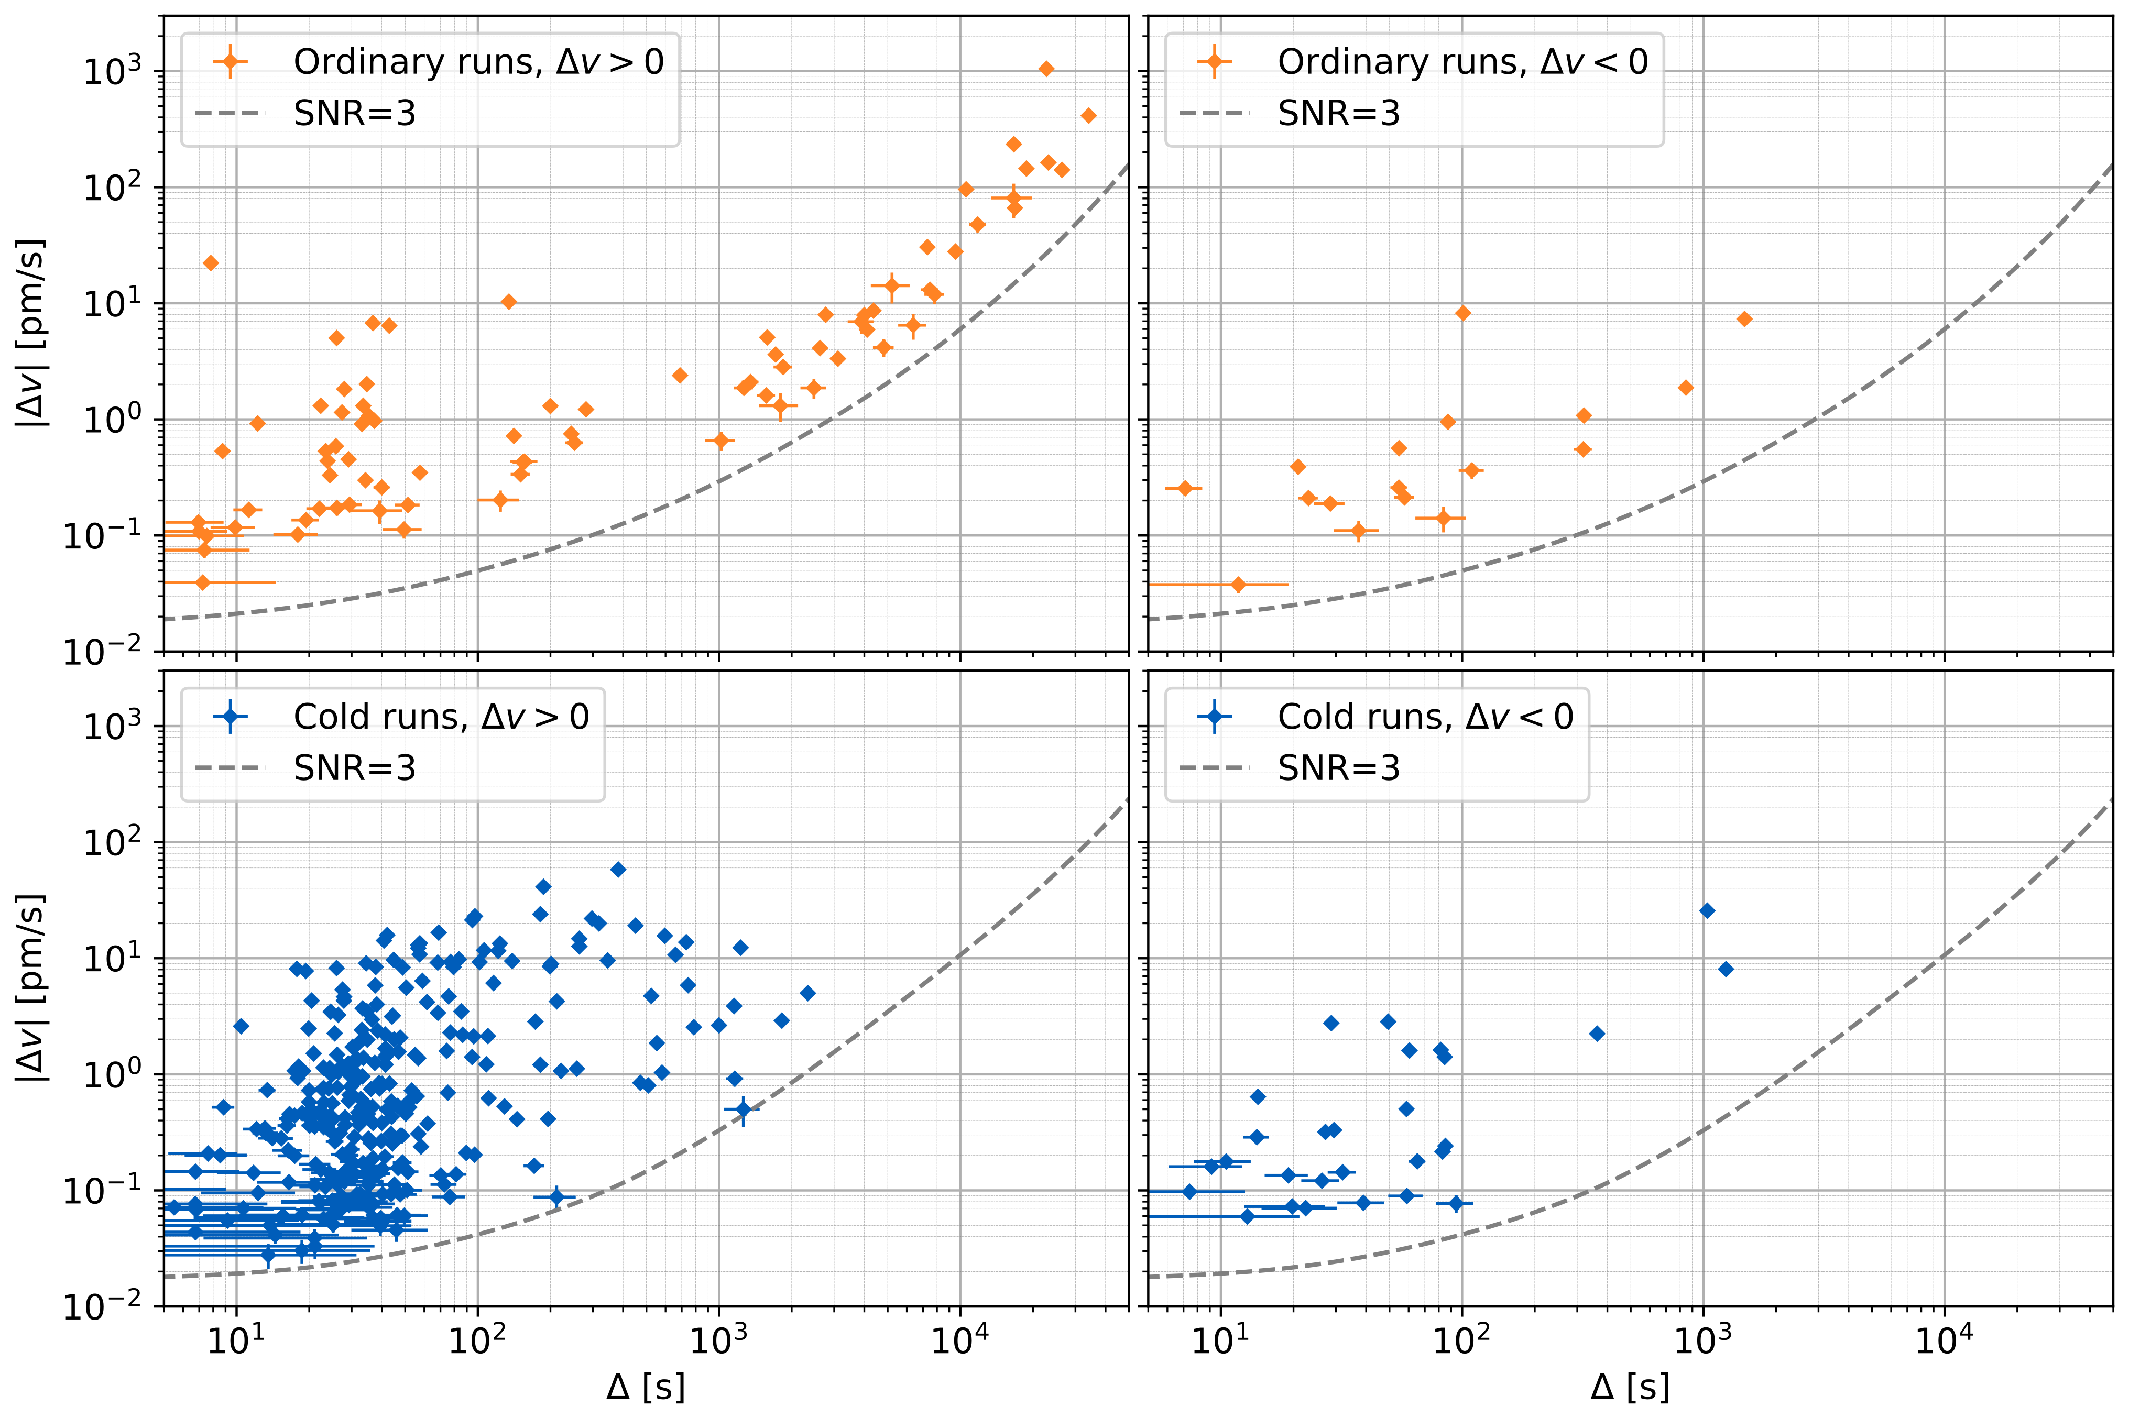
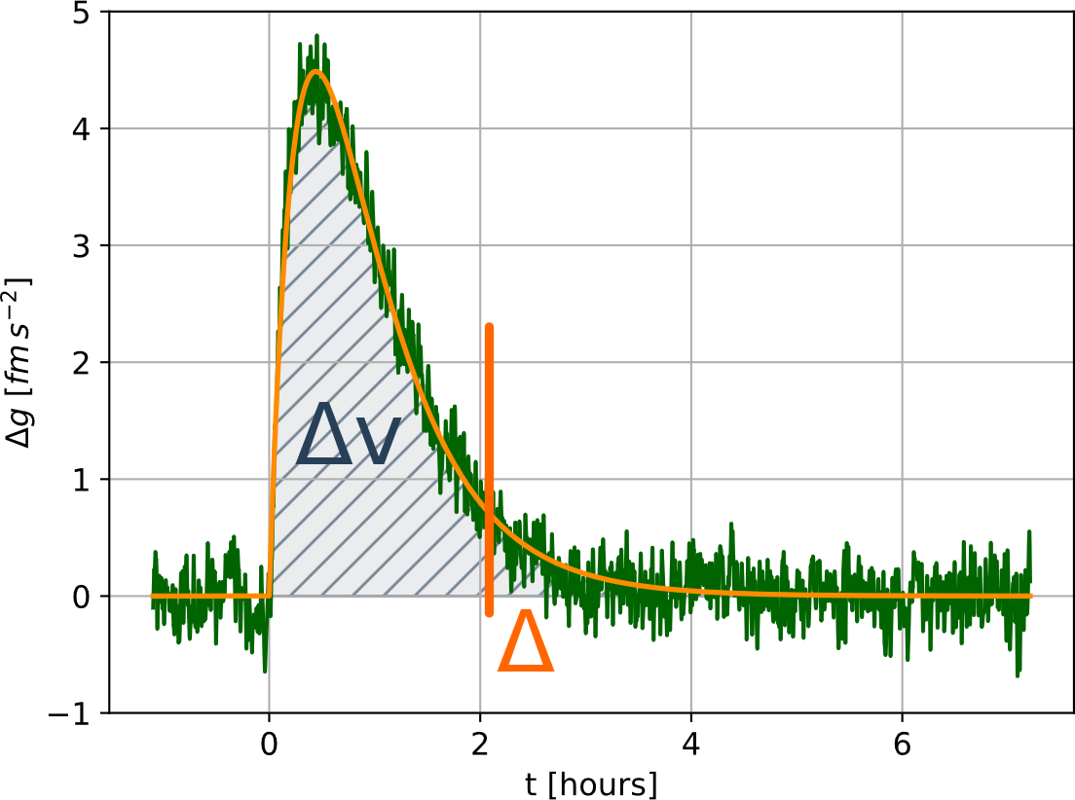
Impulse-carrying: impulse and duration
[ SNR line refers to the best performance of feb17 ]

Slide 13
Physical models
?

Slide 14
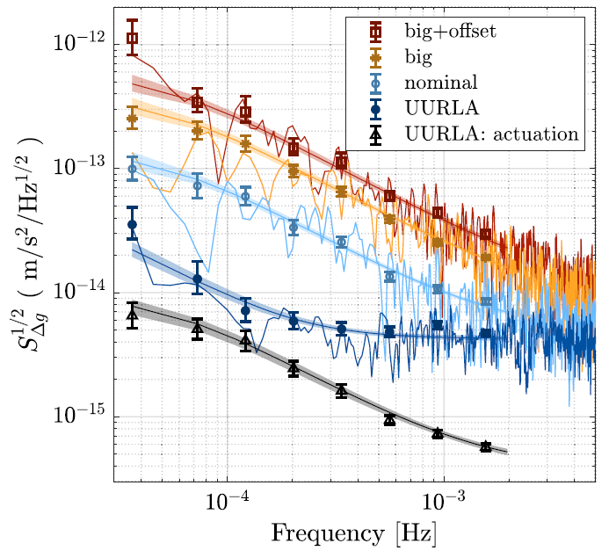
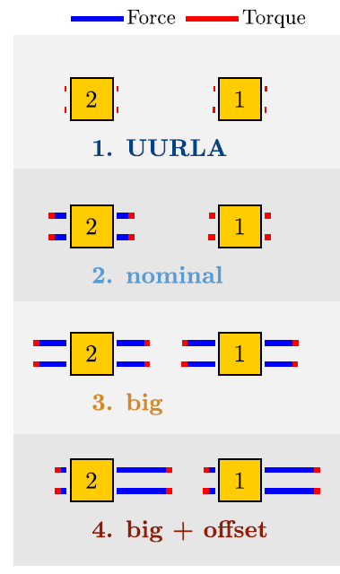
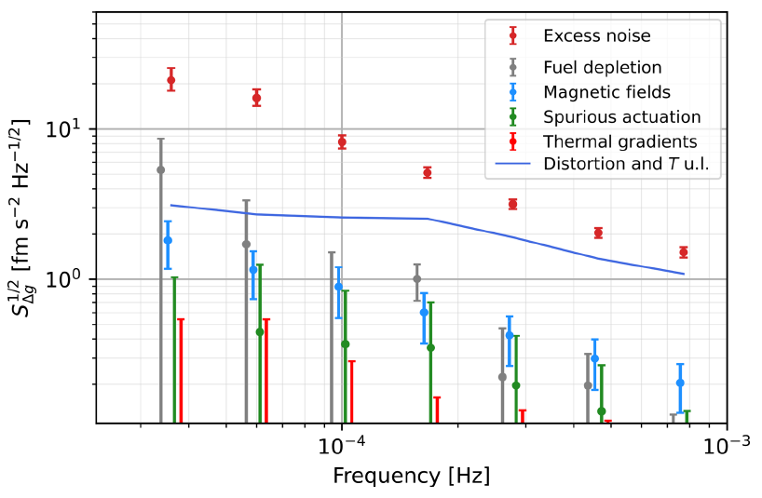
Physical models and noise projection
Actuation noise
Actuation stability noise
Actuation white noise
Actuation crosstalk noise
Actuation nonlinearity noise
Stray Electrostatics noise
Electrostatic field noise and DC Charge
Electrode V noise and DC bias
Charge noise and DC bias
Charge noise and TM position
Continuous Discharge Noise
Sensing bias noise and TM position
Sensing Amplifier Acceleration Noise
Brownian noise
Temperature noise
Mean T noise
Thermal Gradient Noise
Laser radiation pressure
→ Analysis:
Decorrelation of synchronous time series
Dedicated experiments
Estimations
↑ LPF actuation experiments with modified authority
← LPF post-processing time series decorrelation

Slide 15
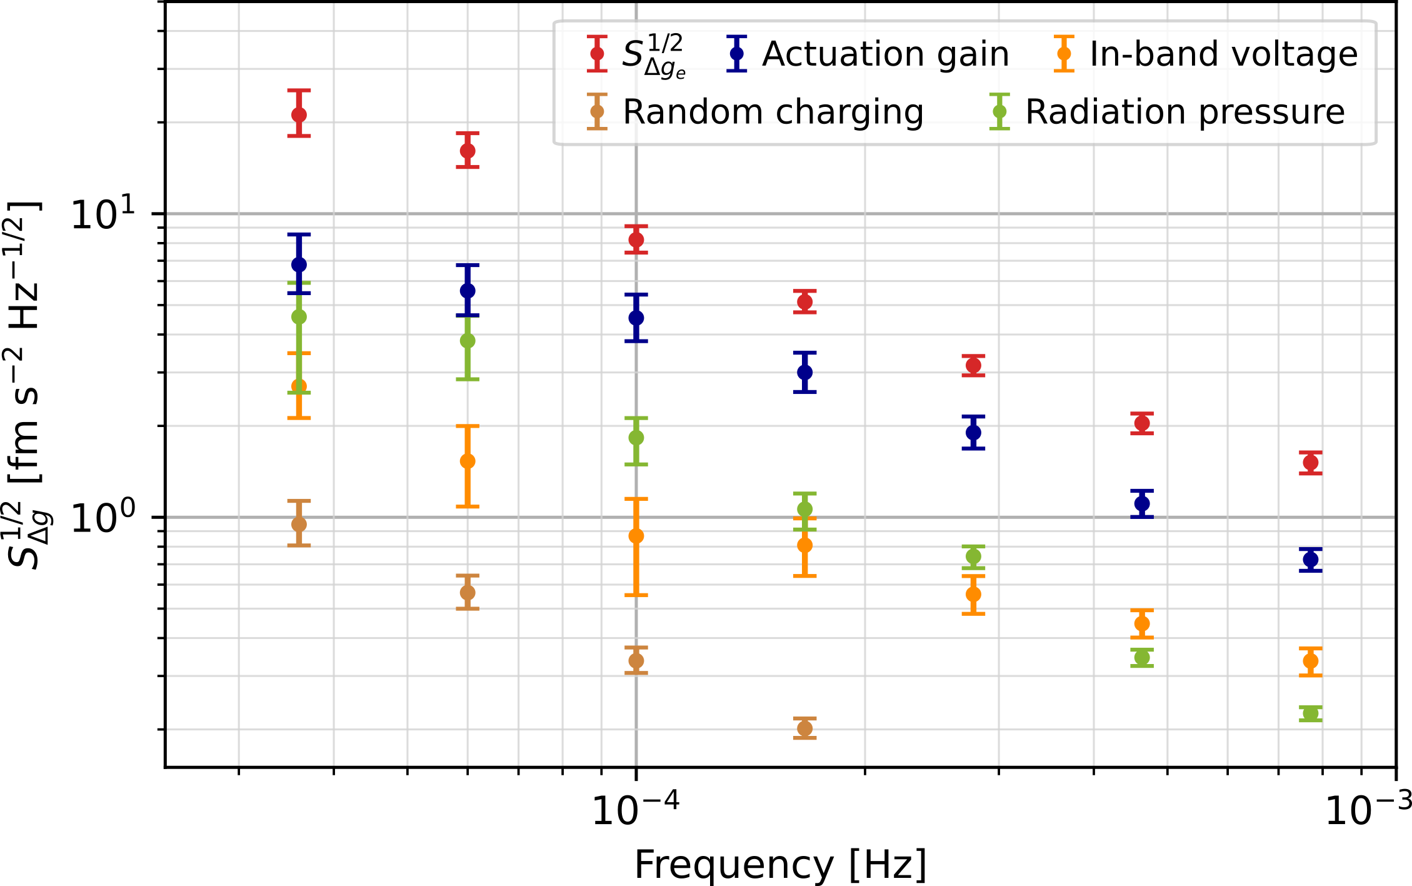
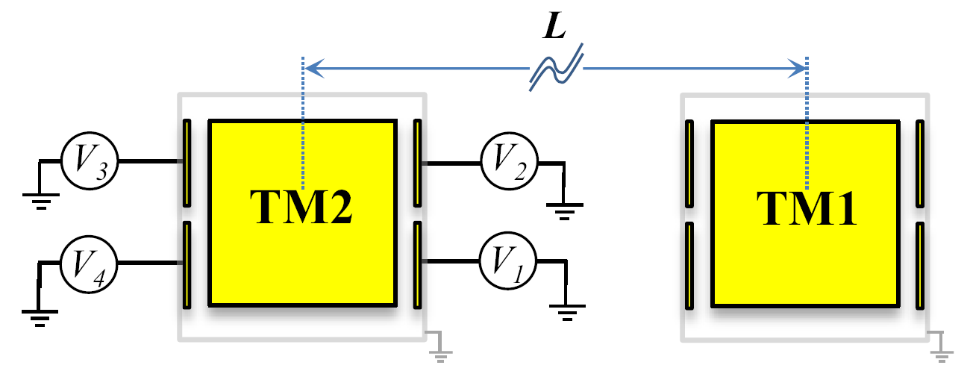
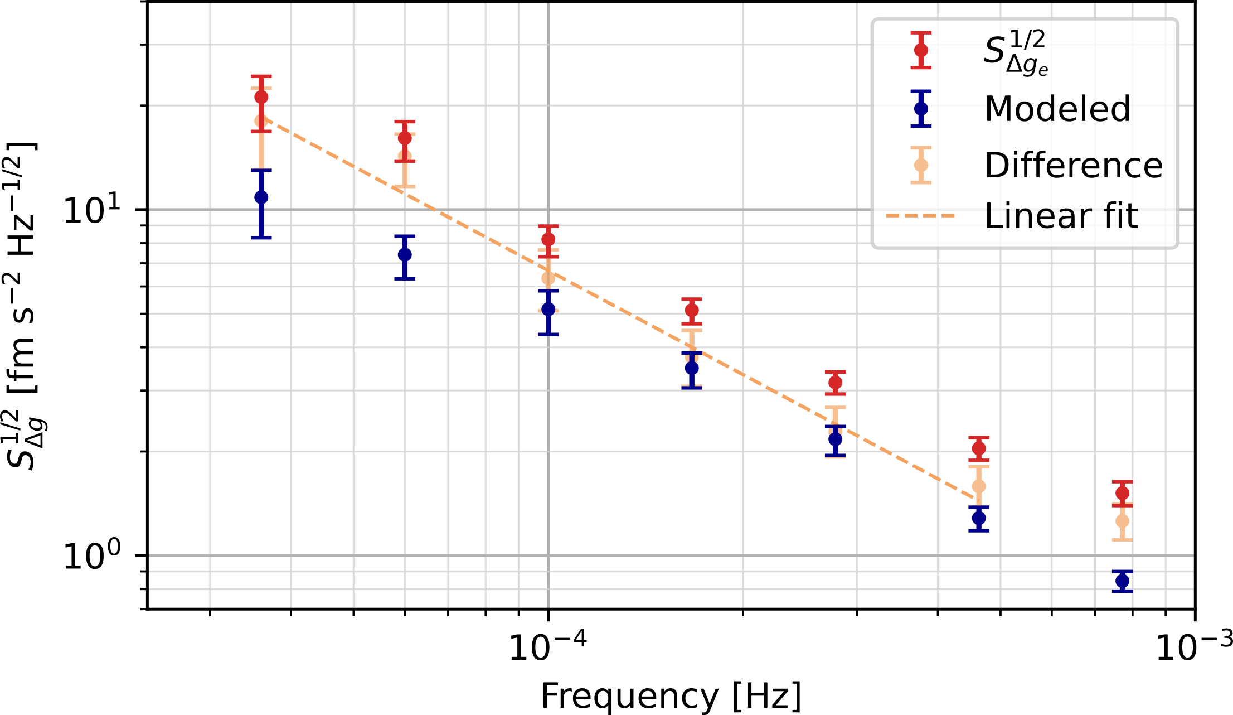

Physical models and noise projection
Actuation: gain fluctuations
Major known LISA-band noise source, though not dominant.
Up to 20-40% PSD LPF Feb17 (see PRD 109, 102009 (2024))
Uncorrelated gain fluctuations of order of tens ppm/Hz^{1/2}, inducing spurious unwanted/unknown forces. Note: no actuation along x on LISA.
Excess over Brownian
In-band voltage fluctuations
Laser radiation pressure
Suppressed through TM discharging (see PRD 109, 102009 (2024))
Negligible if kept under control
No direct measurements, but estimates.
Magnetic interaction (three axes)
Random charging
Unmodeled noise power fraction $$\left(54±9\right)\%$$
(in-band magnetic fields)
Mitigated through TM low-susceptibility alloy, and low S/C magnetic gradient.
Next talk!
Suppressed through TM DC voltage compensation.

Slide 16



Investigating on the excess noise
Patch-potential fluctuations self-interaction:
Self-interaction of quasi-static fluctuations of TM patch potentials, driven by contaminant diffusion - CQG 41, 195009 (2024) -
→ Action: surface investigation with Kelvin probes.
Additional voltage noise:
Uncorrected μV inaccuracies in the actuation waveform effective amplitudes.
Down-conversion of high-frequency disturbancies.
→ Action: LISA FEE testing
Unmodeled gravitational noise:
Non-thermal deformation of components surrounding the TMs, outgassing of volatile fraction (close to TM).
Pressure fluctuations:
Unmodeled picoPascal/Hz^{1/2} fluctuations.
Magnetic interaction:
Down-conversion of high-frequency disturbancies.
→ Action: GRS testing

Slide 17

LPF impulse-carrying glitches: models?
Gravitational signals
No permanent displacements.
Mechanical frequencies are way higher than the LPF band.
(thermo-)mechanical distortions could be detected.
Thermal effects
No triggers in T time series
Thermal coefficient: $∂Δg/∂T$ $∼0.5$pm s⁻² / K
Gradient coefficient: $∂Δg/∂ΔT$ $∼10$pm s⁻² / K
One would need glitches with amplitudes of order mK, while our resolution is tens of μK
Platform acceleration
Considered and ruled out.
Electrostatic forces
No sudden charge-up.
Single-electrode events would show lever arm 11mm.
Voltage transients were not detected pre-flight.
Magnetic forces
No triggers in B time series. We exclude static magnetic fields and dipoles.
We exclude magnetic moment variations
Down-conversion of audio-frequency magnetic lines seems unrealistic

Slide 18



LPF impulse-carrying glitches: gas bursts?
Molecular simulations: Analyze individual – localized – sources, implement the correct molecular emission properties, extract $∂F_{TM}/∂Q_{k}$: $F_{TM}=\sum_{k}{\frac{∂F_{TM}}{∂Q_{k}} Q_{k}}$
Simulate emission $Q_{k}$, extract force $F_{TM}$.
Extract geometrical parameter $∂F_{TM}/∂Q_{k}$. → Effective pumping speed from different sources.
Implement design changes (duct and GRSH geometry) to minimize $∂F_{TM}/∂Q_{k}$
Example: a molecule emitted from a cable inside IBM cavity (facing IBM, not EH)
$∂F_{x}/∂Q$ = 3e-23 N / (molecule/s)
= 350 µm/s² / (mbar L/s)
This gives the total outgassing from IBM cavity sources during a “big” glitch:
$$Q∼\frac{Mg_{max}}{\frac{∂F_{x}}{∂Q}}∼\frac{10 fN}{700 μN/(mbar L/s)}$$
To be consolidated and investigated for emission within the GRSH

Slide 19
Conclusions
The authority reduction to UURLA was crucial for all investigations (low-frequency excess, Brownian, long-lasting glitches).
Brownian noise exceptionally corresponds to a vacuum system outgassing to space for 1.5 years.
Sub-mHz noise is partially modeled as actuation noise (40% power).
Glitches to be investigated with an experimental setup.
Investigations are still going on, after 10 years.
Duration [s]

Slide 20
[ slide intentionally left blank ]

Slide 21


The nature of Brownian noise
Random hit “shot noise” by residual gas molecules [Physics Letters A 374 (2010) 3365–3369]
Manifestation of the “fluctuation-dissipation theorem”: white noise in the LISA frequency band.
Strongly dependent on molecular dynamics and system geometry [PRL 103, 140601 (2009)]
Depends on pressure → engineering-level requirement
→ For LISA, this translates into a pressure requirement at the beginning of the science operations (1.5 yr after launch)
P < 2µPa
Test mass
Noise PSD
TM size
Temperature (“mild” dependency here) (stronger dependency hidden in p)
Geometric amplification (LISA GRS EH)
TM mass
Molecule mass
Pressure
Gas flow simulation with Molflow+ GRS XZ plane cross section at y=+24mm.
21

Slide 22









The LPF Gravitational Reference Sensor
Residual acceleration noise down to fm s⁻²/Hz^{1/2} at mHz frequencies. PRL 116, 231101 (2016), PRL 120, 061101 (2018), arXiv:2405.05207
Audio-frequency 6(5)-DOF TM electrostatic actuation (forces+torques). PRD 109, 102009 (2024)
Wide(mm)-gap TM capacitive positioning sensing. PRD 96, 062004 (2017)
Contact-free UV-light Charge Management System, control charge-induced force noise. PRL 118, 171101 (2017) – PRD 107, 062007 (2023)
Sub-nN static gravitational compensation. CQG 33 (2016) 235015
TM launch-lock/venting and grabbing/release mechanisms. (ASR 67 (2021) 504-520)
Vacuum system handling.
Tilt-to-Length mechanisms investigated with LPF. PRD 108, 102003 (2023)
Environmental diagnostics. MNRAS 486, 3368–3379 (2019), MNRAS 494, 3014–3027 (2020), Astropart. Phys. vol. 98 (2018)
++ Tested on LPF thanks to the first sub-pm local interferometer ever flown in space. PRL 126, 131103 (2021), PRD 106, 082001 (2022), PRD 109, 042003 (2024)
GRS1
GRS2

Slide 23





Lowest frequencies, quasi-DC
Very-low frequencies (<30 μHz) dominated by drift+thermal+distortion effects
$$\frac{ΔP}{P}=\left(0.45±0.02\right)\%$$
Residual drift evolving consistently with quasi-static pressure gradient

