Slide 1


LISA Pathfinder – 10 years

Slide 2


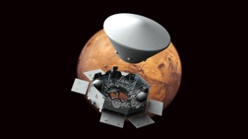


Markets
Aerospace & Defence
Energy
Advanced Facilities
Mobility
Space Defence Science Air Traffic Control
High speed railways Freight & mainline railways Roads & highways Airports Consultancy & New Technologies Architecture Water & environment Ports
Hydrogen & carriers Circular economy Gas Power Renewables & storage Wind & marine energies Sustainable industry
Quark: engineering and architecture for Data Centers.

Slide 3
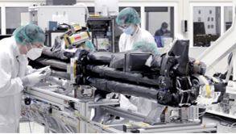
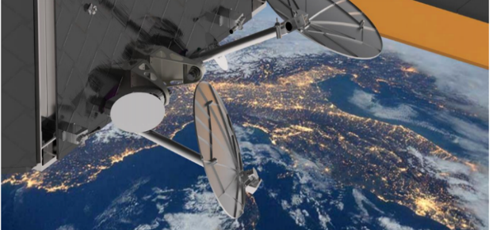
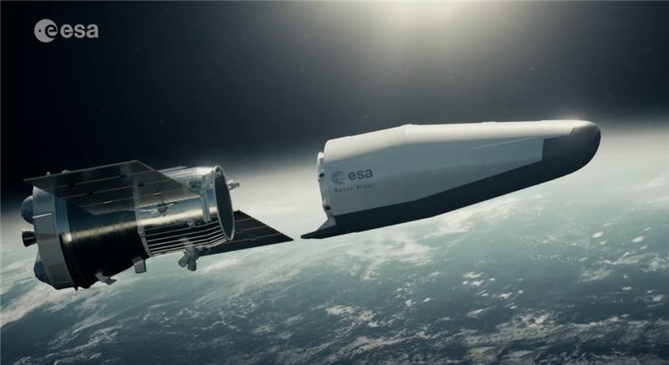
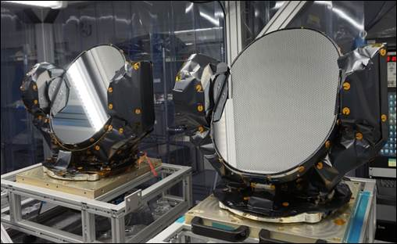
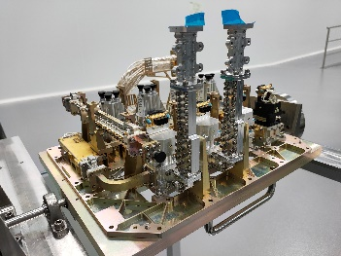
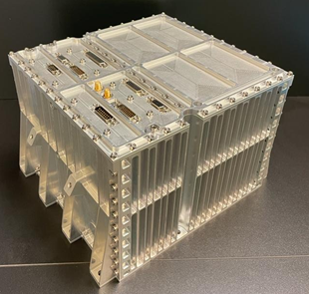
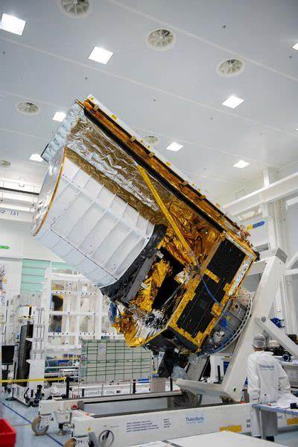
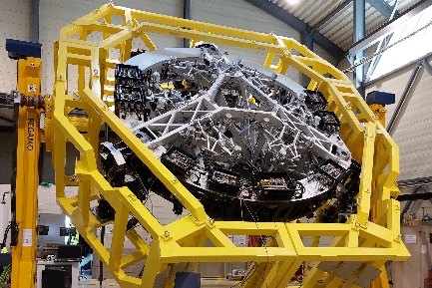
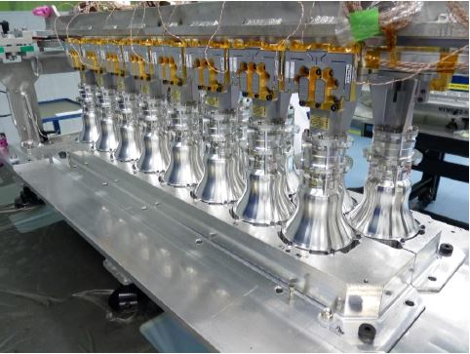
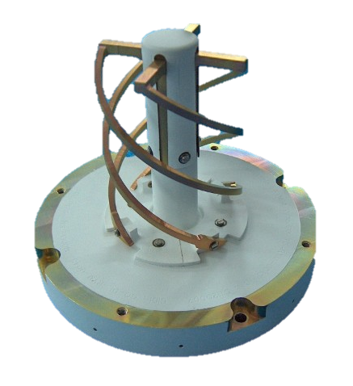
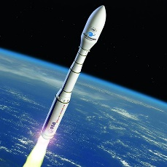
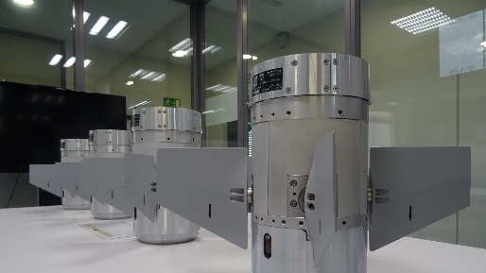
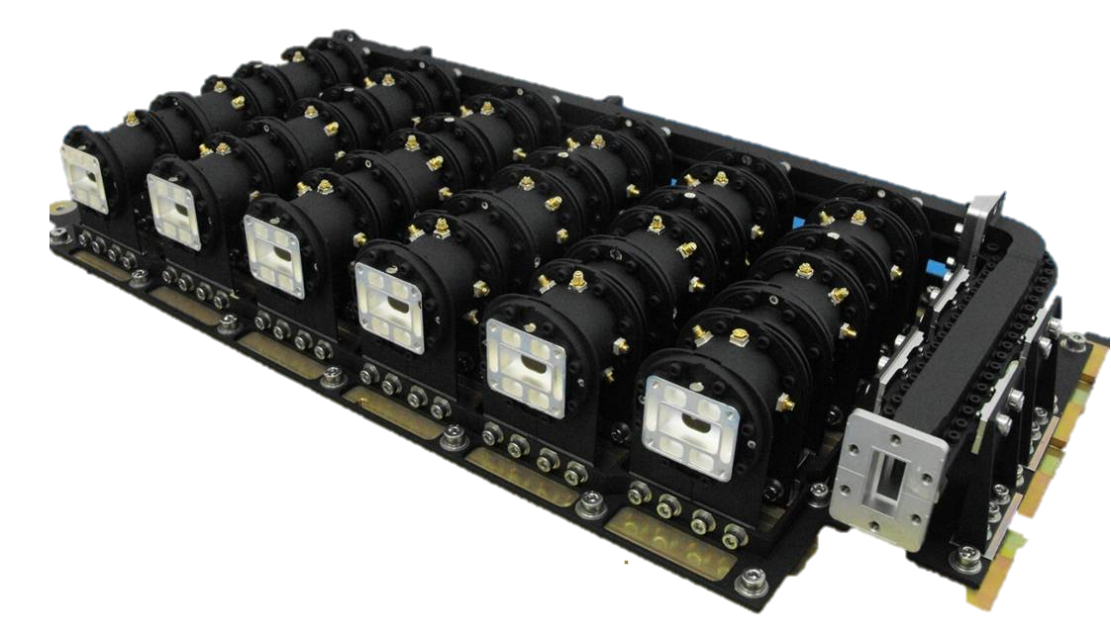
Sener Aerospace & Defence
Product Lines
Electromechanical Systems
Communications
Navigation
Space rider
JUICE boom
anteNNAs kA/q
LNAS ONESAT
SCaNER MTG
M2 ELT CELL
rad. S. SPAINSAT
nAviga
Euclid aocs
ACS IRIS-T SL

Slide 4
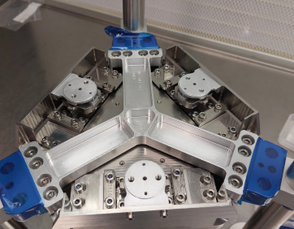
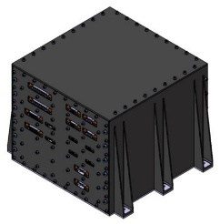
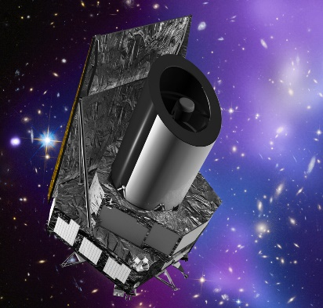
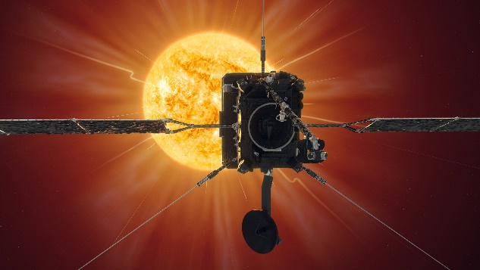
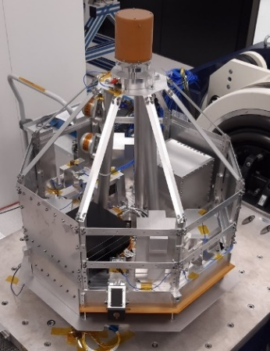
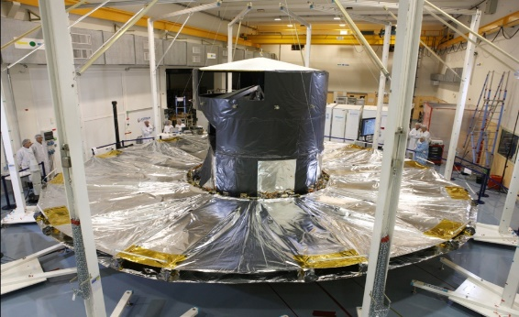
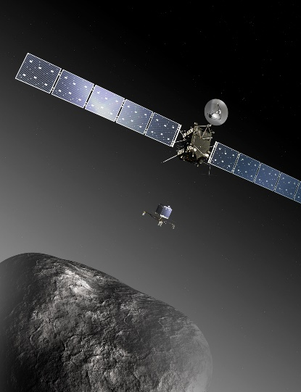
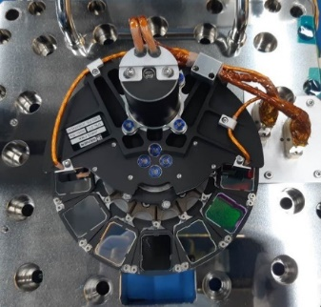
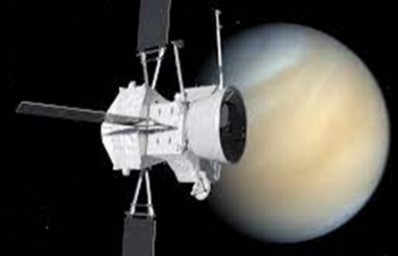
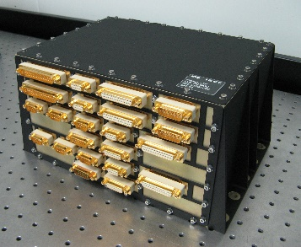
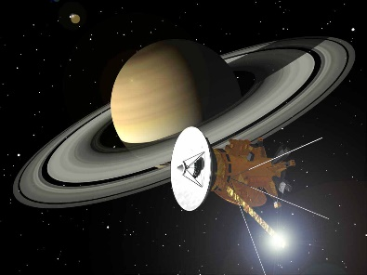
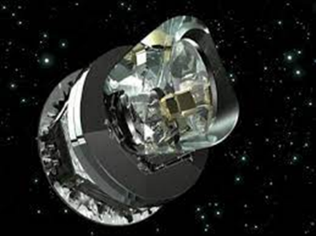
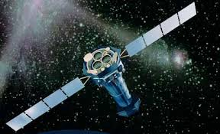
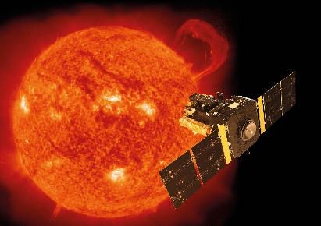
© ESA
Sener: 30 years in Science Missions
© ESA
© ESA
ARIEL
Mec. M2
LISA
DACU, MLTS
HGA
2024
EUCLID
AOCS
M2 mec.
2023
2020
© ESA
SOLAR ORBITER
Antenas
Electrónica Instrumentos
JUICE
Deployable Boom
Janus y Gala
2018
GAIA
Parasol Desplegable
Mecanismo M2
2015
BEPICOLOMBO
COMET INTERCEPTOR
Plataforma B2
Elec. Instrumentos
2013
© NASA/ESA
ROSETTA
Desplegables
Instrumentos
2009
© ESA
CASSINI
2004
XMM-Newton
LISA-PF
Data Management Unit
1999
© ESA
© ESA
HERSCHEL/PLANCK
© ESA
1995
SOHO / HELIOS

Slide 5


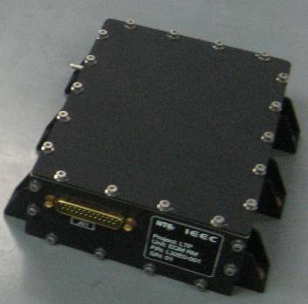
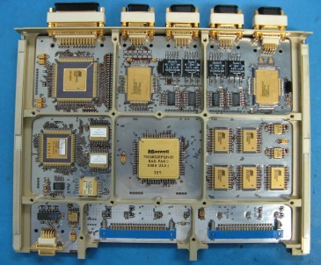
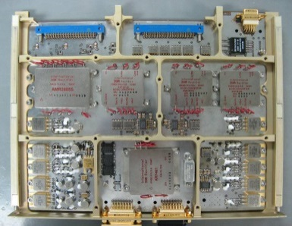
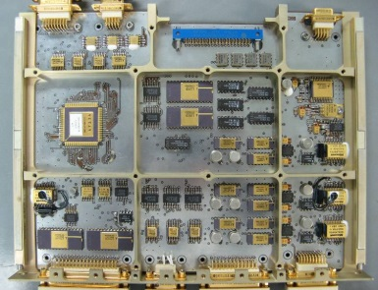
LISA – Data & Diagnostics Subsystem (DDS)
Under IEEC contract and financed by Plan Nacional.
The Data & Diagnostics Subsystem (DDS) consists of:
  Data Management Unit (DMU) embedded equipment and software that is in charge of:
    the control of the Interferometer stability (laser and phasemeter closed loop regulation)
    the acquisition of the metrology science data
  Diagnostic equipment
    diagnostic sensors which shall monitor the LTP payload for certain physical properties during LTP operation
    sensor drivers and control
S/C interfaces:
  it provides the interface to the S/C On-Board Data Handling System for the optical metrology data
  command and control interface to the S/C with the exception of the attitude control of the test masses which is controlled by the S/C DFACS loop directly.
In addition, the DDS takes over the role of the LTP controller for HK-TM acquisition and TC distribution within the LTP units.
LISA TECHNOLOGY PACKAGE
Data Management Unit (DMU)
Radiation Monitor (RM)

Slide 6

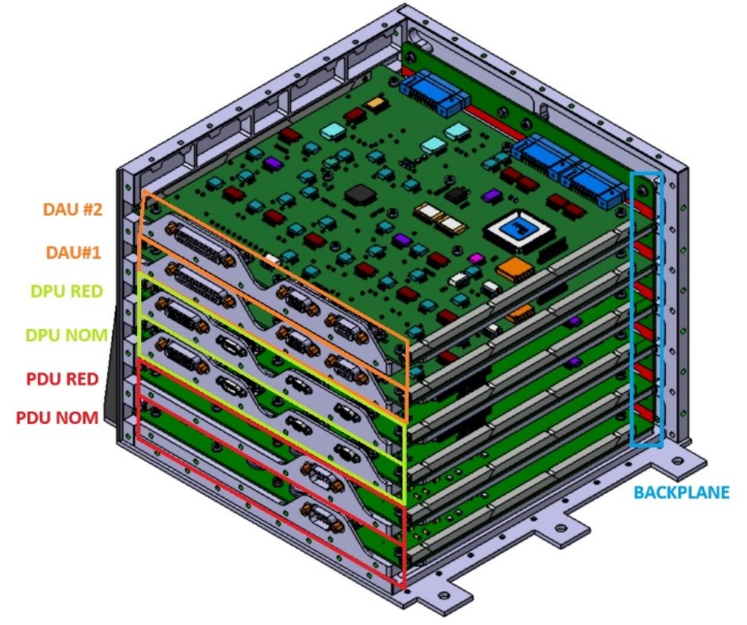
LISA – Data Acquisition and Control Unit - DACU
Following the heritage of LISA-PF DMU, in collaboration with IEEC and financed by AEE via PRODEX as part of national contribution to LISA.
  SENER Role:
  Design and Development of the Diagnostics Aquistion and Control Unit (DACU), key part of the Science Diagnostics System (SDS).
  The DACU must acquire and process the diagnostics sensors with micro-Kelvin and nano-Tesla resolution in the ultra-stable measuring bandwidth of the milli-Hertz.
  Sener is designing an extreme precision and sensitivity acquisition chain that goes beyond the state-of-the art of diagnostics systems in space missions.
  Now in Phase B and PDR to be completed beginning 2026.

Slide 7
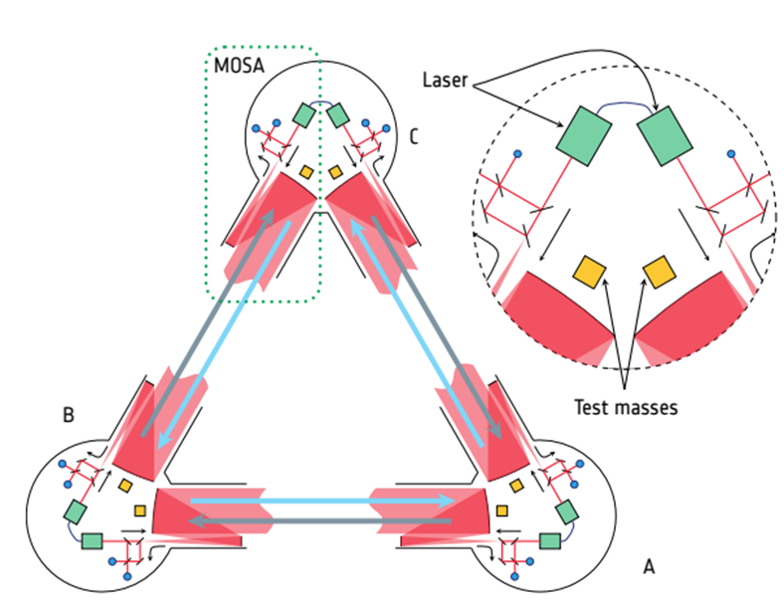
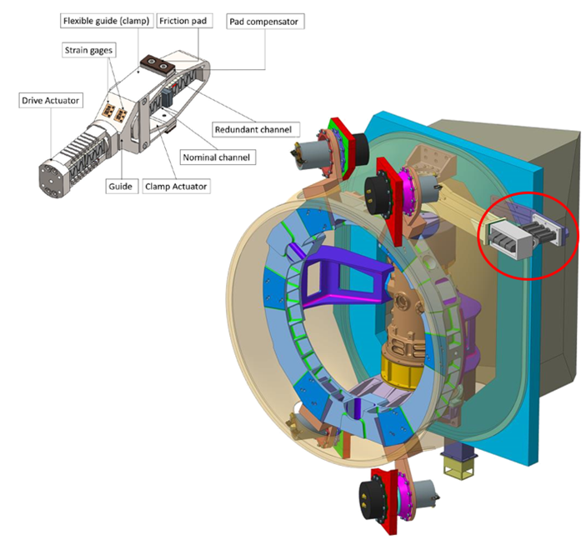
LISA – MOSA Locking and Tracking System - MLTS
Under contract of OHB and part of the Industrial Core Team
MTLS is a subsystem consisting of two main equipment:
  Launch Lock devices, responsible for isolating the launch loads from the telescope.
  Optical Assembly Tracking Mechanism (OATM) responsible for angular positioning of the telescope (one axis) with precision of 1 nrad with low induced forces to the spacecrafts.
Other main challenge for the subsystem is that the magnetic fields are not allowed- this excludes using any DC or stepper motor
The OATM is comprised by the following elements:
  Actuation device: A piezoelectric inchworm linear motor as motion generator device.
  Hinges: flexure pivots.
  Encoder
  Electronic Units

Slide 8
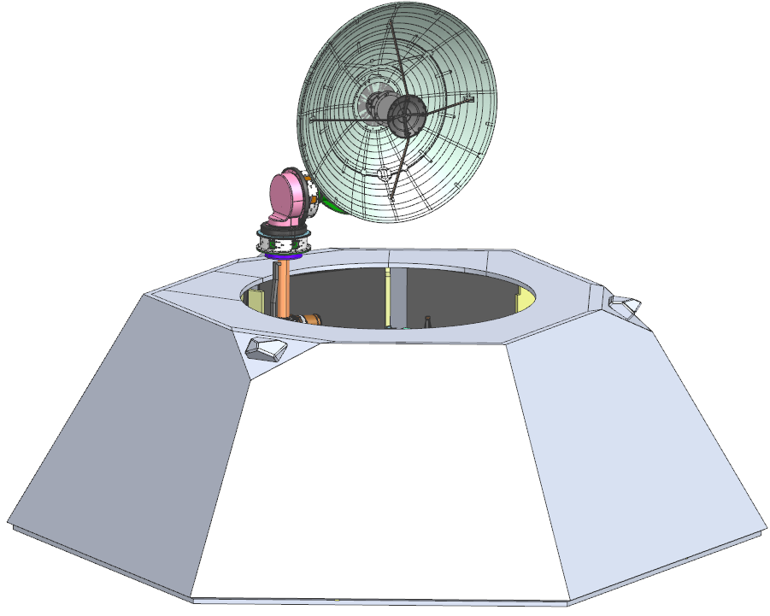
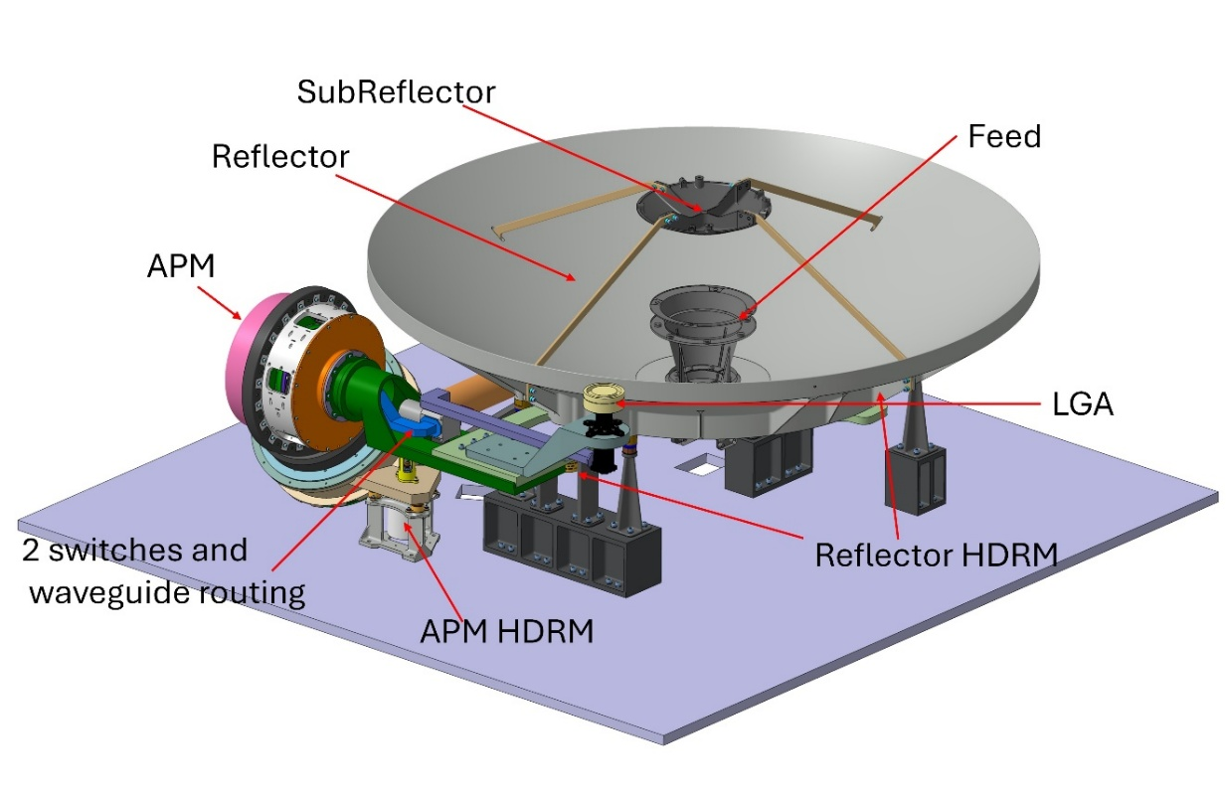
LISA – High Gain Antenna- HGA
Under contract of TASI and part of the Industrial Core Team
The HGA provides communication to the SpaceCraft in Band X using a reflector of 1,25m with 40 kg per each satellite.
It is composed by the following elements:
  Deployment mechanisms in charge of positioning the HGA from stowed to deployed position.
  Antenna Pointing Mechanism using apiezoelectric inchworm motor and reduce magnetic fields.
  X-Band Radio frequency system composed by:
    Antenna reflector assembly: Directivity radiation pattern: How the RF power is spread to the free space.
    Feed; feeding network + horn: Provide efficient illumination for the prescribed frequency and polarization
    Waveguides: Rectangular waveguide section propagating the fundamental TE10 mode.
    Rotary Joints: Contact-less device to route the RF waves through the rotary actuators.
  Antenna Pointing Electronics
  Hold down and release

Slide 9


