Slide 1
LISA Pathfinder Mission Operations Experience and Outlook for LISA Operations
Andreas Rudolph, Head of Astronomy and Fundamental Physics Mission Division
Mission Operations Department @ ESA / ESOC
CSIC, Barcelona, 04-Dec-2025

Slide 2
Presentation Outline
Lisa Pathfinder - Mission and Spacecraft Overview
Lisa PF - Mission Timeline
Lisa PF - LEOP and Orbit raising
Lisa PF - In-flight experience & lessons learnt
The next step – LISA
Conclusion

Slide 3
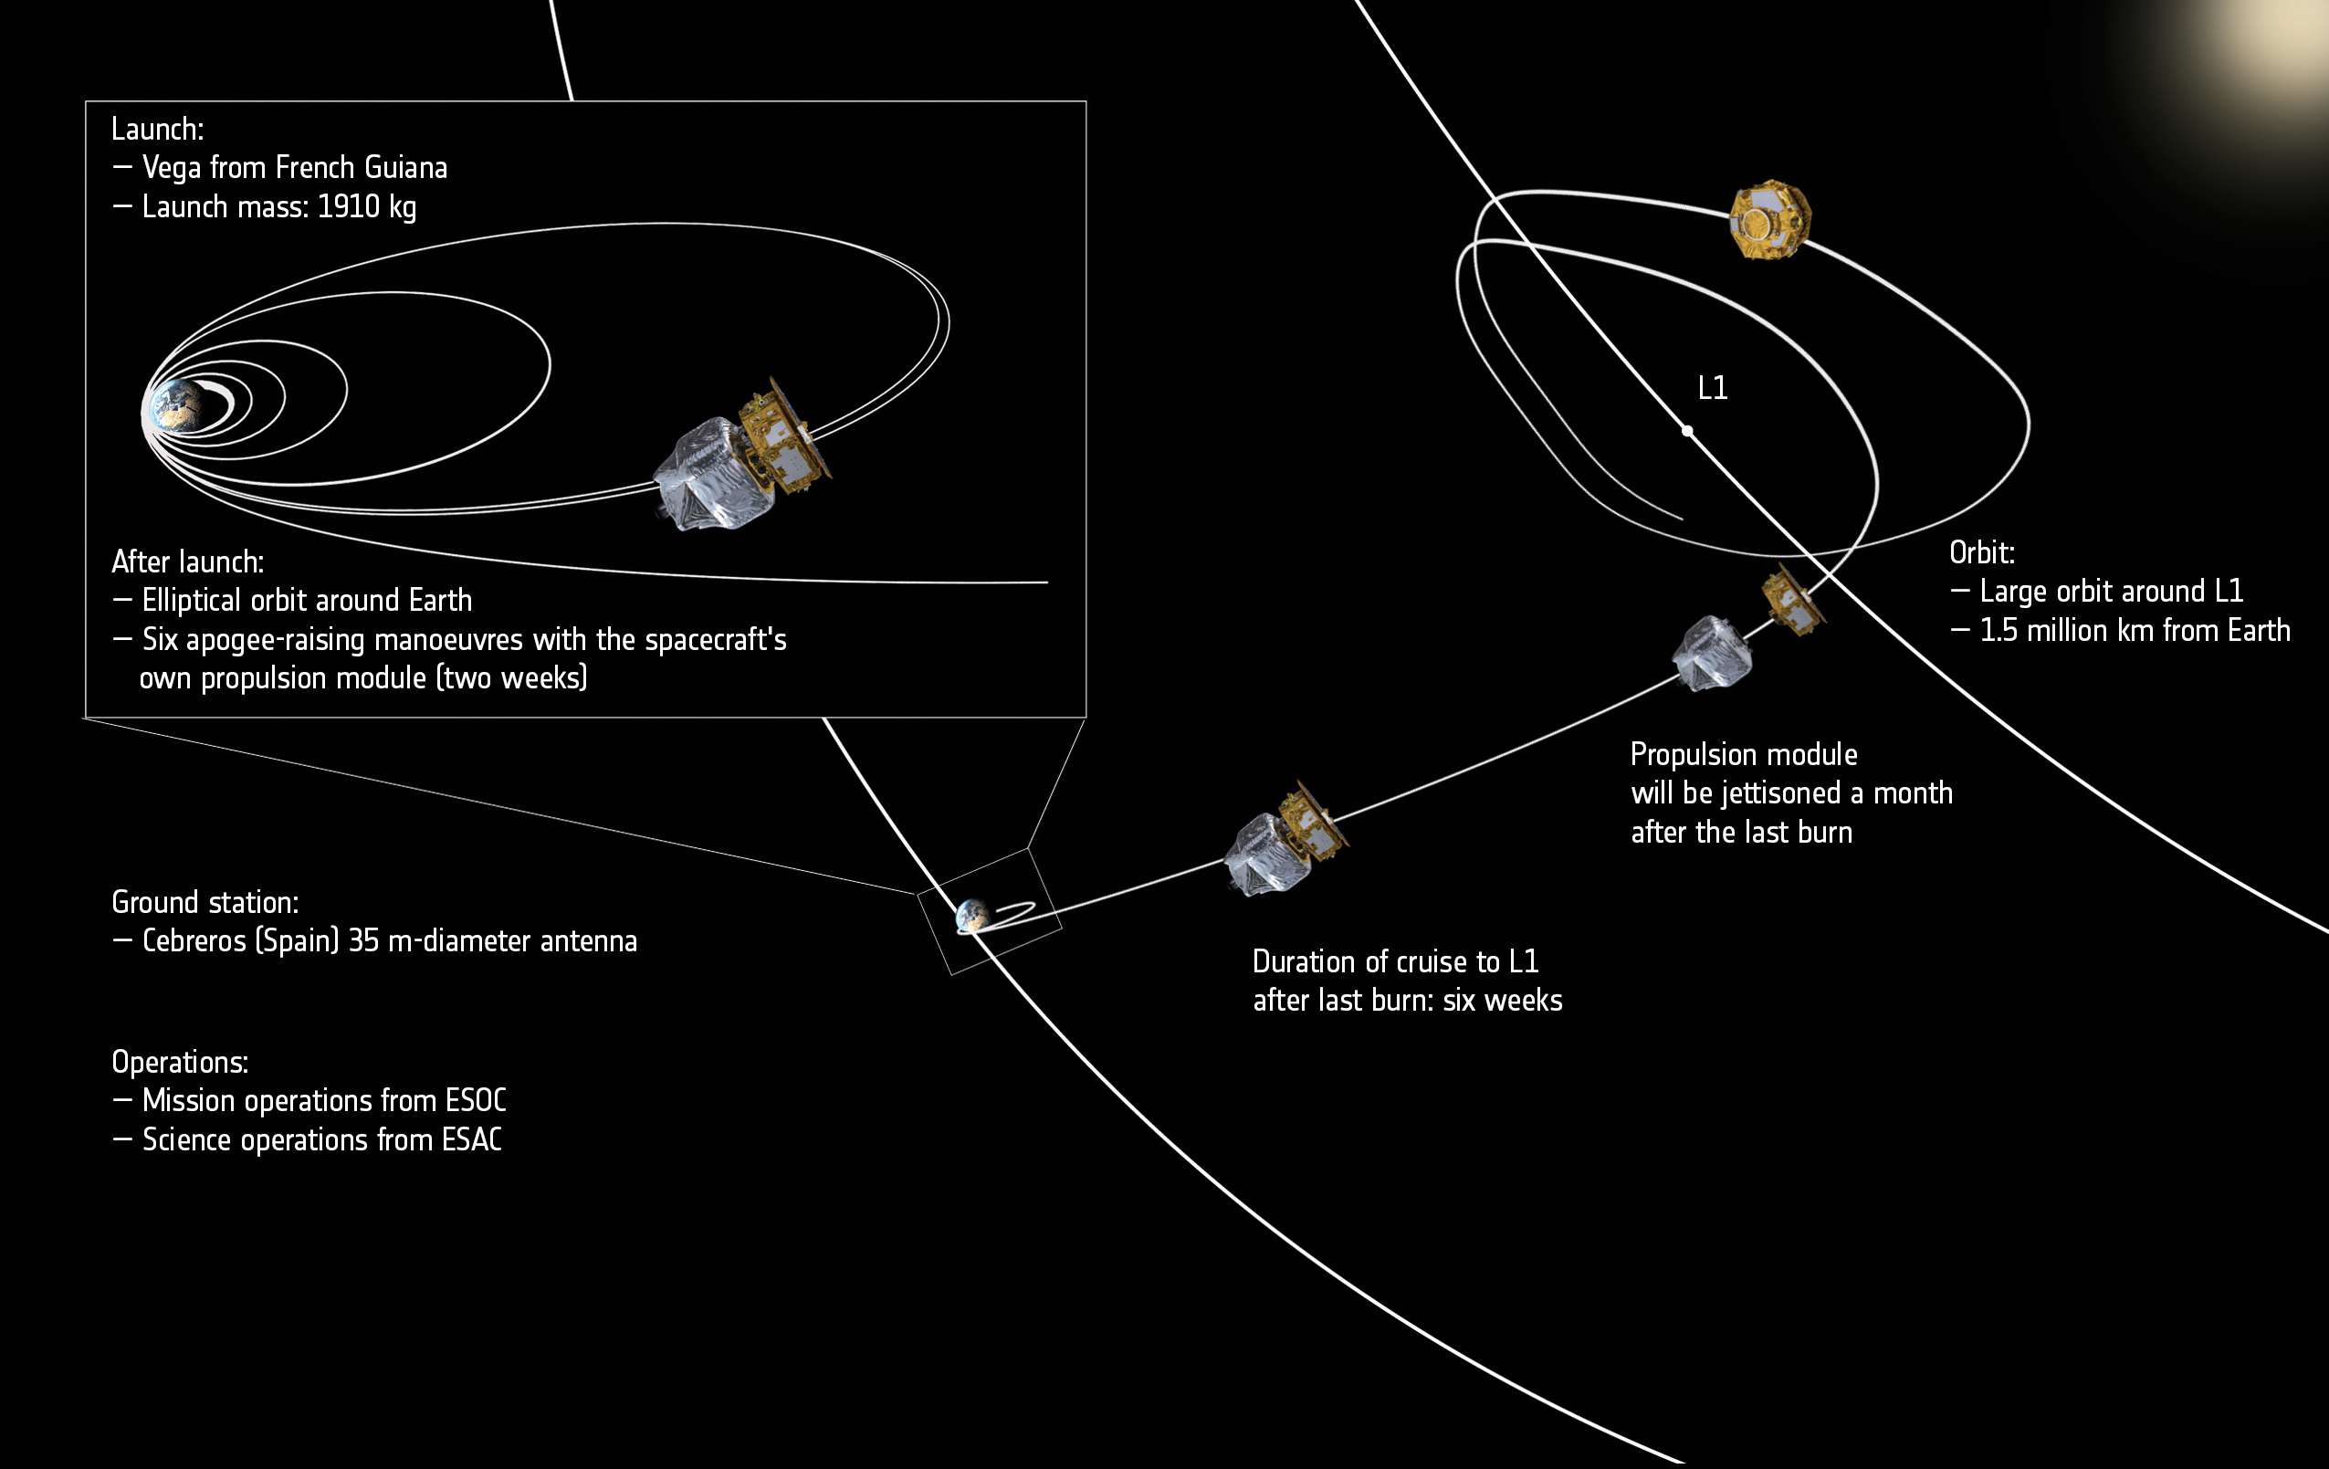
Mission Overview
Notes:
Large orbit around L1 selected to provide the required free fall purity and thermal stability minimising gravitational and magnetic disturbances from the earth.
A mixture of all type of orbit: LEO to highly eccentric earth orbits and then to L1! Injection into a near-equatorial eccentric LEO (~207*1540km).

Slide 4
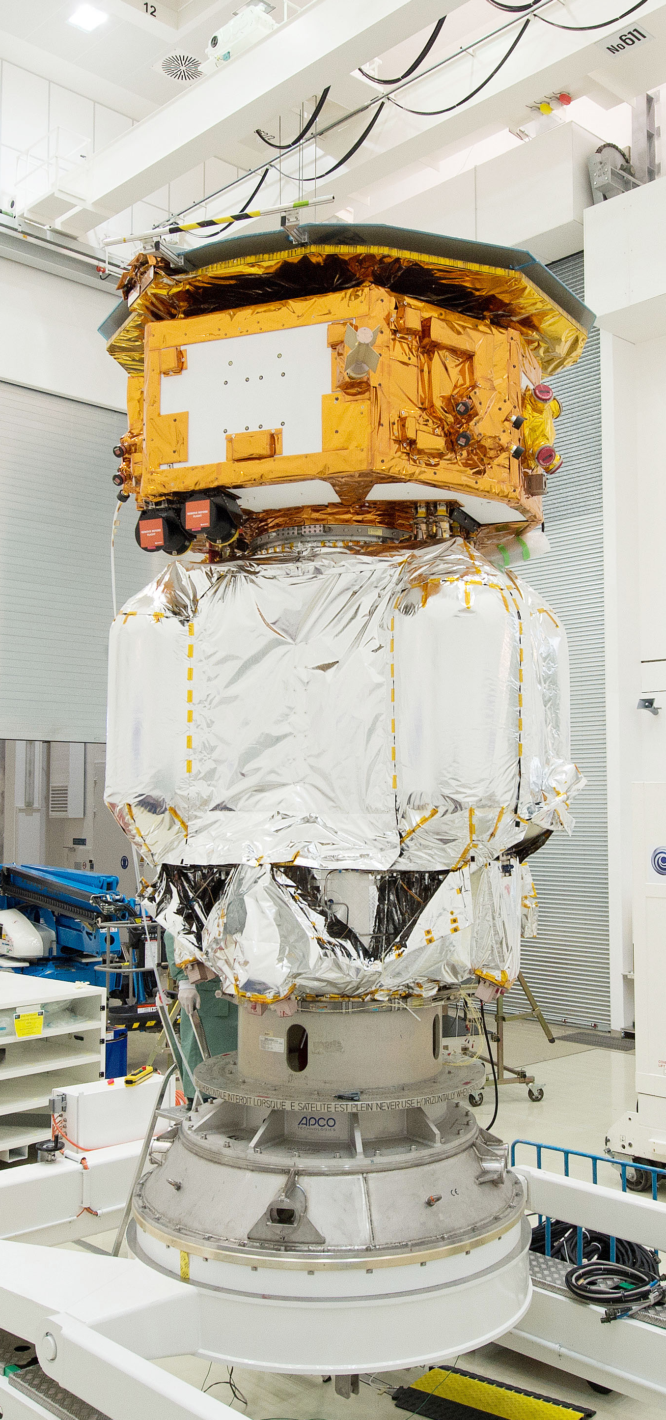
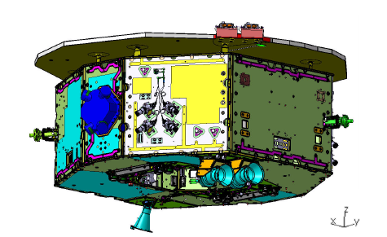
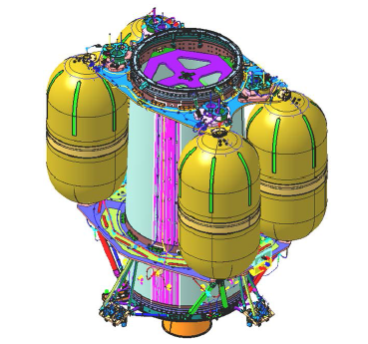
The LISA Pathfinder Spacecraft
Composite spacecraft:
Propulsion Module (PRM) for transfer to Sun-Earth L2 (delta-V= 3.1 km/sec)
Science Module (SCM) hosting the Lisa Technology Test Package (LTP) and Disturbance Reduction System (DRS), avionics (incl. drag free control logic) and cold gas micro-thrusters
TT&C in the 8 Ghz (X-band) frequency band
Mass at launch: ~1,910 kg of which
SCM: 425 kg
PRM: 1,485 kg (including 1,264 kg of bi-propellant)
Notes:
Artist impression and picture of composite spacecraft (at IABG)
¼ of mass science module; most mass for PRM and bipropellant

Slide 5
Lisa Pathfinder - Ground Segment Overview
Notes:
Traditional ground segment with a split between MOC and SOC. Complexity in ground station network: X-band antenna for LEOP with X-band acquisition aid and 2 m Malindi terminal.

Slide 6
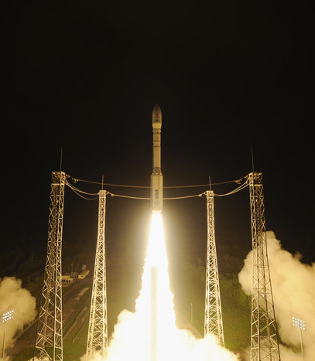
LISA PF - Mission Timeline
Launch on VEGA, VV06, on 3-Dec-2015 from Kourou (delayed by 1 day) – 10 days LEOP including orbit raising
Transfer to SEL#1 and separation on day 50 of the mission
Commissioning completed after 3 months – Feb-2016
Routine (and extension) phase of 16 months including LTP and DRS sub-phases until Jun-2017
De-orbiting, technology test phase (<1 month) and mission passivation on 18-Jul-2017

Slide 7
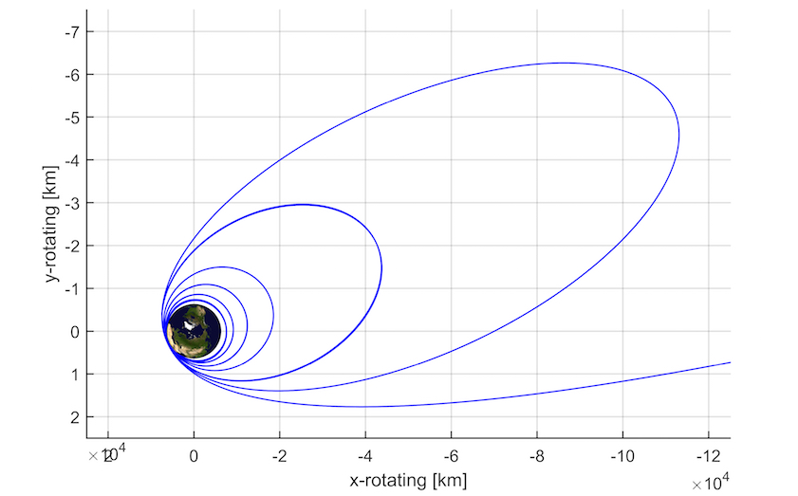
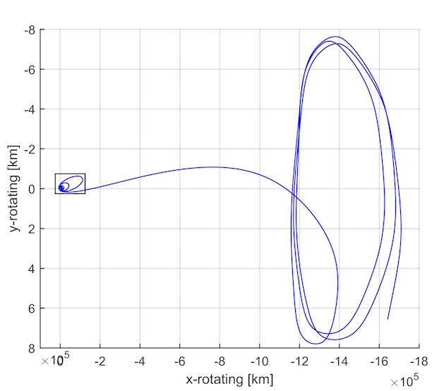
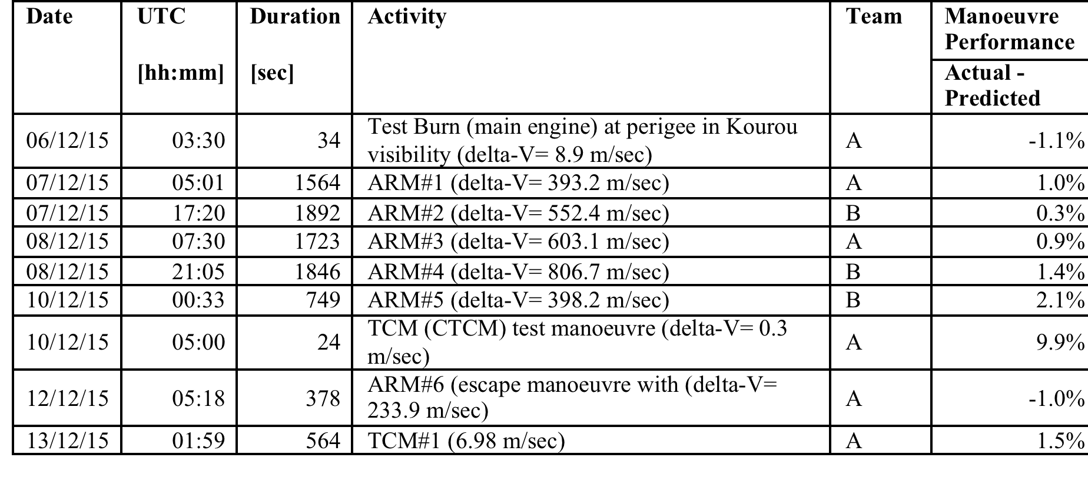
LISA PF - The Orbit Raising Sequence (as flown)
Orbit raising through the Van Allen Belts => radiation impact on spacecraft
Manoeuvres had to be performed in “open loop”
☀️
Notes:
Orbit raising strategy: minimise gravity loss of ARMs, radiation dose on the spacecraft and a margin of 2 days for delay in any one manouevre. In addition, ISS minimum separation constraints had to be observed (>35km at ascending and descending nodes).
Radiation impact on star tracker (acquisition mode not working reliably during proton belt crossing and some SEU effects on onboard computers). Operational work-around defined for star tracker issue.

Slide 8
LISA PF - In-Flight Experience
Transfer and Commissioning:
Composite spin-up to 5 deg/sec, PRM separation and Science Module de-spin using cold gas micro-thrusters in SEL#1 successful (7.5 hours to de-spin !);
Critical test mass de-caging (launch hold mechanism) successful;
Surprises with the first test mass release – see next slides;
Routine (and extended routine) operations:
Split between European (LTP) and US (DRS) experimentation phase;
Fast turn-around planning executed as needed for such a physics lab in space;
Few hardware failures (e.g. DRS thrusters) successfully mitigated;
De-orbiting burn during extended routine science ops (see next slides);
Technology test phase (~2 weeks at the end of the mission): prime time for technological tests (e.g. test mass release experiments, cold gas, etc), which would have been too risky to do earlier in the mission.
De-orbiting &Passivation: space-debris regulation compliant and definitive end to a very successful endeavour

Slide 9
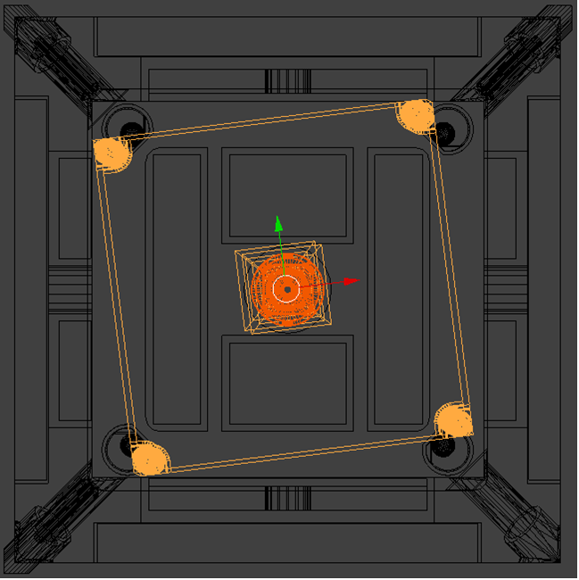
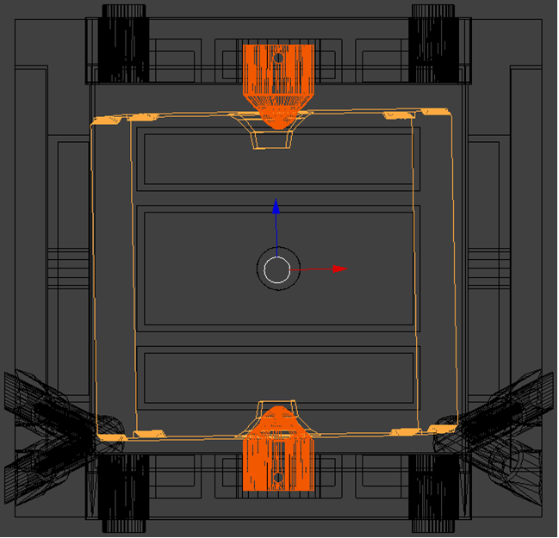
LISA PF - Test Mass Release and Electrostatic Capture
Pictures courtesy Airbus-DS, Immenstaad, Germany
Notes:
Picture shows test mass and plungers; plungers have pins that can be moved by 50 microns; ideal: release conditions below 5 microns/sec and 200 microrad/sec; not quite achieved – test mass getting stuck and touching housing; joy stick type ops capturing test mass electrostatically when in good position;

Slide 10
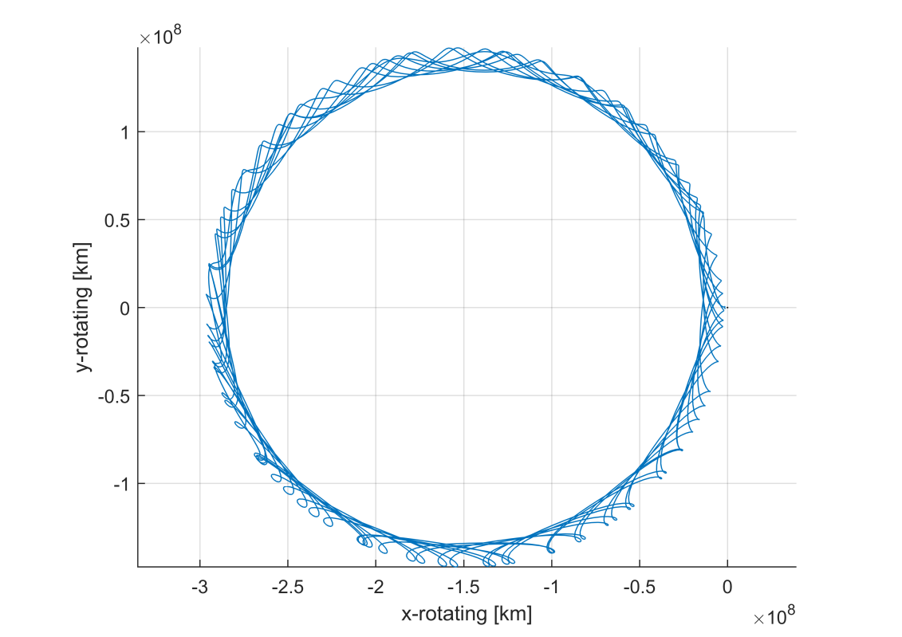
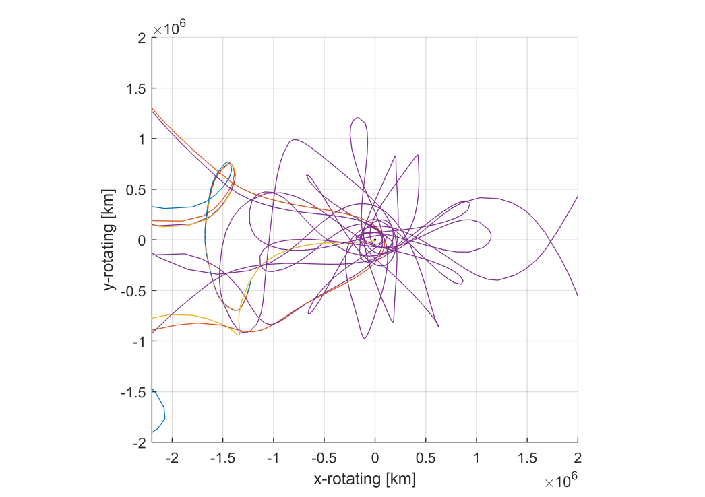
LISA PF: Deorbiting
Deorbiting burn: ~1 m/sec using cold gas thrusters at maximum thrust started 9-Apr-2017
Heliocentric orbit minimising the return probability to the earth-moon system (>100 years)
Notes:
Trajectory displayed in the Sun-Earth rotating frame
Regular close approaches to the Earth occur every 14years.
Current estimates put the probability of return to the Earth-Moon system at < 0.2% over the next 100 years.

Slide 11
Lisa Pathfinder – Some Lessons Learnt
Complex LEOP and orbit raising through Van Allen Belts due to the low injection orbit with this size of launcher:
avoid if you can (by far the best option) - if not at least use accelerometers (closed loop orbit control) – in any case different for LISA
Lisa Pathfinder - a physics lab in space: collocation of operations, science operations and Principal Investigator teams at ESOC during early routine was vital to efficient planning and fast turn-around for this type of mission;
A realistic test environment (ops simulator extended with a high-fidelity payload model; engineering model bench) and extensive validation of science test runs essential for smooth operations;
Test mass release operations requiring a lot of manual interaction/tuning from ground for successful electrostatic capture => additional experiments performed during the test phase as a pre-cursor for performing this autonomously on-board for LISA and already shared with the LISA project team
Design to use available downlink margin, and maximize science data return

Slide 12
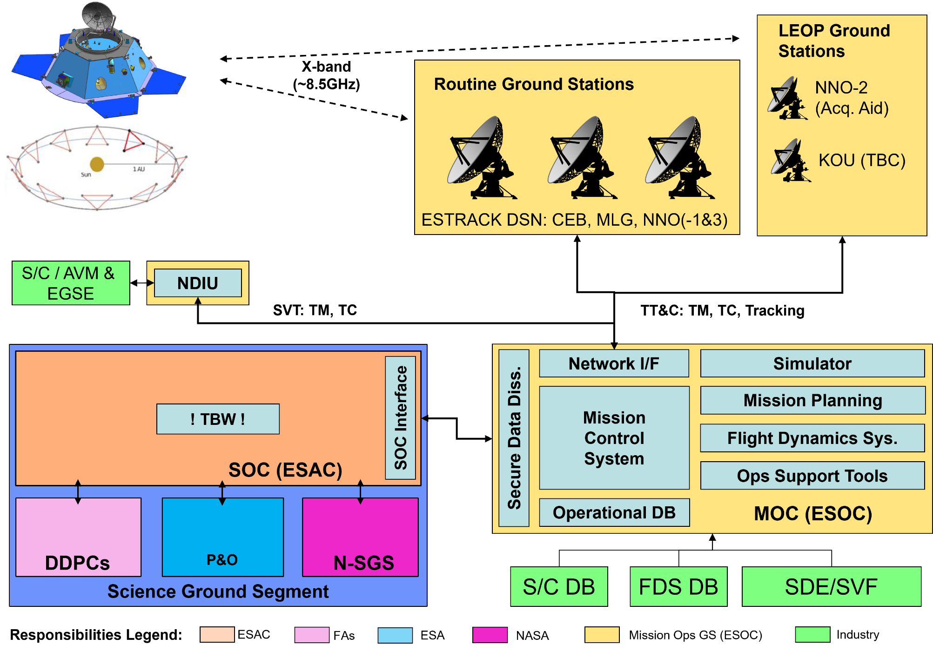
The LISA Mission and Ground Segment – Overview
Single Ariane 6.4 launch of the 3 spacecraft into a low energy earth escape orbit (Launch and Early Operations Phase ~ 2 days)
Transfer towards target earth leading or trailing orbit (+/- 20 deg from earth) using electric propulsion (~19 months TBC including NECP)
On station commissioning (3 months), nominal science phase (4.5 yrs) and extended science phase (5.5 years, subject to future approval)

Slide 13
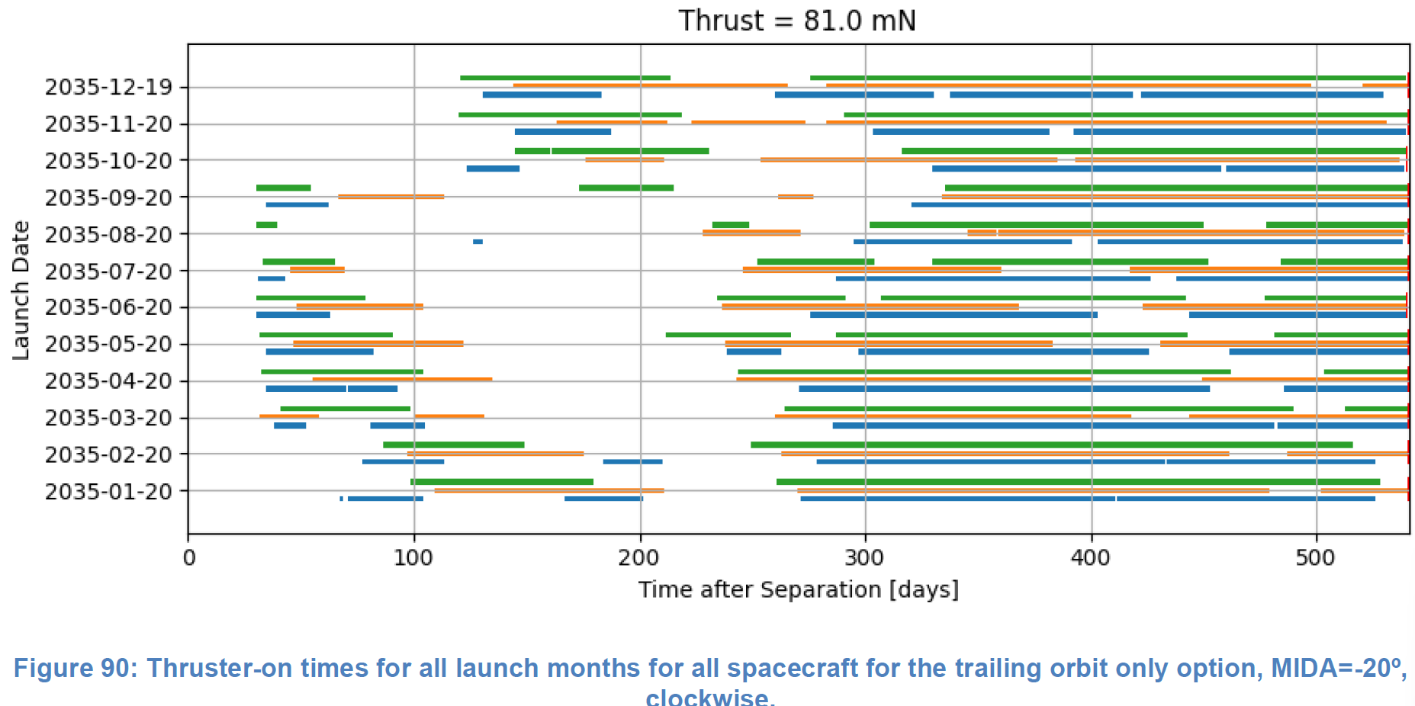
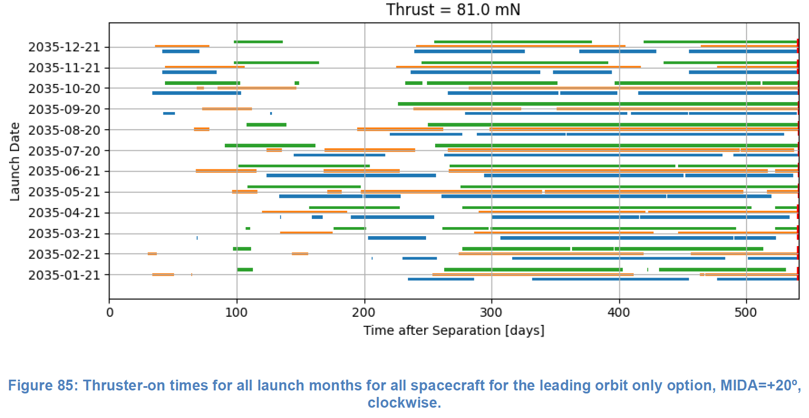
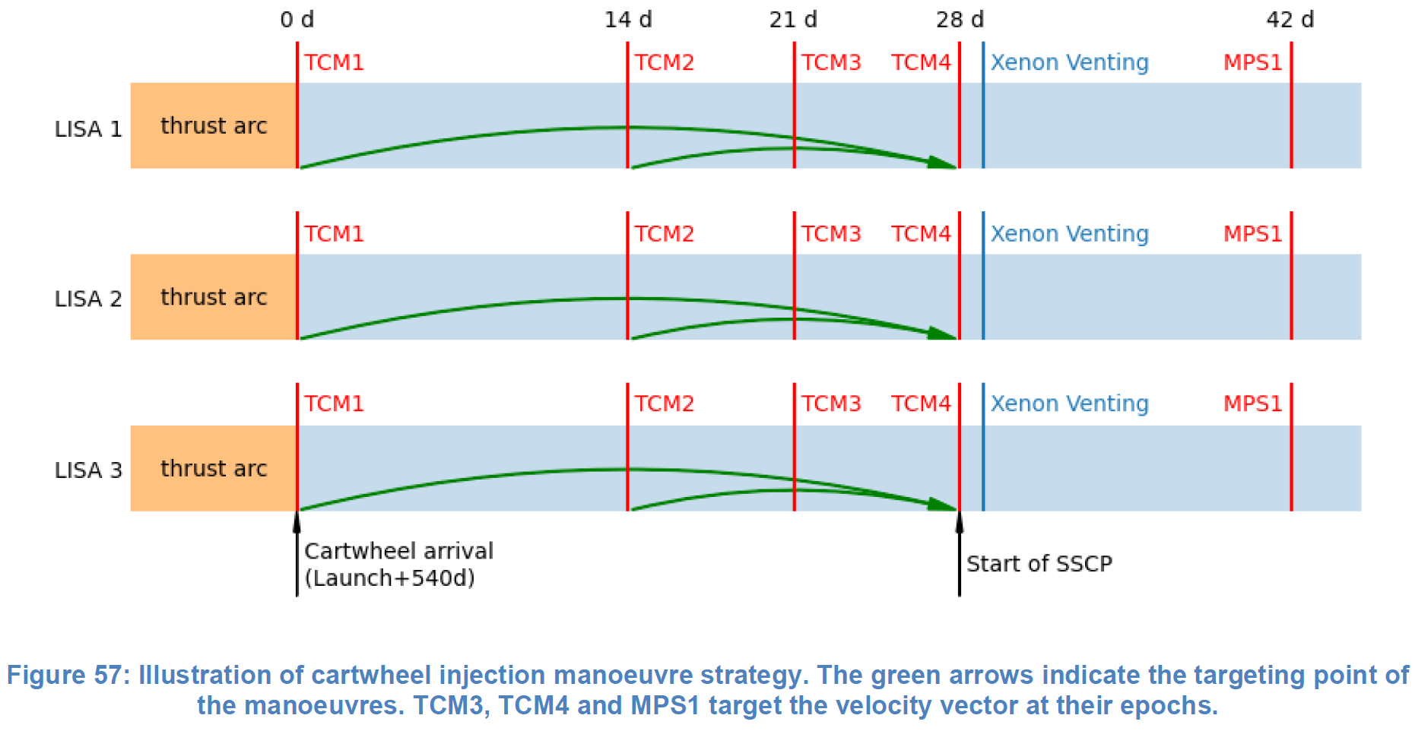
Transfer and final Injection Strategy
Injection Strategy targets a state vector at reference Epoch, with critical parameters (RoM):
Radial position dispersion < 10 km
Along-track velocity dispersion < 0.5 cm/s
=> Ensure the LISA orbit is compliant to the Constellation requirements (arm-length, velocity, angle) for the remainder of the mission

Slide 14
MOC design drivers – Nominal & Extended Science Phase
“Juggle” 3x Spacecraft simultaneously:
Driver for MOC systems development and MOC teams
Anomalies affecting Constellation will require complex recoveries at Constellation level
Science and HK telemetry data provision to SOC within 15m of end of downlink by the constellation
Auxiliary products provision to SOC within 24h
Maintain the on-board timeline at a commensurate future horizon:
Nominal Mission Planning Cycle of ~30 days and SOC Payload Operations Requests TBD schedule
Periodic and Geometry related products (ephemeris, guidance attitude, PAAM, etc) planned at a cadence of ~ 30 days
Implement the Relay/Passive SC rotation schedule every 15 days, and maximize TM data return
Perform Orbit Determination and distribute the solution every 14 days
Implement Protected periods upon reception of request from SOC:
Duration up to 14 days (up to 10 times/year), within 2 days (expected to require re-plan)
Short term protected periods of duration up to 2 days, within first DTCP (assumes Space Segment allows this without the need to re-plan)
Implement extension/additional communication periods (up to 6 hours) in case of alerts (station availability permitting)

Slide 15
LISA – Inter-Spacecraft Link, Data-Flow & File-Based Ops
LISA-3
D3_HPHK
D1_HPHK
Move files at start of DTCP
P1_HPHK
Example data flow for House-Keeping Telemetry – LISA1 (relay) from / to LISA-2 and then Ground
LISA-2
LISA-1
D2_HPHK
P2_HPHK
D3_HPHK
P3_HPHK
D2_HPHK
D1_HPHK
P1_HPHK
Separate TM streams foreseen for Science and other data considering also different priority of data
Ground
D2_HPHK
P2_HPHK
D3_HPHK
P3_HPHK

Slide 16
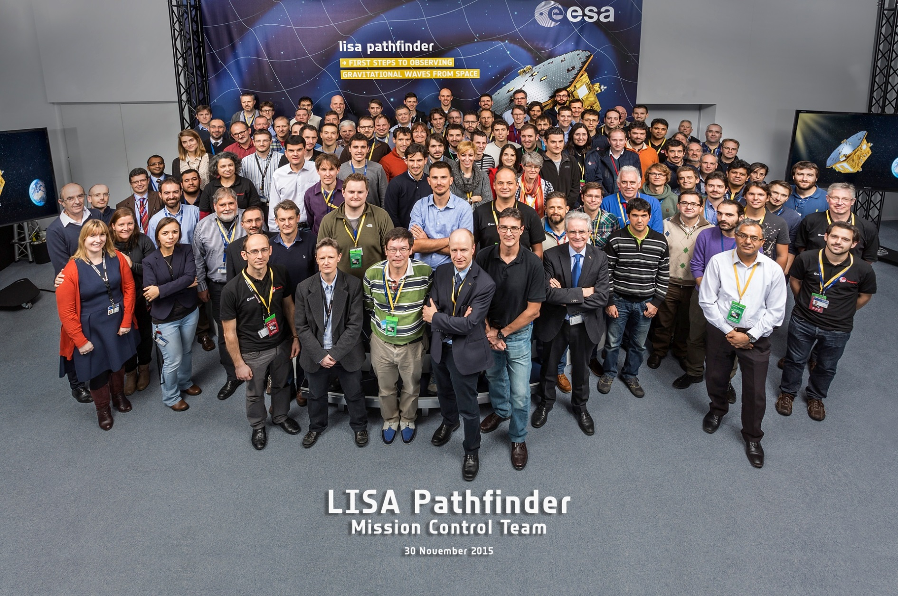
Conclusions
GO LISA !

Slide 17

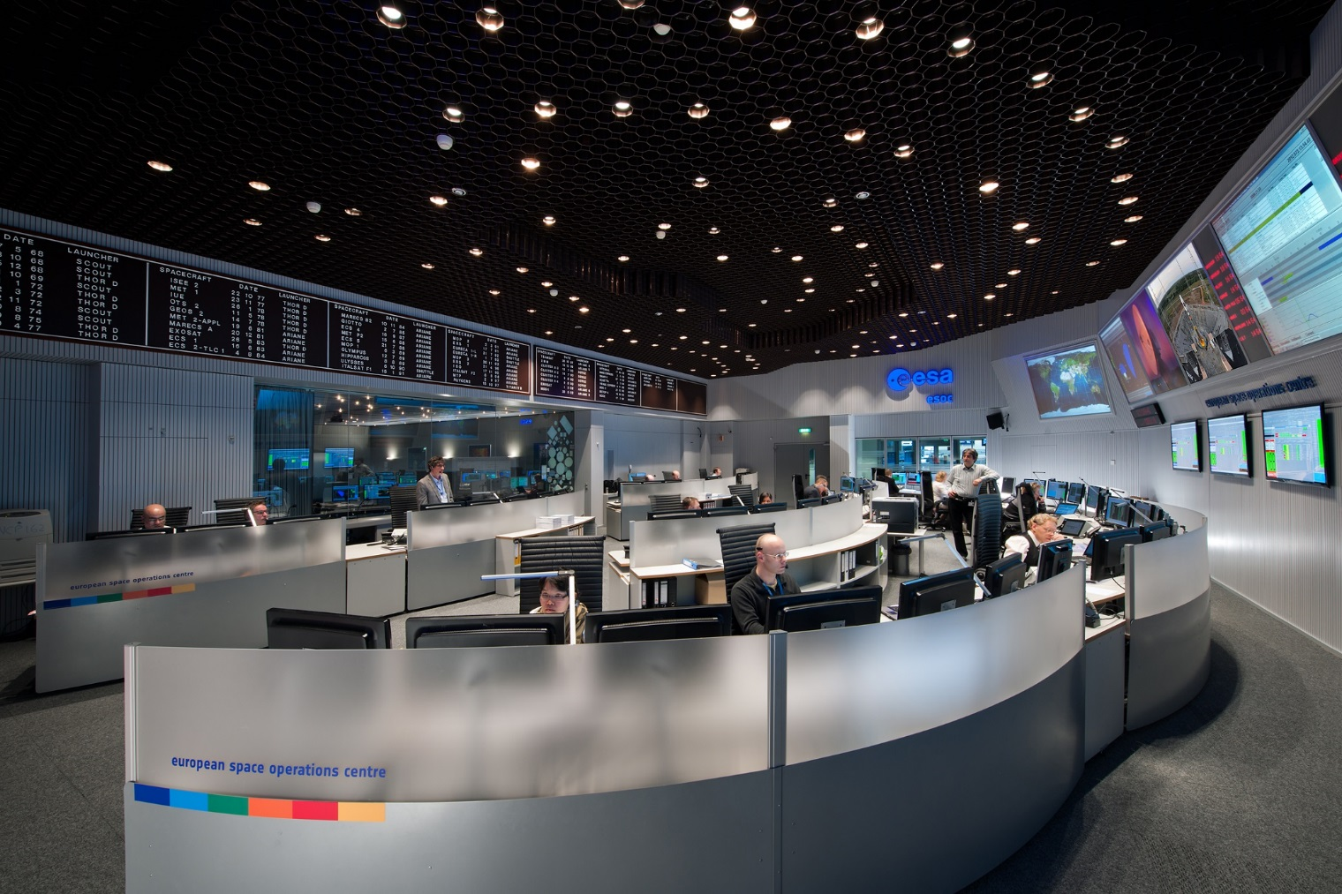
THE EUROPEAN SPACE OPERATIONS CENTER
WHERE MISSIONS COME ALIVE

