Slide 1
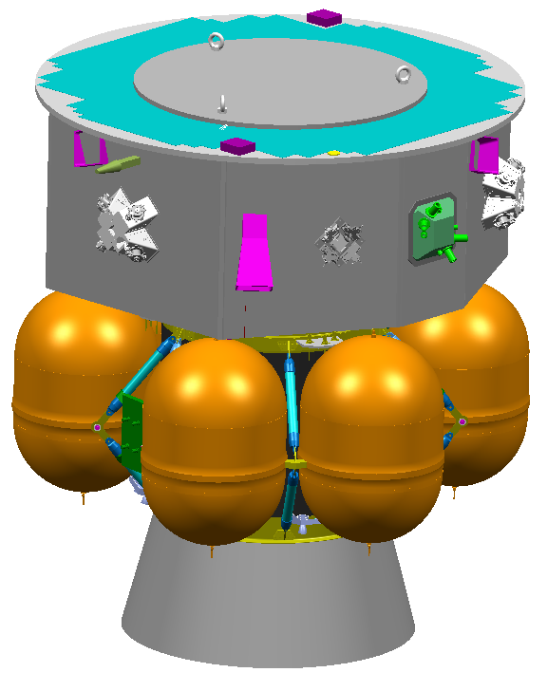
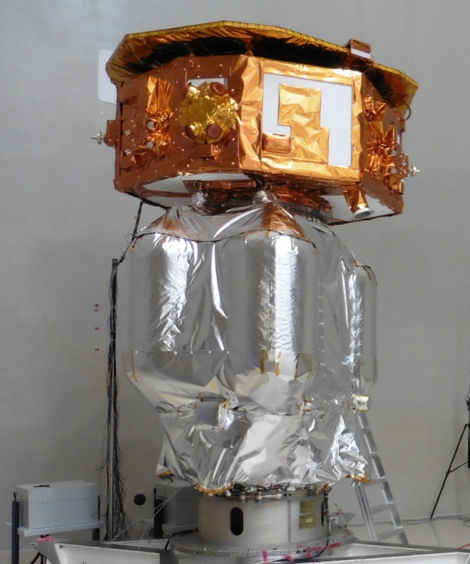
Lisa Pathfinder – View from Industrial (Prime) Perspective
2004
2015
C.Trenkel on behalf of Airbus UK

Slide 2
There is no single view!
Depending on who is asked, you will get very different answers…
Airbus management
LPF management
LPF engineers and scientists
And, of course, when you ask…
At the beginning of the project
When major problems are identified, but not yet solved
When cost & schedule appear to grow forever
After both ESA and Airbus Management have been replaced
When major problems are finally resolved and the end is in sight
When the (excellent) in-flight results are in
…dare I say it - after Airbus lost the LISA contract

Slide 3
A few flashbacks that may shape one’s view…
Overoptimism
Starting point:
ITT called for LTP to be delivered in 2006 and LPF to be launched in 2008
LPF had three micro-propulsion systems
Cold Gas
FEEP
Colloidals
LPF had two inertial sensors
LTP
US DRS
LPF was also going to resolve various geo-return issues
Using a “best practice” procurement approach
Having a full set of stringent specs
… all whilst officially being a low cost mission

Slide 4
A few flashbacks that may shape one’s view…
Fast forward to PDR (2005/2006)
LTP to be delivered in 2008
LTP mass ≈ doubled
LPF had three two micro-propulsion systems
Cold Gas
FEEP
Colloidals
LPF had two one inertial sensors
LTP
US DRS
LPF specs had been updated to full rigour of major ESA mission
…but the budget never kept up

Slide 5
A few flashbacks that may shape one’s view…
Best practice procurement – Theory and Reality
Theory:
Ideal specification is prepared
Made available to all potential contractors
ESA / Airbus assess proposal based on technical merits
Competition ensures geo-return goals and low prices
Reality:
Geo-return shares for small countries were specified
Contractors from those countries knew
that they had to be selected
and how much their national geo-return share was
So they asked for it – so much for competition ☹

Slide 6
A few flashbacks that may shape one’s view…
Financial pressures and outsourcing choices leading to ultimately wrong decisions…
To save money (250k…), no high precision SC master oscillator distributing a single high quality clock to the platform and instrument was implemented
At the time, there was no definite technical requirement for this – the full implications were not understood
This saving was MUCH less than the eventual cost and effort to the mission of having two clocks on-board
Outsourcing the critical on-board software, underestimating the complexity and with incomplete specifications, proved to be another costly mistake
Eventually, the development and functional verification had to be taken in-house, at significant added cost and delays
Inevitably, continuously rising costs soured relations between ESA and Airbus…

Slide 7
A few flashbacks that may shape one’s view…
Things we would rather forget…
Damaging the flight structure
During static testing of the structure at Stevenage, hydraulic rams were unintentionally activated at full load, damaging the flight cylinder
Contraves rapidly repaired that cylinder which became part of the useful STM
Battery damage
A sophisticated battery monitor was used to support the lithium-ion battery and ensure safe operation
Unfortunately, the monitor used a small amount of power and there was no physical disconnect in the design
The monitor remained active while the spacecraft was placed in storage waiting for LTP and cold gas - draining the battery to a level which damaged it

Slide 8
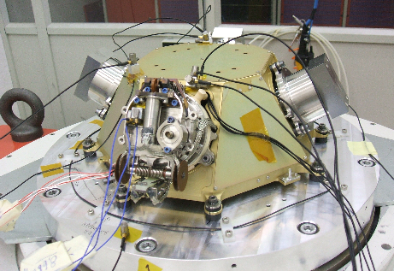
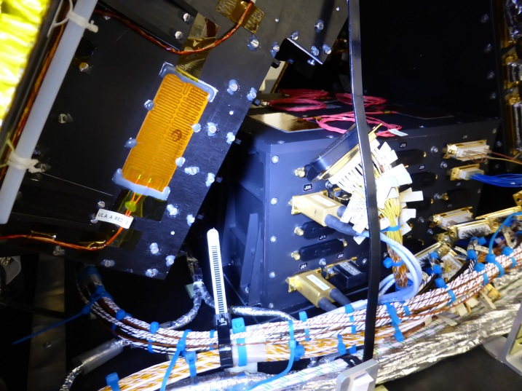
A few flashbacks that may shape one’s view…
Technology Maturity (on Platform Side)
ESA and Airbus jointly tried very hard to get a FEEP solution for LPF – but the FEEPs turned out to be much less mature than claimed
Even with two suppliers developing two different technologies (!)
Eventually, a major re-design of the platform to accommodate cold gas solution (based on GAIA) was required
This was an extremely difficult and painful decision… having, many years earlier, discarded cold gas in favour of FEEPs!
FEEP Development
Cold Gas MPE squeezing in

Slide 9
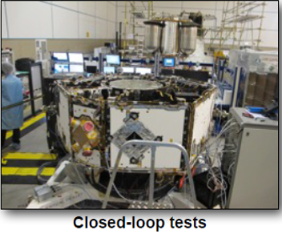
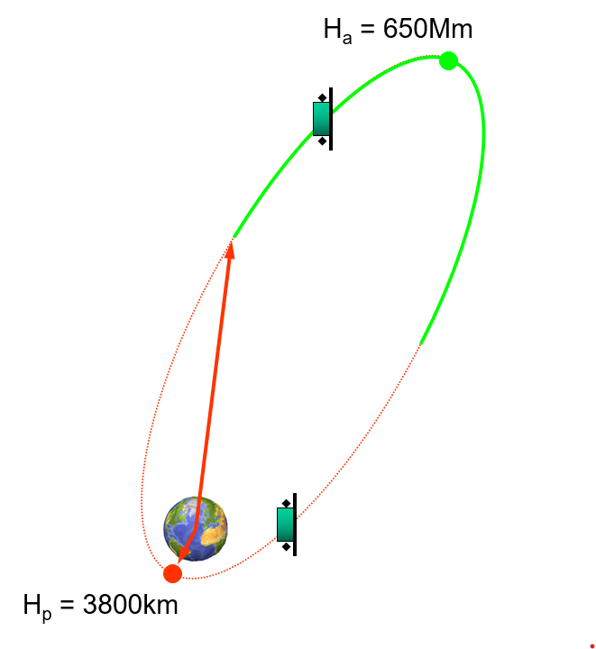
A few flashbacks that may shape one’s view…
Light at the End of the Tunnel!
The SC test campaign went very well
ESA and Airbus fully aligned on the objectives
Both sides included very experienced test engineers
Approach was focussed and pragmatic throughout
Honourable mention…
Worries about (new) launchers and shrinking mass margins
Highly elliptic orbit as backup(!)
Conclusion: ”HEO is feasible but not recommended”
Overall quite a rollercoaster… and this was not even the LTP!

Slide 10
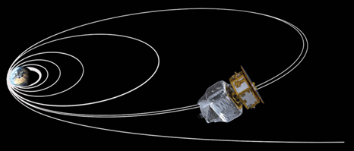
A few flashbacks that may shape one’s view…
Launch and LEOP
The launch from Kourou and subsequent LEOP campaign were flawless
Tight launch window (1 minute)
Six apogee raising manoeuvres (using LPF PM)
ESA and Airbus teams working very well together
In words of ESOC:
Most complex LEOP ever
“We are not doing that again…”

Slide 11
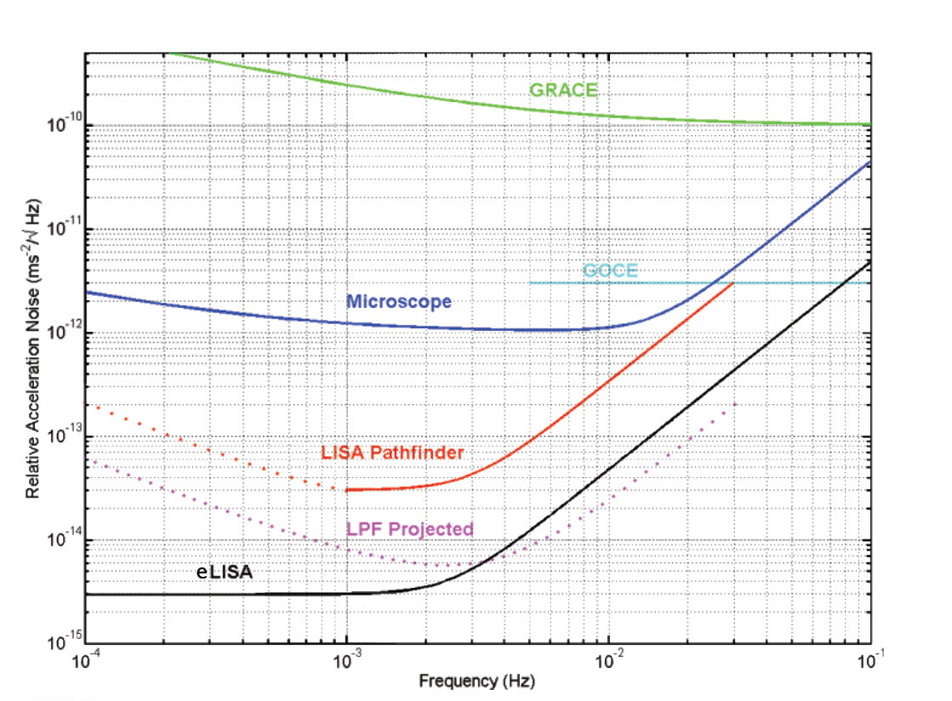
LPF results in context
Pre-flight predicted performance
In LEO
at L1
LPF did certainly not lack ambition ☺

Slide 12
LPF results in context
In-flight measured performance
LPF in-flight (2017)
LPF was not just a minor improvement…it was a huge leap!

Slide 13
LPF results in context
LPF did not just meet its requirements
it performed better than we could hope for
Two other gravitational missions, trying to break new ground, were not quite so fortunate:
Gravity-Probe B (NASA, launch 2004)
Microscope (CNES, launch 2016)
Both missed / underestimate significant noise sources
So why did LPF perform so well?

Slide 14
LPF results in context
Let us remember a few things:
Correct residual gas damping estimate was published in 2009
Thanks to invaluable Trento torsion balance measurements (not just for this)
Resulted in significant ISH re-design with venting to space
Remember that we the LTP should have been delivered in 2006(!)
Gravitational balancing (I)
A payload modelling error resulted in an in-flight performance that was worse than pre-flight CBE… but along the non-critical Y
Still within requirement
Along the critical X, the balancing was much better than pre-flight CBE
Actually, in part, thanks to the mistake above(!)

Slide 15
LPF results in context
Gravitational balancing (II)
There was a near-miss pre IBM design – the “other” TM was not included in the gravitational model(!)
Spotted by CGS, just in time (thank you CGS!)
This mistake would have been a disaster
Probably my personally most traumatic memories ☹ !
Magnetic environment
Pre-flight verification of local DC gradient was limited by test methods
Worst case prediction was not realised in space
TM release and DFACS capture
Release velocities > 10x requirements
During release, TM electrically short-circuited IS-FEE (!)
Pre-flight analysis had shown that this would be “impossible”

Slide 16
LPF results in context
In Summary:
LPF performance was exceptional, and no significant noise source was missed or underestimated
Not to be taken for granted – see GP-B / Microscope experience
A lot of hard work and “hard thinking” ensured that meeting the mission requirements was never in doubt
But the fact that the performance was so good was “a bit” fortunate ☺
Remember: Fortune favours the bold!
(And I didn’t mention the fibre inside the ISH…)

Slide 17
Back to “Airbus’ View”
This is my view of Airbus’ view:
 | Airbus Management | LPF Management | LPF Engineering
At project start
Major problems appear
Cost & schedule grow forever
Airbus / ESA management replaced
Major problems resolved
Excellent in-flight results
Airbus lose LISA contract

Slide 18
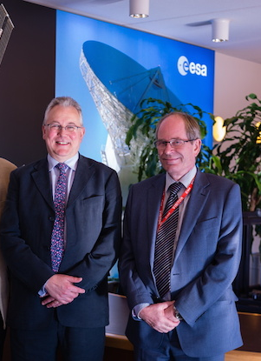
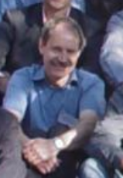
Finally…
Nevertheless:
Airbus UK are extremely proud to have contributed to the success of LPF, the first science mission primed by Airbus UK since Giotto in the 1980s(!)
Many greetings also from these chaps – two of them were with LPF from start to finish
It has been a privilege and pleasure to be part of such a journey with you!
In memory: A.Cross, A.Swallow, A.Jones, D.Hilliard

Slide 19
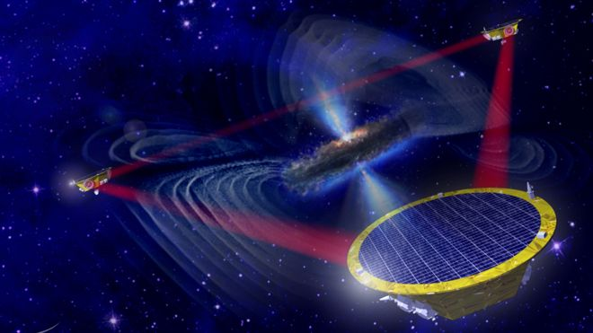
2004
2015
> 2035

Slide 20
A few ‘personal’ words on LISA
So - will LISA learn from LPF?
I really really hope so…
My own past experiences have been “mixed”:
LISA Mission Formulation (2008)
ESA Project Manager, after Airbus UK presentation showing LPF DHS architecture and the link between platform and payload data busses:
“I don’t understand why you are telling us about LPF – this is a LISA progress meeting”
LISA Phase A (2018)
(New) ESA Project Manager, after I expressed frustration at the slow rate of progress and completely reopening old trades:
“Don’t worry Christian, we are only in Phase A”

Slide 21
A few ‘personal’ words on LISA
LISA Payload Mass:
Mission Formulation (2011), after 5-6 years of intense study
≈ 330kg per spacecraft (excl system margin)
LISA ADS proposal (2024)
≈ 700-950kg per spacecraft (excl system margin)
LISA ADS proposal (2024)
Chapter on LPF lessons learnt – some of CT contributions:
Do not outsource critical and closely coupled subsystems
Do not let geo-return & financial politics dictate the industrial setup
Do not restrict / limit / control information flow (no “silo mentality”)
These were all taken out - “we cannot tell ESA this”
LPF X Anniversary Workshop (yes this one)
ESA LISA team “too busy to attend”…

Slide 22
A few ‘personal’ words on LISA
So – here’s my chance to say what I wanted to write in the proposal ☺
Do not force Prime to outsource critical and closely coupled subsystems
You will regret it later
Do not let geo-return and financial policies dictate the industrial set-up
You will regret it later
No ESA / industry / academia “silo mentality” with open information exchange
Establish one single team from the start
Use one single master oscillator across any closed loop system
You will regret it if you don’t
Test, on the ground, everything you can
Including gravitational balancing – test and / or provide active control
If a technology with heritage exists that works, and works well enough – don’t be tempted by potentially better solutions. LISA is complex enough!
Remember the FEEP…
(Stefano do not listen to Philippe!!)

Slide 23
A few ‘personal’ words on LISA
ESAs decision to take responsibility for LISA performance largely away from Prime may be a good thing
As much as it ‘pained’ some of my Airbus colleagues
If you want to work with companies who need to make a profit, you need to keep requirements and interfaces simple
Provided ESA don’t fall into the old “bad habits” of wanting to restricting or control information flow
Involve the full team, academia and industry, as much as you can – it will pay off later!
Does anybody in this room have influence on the ESA LISA team to “ram this message home”? I hope so!
LISA has been studied for long enough – can you just build the thing now please!

