Slide 1
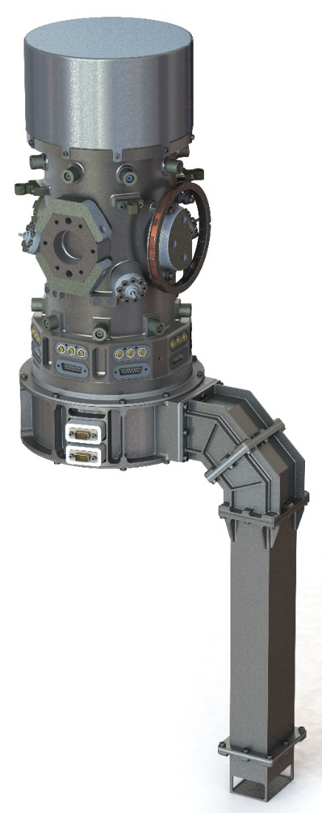
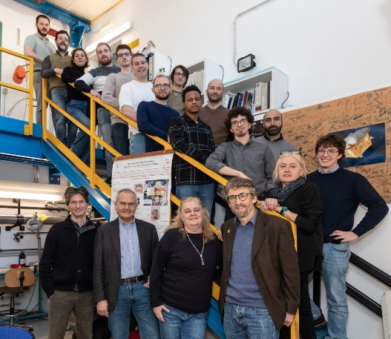



The gravitational reference system
from LPF to LISA phase B2:
LPF ops logbook observations and subsequent evolution of the LISA GRS
Bill Weber
LISA GRS PI team
Barcellona, 20251203

Slide 2
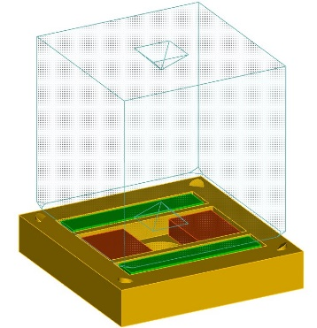
LISA test mass – electrode geometry 2025: as designed 2002 and tested 2016
from Dolesi / Weber presentation (2002)
4 mm X-gap
46 mm, 2 kg Au-Pt TM
EDU» trento_yzin_z('din',4,'dx',4,'dy',2.9,'dz',3.5,'win',16,'mass',46,...
'cagehole',12,'double_inz','plt','xyz');
Modified Trento Design (2 sensing electrodes on every face, YZ injection)
Assume Trento bridge: capacitance noise = 4.3674e-007 pF V / rtHz
DESIGN
X faces (mass face 46 x 46 mm
Two sensing electrodes: 14.5 x 36 mm , gap 4 mm, Rphi 10.75 mm (6 mm laser hole)
...
Sensitivities (nm or nrad/rtHz):;
x y z phi th eta
0.88965; 0.9; 1.4784; 82.7579; 57.8778; 96.9437;
Neg Electrostatic Stiffness (nano / s^2):
wx^2 wy^2 wz^2 wphi^2 wth^2 weta^2
LTP Total; 56.4967; 2358.58; 2716.4987; 1599.5227; 2859.9274; 2457.0655;
LTP Specs; 950; 950; 2850; 3850; 3850; 3850;
LTP Act freqs (nano/s^2); 1.3; 2.2; 3.7; 16; 27; 23;
LISA Specs; 250; 250; 550; 550; 550; 550
LISA Act freqs (nano/s^2); 0.1; 0.1; 0.3; 0.5; 1; 1;
Bortoluzzi Bottom Line: Mass Mass 1.9467 kg, inner housing dimensions: 54 x 51.8 x 53 mm
LTP /
SMART-2
LISA
What is the biggest TM with the biggest gaps that we can launch?
How big are the remaining forces – electrostatic, thermal, molecules, ecc – in this configuration?
→ torsion pendulum, then LISA Pathfinder in orbit test

Slide 3
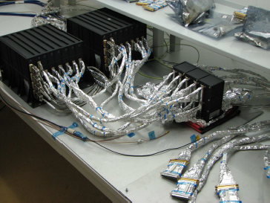
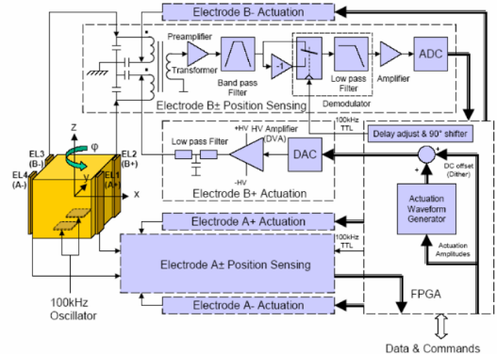
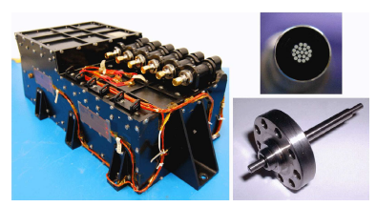

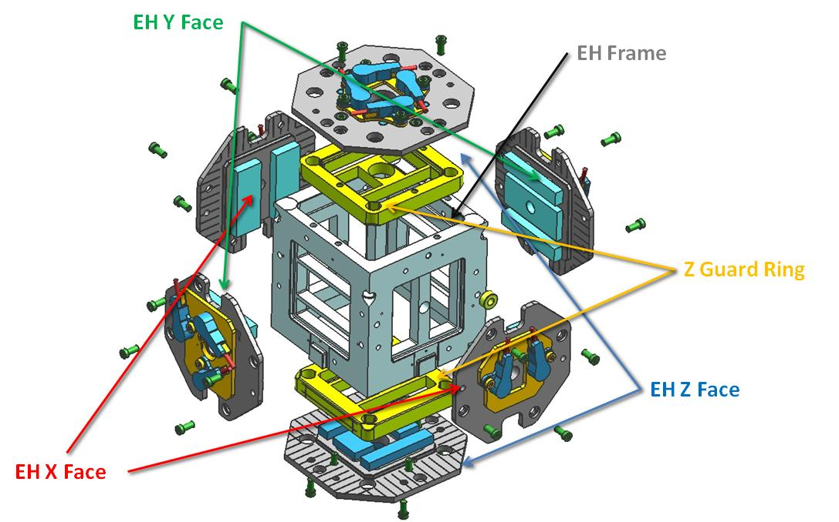

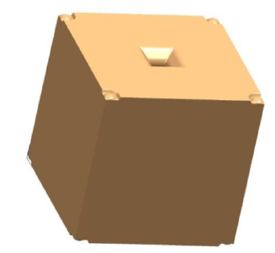
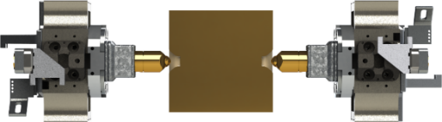
FEE sensing / actuation electronics (ETHZ)
UV charge management device (ICL)
Grabbing positioning release mechanism (GPRM) (RUAG)
Ti vacuum chamber
gravitational balancing
Single-shot launch lock caging / venting (RUAG)

Slide 4
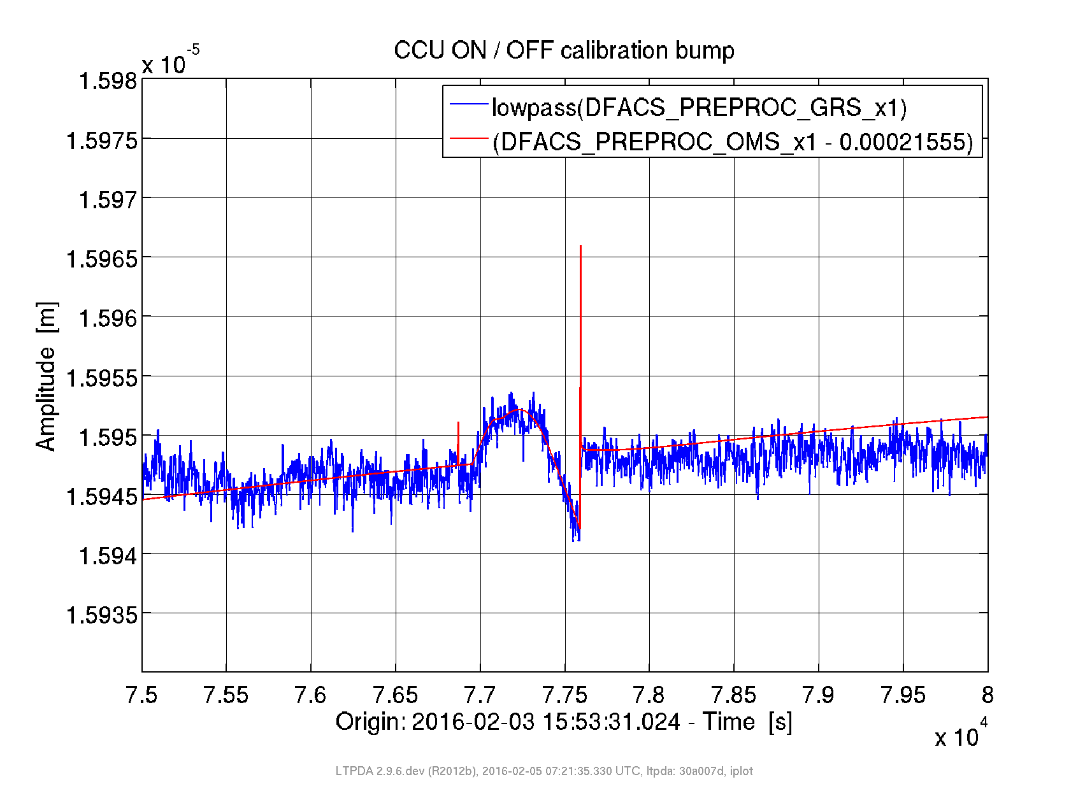
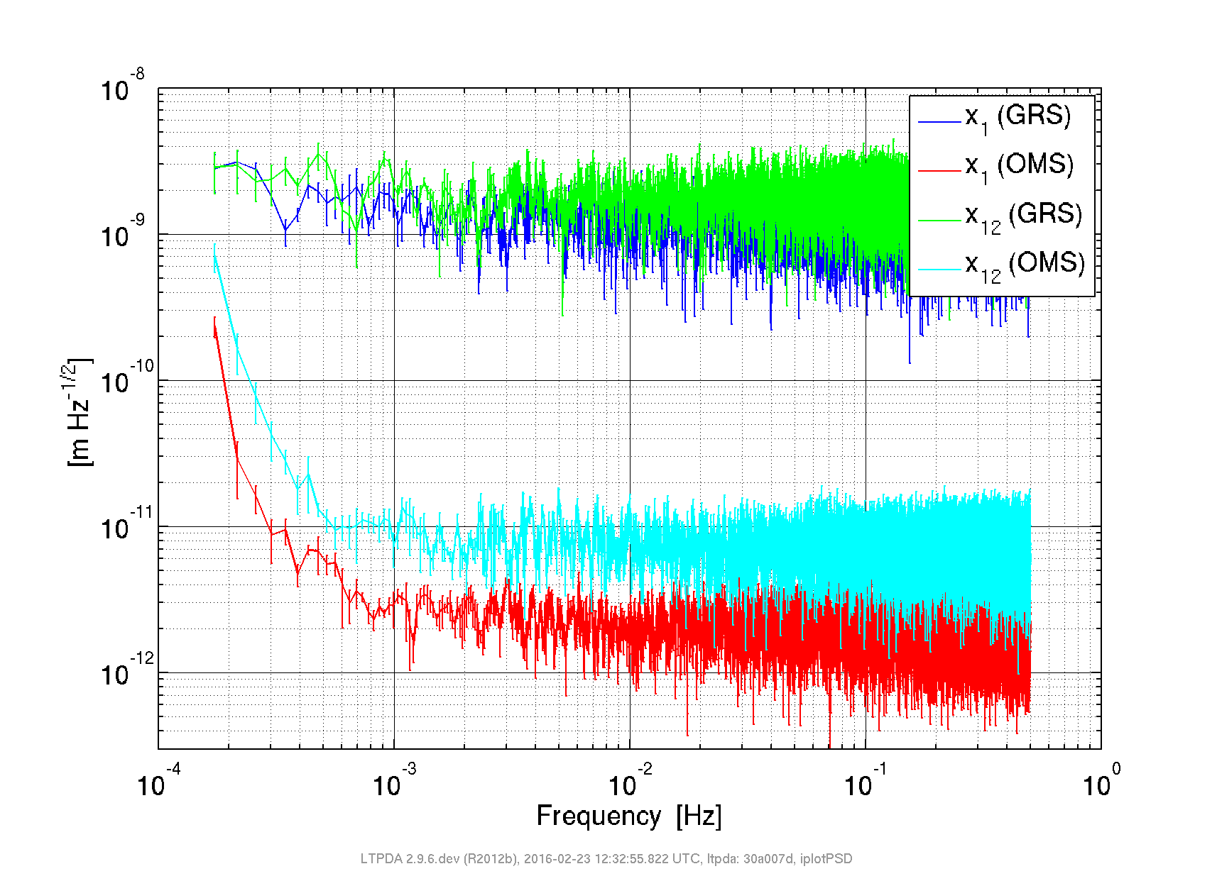
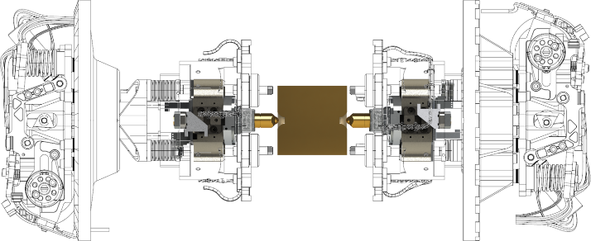
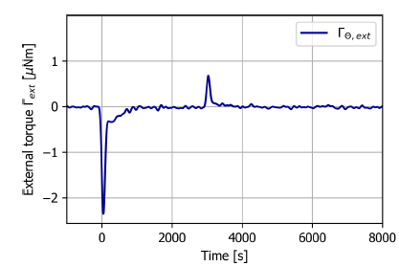
20160203 TM decaging, vent and grabbed TM sensing
See Luigi Ferraioli (ETH) talk for FEE!
IFO
GRS
IFO with 3% contrast!
see Gerhard Heinzel talk
parasitic performance tests “pre-release”
GRS and IFO see the same test mass motion!
GRS nm/Hz^{1/2} sensing with 4 mm gaps works
SC rolls when GRS vents gas to space
  consistent with internal outgassing (not leak)
LPF GRS not designed for TM alignment when caged or grabbed
  same for LISA
  one-shot cage / vent mechanism rebuild for LISA
  provided by ASI
GRS2 decage/vent
GRS1 decage/vent

Slide 5
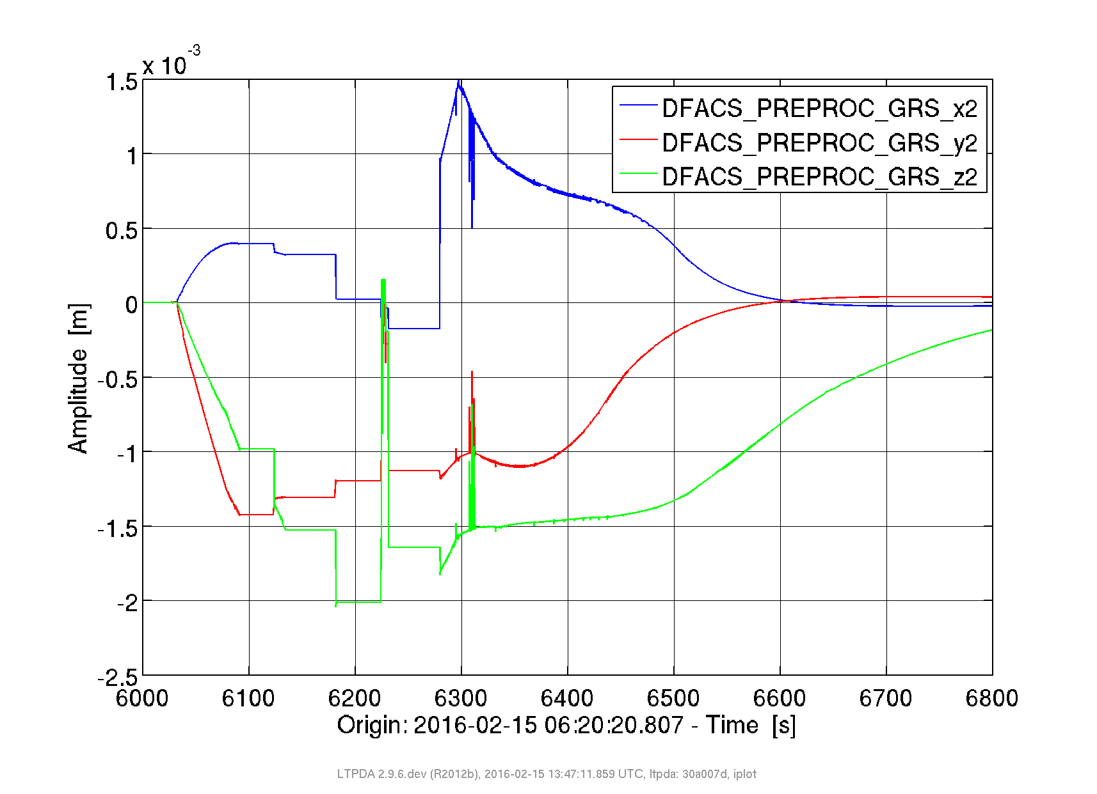
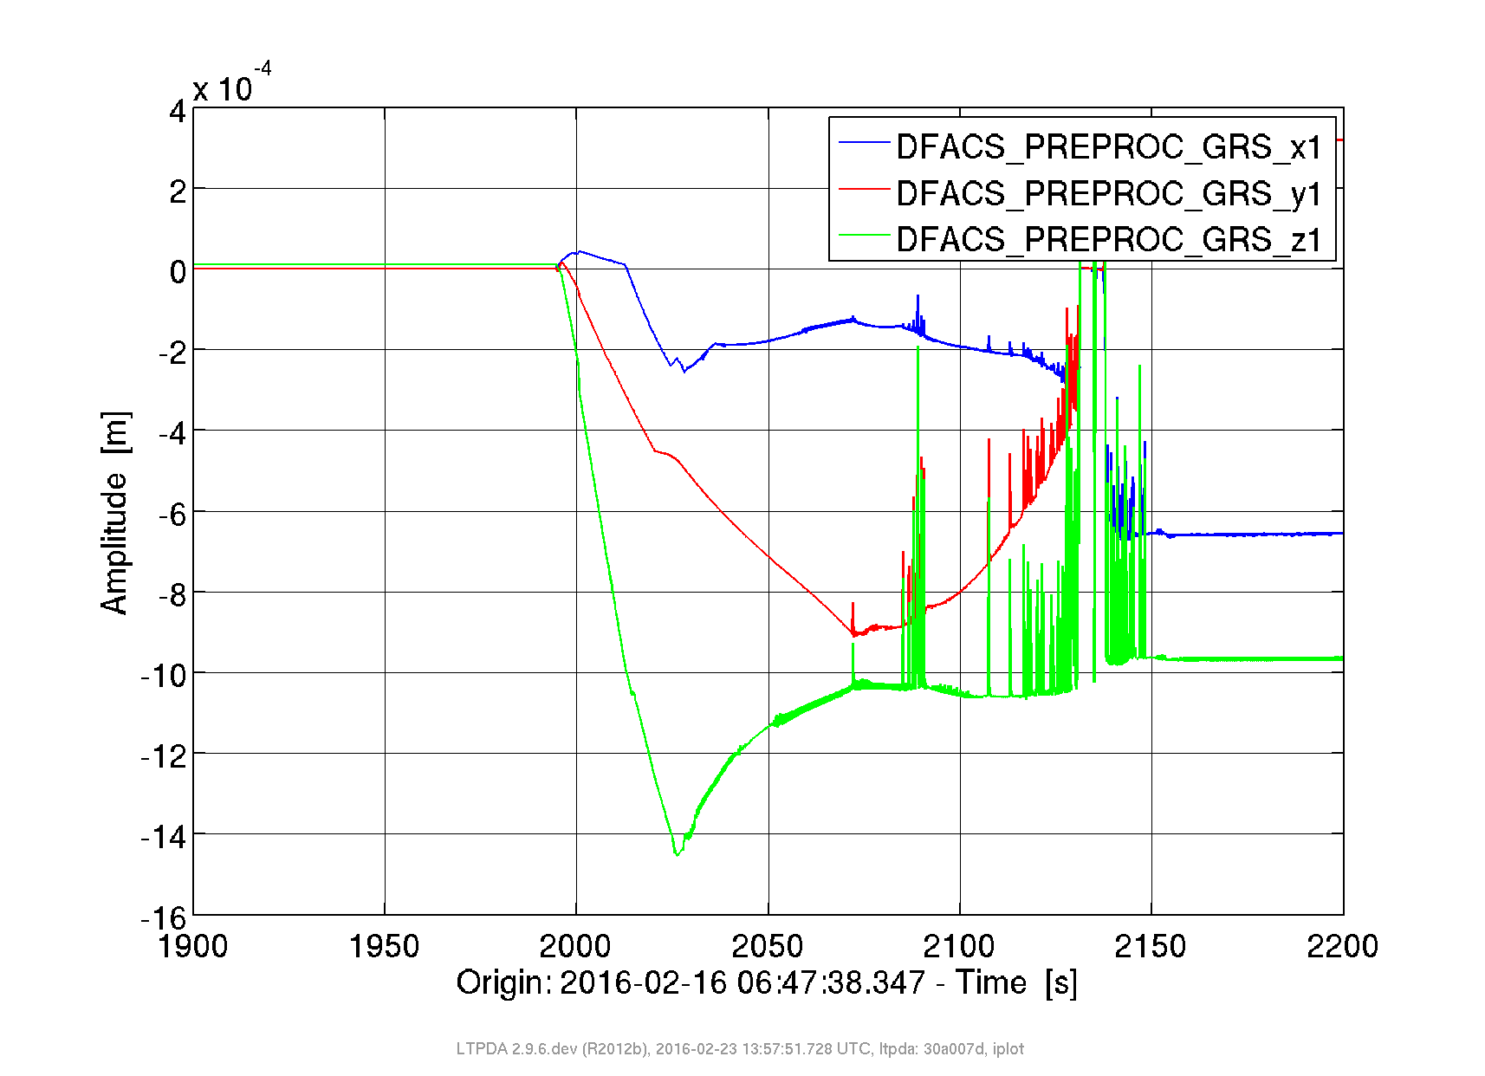
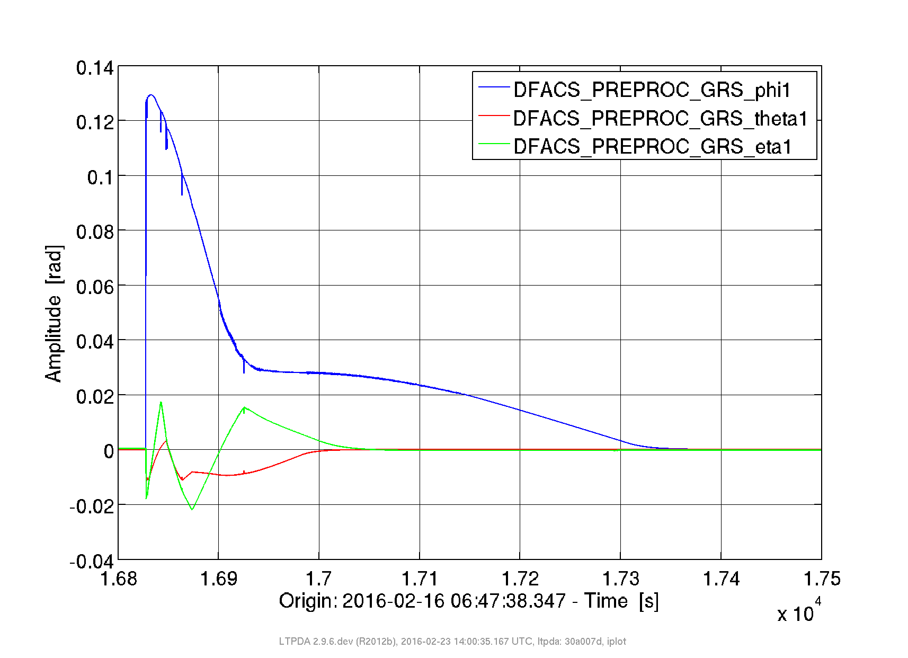
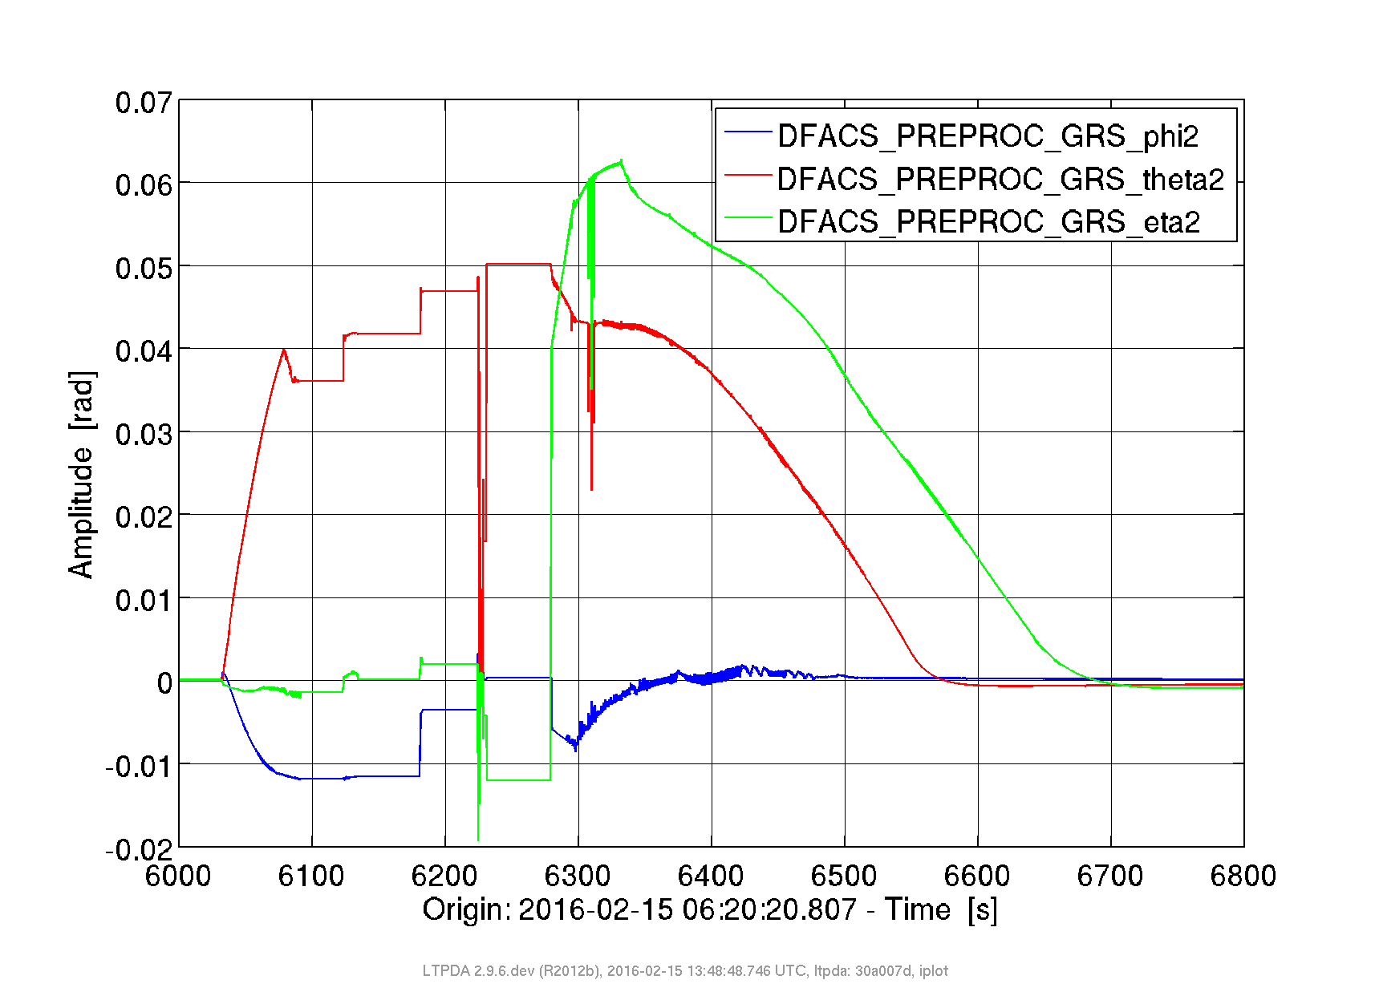
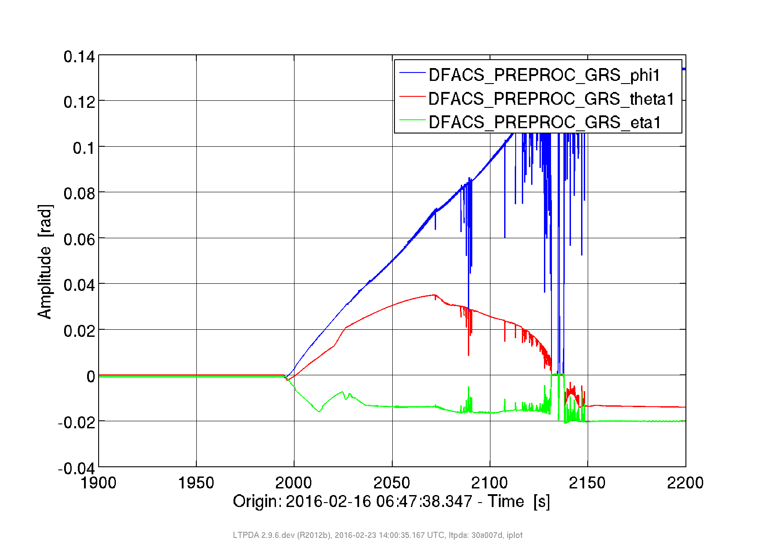
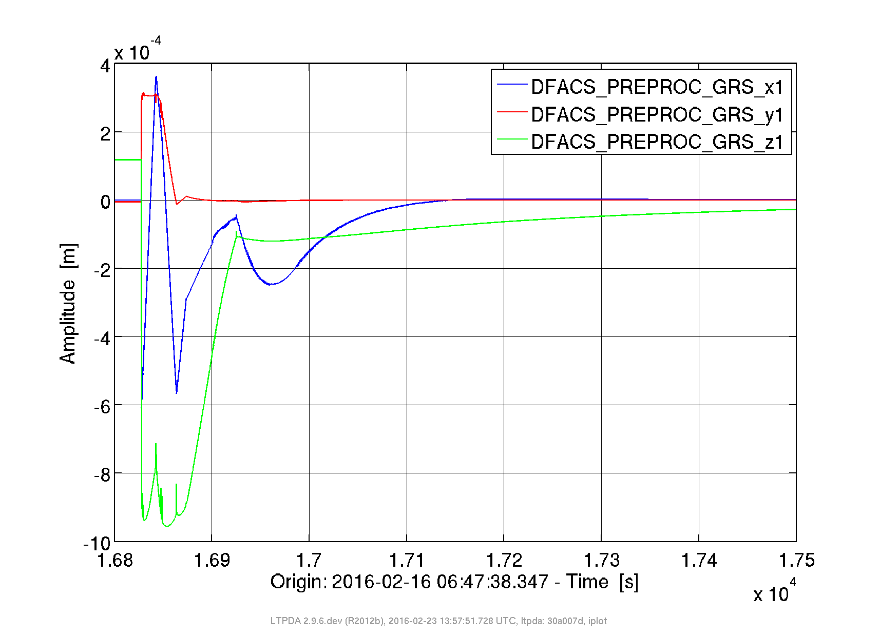
20260215-16: release of TM2 and TM1
TM2 release
TM1 release ... first and second tries
release always “successful” (we released and controlled the TM)
often excess velocities (up to 50 mm/s) and control by bouncing
  extensive end of mission tests (50 TM1, 50 TM2 releases)

Slide 6
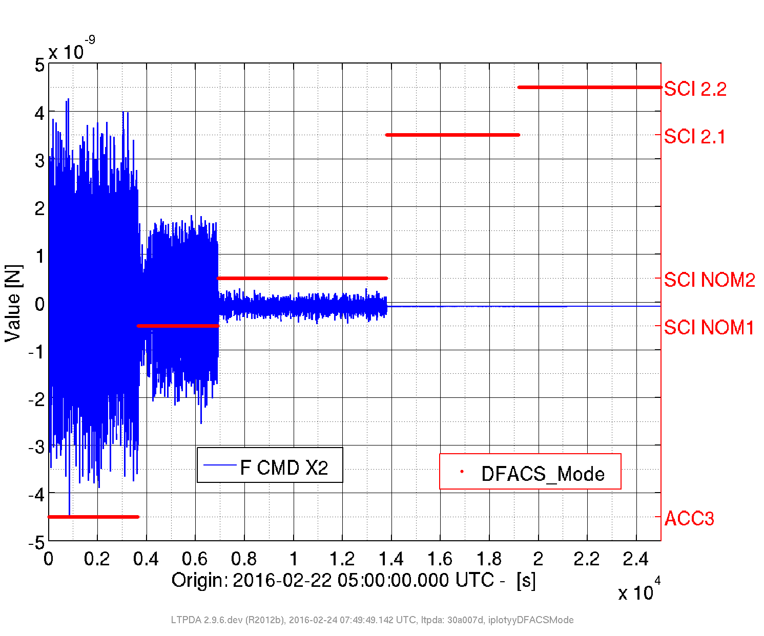
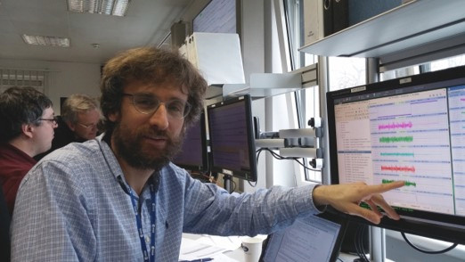
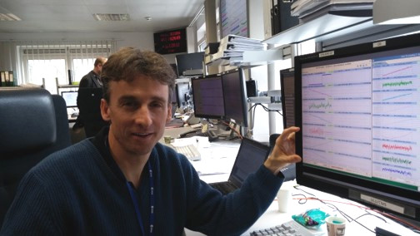
20160222 Start of drag-free control, DC force levels
BW 0.5 mHz
BW 10 mHz
TM1 drag-free
FEE HR
FEE WR
(both TM forced to SC)
Notable improvement from accelerometer mode to drag-free mode

Slide 7
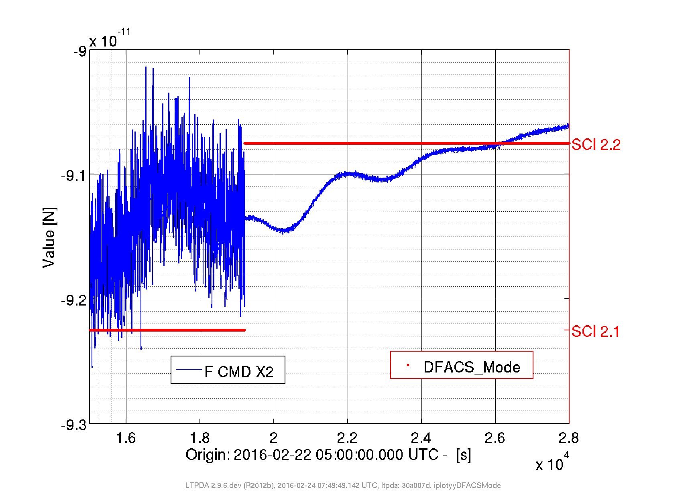
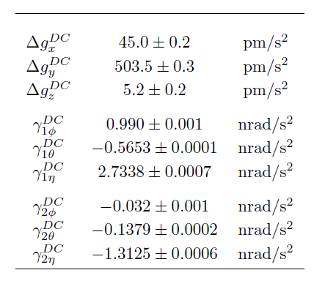
20160222 Start of drag-free control, DC force levels
|F_{X2}| < 100 pN!
Δg_{x} < 50 pm/s² !!!
MAX
ALLOWED
500
1050
1850
8
11.5
13.5
8
11.5
13.5
we’re in drag-free!
all 9 DC force DOF well in specs!
agreement with model even better
  spacecraft gravitational balancing
  GRS gravitational balancing

Slide 8
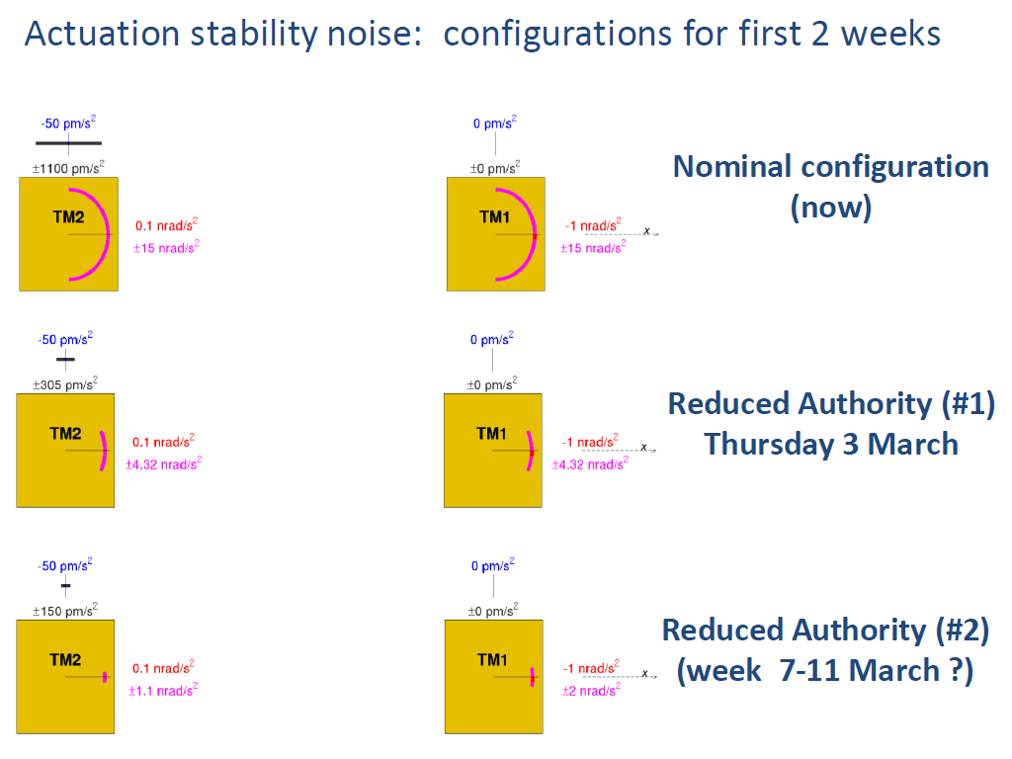
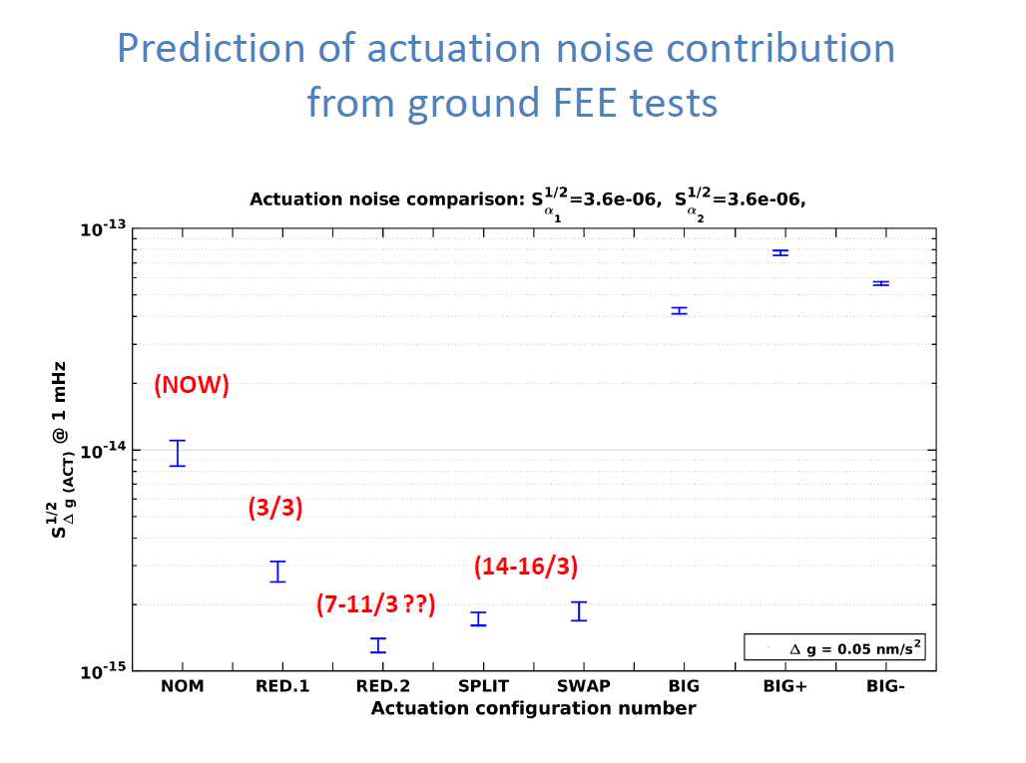
End commissioning, late Feb 2016
lobbying to lower the actuation authorities
our model and ground tests predicted decreasing in Δg noise with lower force / torque authorities
authorities were reduced (by start of science)
slightly different numbers
reduced authorities rebaptized:
  “reduced”
  “ridiculously low authority”
  “ultra ridiculously low authority”
  limiting factor was TM1 φ torque (1 nrad/s²)

Slide 9
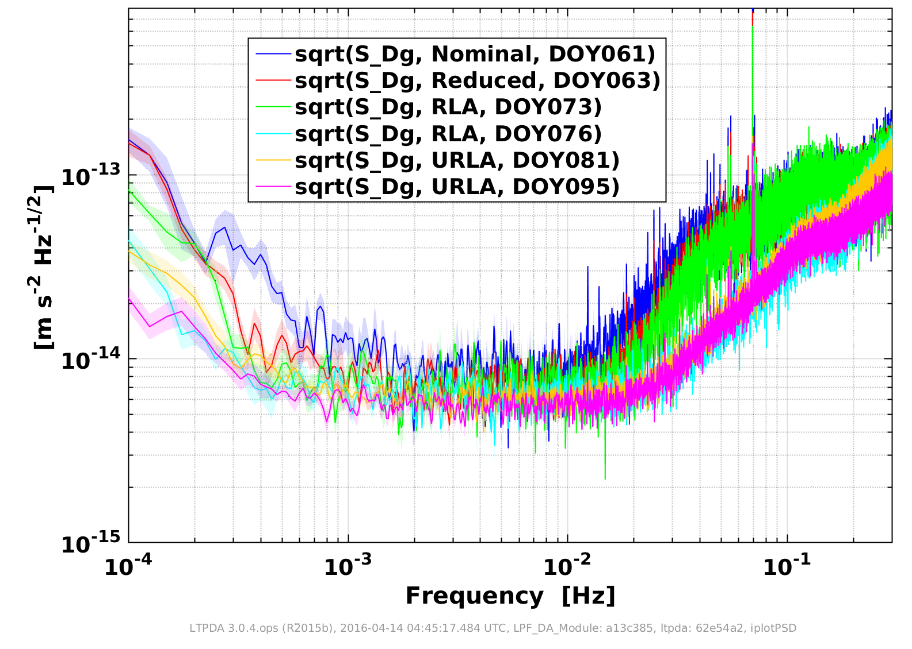
March – April 2016: lowering noise levels (actuation and gas damping)
low frequency improvement with lowering authorities
thanks to gravitational balance (and everything else working...)
several mHz improvement with vent to space
fog slowly burning off ... what is underneath?

Slide 10

A year and a half later ... gas damping brownian noise
the mHz noise – and thus p – are still decreasing
lower T from 295 K to 285 K: cut noise power in half
compatible with water evaporation
“between the glitches” at 0° C ... noise decreases further
all other mHz force noise sources – GRS and otherwise – are small
matching or improving upon LPF residual gas pressure improves LISA instrument sensitivity at several mHz

Slide 11
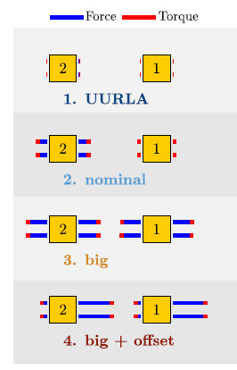
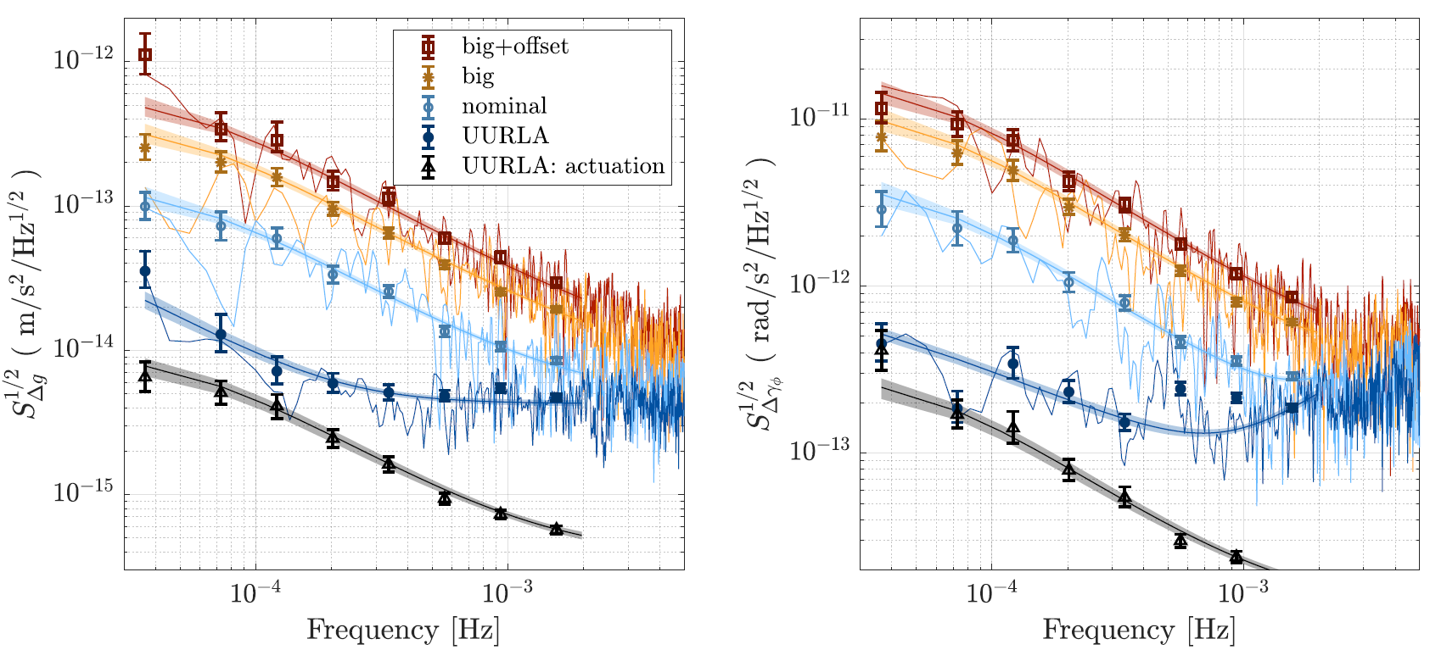
20160516-0525: actuation stability test campaign
analysis Chiavegato thesis
actuation gain model works!
  force noise scales with forces / torques
    limit DC forces and torques (φ) for LISA
  the measured acceleration noise from actuation is as we estimate from applied forces and ground measurements
actuation is the biggest known source of LPF low frequency noise
  it does not however dominate the LPF 0.1 mHz noise floor (20-40% of noise power)
    it would have if the LPF x/φ gravitational balancing had not been so good
    by a factor 50 (power) with “NOMINAL” force authorities

Slide 12
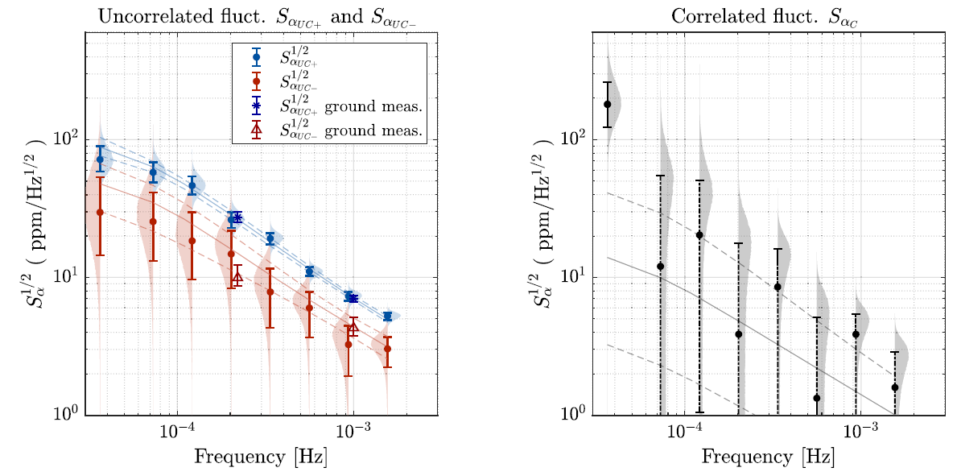
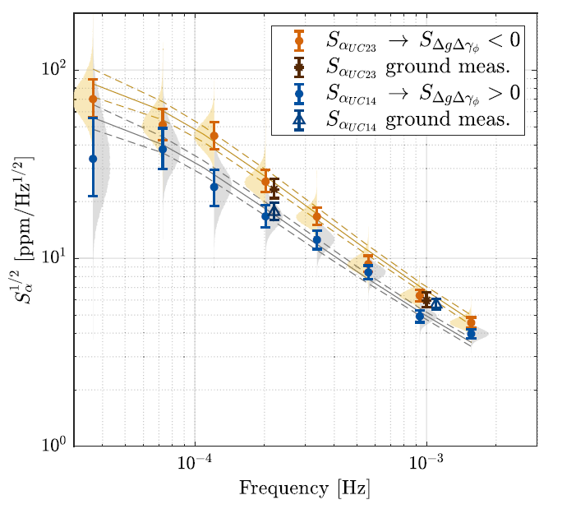
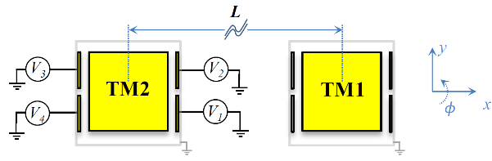
20160516-0525: actuation stability test campaign
actuation noise in-flight consistent with that on ground – electrode by electrode!
  dominated by uncorrelated electrode amp gains (not reference voltage)
+X forcing electrodes statistically noisier than –X electrodes
electrodes 2/3 statistically noisier than electrodes ¼
testing on ground matters:
for LISA test both at FEE level and with torsion pendulum (force noise)

Slide 13
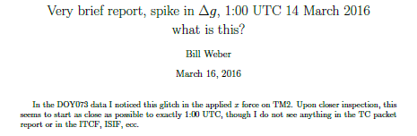
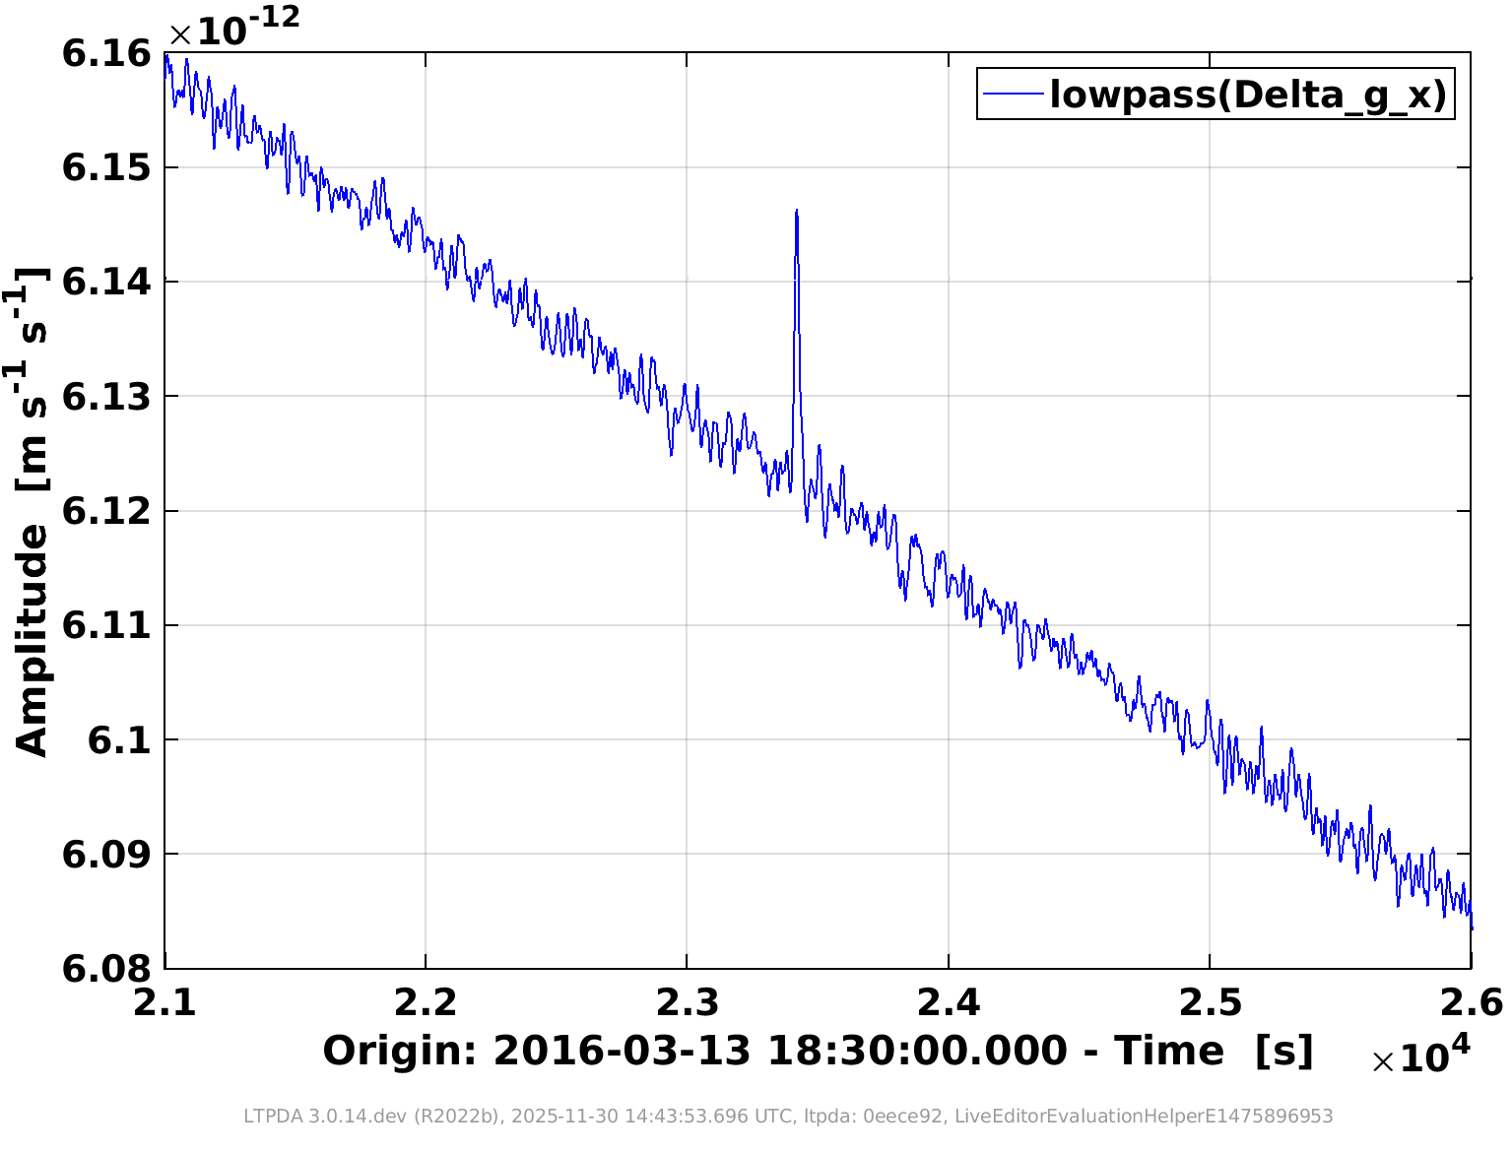

20160314 01:00 ... (my) first glitch
during an early noise run ... in “ridiculously low authority” (RLA)
fast, τ < 20 s
modest impulse, Δv ≈ 0.4 pm/s
a population of force impulse events, of order 1 per day
mostly minutes and order 1 pm/s², mostly positive (towards IFO)
some hours and up to hundreds of pm/s²
not trivial to discriminate from “burst GW events”
see Lorenzo Sala talk

Slide 14
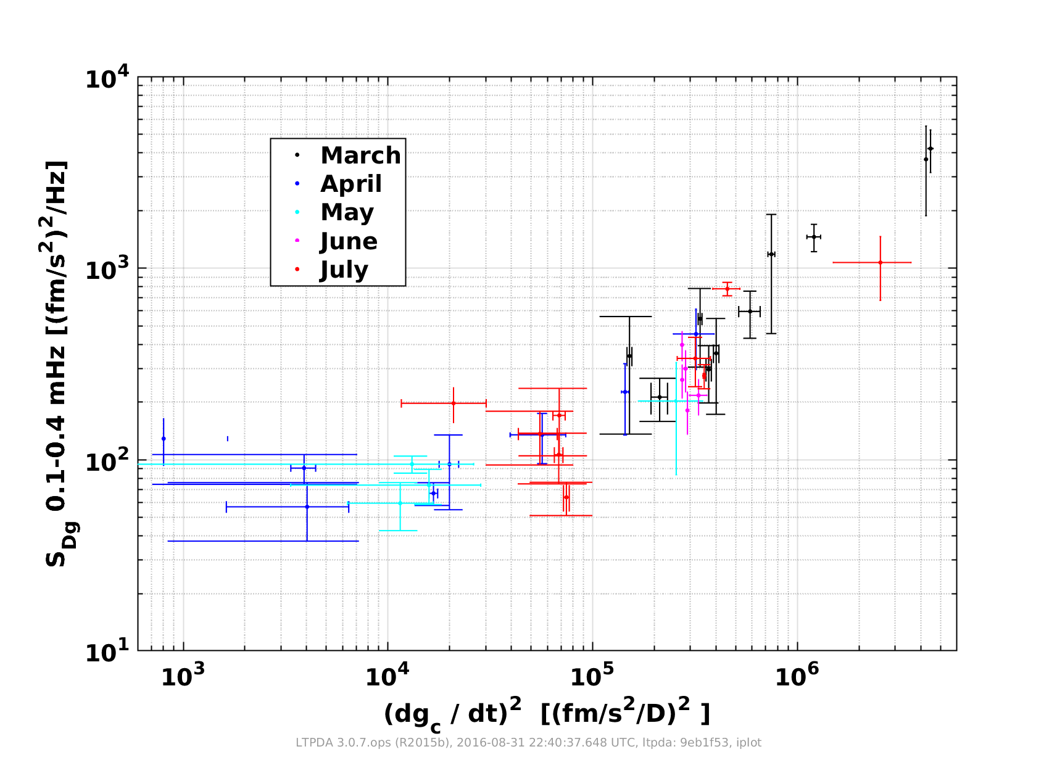
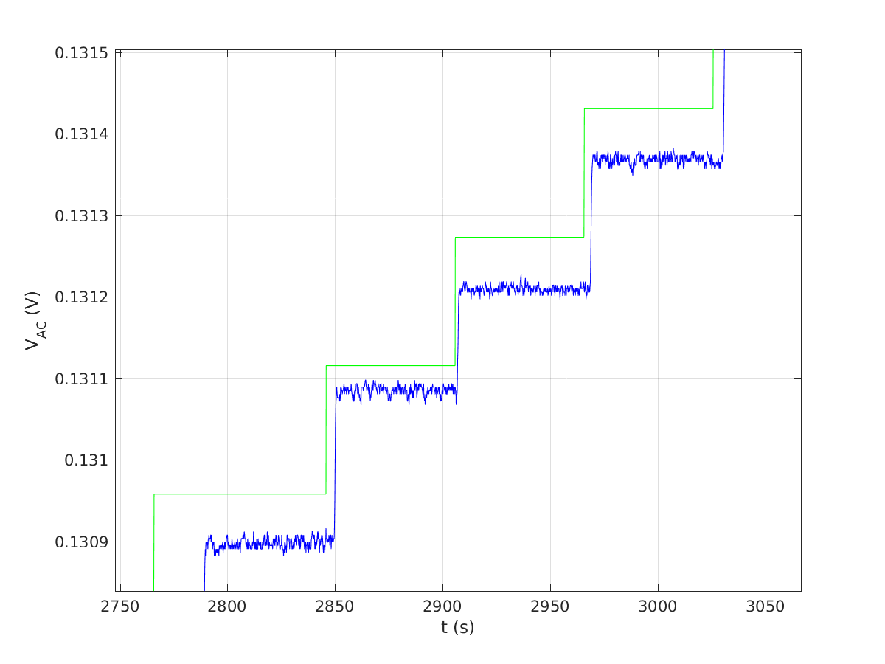
Summer 2016 :
watching the low frequency noise increase ... with dΔg/dt
Lab actuation amp test
LPF FEE “EM-lite”
Actuation amplitude:
not all LSB created equal!
The reason: actuation non-linearities, see Luigi Ferraioli FEE talk!
correctable (in software) for LPF
design LISA FEE to avoid this “roundoff” error
have a ground truth FEE + GRS operative during LISA operations

Slide 15
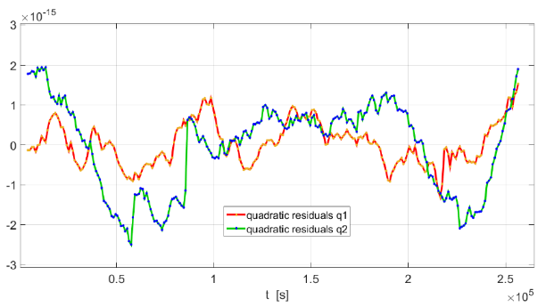
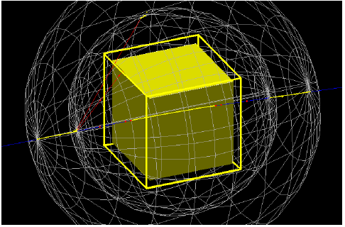
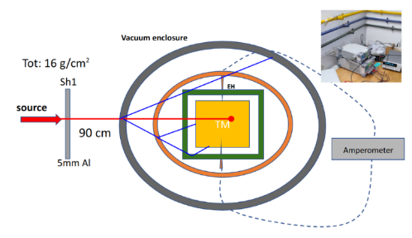
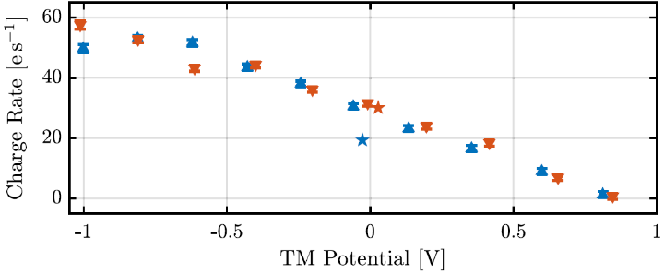
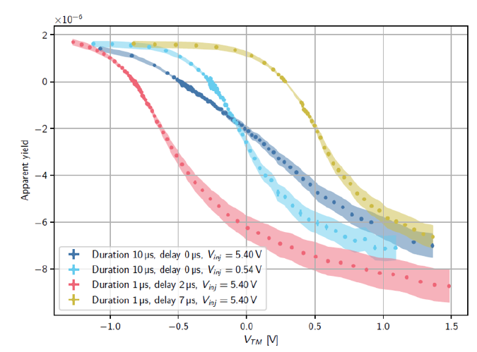
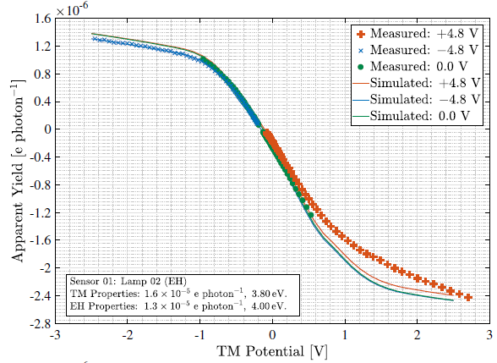
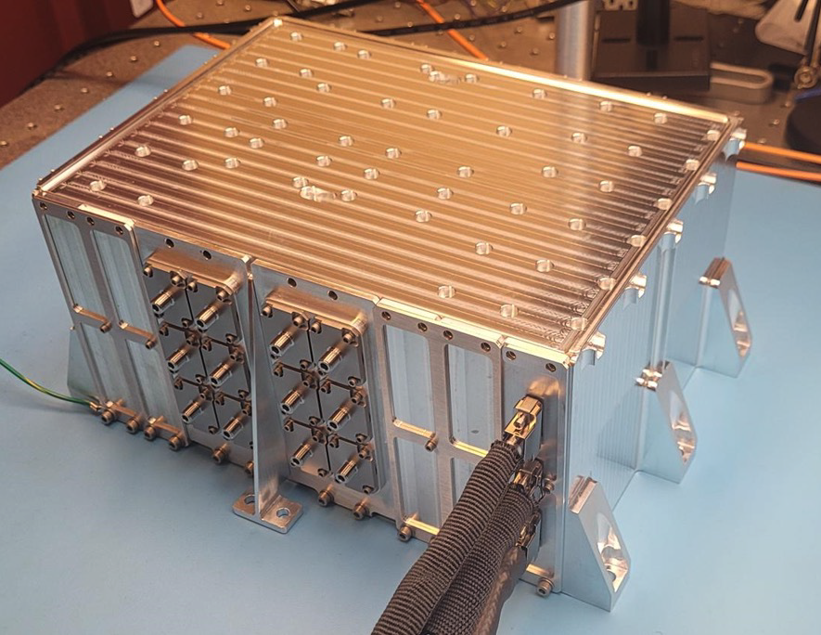
Stray electrostatic forces and mitigation for LISA
LPF cosmic ray charging
ESA “test mass charging toolkit” simulation (OHB/Urbino/UTN)
λ_{EFF} ≈ 1200 e/s
Trento proton beam experiment
LISA pulsed-LED (250 nm) CMD from NASA/UF
Dal Bosco thesis
+/- 0.6 V
254 nm Hg lamp-based CMD
(Imperial College)

Slide 16
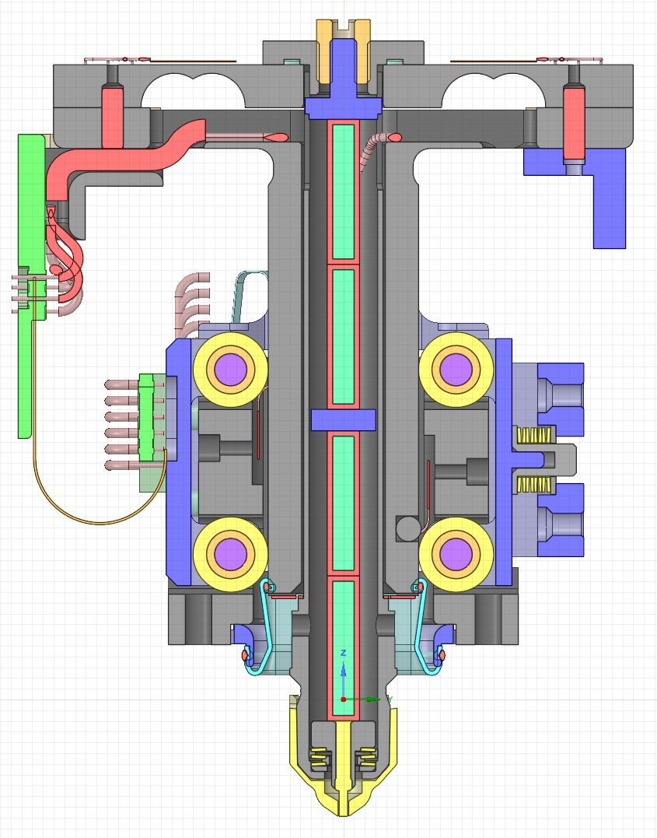
LISA GPRM
LISA requires greater autonomy
6 TM (not 2)
6 minute roundtrip light time (not 10 s)
LPF excess velocities due to “secondary” collisions, lateral motion / misalignments
Optimized Force Sensor 0.5mm
LISA design improvements
two cold redundant piezo stacks, each with 27 μm stroke (up from 16 μm)
improved “roller-roller” guiding
improved force sensing
improved testing for lateral motion
requirements 15 μm/s and 500 μrad/s
DFACS should be ready to handle bounces as contingency
Increased Tip Stroke
Optimized Side-Guiding

Slide 17
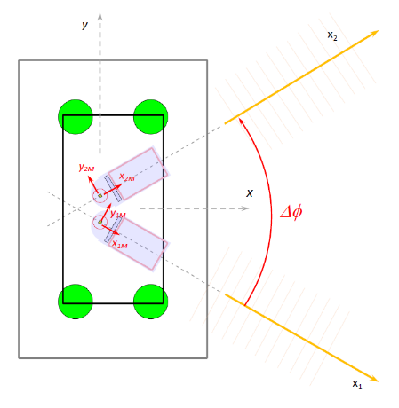
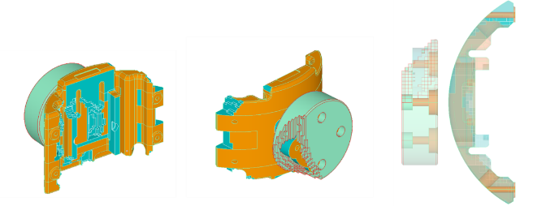
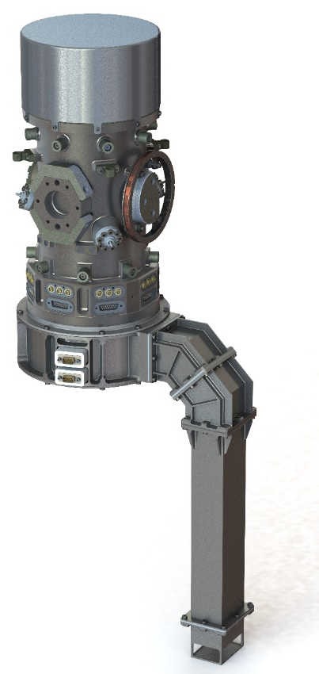
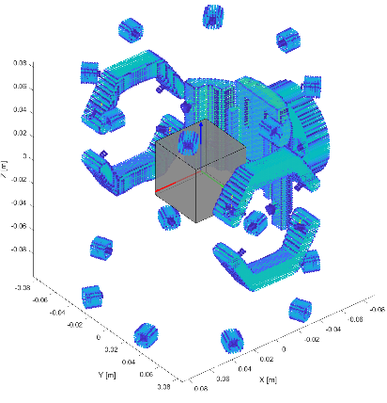
GRS gravitational balancing and DC forces in LISA
LISA DC force requirements
Δg_{x} Δg_{y ,} Δg_{z} < 500 pm/s²
γ_{φ} < 1 nrad/s²
γ_{θ} , γ_{η} < 3 nrad/s²
Additional requirements on SC “common mode” and MOSA DC forces
GRS gravitational balance authority request
35 nm/s²
limited / zero on y, z
GRS residual error allocations < 100 pm/s²
LPF-like IBM
LISA EBM-x (10 nm/s2)
LISA EBM-y envelope

Slide 18
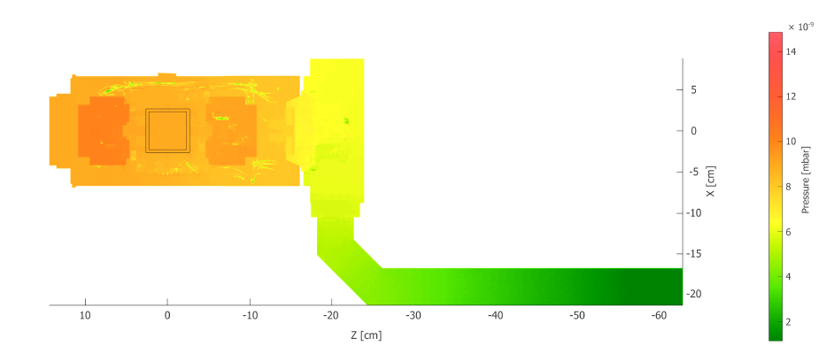
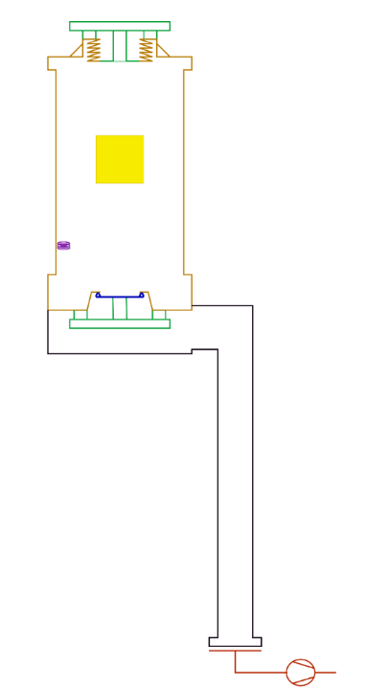



LISA GRS vacuum system and strategies
Requirement 2 μPa from day 1 science ops:
similar to LPF end of operations
hermetic vent duct with ground vac IF
pumped on ground, up to 2 weeks pre-launch
drastic reduction in water permeation
larger conductance to space
40 L/s for water (up from 20 L/s)
better modelling and sample testing
200 g of plastic inside GRS VC
early, better system level testing
direct VC, VD outgassing measurements
refine bakeout (coupled with discharge test)
long term storage monitoring (Pirani in VC)

Slide 19


No smoking gun for glitches ... strongest candidate is population of “gas burst” event
entering through EH holes, mostly towards IFO – away from IBM – and no torque
Can we test the “gas burst” hypothesis for glitches?
Could we improve the flow paths to limit forces on TM?
typical glitch of order 10¹¹ molecules, peak flow of 10⁻¹¹ mBar L/s – for glitch coming from IBM cavity
total outgassing from GRS order 10⁻⁷ mBar L/s
but most material in GRS does not make glitches
can we detect with pressure gauge / outgas test?
Currently under molecular flow (MOLFLOW) analysis ...

Slide 20






Summary: experimental situation for free-falling TM in LISA
UTN ground test upper limit
LPF result
LPF noise model
LISA requirement
LISA Pathfinder left us with a detailed, experimentally anchored force noise budget
  but it doesn’t explain everything
  we can’t test to LISA limit on ground
  but we can mitigate key risks (we think)
next 2-3 years critical for testing and consolidating GRS on ground

Slide 21
Thank you!

Slide 22


Vacuum system in proposed baseline GRS
vent valve
(Viton seal)
leak
permeation (water)
GRS VC
baked / tested / sealed
input from leak and water perm. from VD
conductance to space (25 L/s, 9 L/s from EH)
location of outgassing “felt” by TM
  F_{x} not just p
risk of contamination TM surfaces
GRS VD
most of storage time in vacuum
  new for LISA (ground vac IF)
limited time exposure in system AIT and just before launch
  reabsorb water
higher (2x) conductance to space
little sensitivity of F_{x} to outgas

Slide 23


Pressure allocation strategy with baseline CVM design
Baseline
(CVM)

Slide 24





GRS product breakdown
GRS head
46 mm Au/Pt TM
heavy 1.92 kg
Au coated
Ti vacuum chamber
vented to space
  through viton-seal vent valve and vent duct
gravitational balance masses
optical window for TM IFO
conductive (Au-coated Mo) shield
contact-free capacitive sensor and electrostatic actuator
Au-coated, bulk Mo electrodes (injection / sensing) with sapphire spacers
“big gaps” (4 mm x)

Slide 25


GRS product breakdown
GRS mechanisms and controller
Multi-use “grabbing positioning release” mechanism (GPRM)
for TM operations in flight, typical loads 1 N
must release with < 15 μm/s velocities
Single shot “caging venting mechanism” (CVM)
simultaneous release of 1.2 kN launch lock and open of vent valve

Slide 26


GRS product breakdown
6DOF sensing and actuation electronics (FEE)
“gap sensing” at aF/Hz^{1/2} level with AC 98304 Hz resonant capacitive / inductive bridge with homodyne detection
audio frequency-based force actuation for low freq TM control
  HR “science mode” (14 V → nN level forces, 200 μm range)
  WR “accelerometer mode” (160 V → μN forces, several mm range)
LPF heritage
new ASI contributions inside the FEE

Slide 27
GRS product breakdown
Charge management device
ULU UV light source for TM discharge
UV LED (peak at 250 nm)
  fast (98304 Hz) pulsed illumination
    sync to injection field to optimize discharge
    makes discharge (and continuous discharge) robust / tunable against surface variations
  DC illumination possible (LPF fallback)
FOH fiber harness

