Slide 1
The Legacy of LISA Pathfinder: Panel Discussion

Slide 2
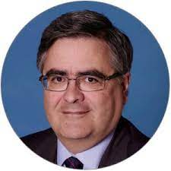
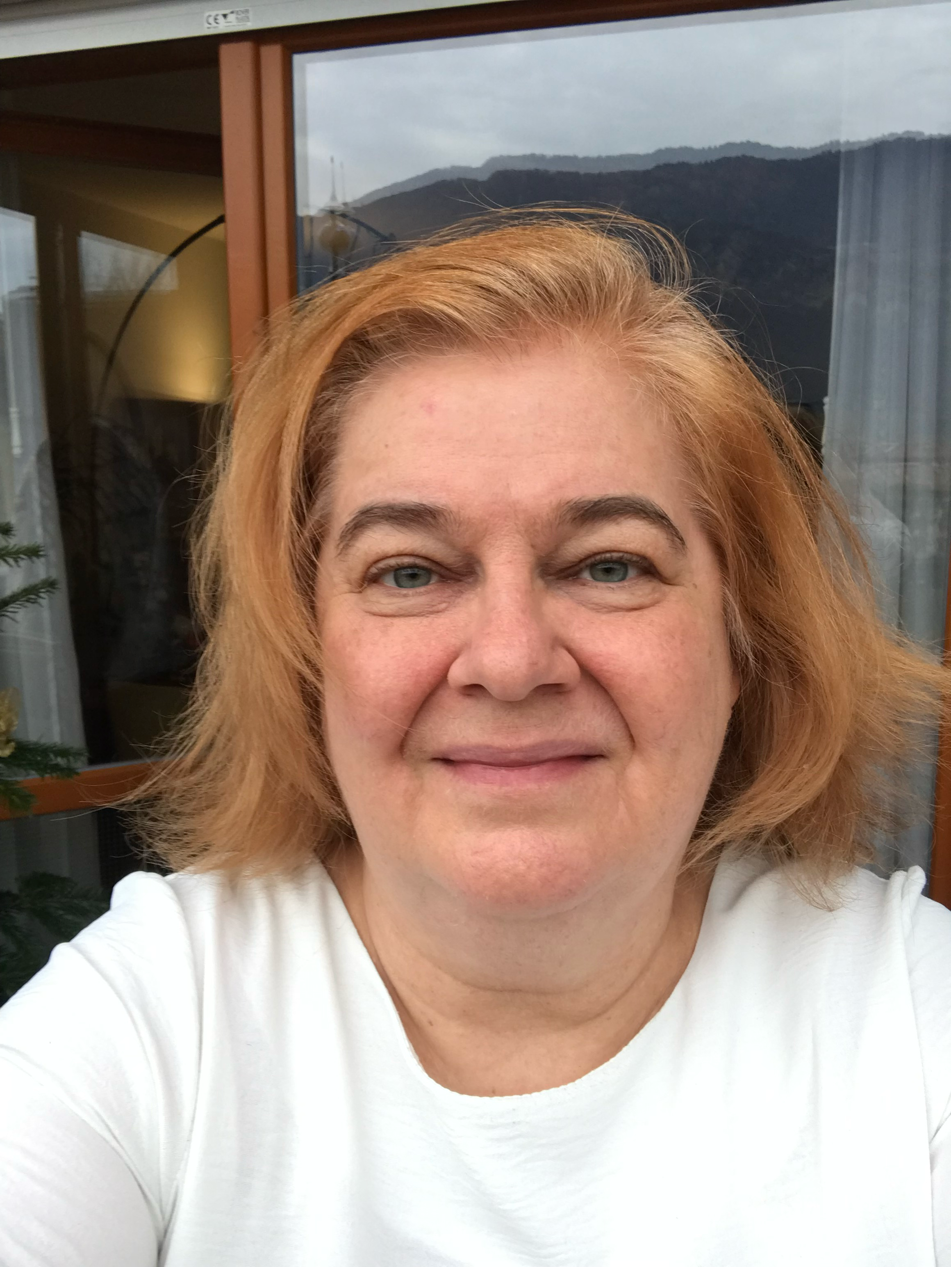
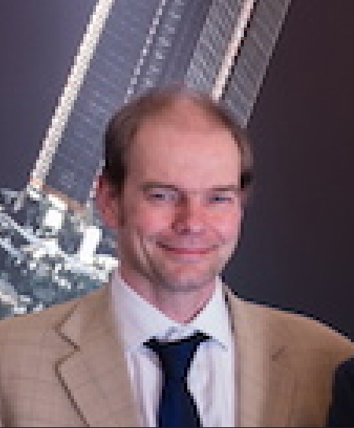
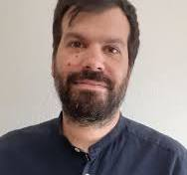
Panelists
Alvaro Gimenez
CSIC/Spanish Space Agency
Rita Dolesi
University of Trento
Christian Trenkel
Airbus
Nikos Karnesis
University of Thessaloniki

Slide 3
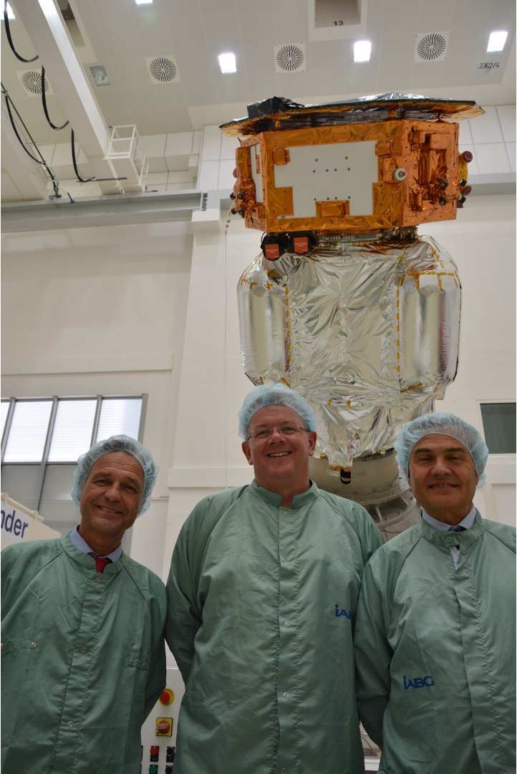
Paul McNamara
I joined the LISA team in 1994 when I started my PhD at the University of Glasgow
After my PhD I continued at Glasgow working on LISA and also GEO600
After a stint in industry, I moved to the US to join the NASA GSFC LISA Team in 2002
I returned to Europe in 2005 to join ESA as the LISA Pathfinder Project Scientist
After LISA Pathfinder, I became the LISA Project Scientist in 2017
In 2020, I decided to take a different position in ESA when I became the Astronomy and Astrophysics Coordinator

Slide 4
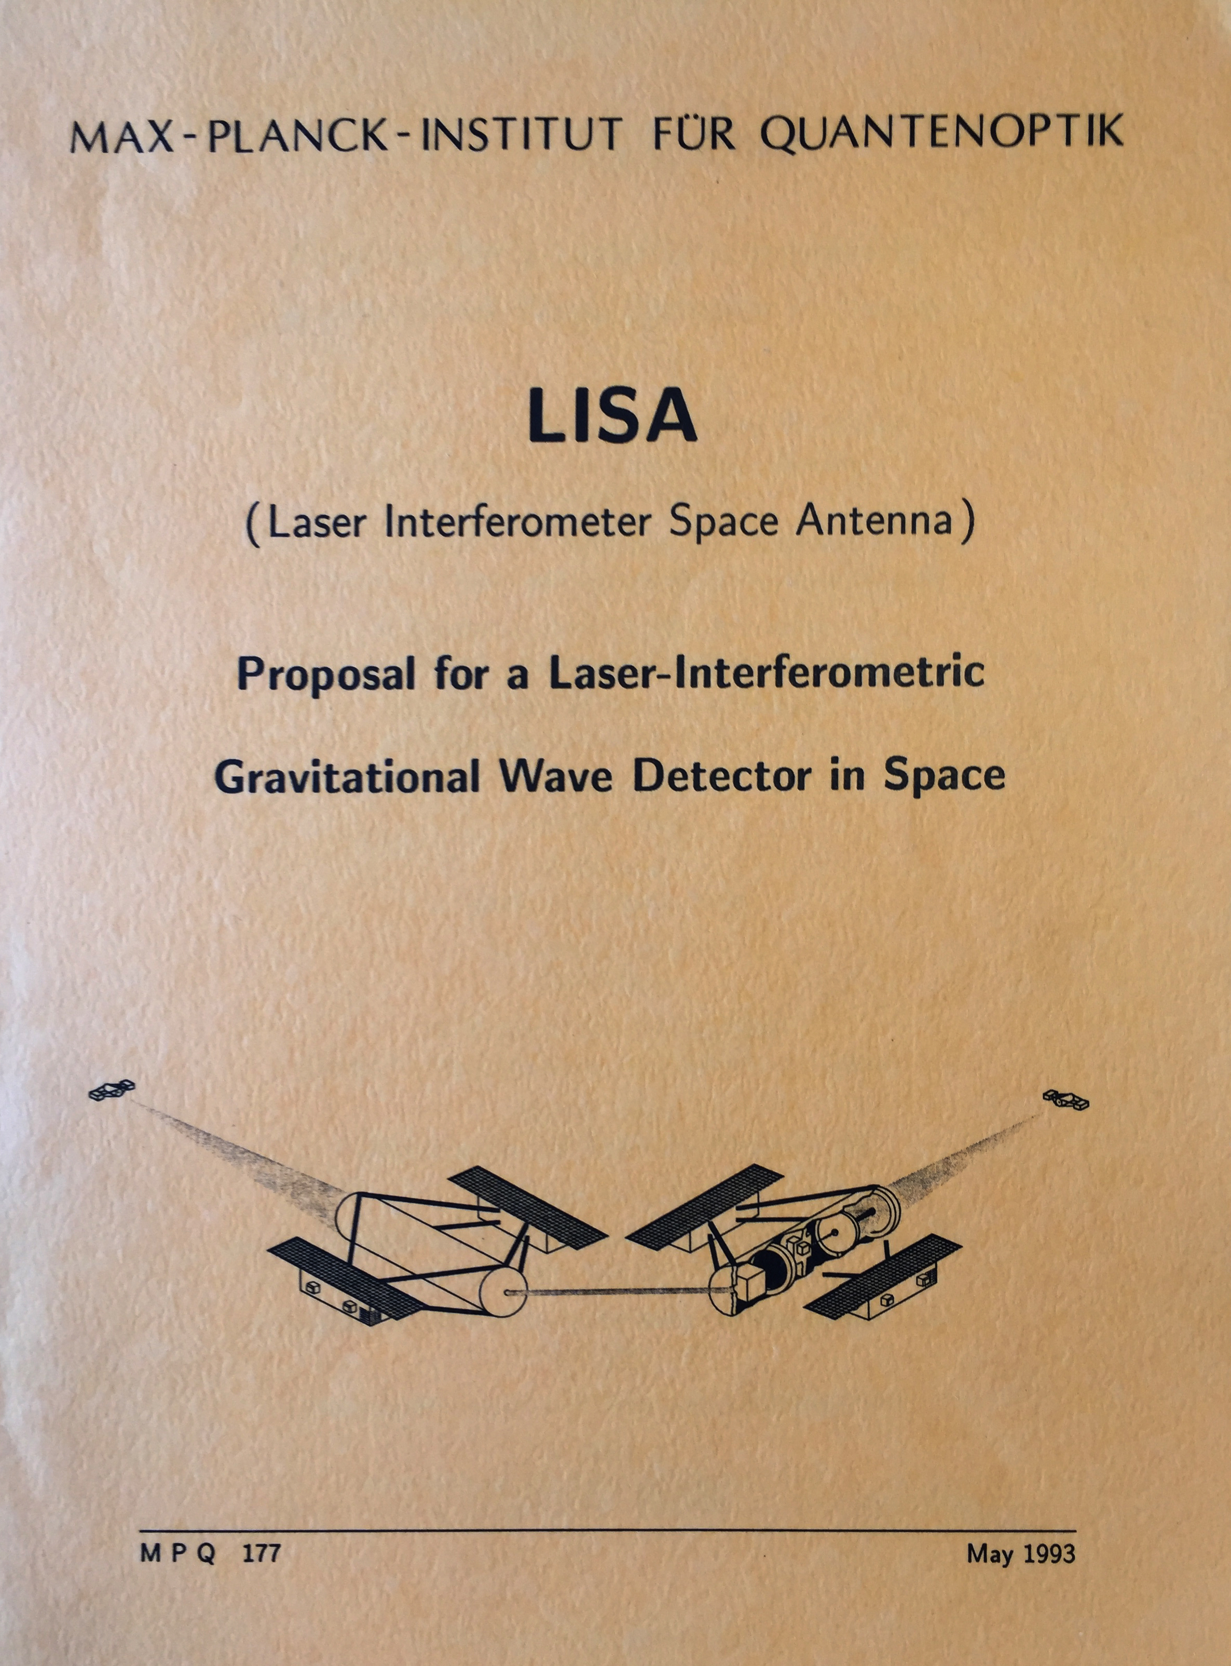
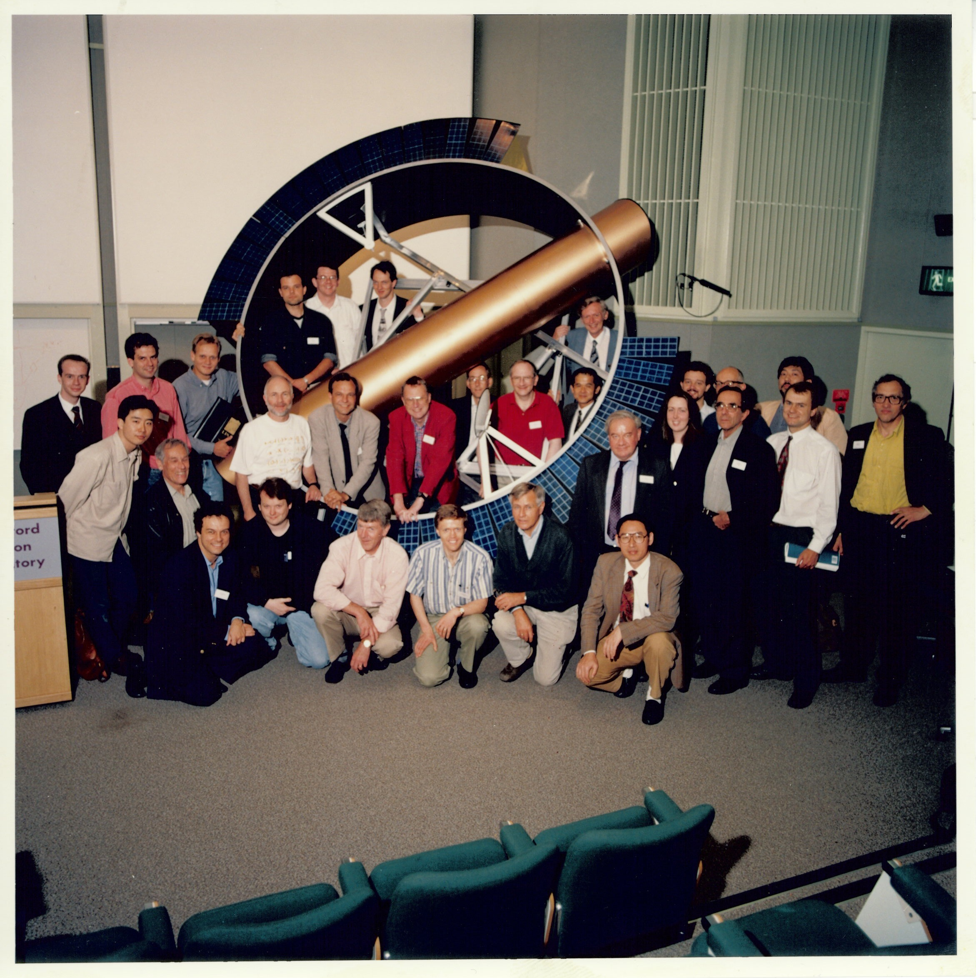
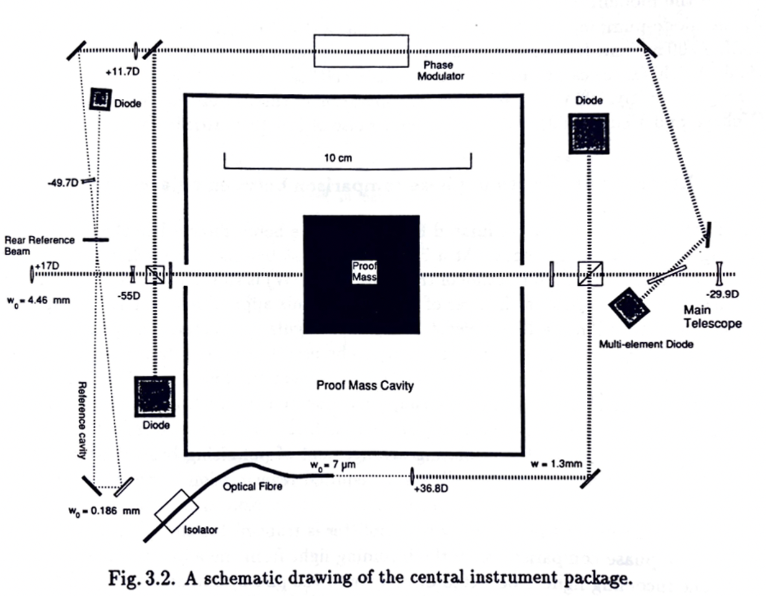
LISA and LISA Pathfinder in ESA
First discussions of a spaceborne GW observatory, called LISA, in 1992, and proposed it to ESA in 1993 as a 4 s/c Medium class mission (M3) in the Horizons 2000 programme
Re-proposed as a 6 s/c mission in 1993 to the Horizons 2000+ call
  LISA was selected as the 4th Cornerstone
  mission in 1995
  Cost cap: 700M AU (accounting units)
  Launch: 2017
ESA/NASA LISA consisting of 3 s/c first appears in
1997
Now proposed as an F-mission (Flexi)
Launch: 2011
  First LISA Phase A by Dornier Aerospace/Astrium
  (now Airbus) in late 1990s
1st International LISA Symposium
Rutherford Appleton Laboratory
1996

Slide 5
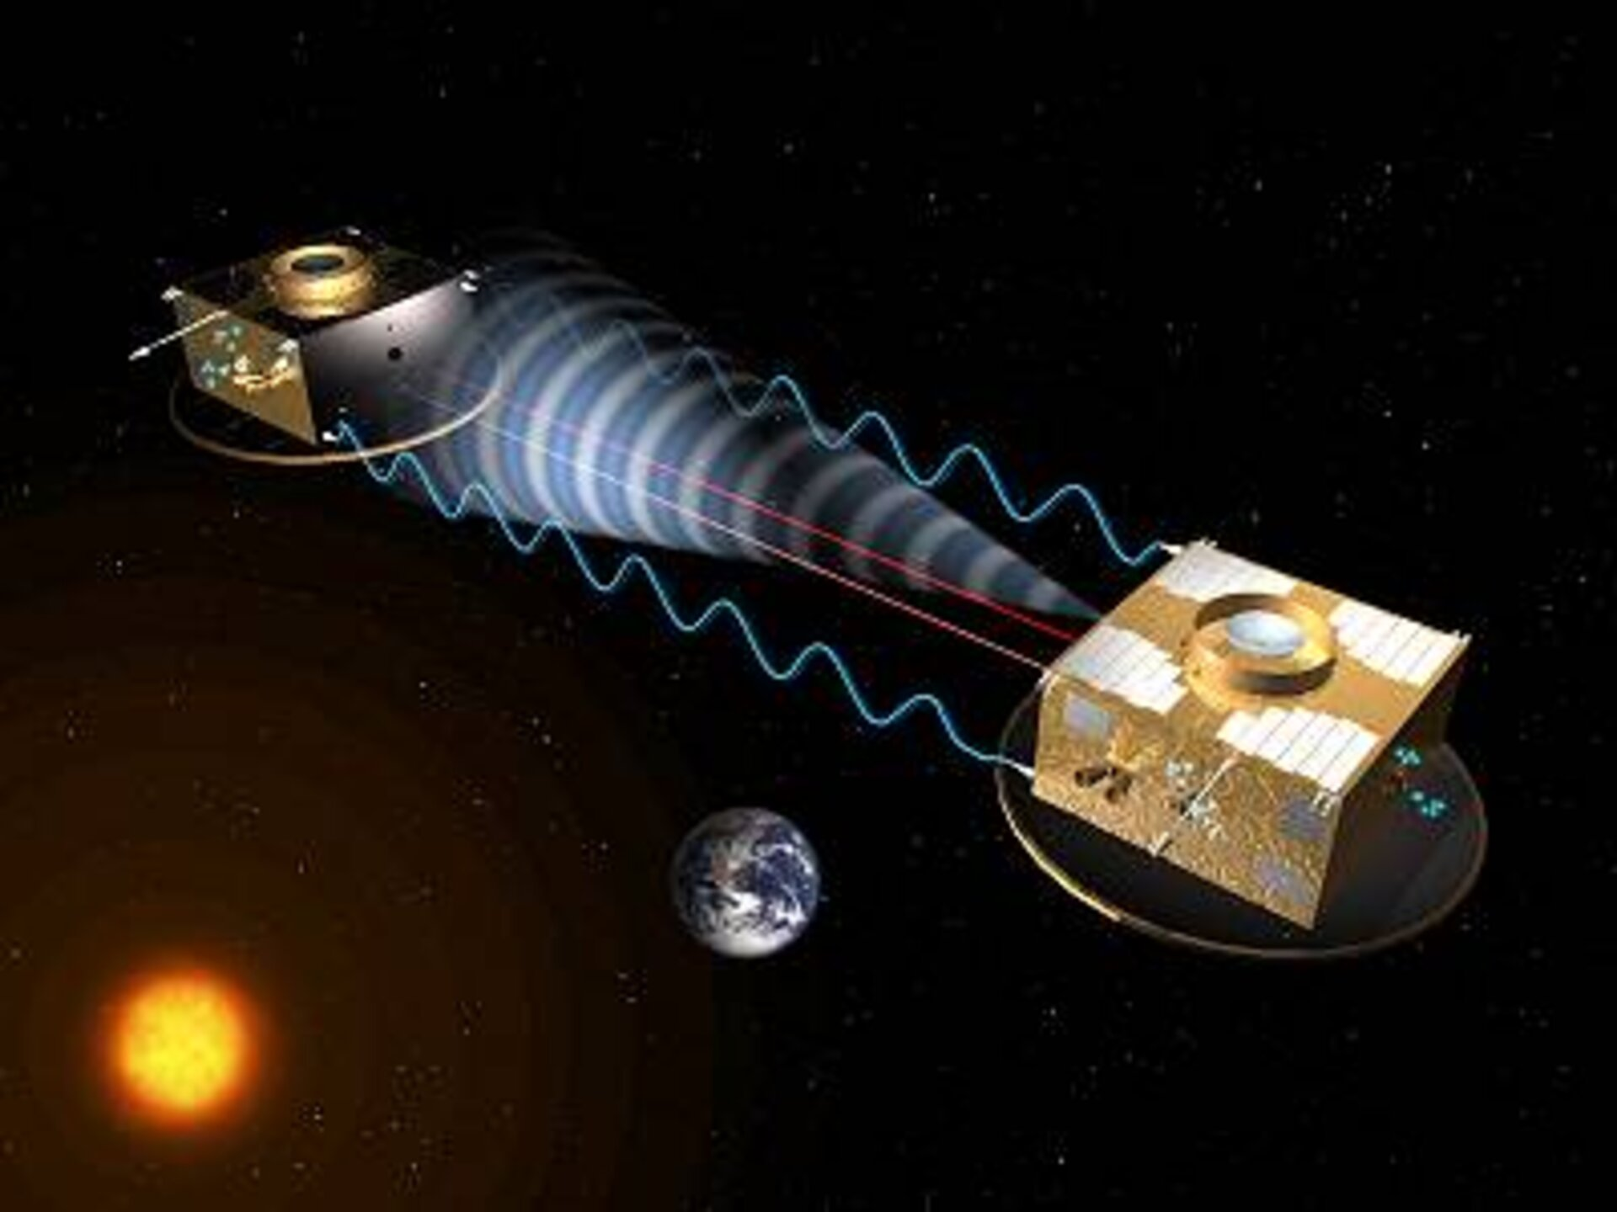
LISA Pathfinder
LISA has been in the ESA system since the mid-1990s
  ESA management recognised the importance of the mission
However, there were serious doubts whether gravitational waves could ever be observed, let alone being able to build an instrument to do it from space
So ESA took a risk…this led to LISA Pathfinder
SMART-2 (Small Mission to Advance Research and Technology) was approved by the SPC in November 2000
  SMART-2 consisted of 2 spacecraft, and was designed to test:
    Drag-free technology (LISA Technology Package (LTP))
    Formation flying (IRSI-Darwin technology)
After initial studies, the formation flying demonstrator was dropped, and SMART-2
became LISA Pathfinder
LISA Pathfinder was adopted by the SPC in 2004

Slide 6
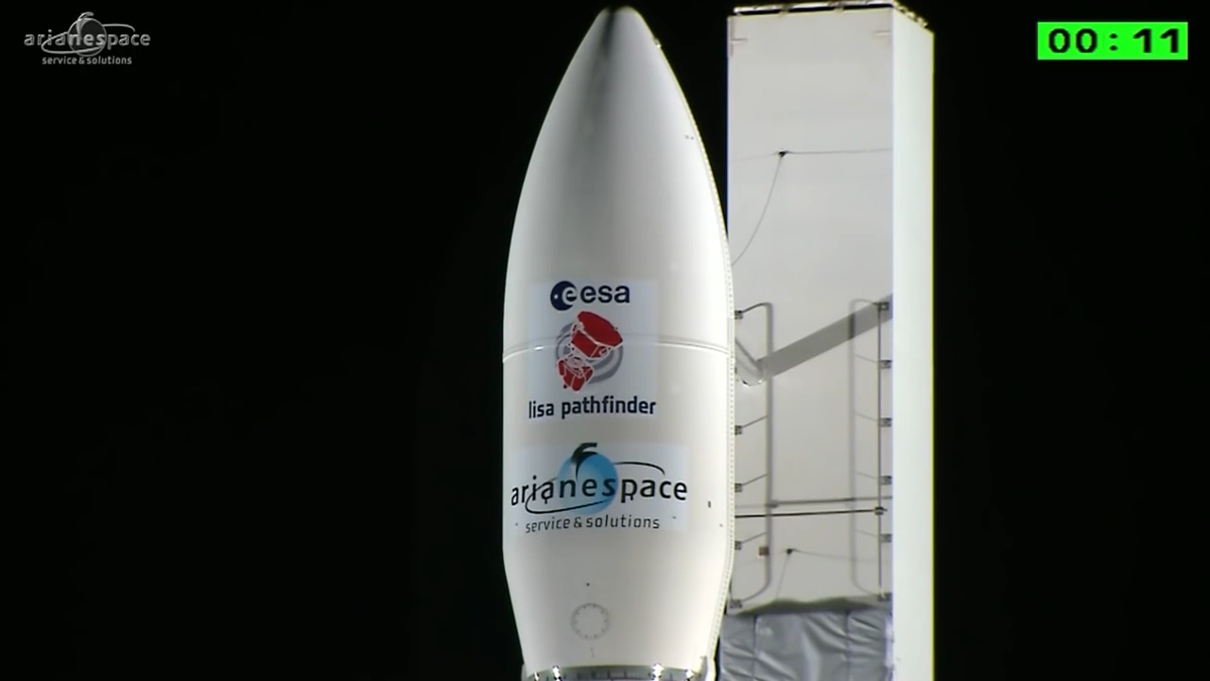
The rest is history…

Slide 7
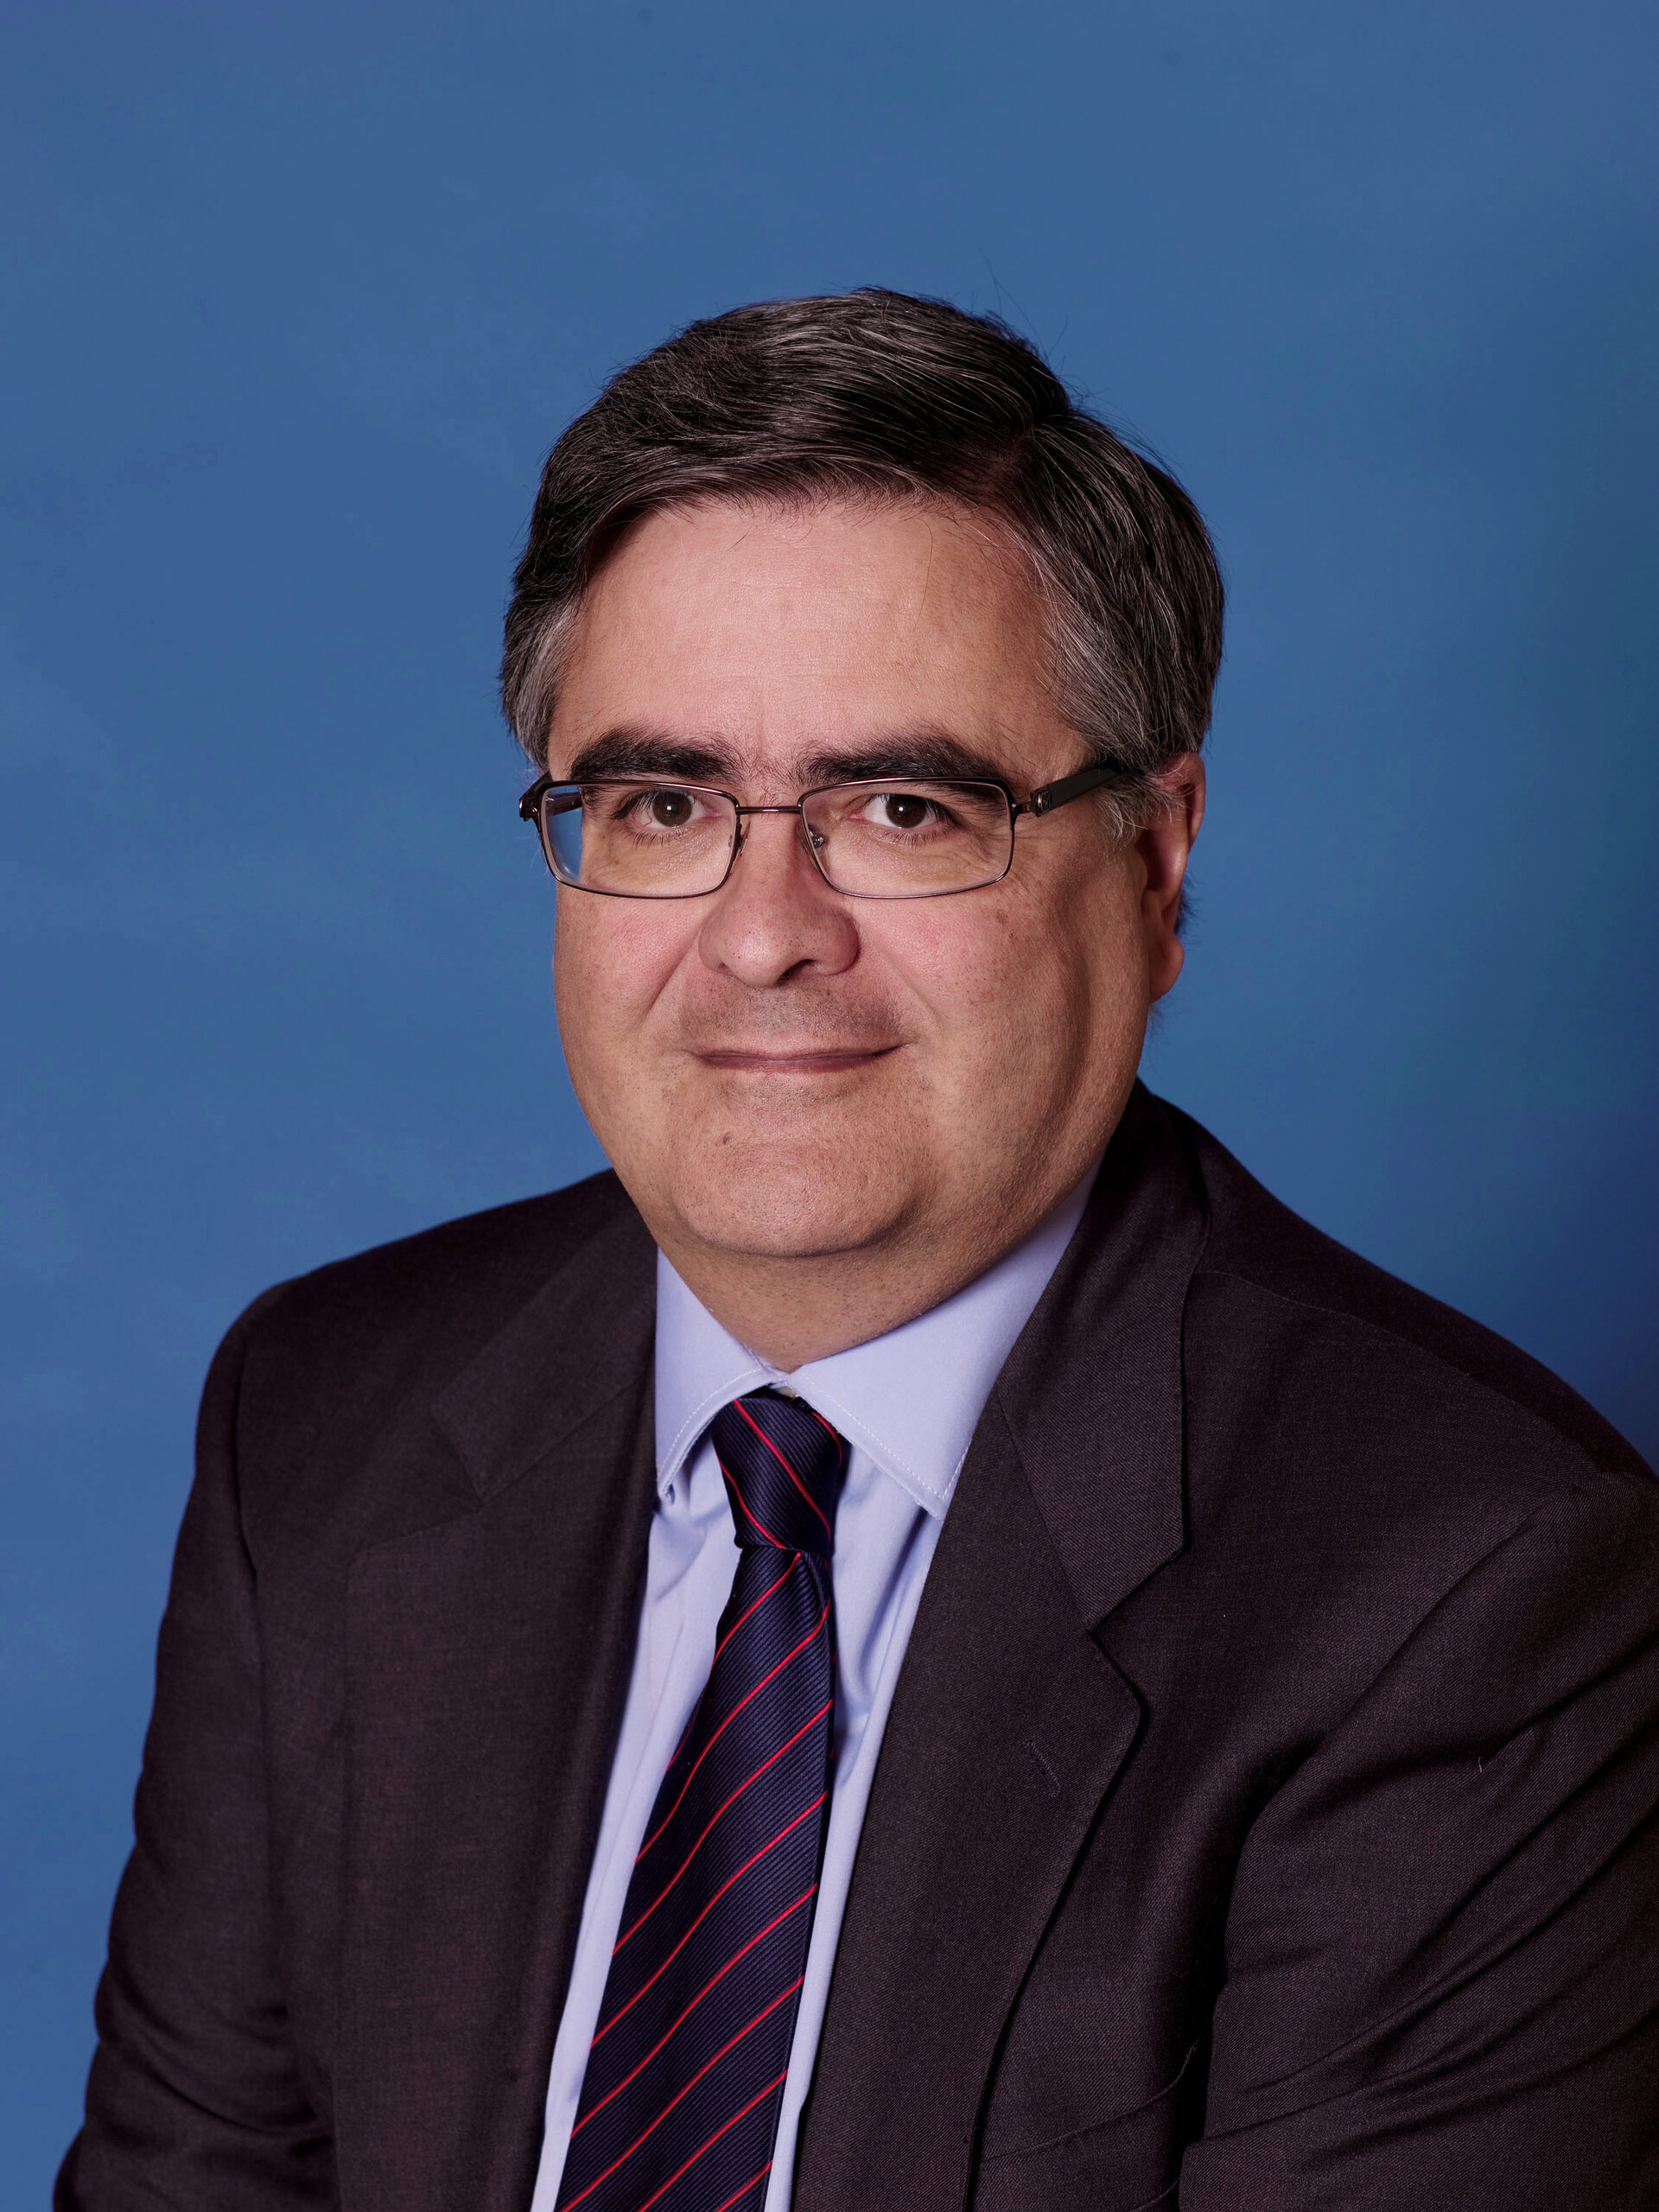
Alvaro Giménez-Cañata
PI of Integral Optical Monitoring Camera
Head Department of Science, ESTEC
ESA Director of Science
Professor at CSIC
Senior Advisor to Spanish Space Agency

Slide 8
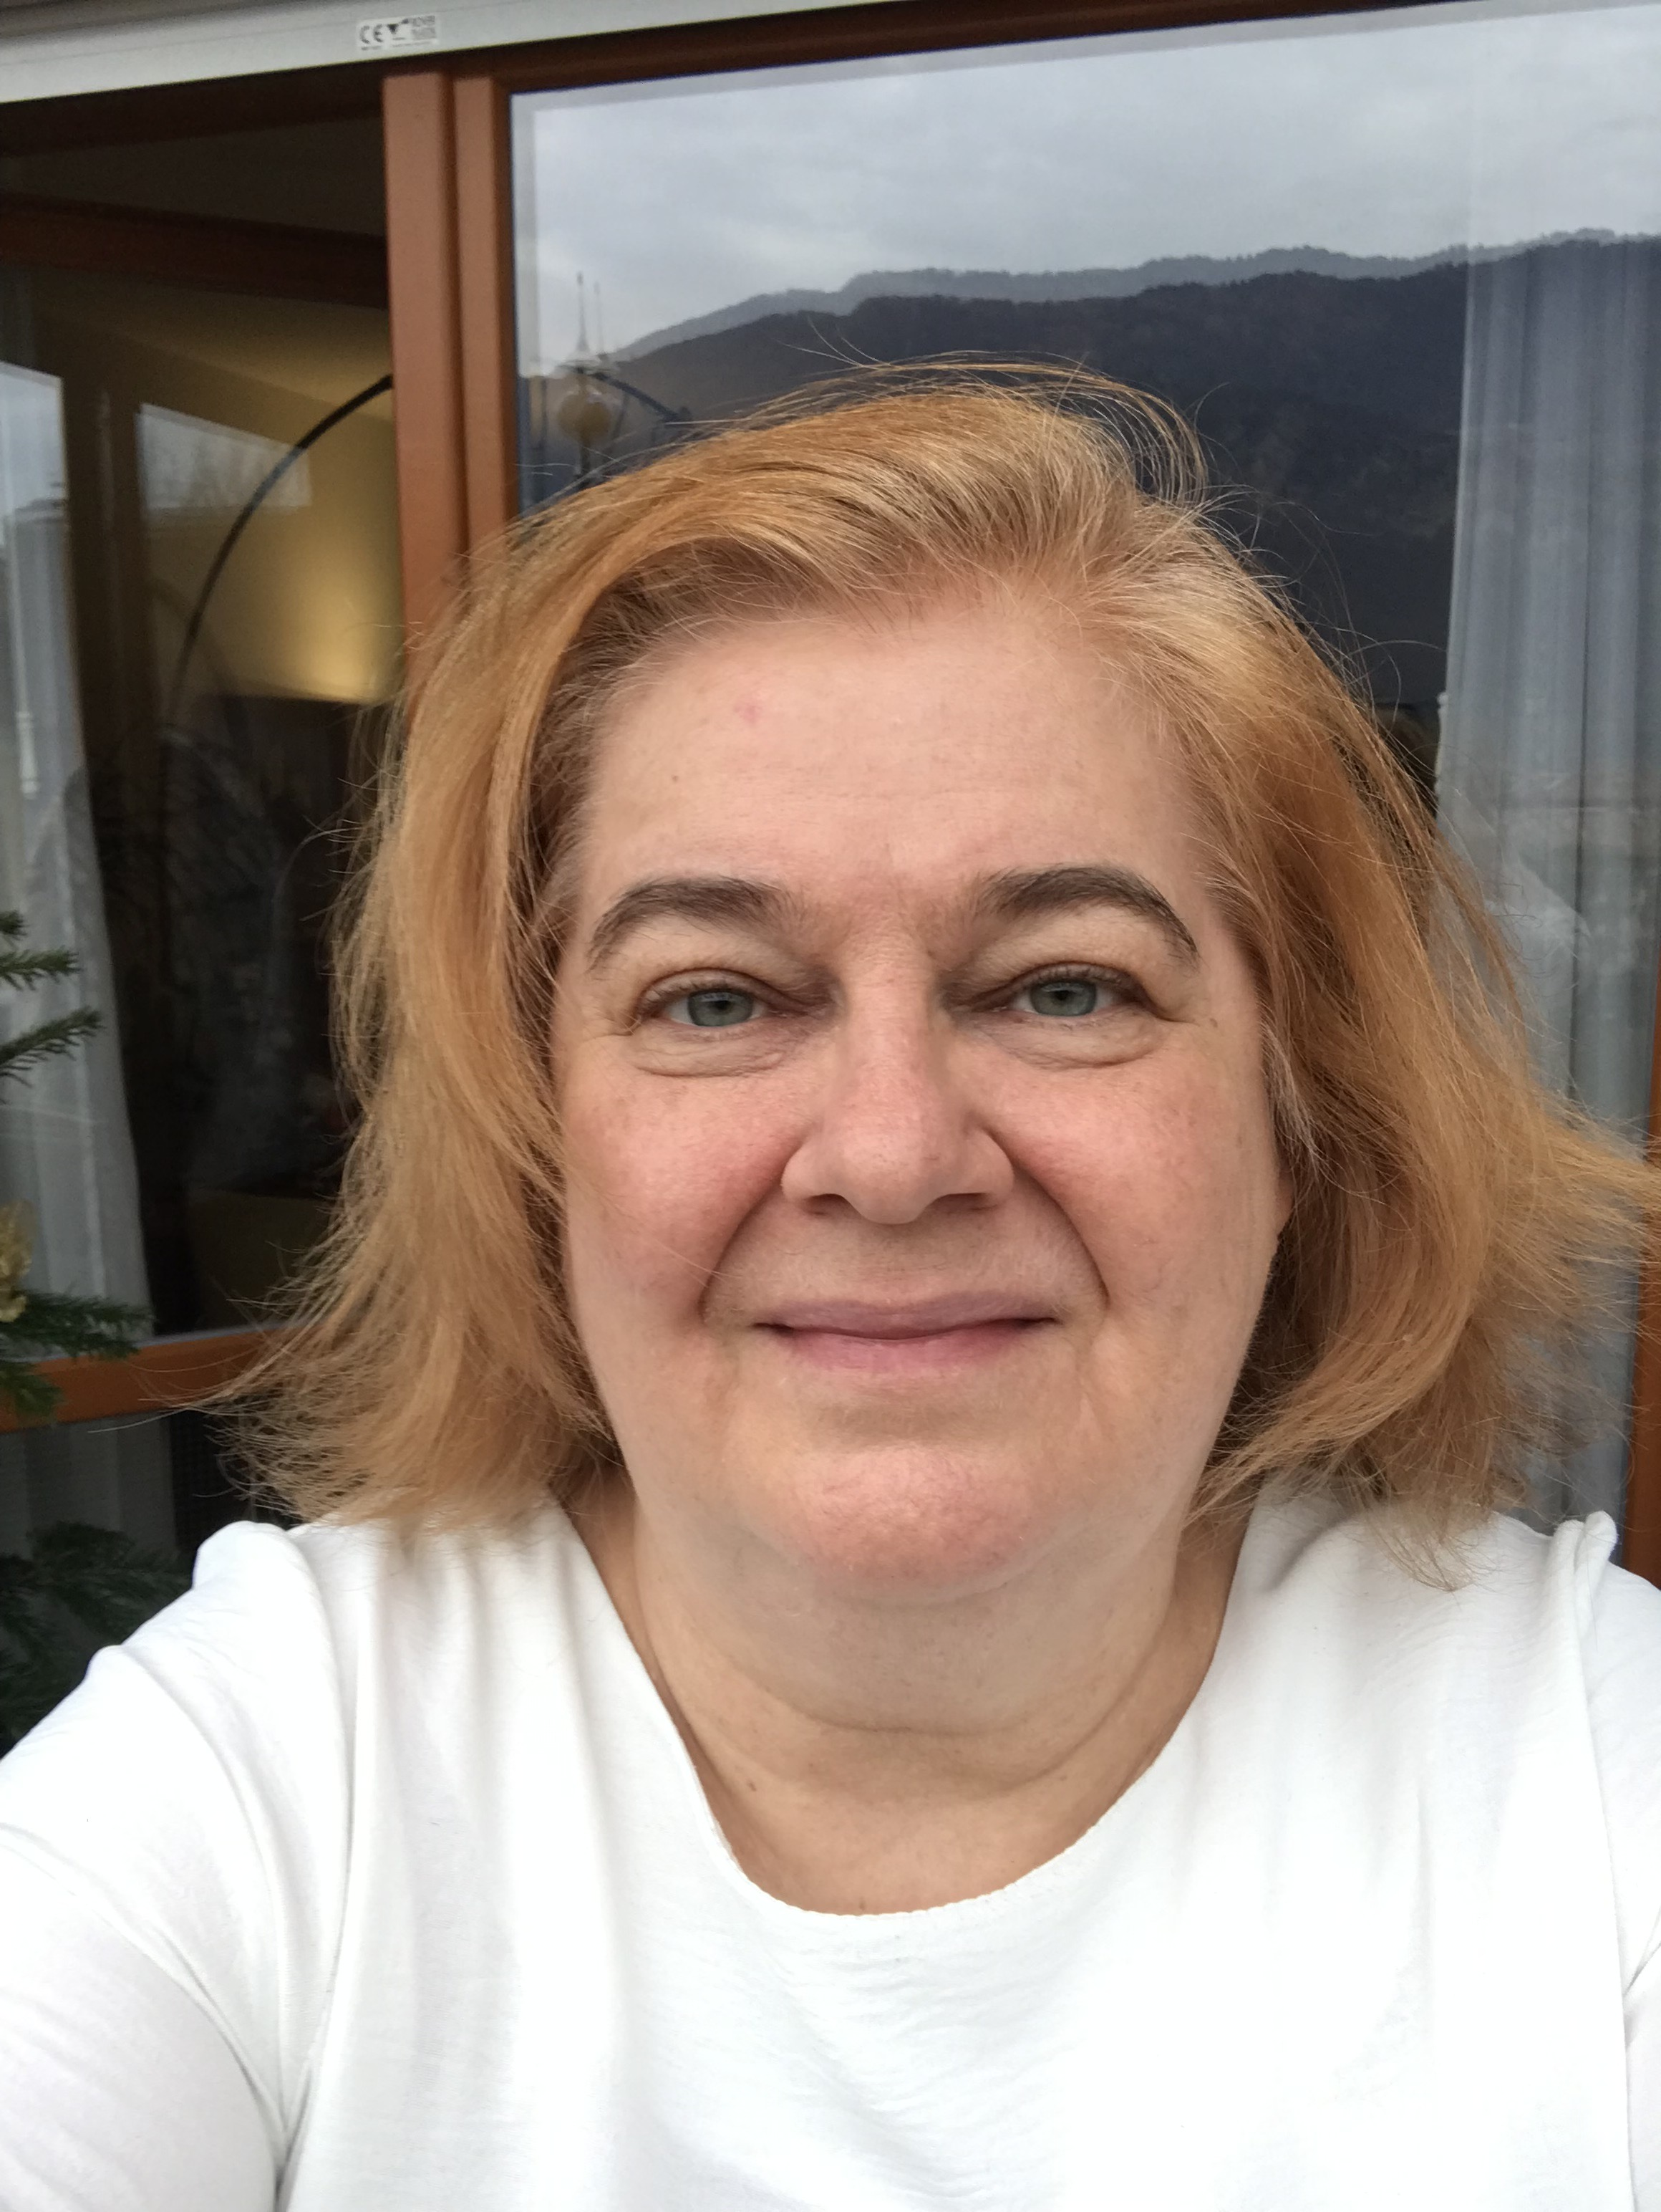


Associate Professor at the Department of Physics, University of Trento
Associated Member of the Istituto Nazionale di Fisica Nucleare (INFN)
Core member of the LISA PF PI Team in Trento
Deputy PI on behalf of ASI of the italian contribution to LISA, the Gravitational Reference Sensor.
National Coordinator of the INFN LISA/LISA PF Research Project
Member of the team that operated the LISA Pathfinder space mission.
Played leading roles in the design, prototyping, and testing of GRS, in laboratory torsion pendulum experiments for small-force measurements, and in mission design and operations in close collaboration with aerospace industries and space agencies involved in LISA Pathfinder (and currently in LISA).

Slide 9
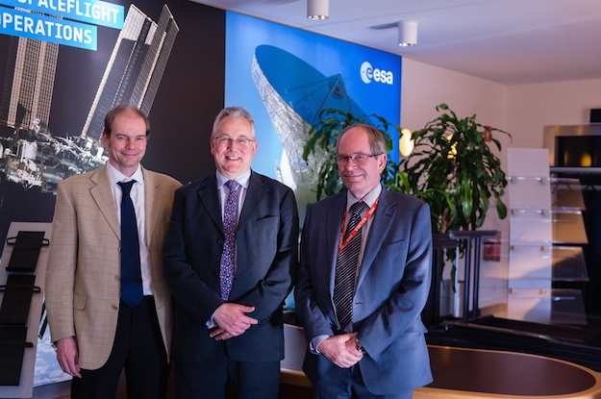
Christian Trenkel
Experimental Gravitational Physicist by training (PhD
Birmingham) - ideal preparation for LPF you might say
First worked on LPF as part of the Charge Management
System at ICL (2004 - 2006)
Astrium / Airbus gave me my "dream job" on LISA
Pathfinder (2009 - 2017):
  involved at the deep end of mission performance
    main responsibilities magnetic and gravitational budgets
    I also had the great job of validating / understanding /
    checking the LTP performance simulator
      noisy spacecraft rotations lead to noise dAx
  debugging and understanding E2E science run simulations
    understanding of slipping clocks, IS SCOE 10Hz oscillation and aliasing conspiring to periodic "kicks" (the famous NCR40)
  then I got a "front row seat" on in-flight performance (I spent 6 weeks at ESOC)
    at the critical moments (TM release)
    through to IOCR, analysing and understanding the science runs
    then E2 support until the end
and I knew then that it was going to be the highlight of my working life :-)

Slide 10
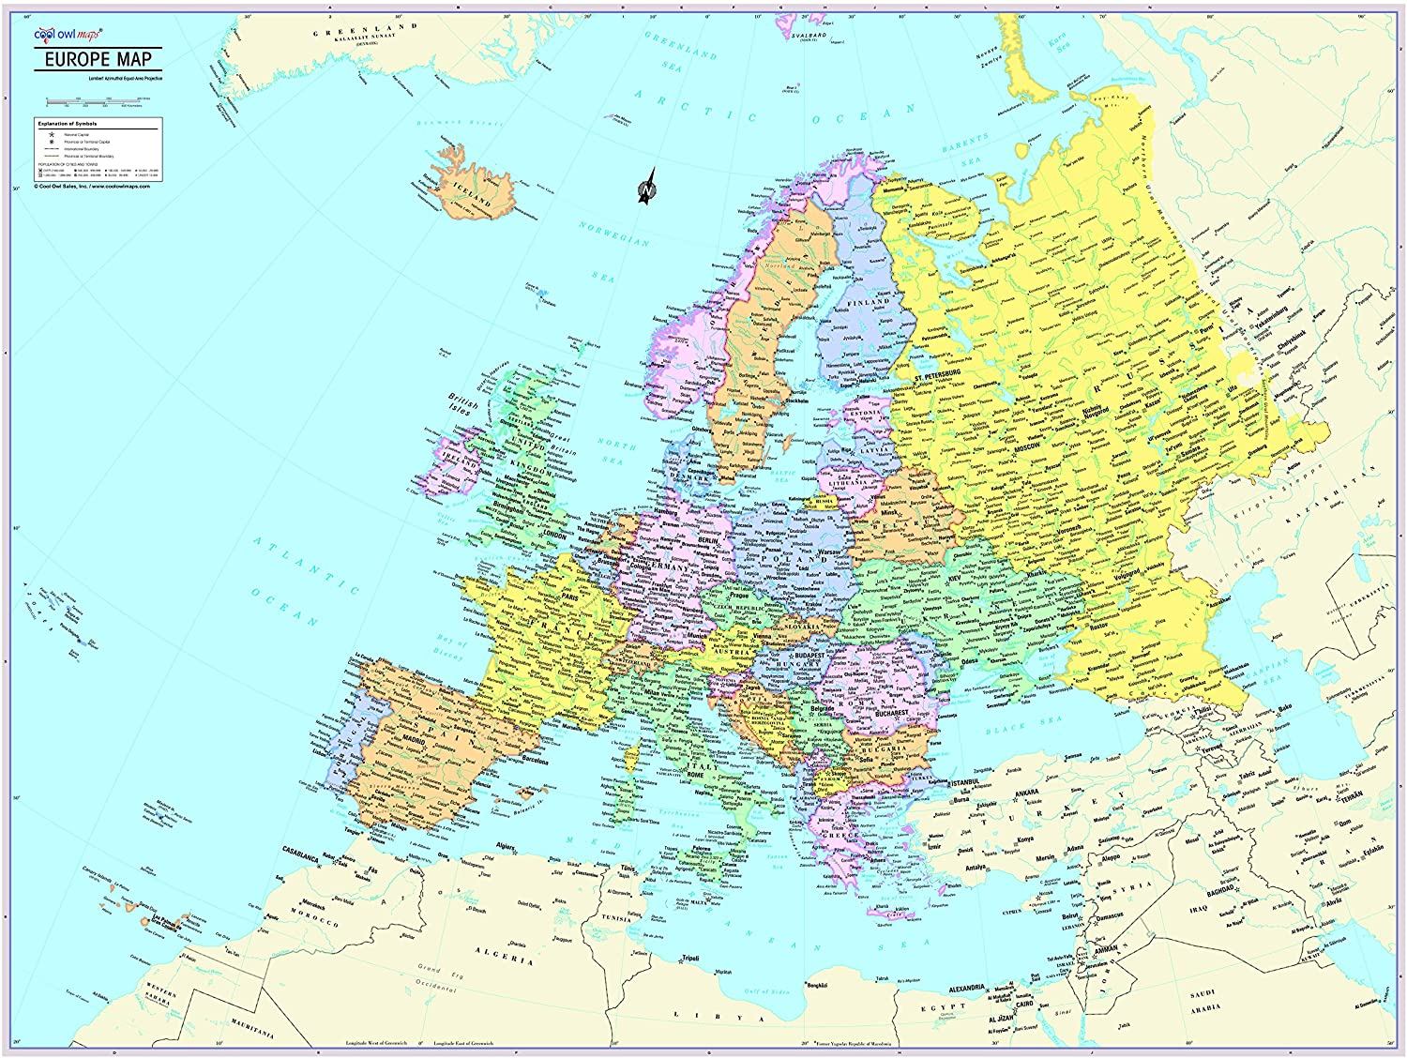
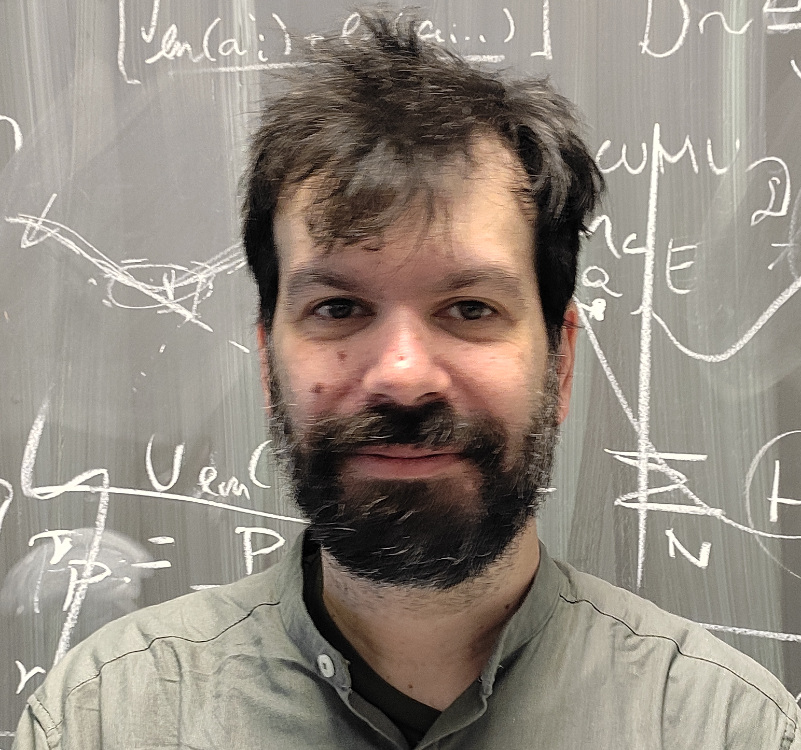
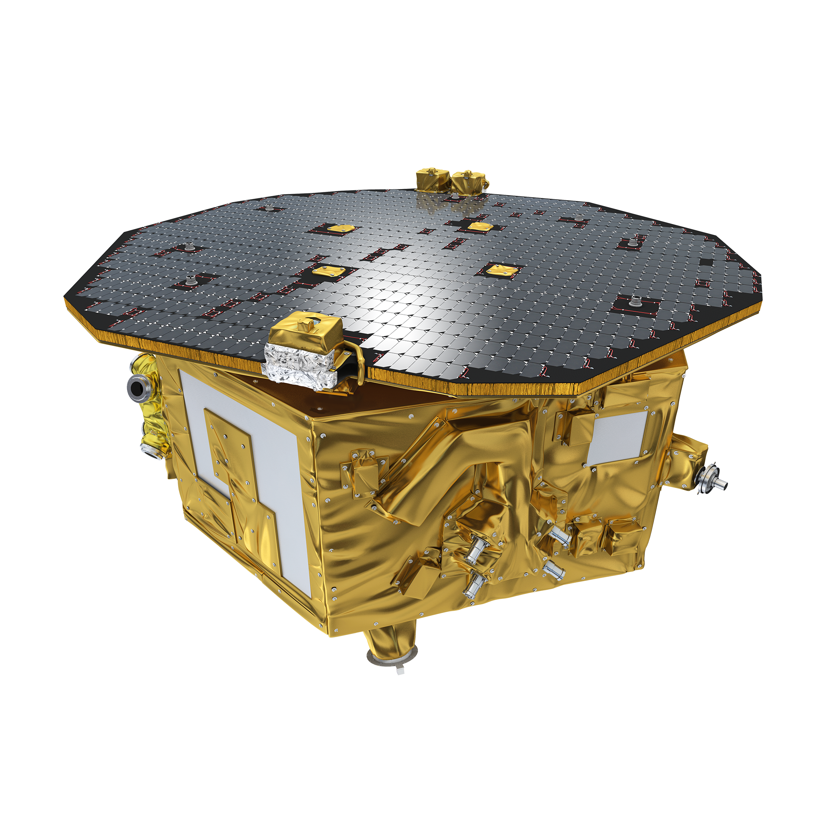
Nikos Karnesis
2011-2015
PhD, IEEC/UAB, Barcelona
2015-2018
AEI Hannover
LPF Operations!!!
2018-2020
APC Paris
2021- 2025
Aristotle University of Thessaloniki
2026 - ☠️ (hopefully)
Athens
The LPF years:
  Preparations for mission operations.
  Data analysis for system calibration experiments.
  Software and analysis pipelines development.
  Operational exercises and schools.
  Mission Operations: Shifts, experiment designs, cataloguing. Coffee & gummy bears consumption.
The (post-2011) LISA years: GW Data analysis, Global Fit, […]

