Slide 1
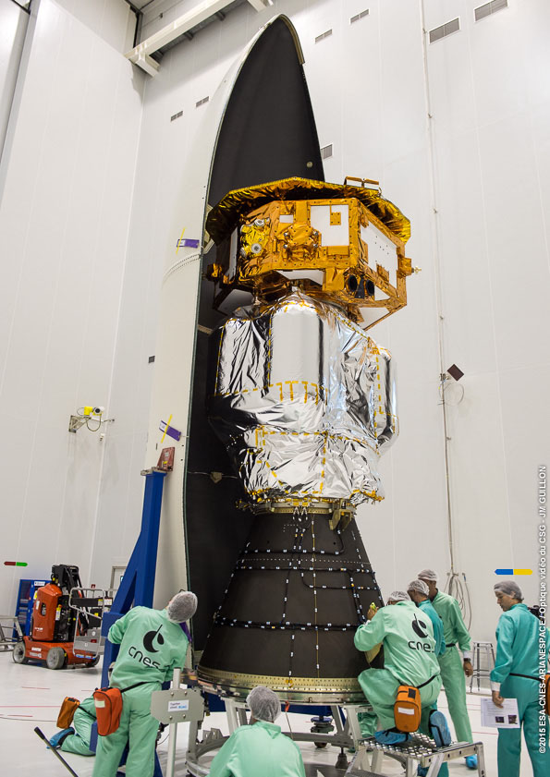
LPF: a leap, not just a project
From LISA Pathfinder to LISA: celebrating 10 years of the LPF launch
Barcelona 3-4 December 2025
César García Marirrodriga – former ESA project manager
Notes:
Fellow LPF’ers,
In the late summer of 2018, in Trento, with the LPF spacecraft trajectory gently tipped over the sun and her software code fatally corrupted with our names, I gave you my view on the management perspective on “how we did it”. In summary it was thanks to intelligence, persistence, embracing change, teamwork, and luck: luck which always found us working.
The Mission Accomplished Symposium was intended to learn lessons from LPF while still fresh in our minds and to celebrate the outstanding results of the mission. However, there was one essential element missing, precisely the main purpose and justification of LPF: the enabling of the LISA mission.
Now, 10 years after the launch of LPF and about 22 years after the start of its development phase, we have gathered here to refresh and relish our memories of LPF, and to find encouragement for the challenges and opportunities that the LISA development will bring.
But first things first. The project progress report. In late 2024 the last bits and pieces of the LPF and LTP contracts were legally closed between ESA and Airbus! Why did it take us so long? Well, there was a certain amount of Au-Pt left over from the mission, which was eventually melted, and some minor accounting discrepancies related to the Indium development. As you can see, it all boiled down to some liquid metals!

Slide 2
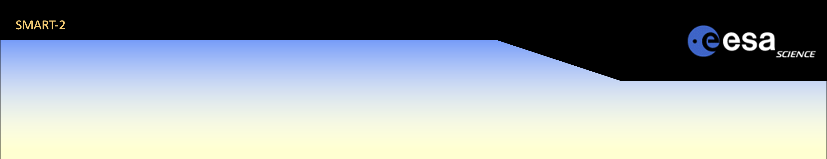



No more ESA templates & flags
13 member states in early 2000
15 at adoption
22 at launch
23 today
Notes:
Still on the reporting side, and on a personal note, I retired from ESA on July 1st this year. This has two major implications in today’s talk. Firstly, I won’t be using the ESA template for the viewgraphs, except for the first one. Second, I am not longer tied in my words to ESA policy. Not that I ever said what I felt it was wrong or false; what I mean is that what follows now is mostly from memory and is likely to lack accuracy and completeness.
In the words of Nature (20 Jan 2011), LPF is a “mission that was created to find obstacles.”
So, what to do when encountering obstacles? We jump over them!
In this talk, I will try to convey the message that LPF was not only a space project, but a quantum leap in several aspects. It was a leap in strategic planning, a leap in technology, a community leap, a leap for Europe, a leap of faith and inspiration.

Slide 3
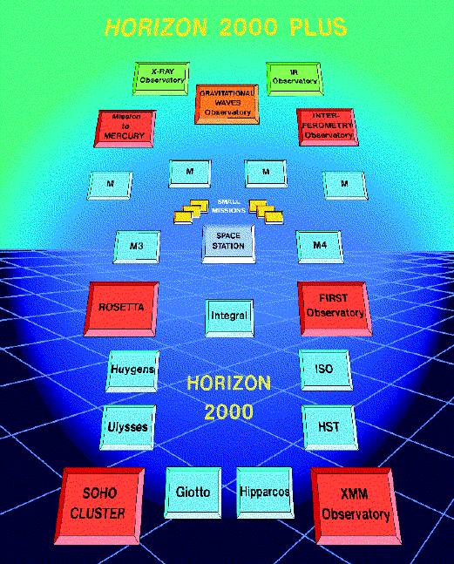
It all starts with a vision
Back in Roger Bonnet’s times…
The vision in 1995
Rosetta
Herschel-Planck
SOHO & Cluster
XMM
The Plus in Horizon 2000+
Mercury
Astrometry
Gravitational waves
(X-ray observatory)
Notes:
Horizon 2000+, a long-term plan
Lets go back to the Ministerial Meeting in Granada in 1992. The ESA Council asked for a plan in 1995 taking account scientific, technical and political developments and after consultation with the scientific community for the continuing implementation of European space-science policy. More than seven hundred European scientists were involved in this exercise at all levels. Work culminated in a meeting in Rome in September 1994, under the leadership of Roger Bonnet and Prof. L. Woltjer (Survey Committee).
The programme, called Horizon 2000 Plus, covered some ten years PLUS missions beyond 2006. It included three new Cornerstones, aiming at reaching the extremes of knowledge, instrumentation and technology.
They were:
a mission to Mercury
an interferometry mission, for which two options are envisaged: an infrared option that would be capable of detecting extra-solar planets, and an astrometric option which is designed to achieve resolutions two orders of magnitude better than Hipparcos
a mission in fundamental physics aimed at the detection of gravitational waves.
A number of other objectives were also indicated as priorities, such as a solar-science mission, which later became Solar Orbiter. SOHO was launched on 2 December 1995, still running, and the science community met just last week in Paris to celebrate their 30th anniversary. Congratulations!
Looking at the H-2000+ chart, one can only wonder the foresight of the community back in 1995. The lapse is now at 30 years, with about 10 more to LISA launch: that is -at 40 years- really something of a leap in strategic planning, only comparable with the vision of Gaudí and the city of Barcelona when dreaming of La Sagrada Familia at the turn of the 20th Century.
More relevant, LISA came into the ESA picture as a large, mainly European mission. If I’m not mistaken, the first concepts in the 80’s were American, but these concepts “migrated” to Europe around 1993 as a mid-sized mission. Europe did not follow others, but took a worldwide leadership leap in the new and uncertain space science of observational GW physics.

Slide 4
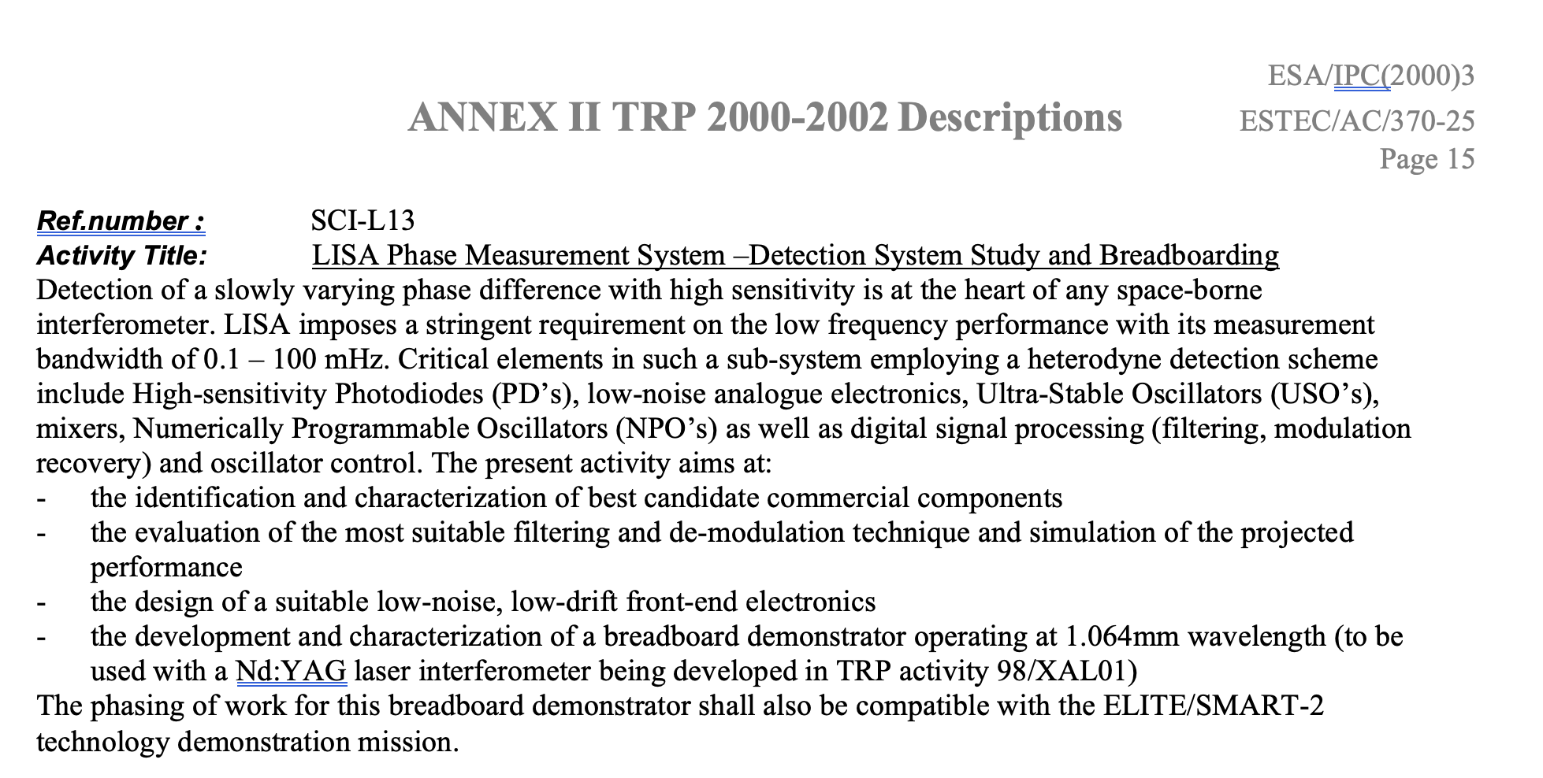
Technology gap
Notes:
Well before my time, it was generally accepted that LISA meant such a leap in space technology that major early developments were mandatory before programme and financial commitments.
Around September 1999, while working with Giuseppe Racca on SMART-1, I was asked to attend a meeting where two scientists –both sitting here– would introduce the needs and goals of LISA.
They mentioned pico-metres and I got nervous. My only knowledge at that scale took me to a lab in Helsinki where they had a heavily isolated and cryogenic facility claiming to reach those sub-atomic levels. Not something one could fly to space.
The meeting was in Madrid, and I thought my Scottish boss wanted me there to chaperon him in the city. Little I knew!
Then, in the early 2000’s, at a large gathering at the UNESCO building, Roger Bonnet took a bold decision: there would be a European technology demonstration for LISA to mitigate the technology gap and create a long-standing moat.
As SMART-1 was helping Europe dream about travelling to Mercury, SMART-2 would support the LISA dream. These two precursor missions have been instrumental to giant leaps in space technology and, hopefully, in space science.

Slide 5
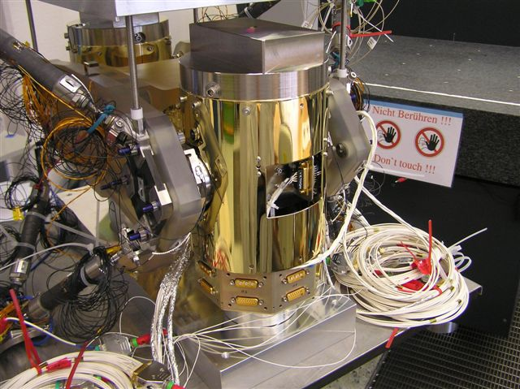
Technology gap
The canonical list, a long list of firsts:
Drag-free attitude control system
Formation flying of 3 bodies: 2 test masses and 1 spacecraft
Automatic control of 15 degrees of freedom, 10 times a second
Nano-metre position precision in all axes
Pico-metre position precision in one axis
DFACS compensation of the largest disturbance: the solar pressure
Which is ~21 μN (+7 μN of IR radiation)
Thrusters accurate to less than 1 micro-Newton
DFACS compensates all known disturbances
About 17,000 parameters in the automatic control system
More than 30 different sources of disturbances to the control system
Test masses: large mass, high purity, freely floating
Capacitance position and angular sensors at 4 mm distance
Extremely low noise capacitance electronics
Contactless removal of electrical charges
Holding the test masses on ground, for launch, and release them for free flight
Vacuum within the vacuum of space, including modelling of venting rates
Thermal insulation (10 micro-Kelvin/√Hz) at room temperature
Electro-magnetic modelling, insulation and compensation
Compensation at nano-g level the self-generated gravitation field
Micro-Newton, low noise thrusters as the only AOCS actuator
Notes:
More in detail, what was the technology gap that LPF was addressing? There is the canonical list:
Don't worry, I won't elaborate on any of them. You know better than me. To each of you, every line will bring different but complementary memories
(...pause)

Slide 6
Technology gap
The extended list, another long lists of firsts, which took twice the effort:
Finding the sweet spot for the laser operation, maybe not helped by the uncertainty on the laser power dissipation through the electro-optical chain
Suppressing laser and TTL noise in the optical system
Synchronisation of signals, actuation commands and data stamping
Finding an acceptable micro-Newton propulsion system
Completely changing the micro-rocket technology and configuration after System CDR, the role of the sun (from DC force and disturbance to actuator) the DFACS and the software
Verification of the optical system via the TOQM (thermo-optical qualification model)
Designing the separation springs between the propulsion module and the s/c due to the minute thrust authority
Designing the s/c while the launcher vehicle was in development, leading to a novel shock testing method and facility, AND launcher system safety constraints
...
Changing the mission reliability led to redundant architectures and units; this introduced, among other things, a new switching unit for the Front-End Electronics, which added noise and complexity
Test mass manufacturing, corners, internal voids, surface finish and crevasses
Optical window material, fixation, coatings
Photo-diode technology, radiation tolerance and mounting
Fibre injectors onto the optical bench and into the vacuum enclousure
Verifying that UV photons generate electron emmission from non-pure Au
Allowable loads for Zerodur given the surface finish
Changing from isostatic to hyper-static LCA mounting
Finding fibres compatible with UV
Testing of test mass release, of the electronics for long hours
Simulating with GSE or SCOE the behaviour of the TM and electrodes
Notes:
There were many more technological and practical challenges that LPF had to circumvent. These typically don’t make it to the project presentations or talks, but were significant enough to keep all of us busy and worried. Not being exhaustive, here follows a list that will help you remember, and may make you smile.
(Brief reference to FEEP and TOQM)
...
Each and all of these meant a leap in knowledge and in technology.
These issues were new to the space business, and they are not any more.

Slide 7
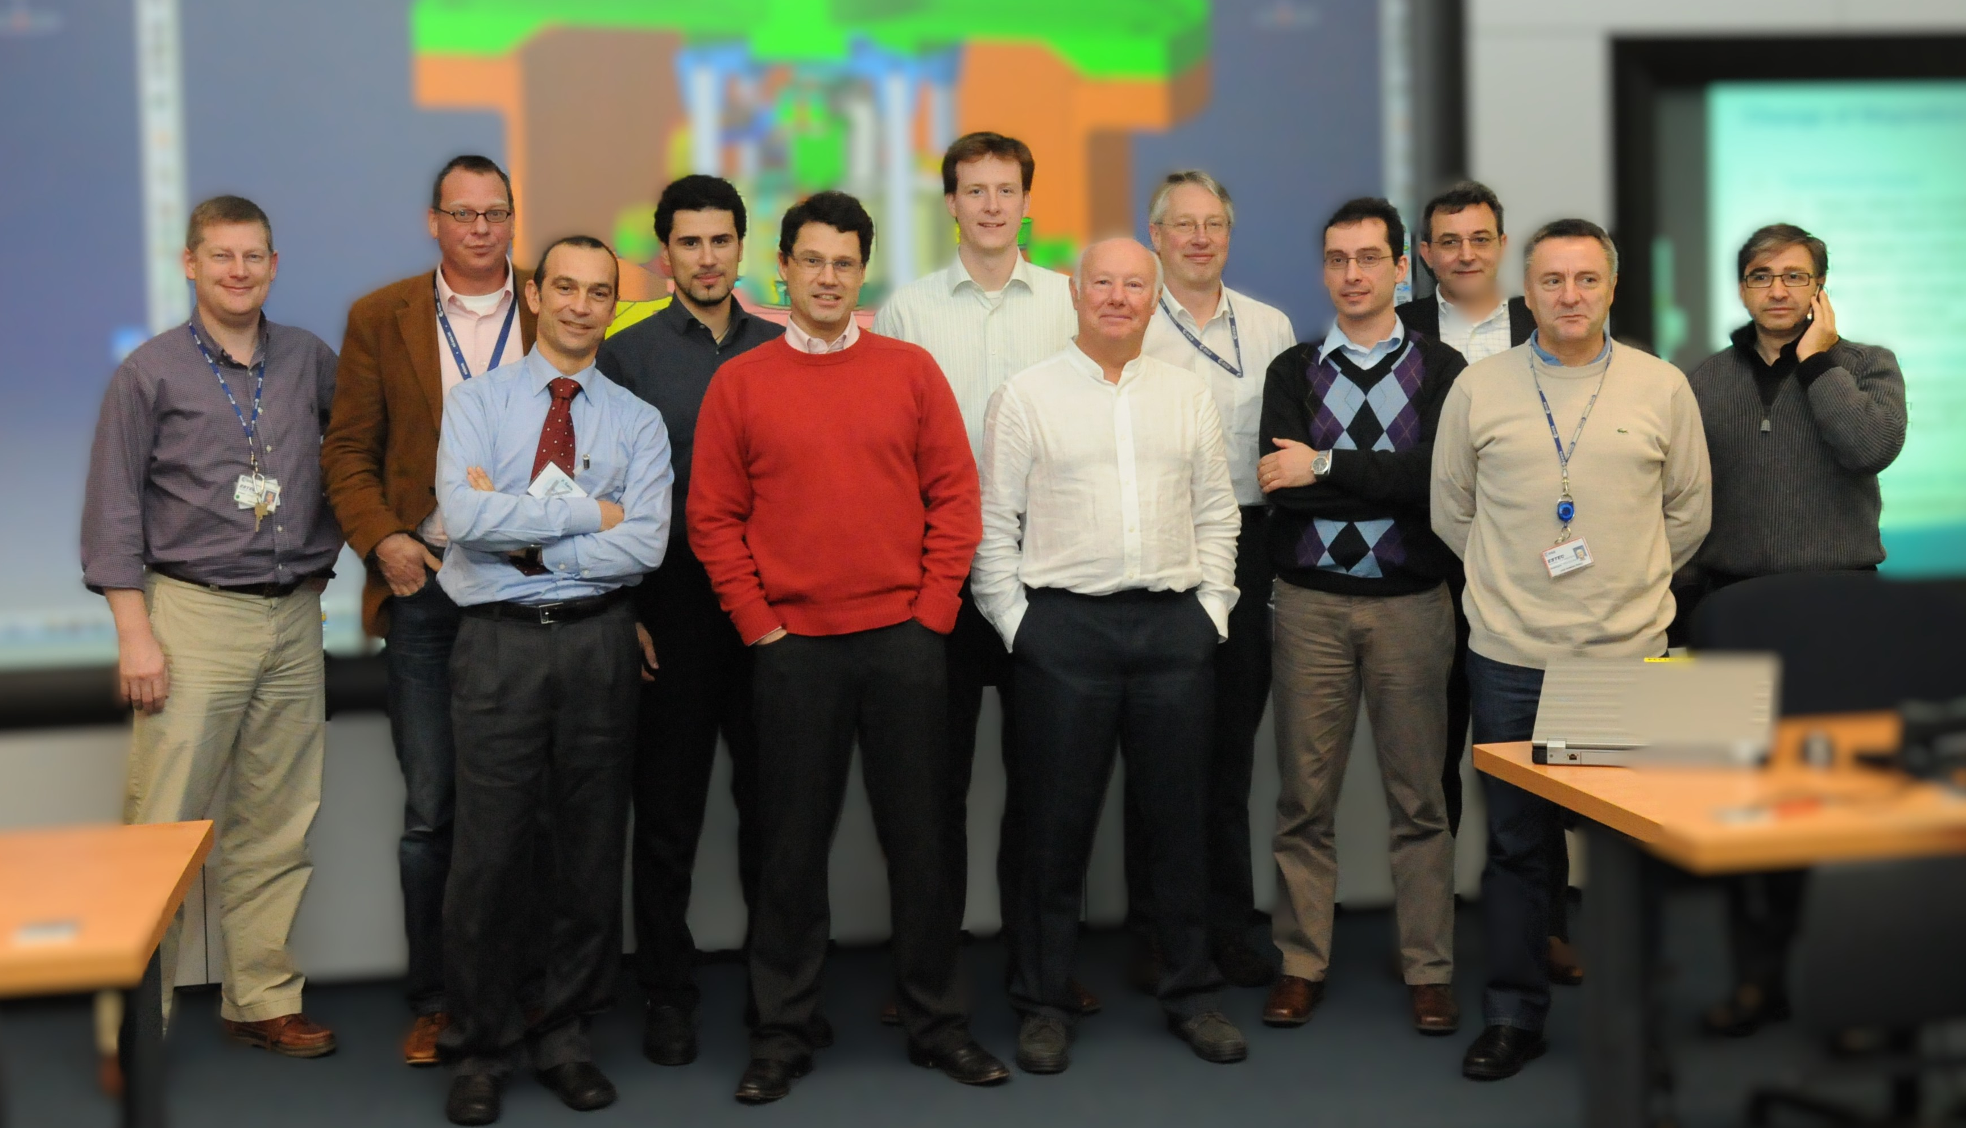
Caged in a mechanism
Notes:
However, I think a most notable leap in the expectations of technology concerned the caging mechanism. This was reported as a “missing part delays space mission” in Nature on 20th January 2011. <<“All the rest is waiting for one part. It’s heartbreaking” says Vitale.>>
Well, Stefano, I’m sure you’d agree that was an over-simplification, wouldn’t you?
On this topic, let me focus here on the evolution and change of expectations, as the technology leap is well known by most of us.
The original caging technology was based on a miniature hydraulic system withing the GRS, which was doubtful since inception. Despite this, all parties worked hard since the kick-off in November 2005.
The PDR had a delta and a close-out. The CDR lasted from June 2007 through end of May 2008. By September 2010, the number of open and blocking NCRs during the production of the flight units became unworkable.
A maverick Task Force operated from September to December, coming up with a concept of caging mechanism, which also meant dramatic changes the GRS & LTP contributions by ASI and DLR. It was a bet the company proposal.
This led to a fantastic and unbelievably fast industrial work in 2011, with flight hardware completion in about one year. Member states, scientists, industry and ESA took a bold leap in change management, and it paid off.
It is rewarding that some of those directly involved back then are sitting here today. We all may have regrets of this or that, but –arguably– the joint work in those 18 months made LISA possible.

Slide 8
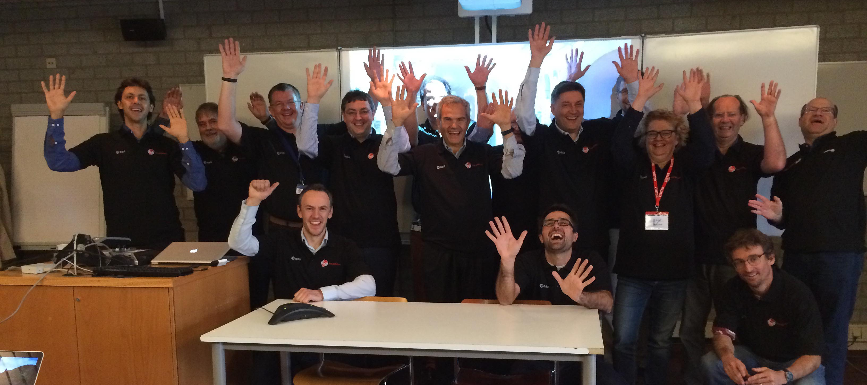
Who is doubting here?
?
The SWT get their mission polos in Oct 2014
Notes:
The L-missions order in November 2013
Cornerstones turned into Large missions, and project adoptions and developments took longer than expected.
In the face of the many challenges encountered by LPF, and despite LISA changing names –and even fading away from the science programme–, Europe and ESA kept marching on the dream (the goal) of leading the way to GW observations from space.
That was until November 2013. Then, ESA decided to prioritise an X-ray observatory as L2, and leave LISA for L3. I could only feel the weight of my responsibility (should I say shame?) for not having completed LPF sooner.
Luckily, none of us was ever alone. We, people in this room and many others, shared the burden and kept going with both LPF development and LISA studies.
Sometime around that date in 2013, in the ESTEC canteen, I came across the head of the ESA internal audit office. We knew each other from the days when he had been the head of ESRIN; we had a good relationship, and our talks, being in Spanish, had an added level of sincerity. “How are you doing” he asked. “Struggling with many problems but making good progress towards the launch in July 2015”, was my answer. Then he confided “César, be honest, do you truly think we will ever launch LISA Pathfinder?” Well, that question, coming from somebody reporting directly to our DG, and sitting at the weekly executive board was quite sobering. And what was my answer? You probably guessed well. I replied that “all facts and the current pace of progress indicate that we will indeed launch the mission”. I promised to myself never to forget the question.
These were the years when LPF demanded a leap of faith. Not only by us, working in the project, but also by our managements and our member states, which twice increased the budget of the mission, and many more times received reporting of troubles and delays.

Slide 9
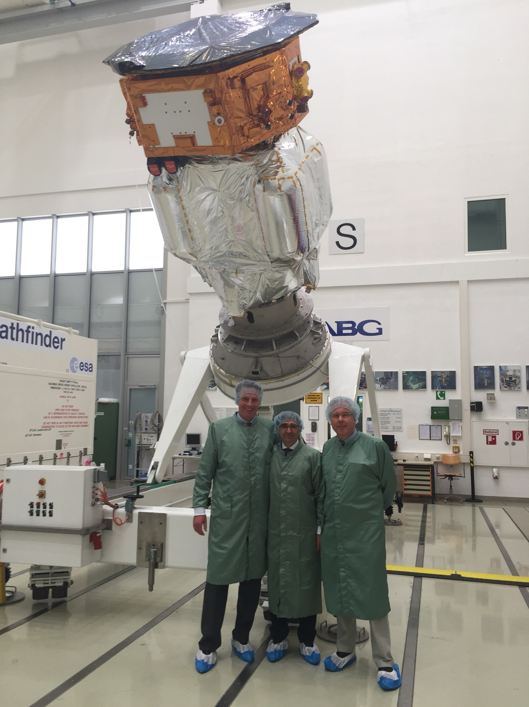
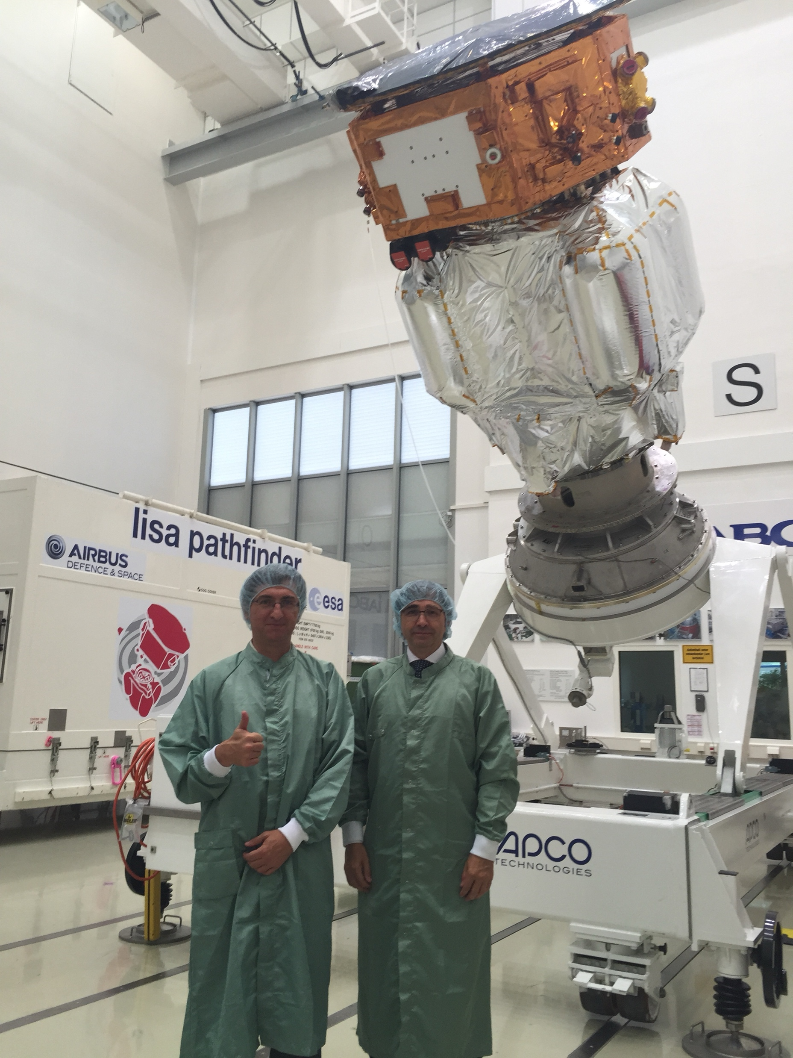
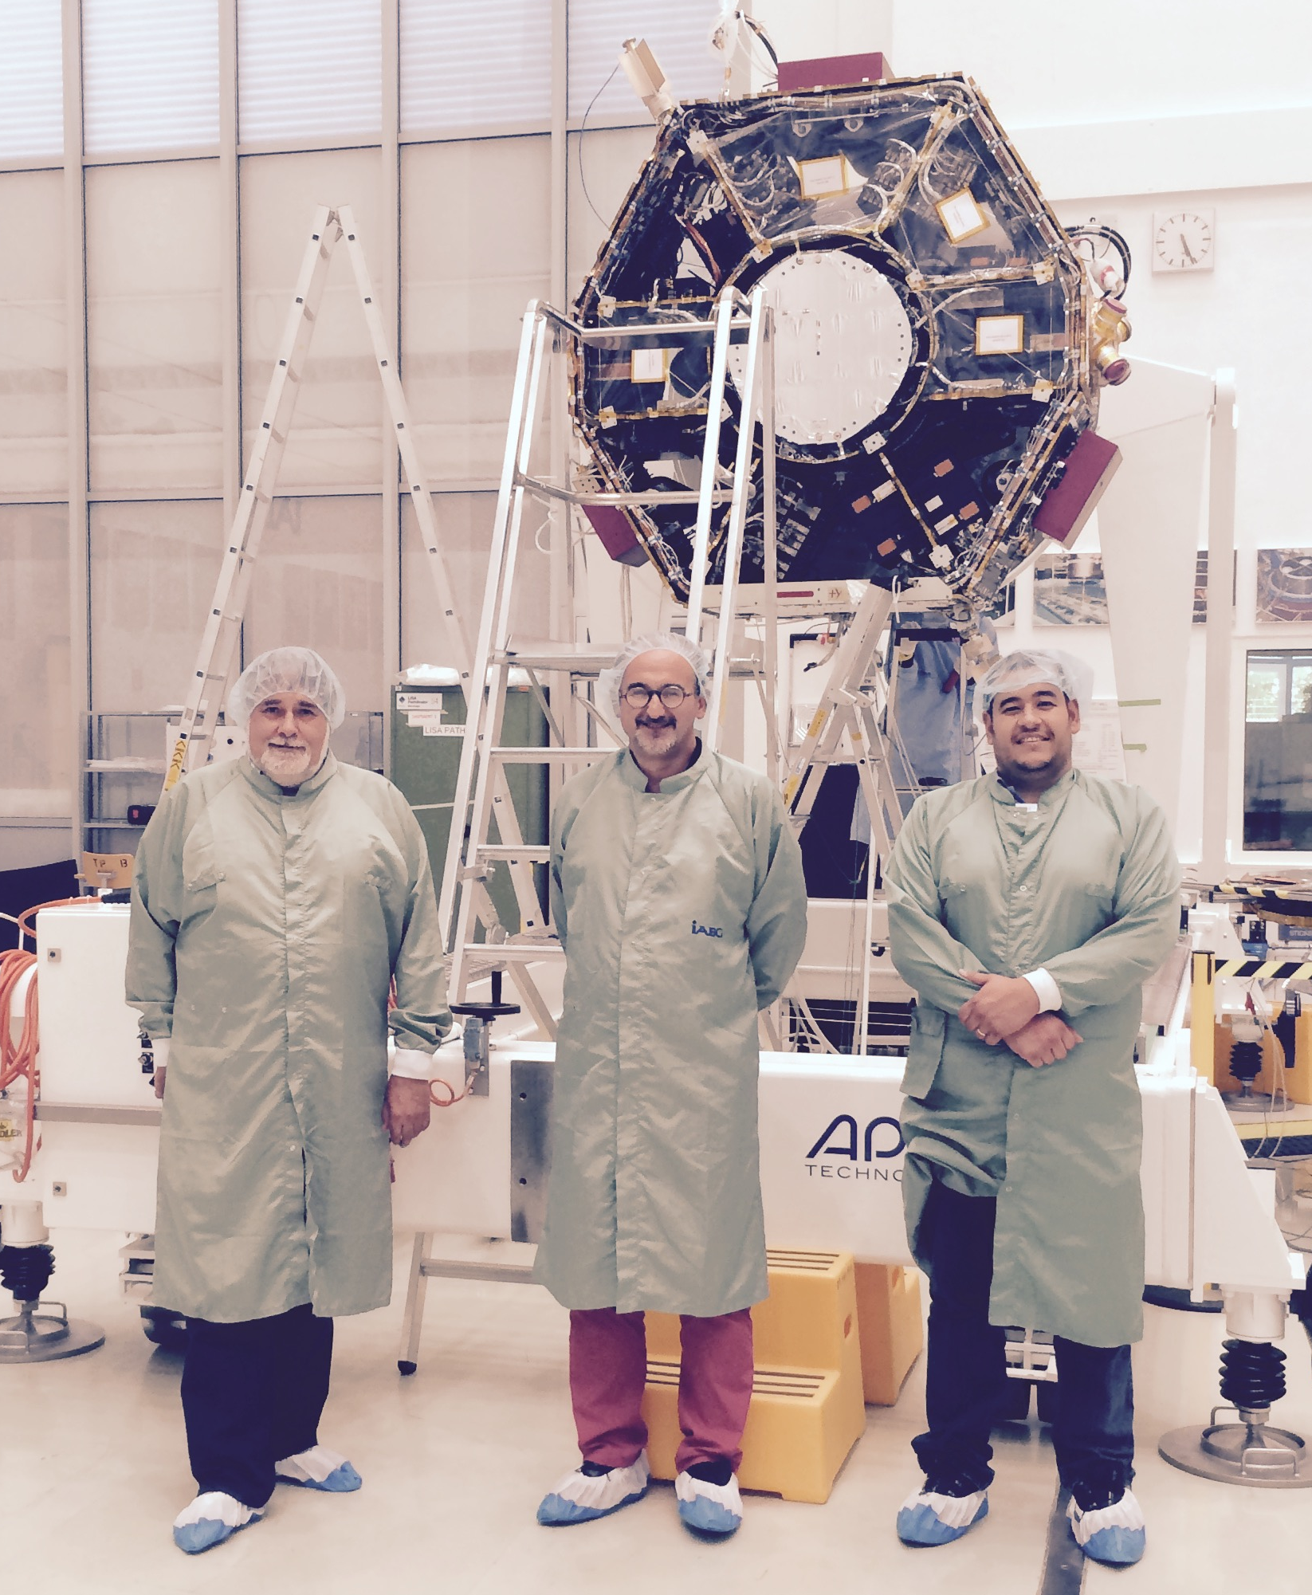
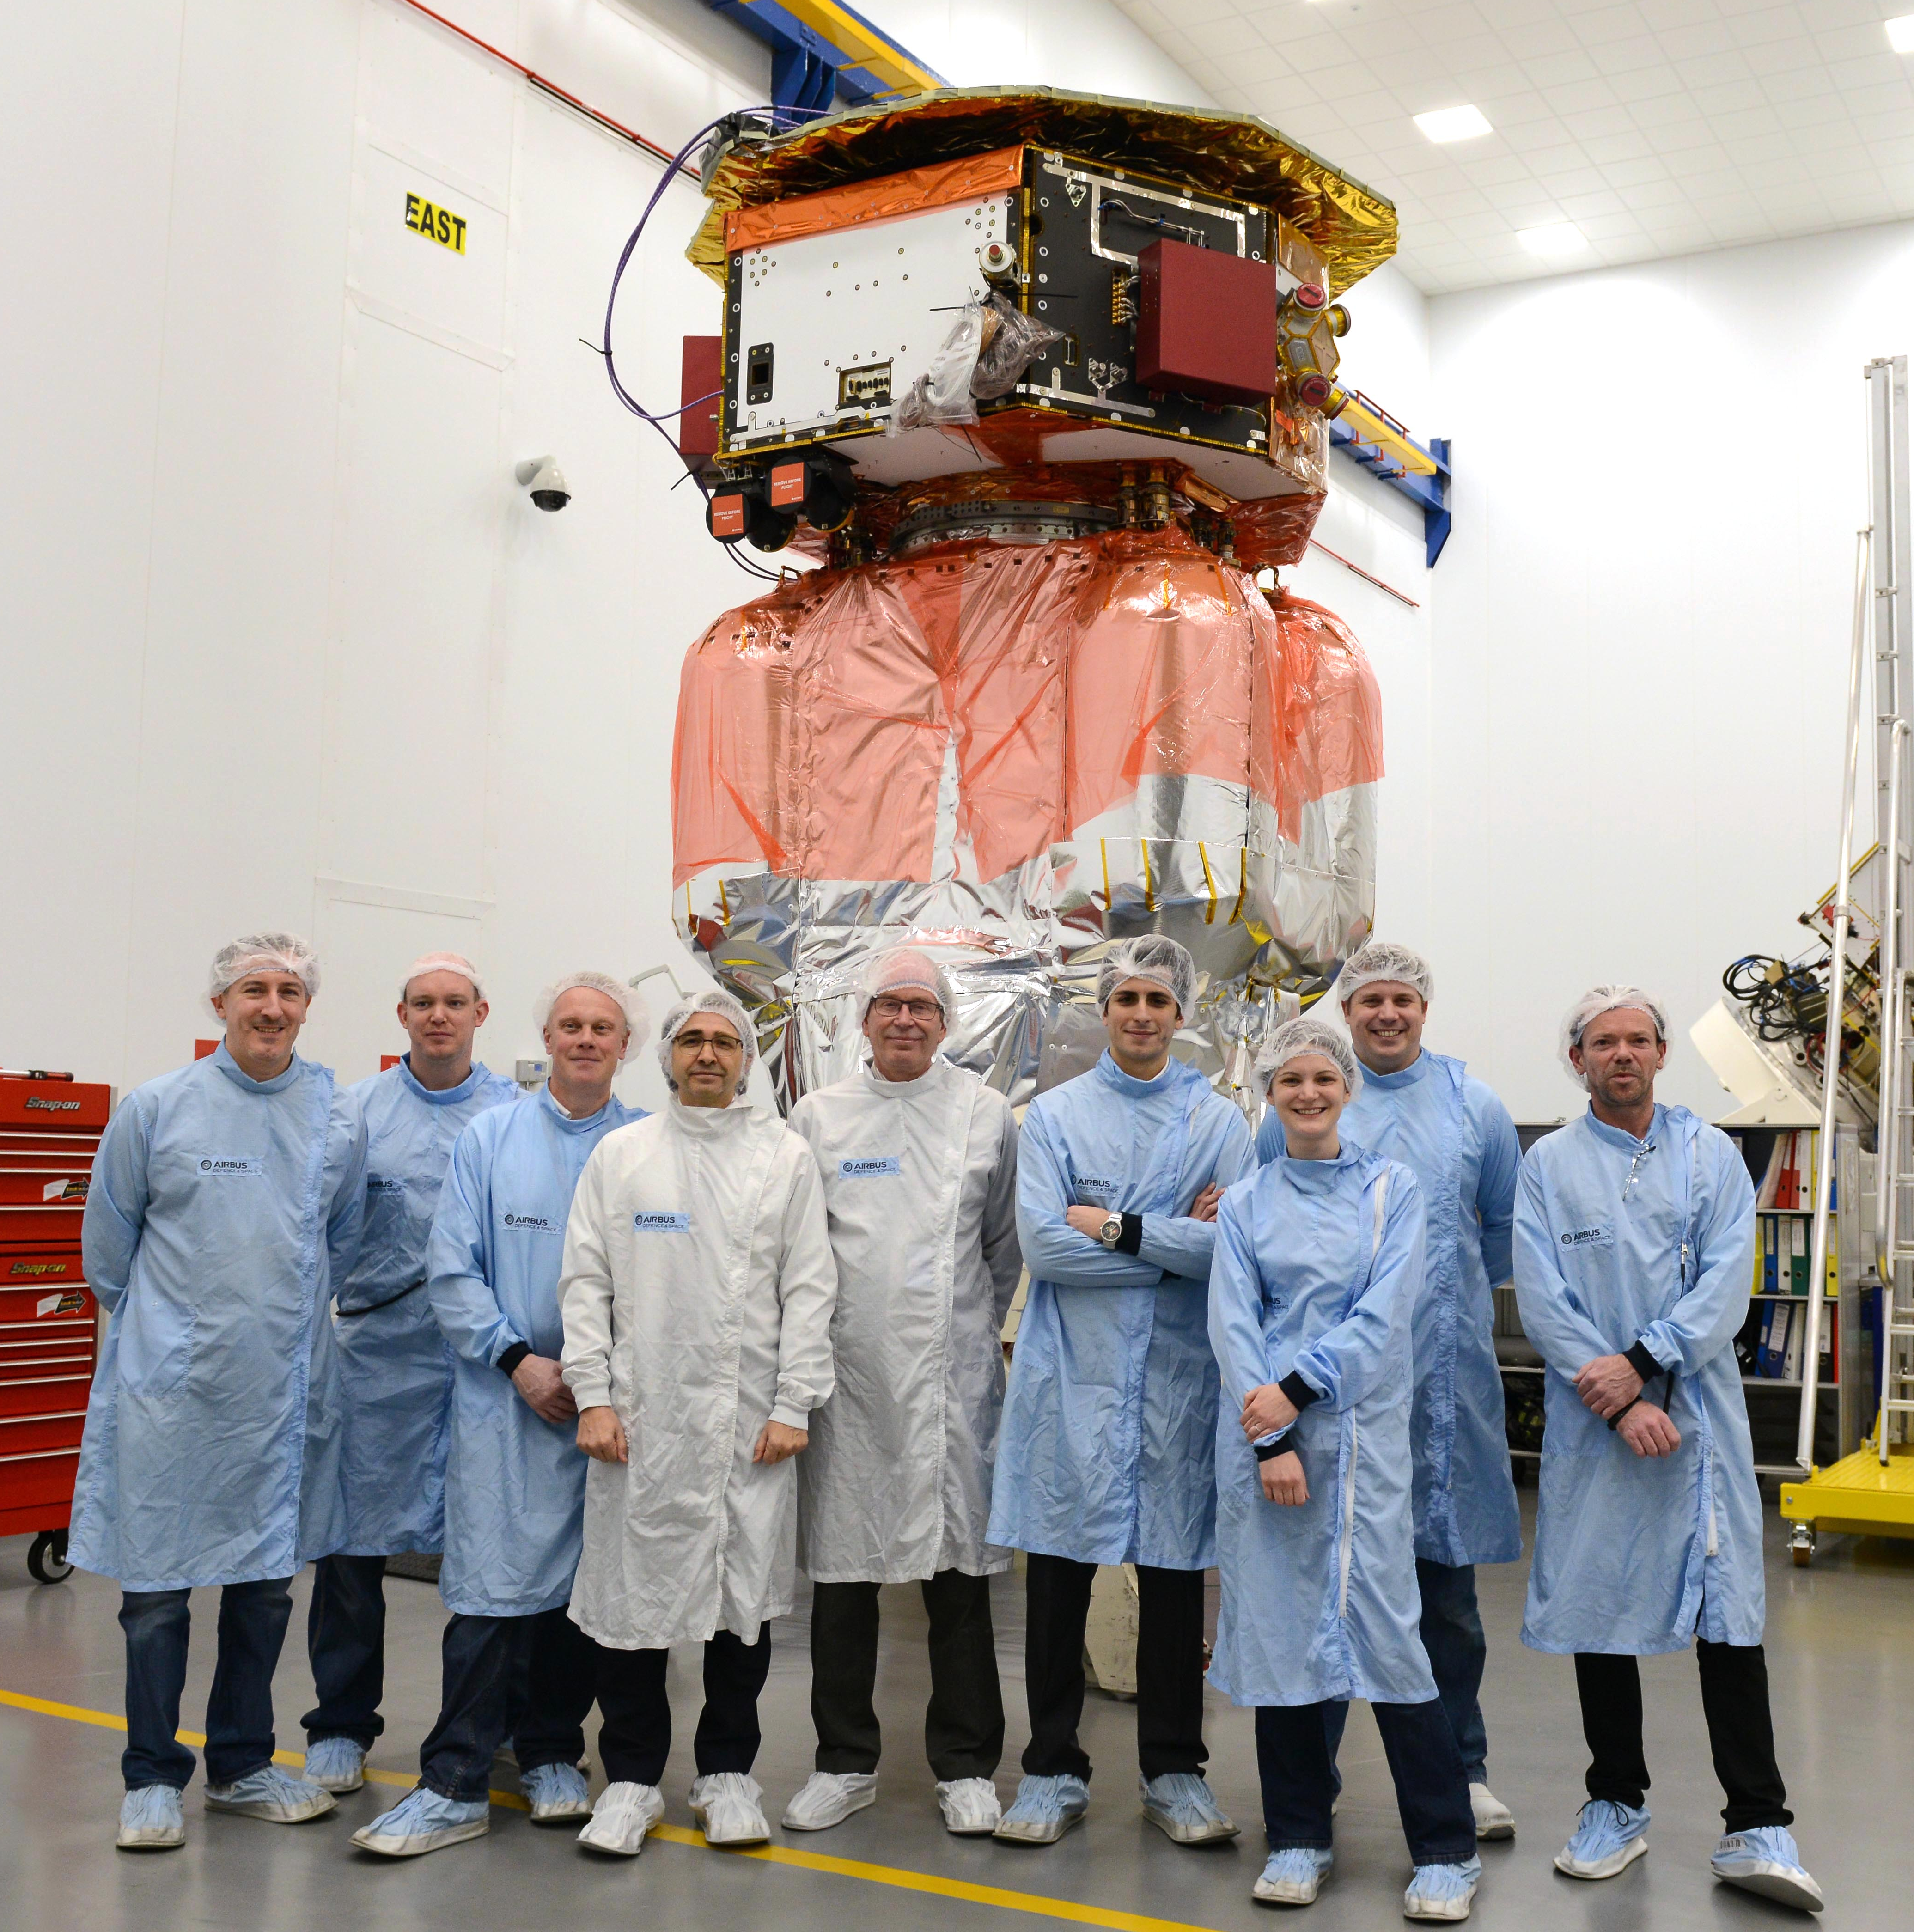
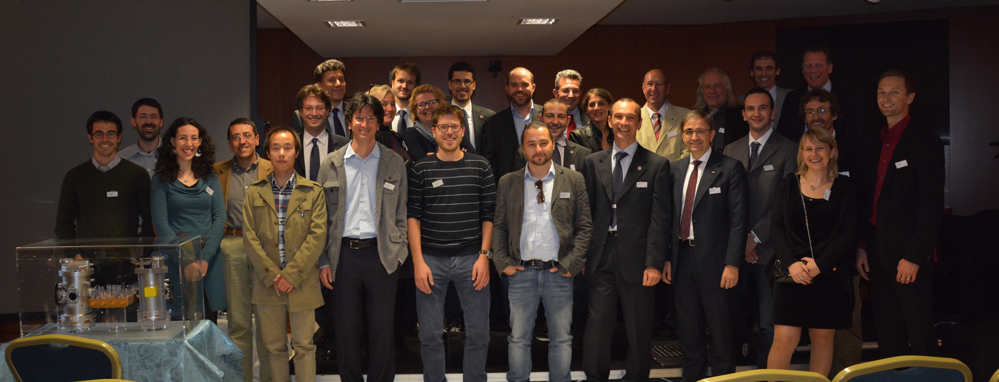
From ground to space: a singularity
Notes:
20141103 CGS media day & delivery
20150227 LPF leaves Stevenage
20150805 ESOC visits IABG
20150901 IABG media day with Jens, Hans-Georg, Carlos
Every rocket launch is a singularity in the equations. Time stops when the countdown reaches “top”. Launching on a relatively new rocket, Vega, in a novel eastward direction was bound to be challenging. A full description would take a couple of hours, but let me just tell you one story that illustrates how risky our business is.
The LRR (launch readiness review) took place on Monday, 30 November 2015, and was successful by lunch time. Later in the afternoon, while Paul and I were presenting LPF in Jupiter 2, some Arianespace colleagues started leaving the auditorium. While this was going on, some of you were flying towards Cayenne.
On review of the thermal analysis of the flight, it was found out that temperatures in the AVUM engine would be freezing out of the qualified range during the coasting around the earth. You may remember that Vega was completing a full orbit until a second AVUM burn would take place when rising again over Kourou. It was this second burn what was at risk.
The hours that followed were frantic for our Vega ESA and industrial colleagues. This also included waking up the Ucranian engineers, in the middle of their night, to review testing results going back to the 60’s. No specific tests had been done for Vega, but the soviets had thrown liquid nitrogen to the engine to check ignition in extreme conditions.
The Airbus and ESA team morale reached rock bottom that day.

Slide 10
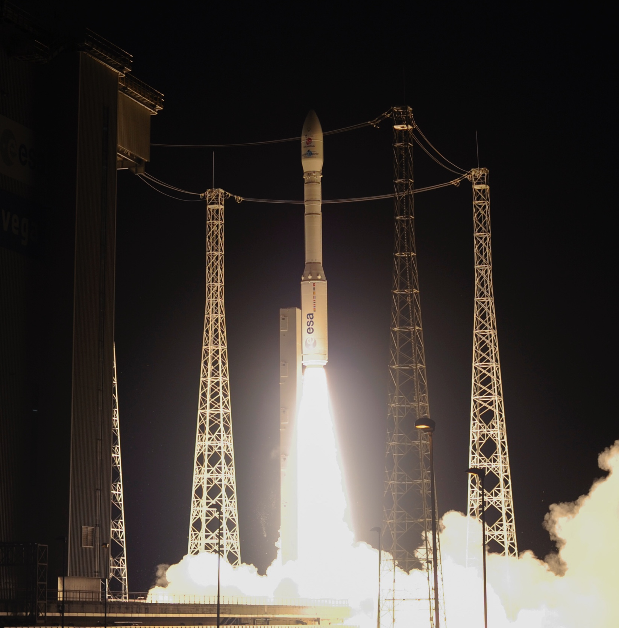
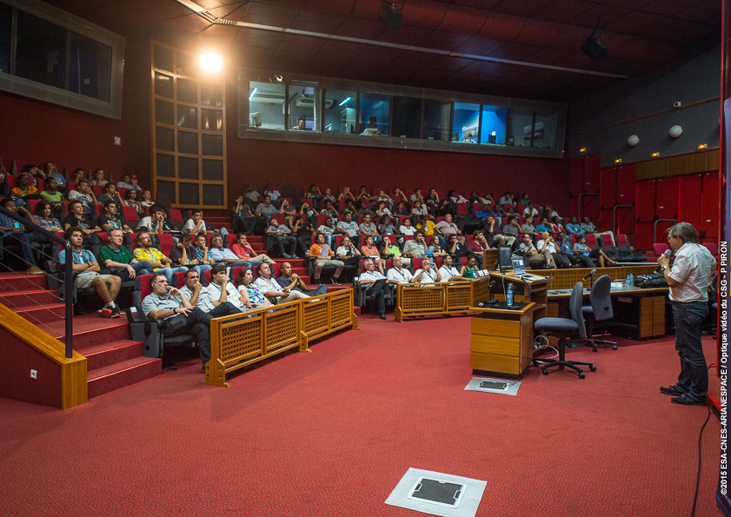
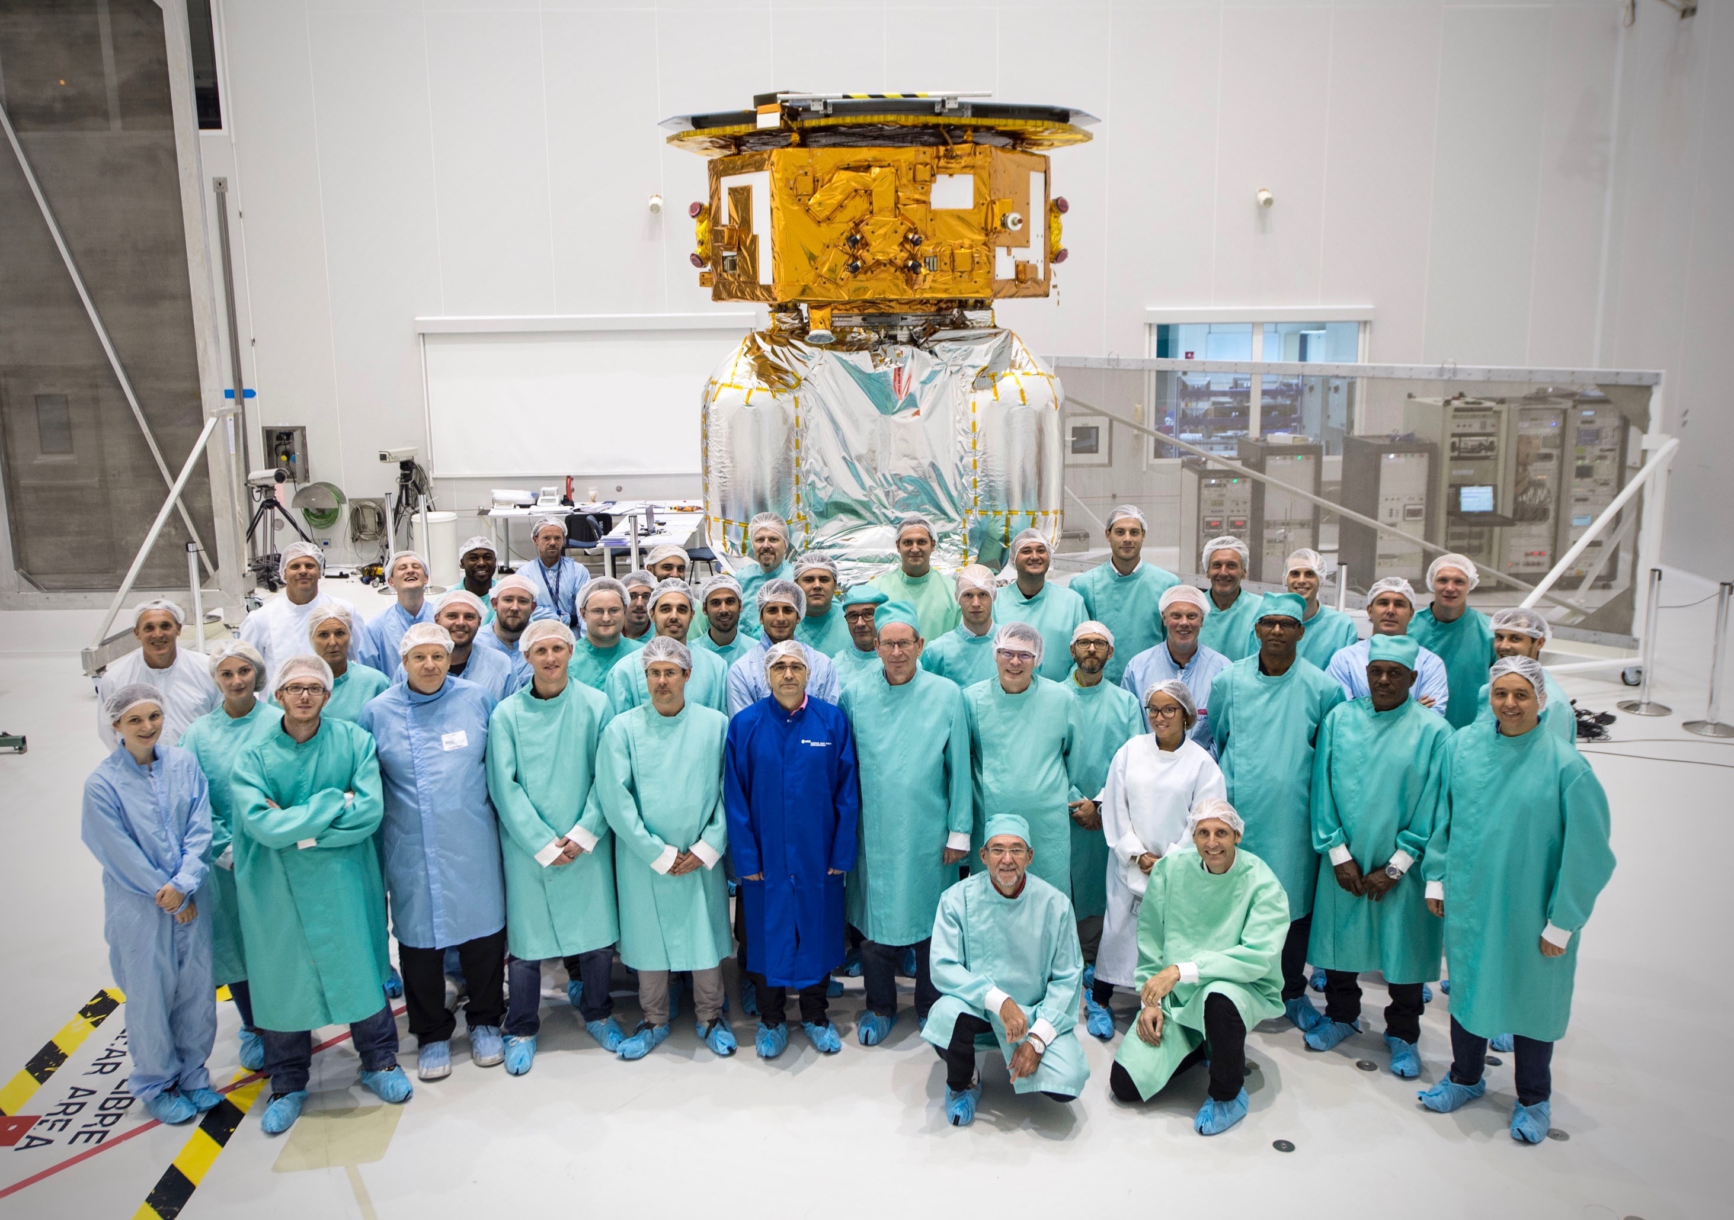
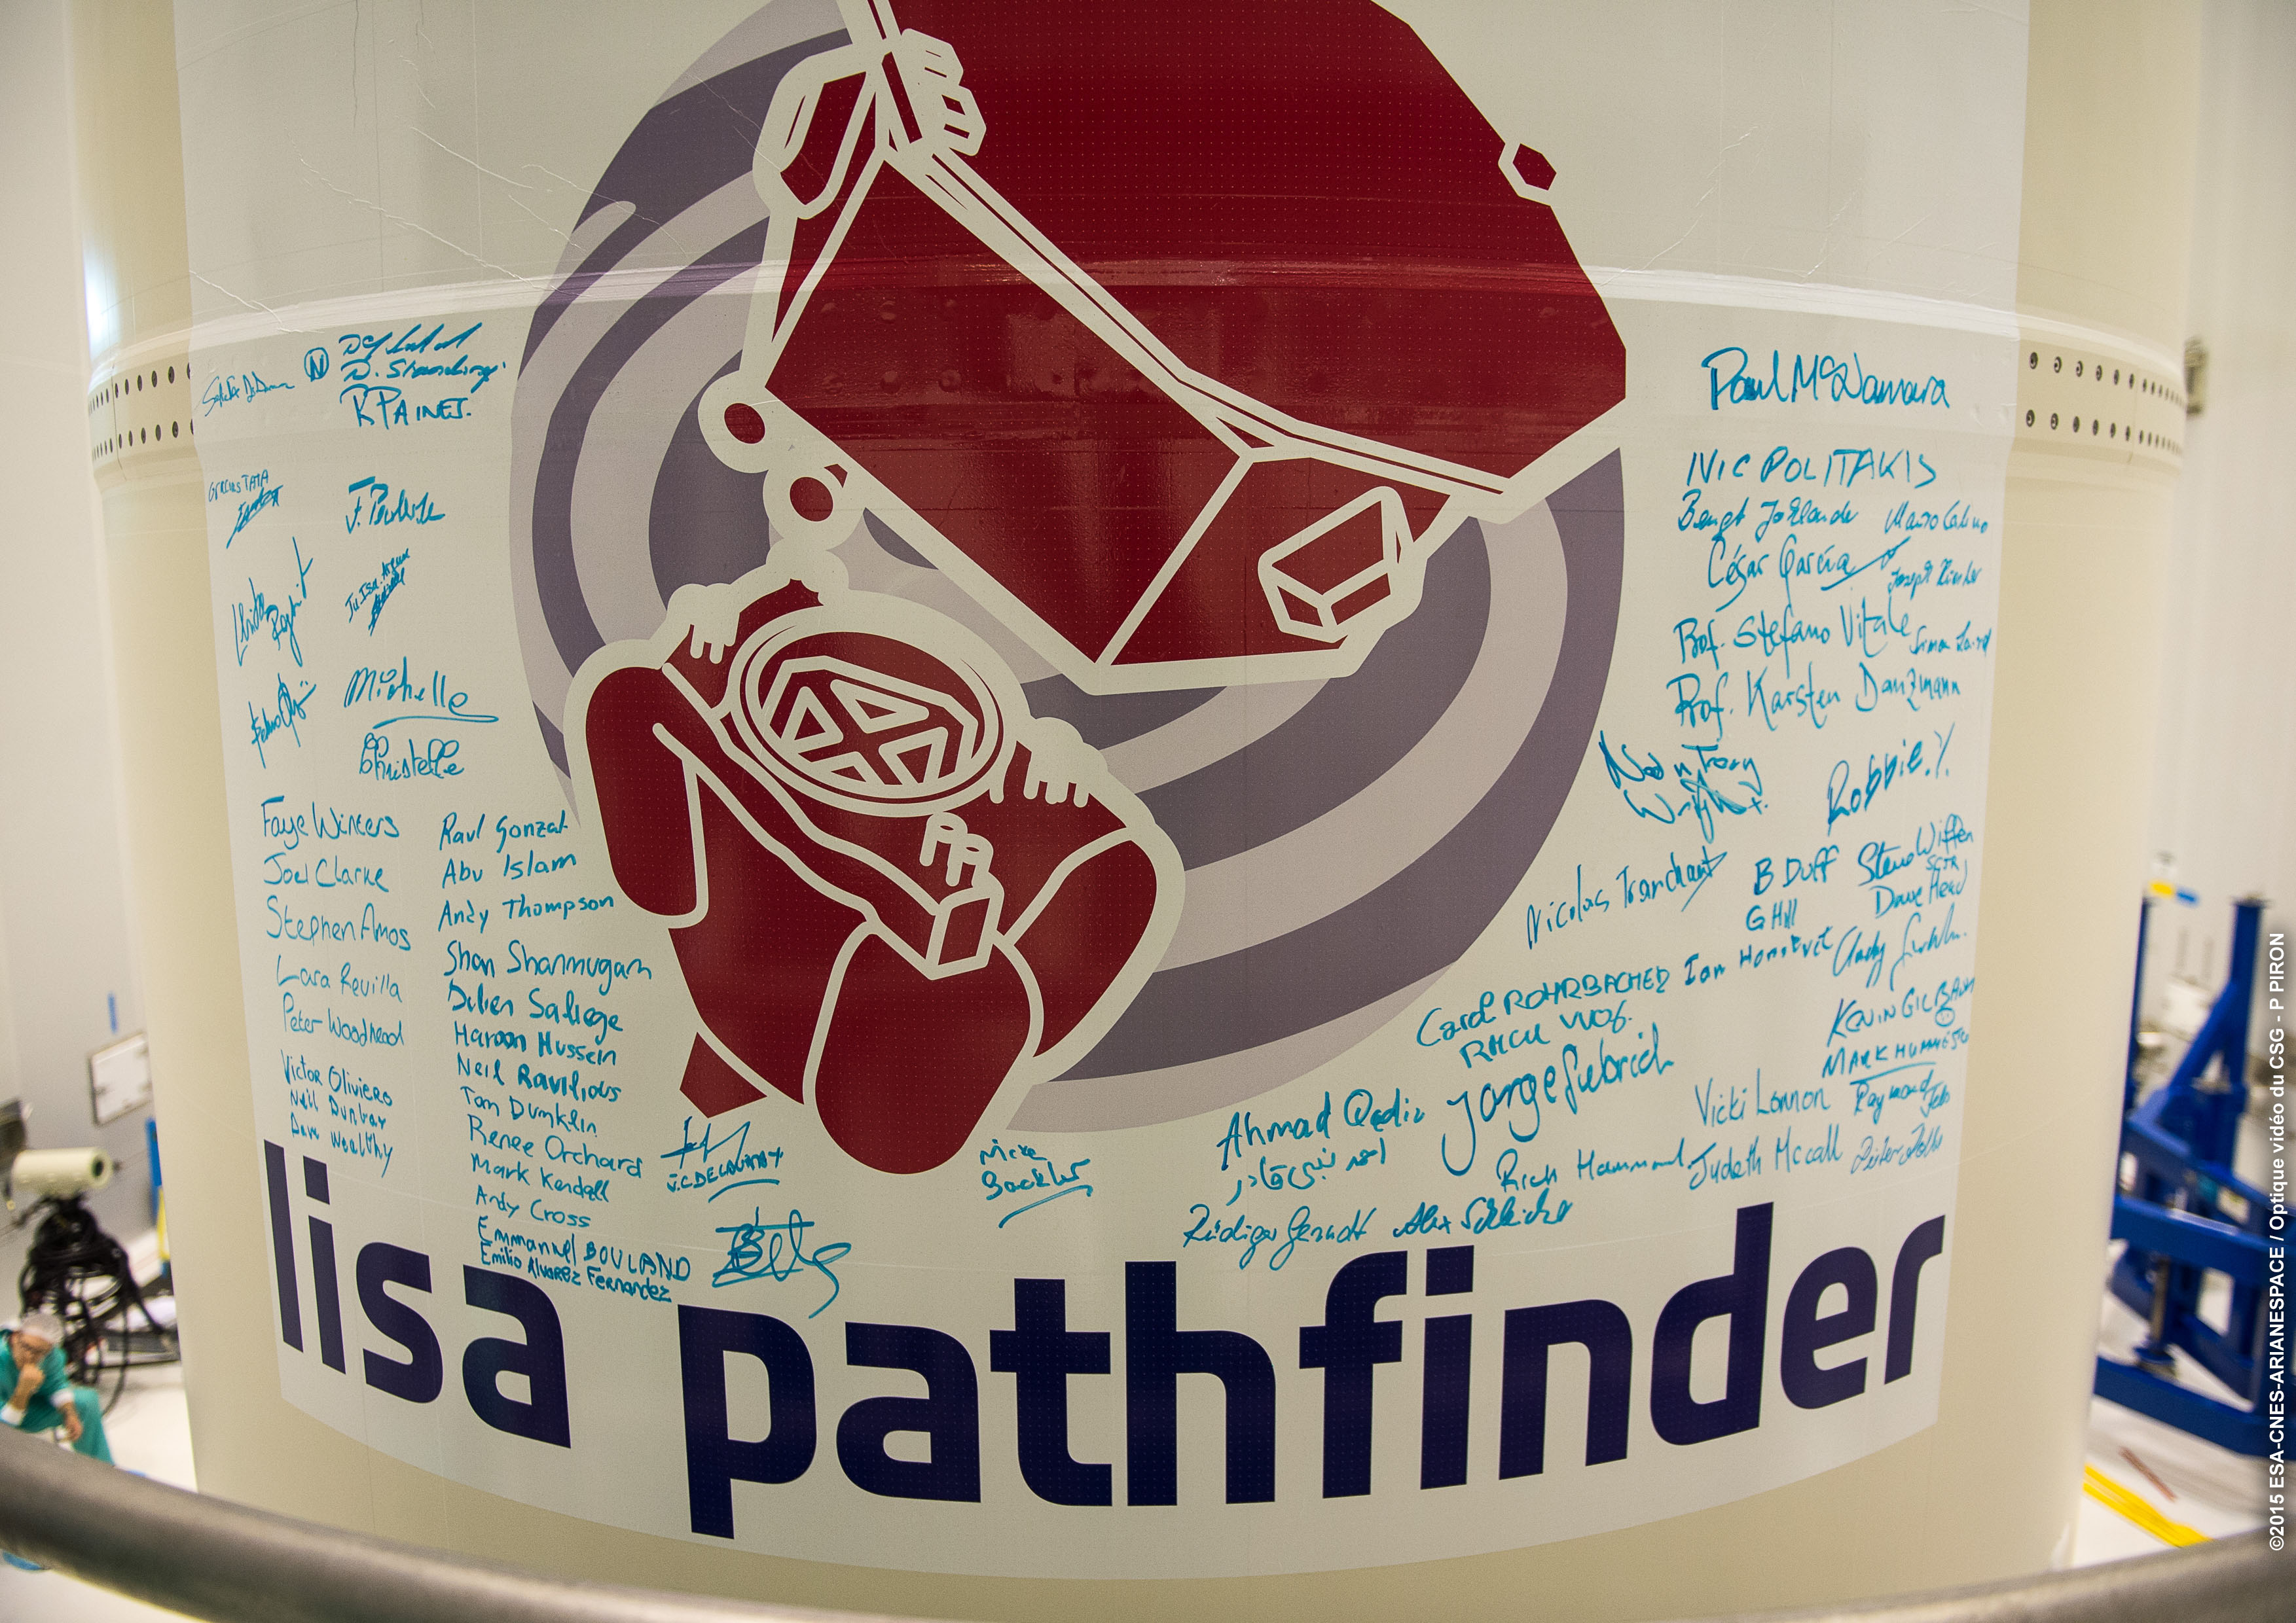
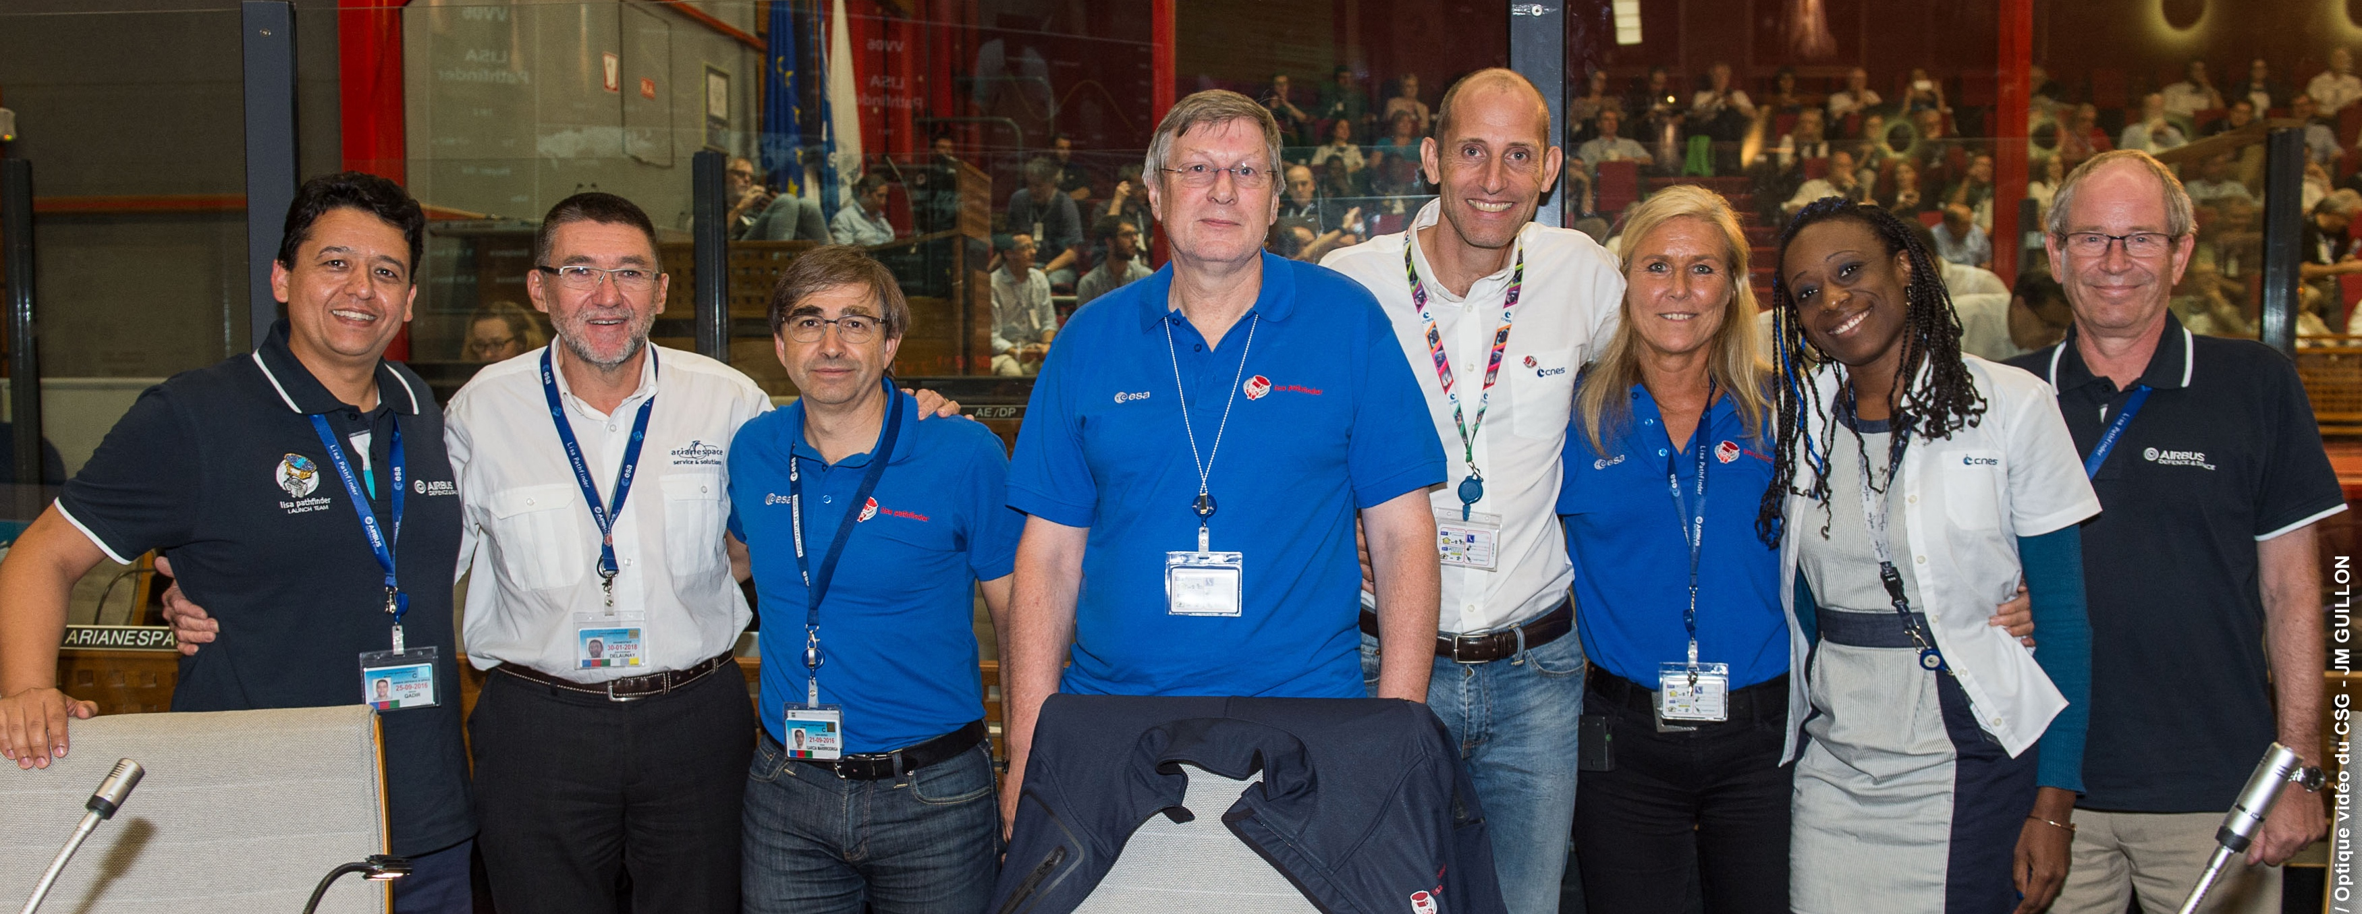
From ground to space: a singularity
Notes:
20151030 family picture
20151117 fairing signature
20151122 scarlet ibis
20151130 Jupiter-2
20151203 Jupiter-2
And the uncertainty was shared by many of you who were present over there.
The LRR take 2 started in the early morning of 2nd December. The air in the room could be cut with a knife. The ESA and CNES DGs were connected by telephone. The presentations were tense and cautions. The questions were direct and pressing.
At a certain point of the discussion, I was asked to step up to the table of the board to answer questions. The ESA’s DG asked me two:
If the second AVUM burn fails, can you still achieve the mission goals?
What do you think: should we launch LPF?
How could anyone be ready to answer with facts?
To the first question the answer was that we had never analysed starting the mission from a low, circular orbit, BUT that we would attempt to use the LPF propulsion module to reach a high highly eliptical orbit and salvage some of the operations.
To the second, I could only mumble that I had no reasons not to trust the assessments given by the launcher experts. A double negative, one could object, but a leap over fatality. I learnt later that the two DGs had had severe discrepancies, and that the decision to proceed with the chronology was taken unilaterally.
Phone calls to the teams followed, and the teams immediately recovered the high morale.

Slide 11
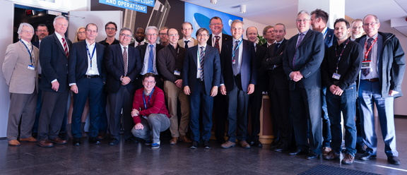
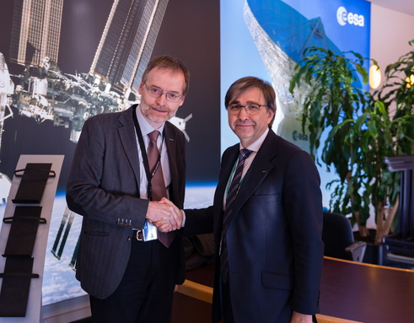
Floating free
7 March 2016, IOCR
Notes:
20150307 IOCR
I assume that some other talks during these two days will describe the events around the in-orbit test masses release and the interferometer and electrostatics systems.
From my side, I can only say that when that happened, I felt that the heavy and long-standing weight I had been carrying on my shoulders for many years vanished.
By IOCR in March 2016, the performance leap had been guaranteed. And that meant, for LISA, that the TRL=7 would be achieved.
The door was open to GW detection from space.

Slide 12
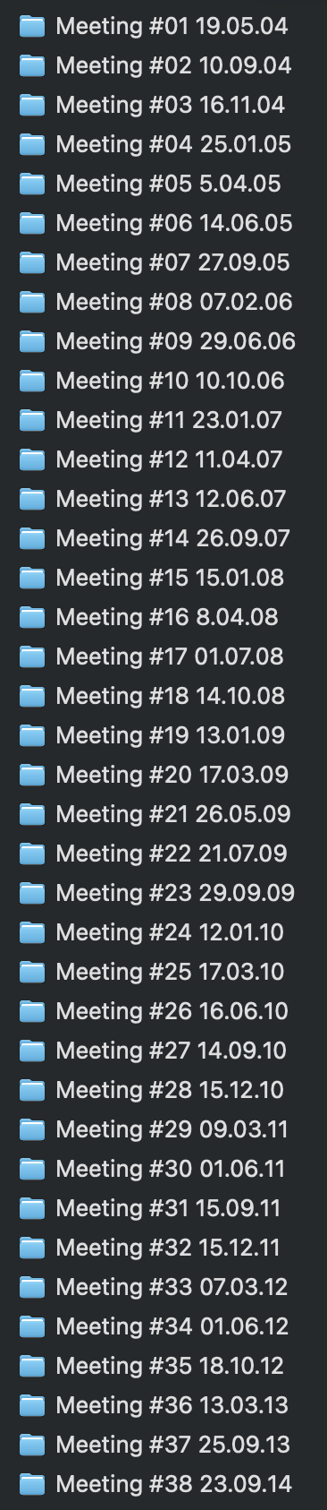
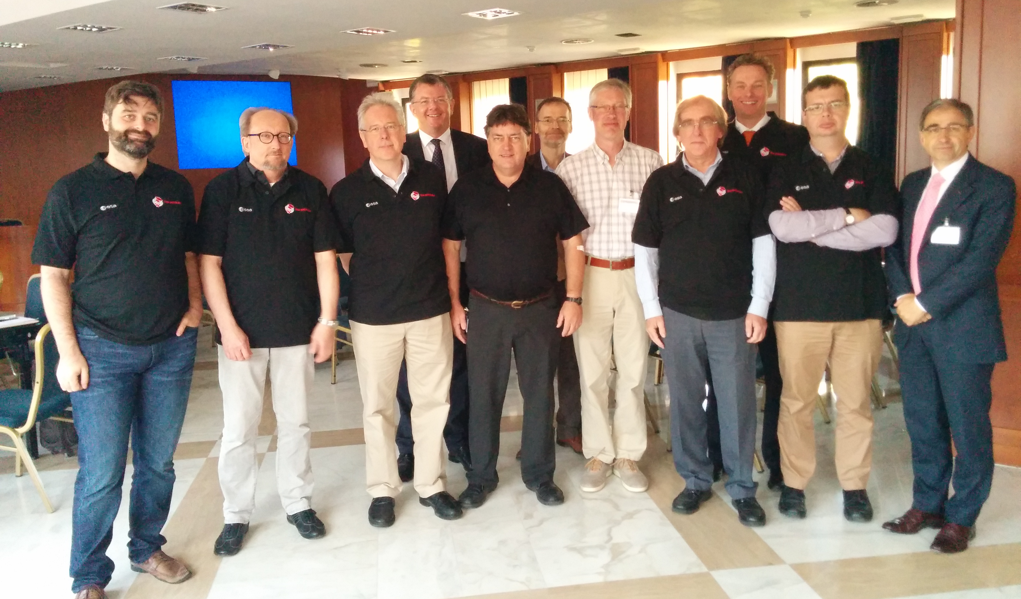
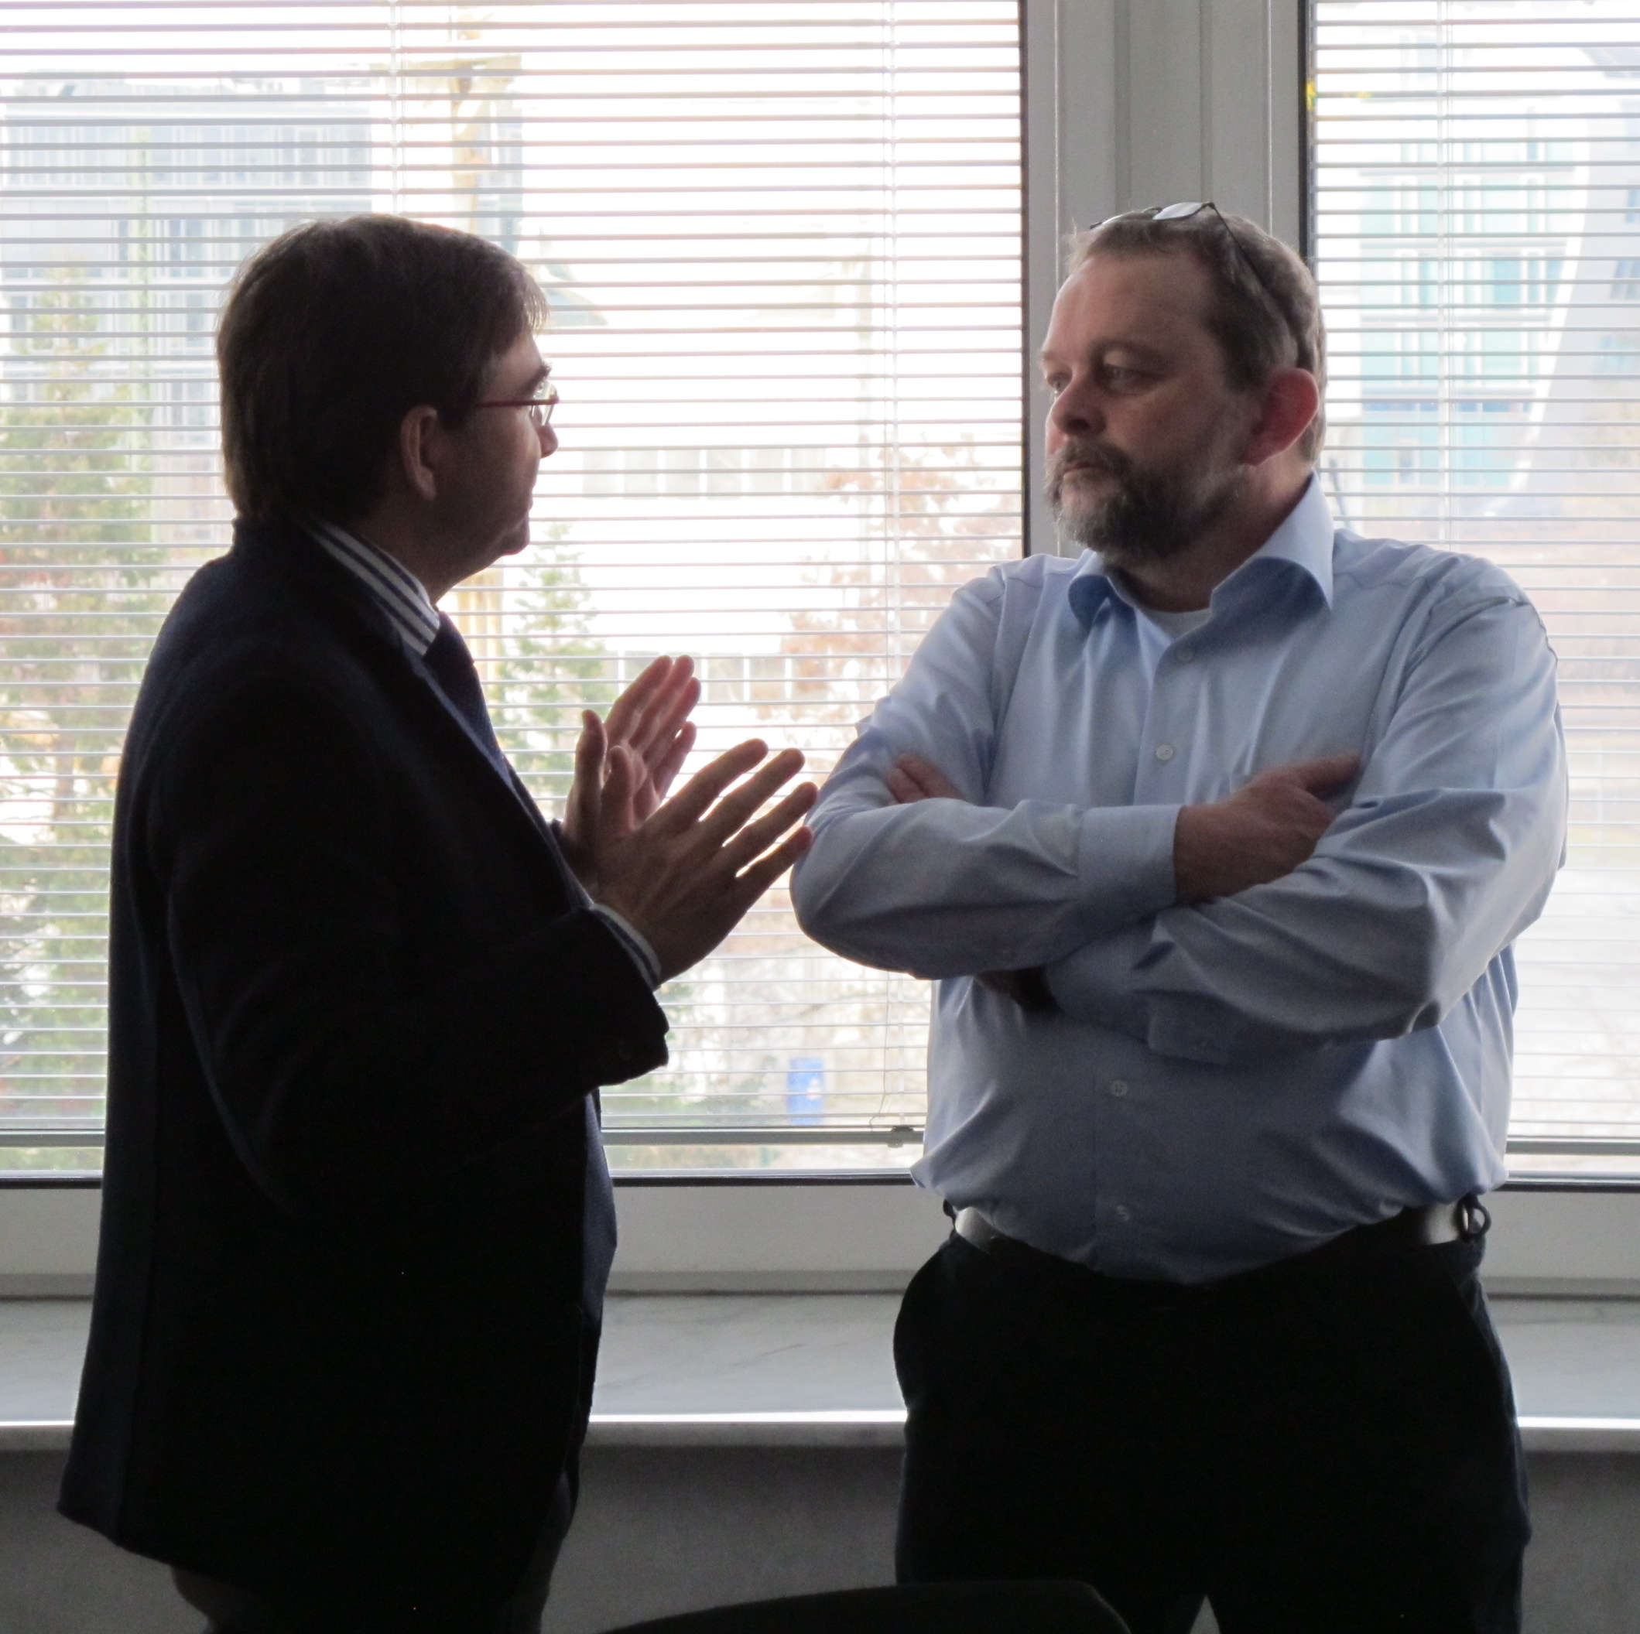
A GOAT with hindsight and foresight
Sorry, no photos of the GOAT. Instead two of NPM and Steering Cttee meetings
Sep 2014 at CGS & March 2012 at DLR
Notes:
Throughout 2015, an ESA-external Gravitational Observatory Advisory Team (GOAT) looked deeply into the scientific and technical implementation of L3 (LISA). Paul McNamara and I were called in one of their meetings on 16th September of that year.
Context: The QAR board had taken place on 3rd September, and the s/c was on its way to Kourou to start the launch campaign. Yes, we were terribly busy, but we were also confident LPF was ready to fly. And we could both give the GOAT a hopeful message about the key steps towards LISA.
The GOAT report came out at the end of March 2016, days after the successful conclusion of the LPF IOCR (in-orbit commissioning review). They concluded that the technical and scientific knowledge base now residing in Europe, because of LISA Pathfinder, argued for the implementation of a GW observatory under European leadership. They took another leap of judgement when affirming that an L3 mission in GW was technically feasible, with laser interferometry between free-falling test masses as a well-established technical baseline.
[Stop here]
The report also addressed the elephant in the room: LISA could start soon after LPF but there were programmatic constraints. Unfortunately, these remained in place until mid 2022, what led to the LISA adoption in February 2024, one year before than expected back then.
The GOAT report and other assessments identified other technology gaps for LISA, beyond what LPF had de-risked. Improving the TRL for these was the work, in Europe and the USA, in the years that followed LPF, and included:
The LISA super-computer, or Phase Measurement System
The Telescope, the laser system, the huge optical bench
An UV photo-diode based electrostatic discharge system
New diagnostics
New IR quadrant photo-receptors
Low noise mechanisms
And many system studies, including data processing

Slide 13
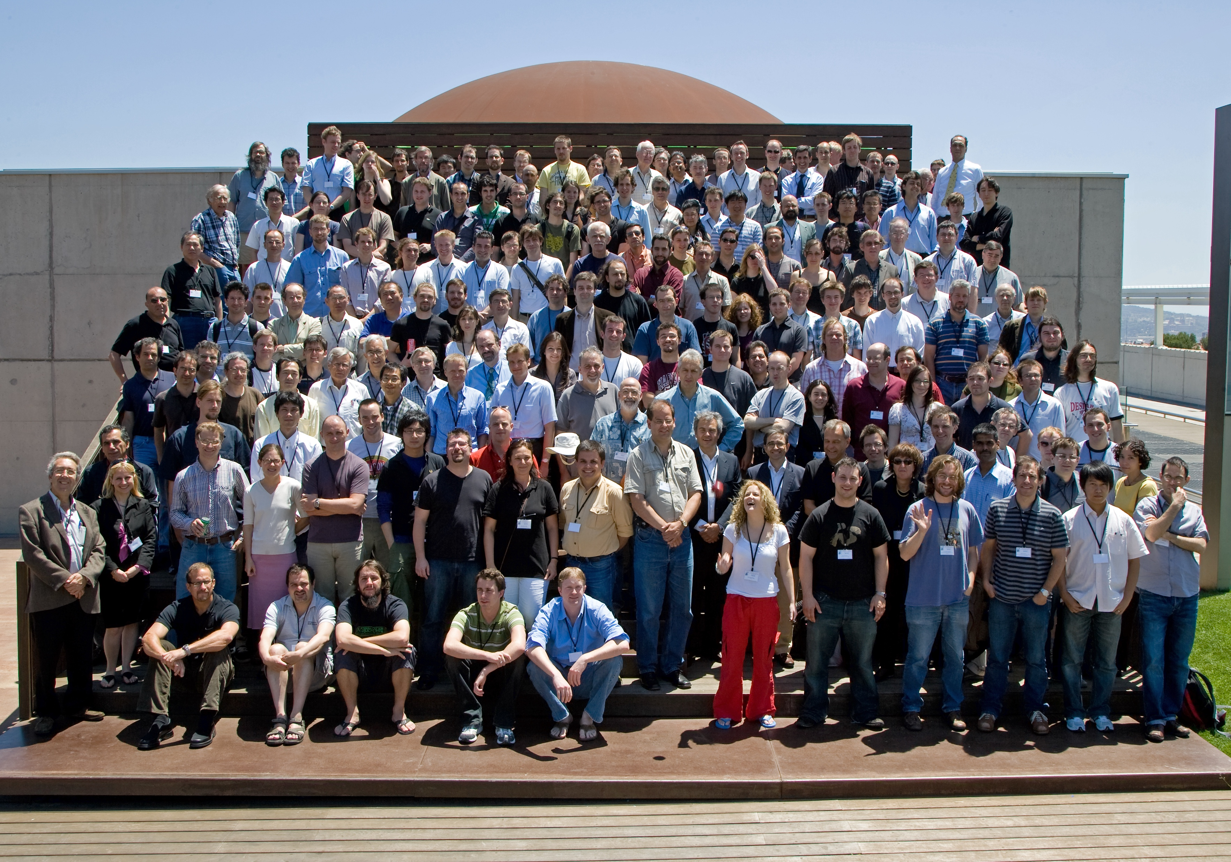
The community’s passage through valley of death
LISA Symposium, Barcelona, June 2008
Notes:
In TRL progression, it is common to languish in the so-called “valley of death”. The project is not financed, the requirements are flowing, the teams are being built up, there is insufficient information and commitment to reach or exceed TRL 5 or 6.
This valley has been unnecesarily wide for LISA after LPF results. I find it amazing that so many individuals, teams and member states have made it through. One could say this has been a leap of endurance.
Over the decades, as an engineer, I have had the priviledge of working with different communities of space scientists. Maybe GW science did not have an established community when LPF started. But believe me when I say that Europe should be happy with your direct experience in space instrumentation development and with your cooperative attitude, in addition to your scientific excellence.
I believe that LPF also contributed to inspire and nurture future generations of scientists and engineers; this is certainly the case of my own son!
Community leap: compare with Soho and Solars.

Slide 14
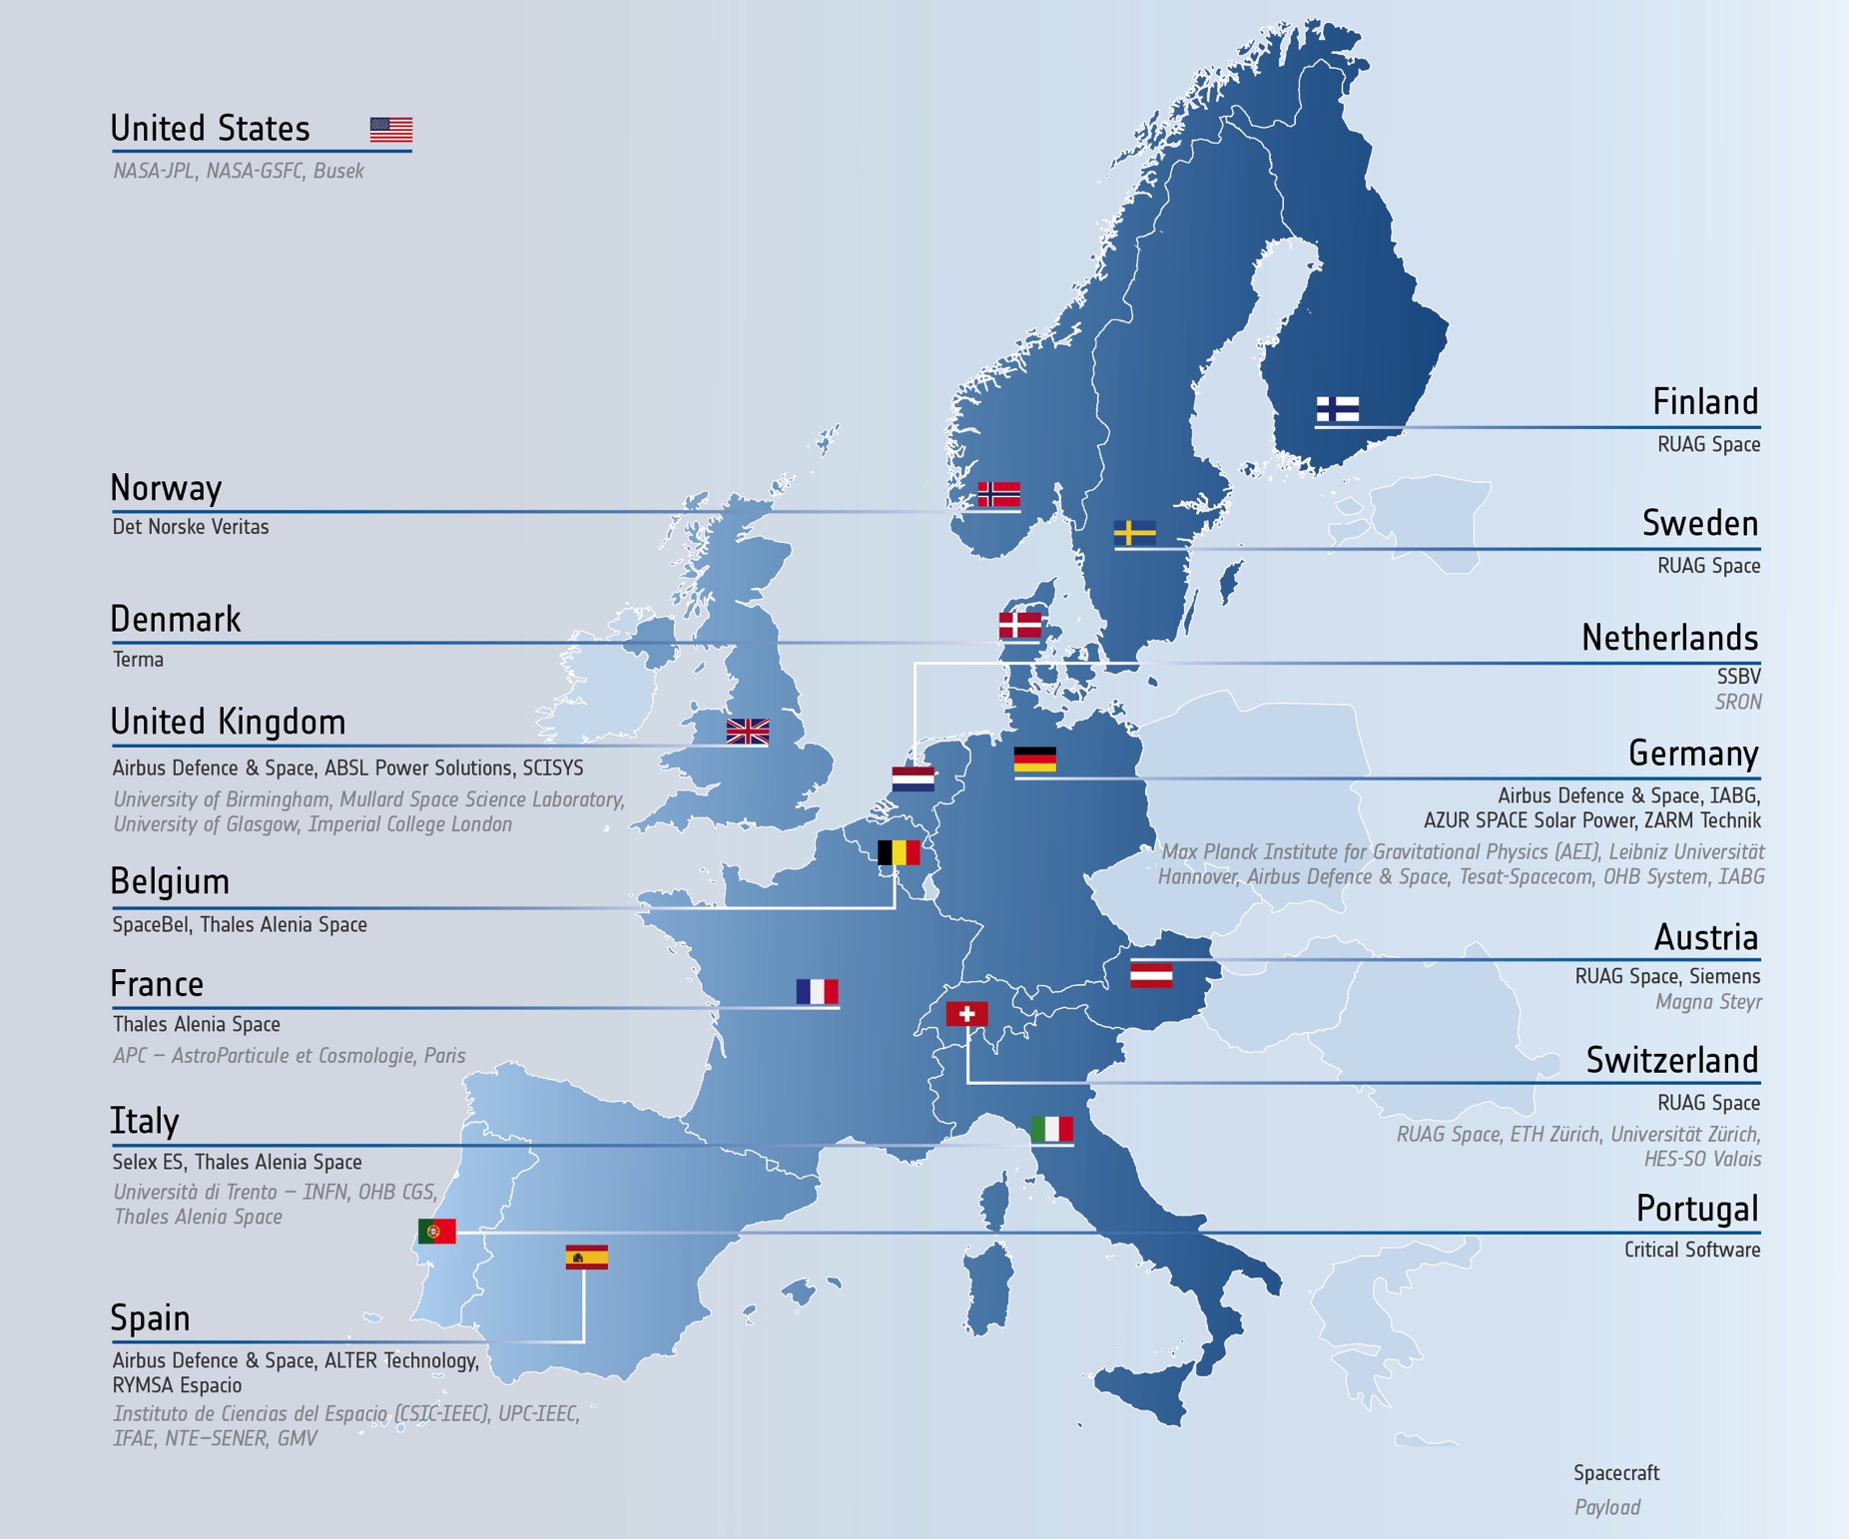
Scientists & engineers working together
Notes:
ESA (ESTEC, ESAC, ESOC, LAU)
EADS Astrium (UK, GmbH)
University of Trento
Albert Einstein Institute
University of Glasgow
University of Birmingham
Imperial College London
ETH Zurich
Institut d-Estudis Espacials de Catalunya
Universidad Politecnica de Barcelona
APC Paris
IFR Stuttgart
Carlo Gavazzi Space
Laben
ALTA
ARCS
Selex
Contraves
Kaiser Threde
NTE
SCISYS
Spacebel
SRON
Tecnológica
TESAT
ZARM
JPL
NASA (GSFC, HQ)
BUSEK

Slide 15
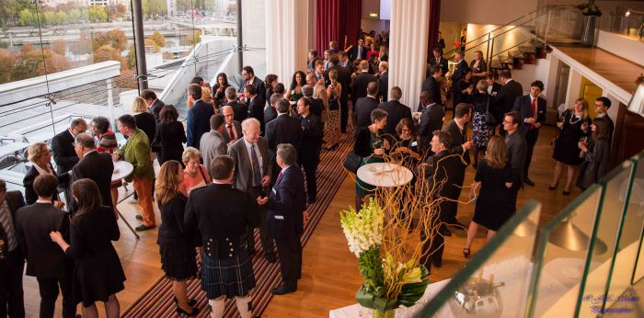
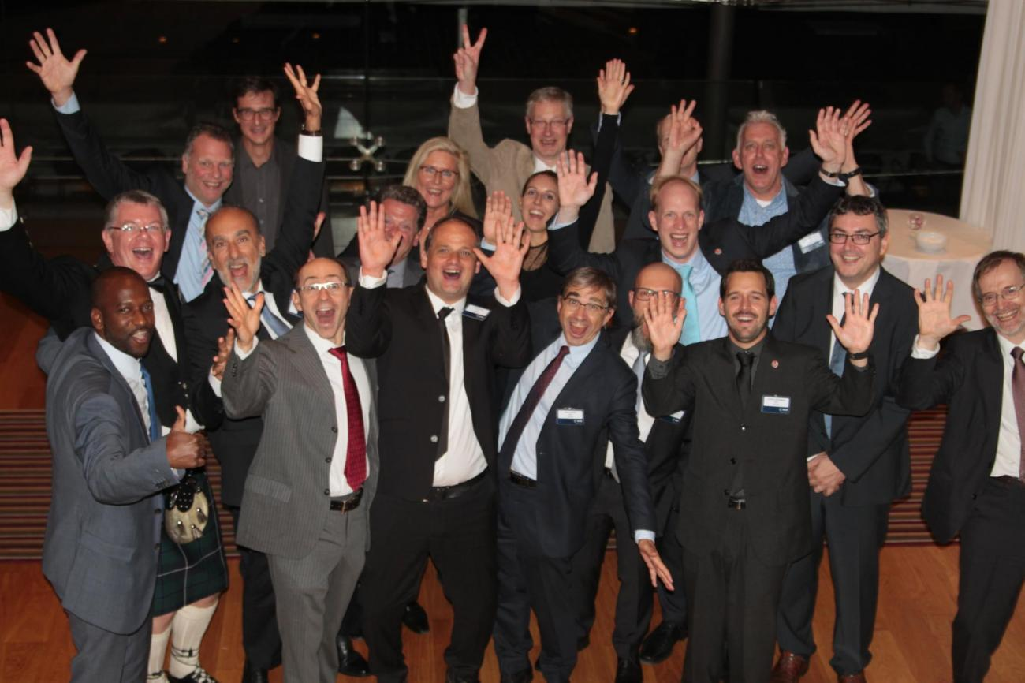
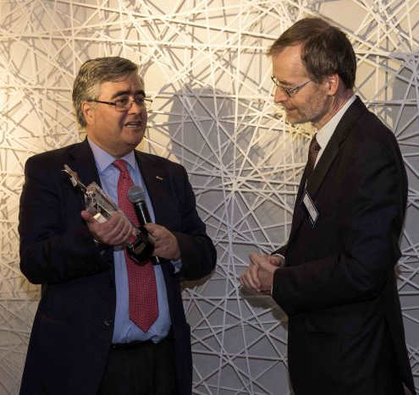
10 years: a milestone to celebrate
2016 ESA Team Achievement Award for the LISA Pathfinder Team
Notes:
[Scientists, space, operations and launcher engineers, managers, all in one room!]
This concludes my thoughts today about the significance of LPF. Yes, we celebrate the 10th anniversary of the launch and the success of the project in opening the door to LISA. It has been a leap in many senses.
However, more than that, I value our life experiences, our personal and professional bettering, and the sight of the younger generations being inspired by what we, together, accomplished.
Thank you very much for your attention.

Slide 16

Thank you!
LPF was the first step to observing GW from space, and opened the door to the present, and the future… Stardate 45397.3
Star Trek The Next Generation
“Hero Worship”

