Slide 1
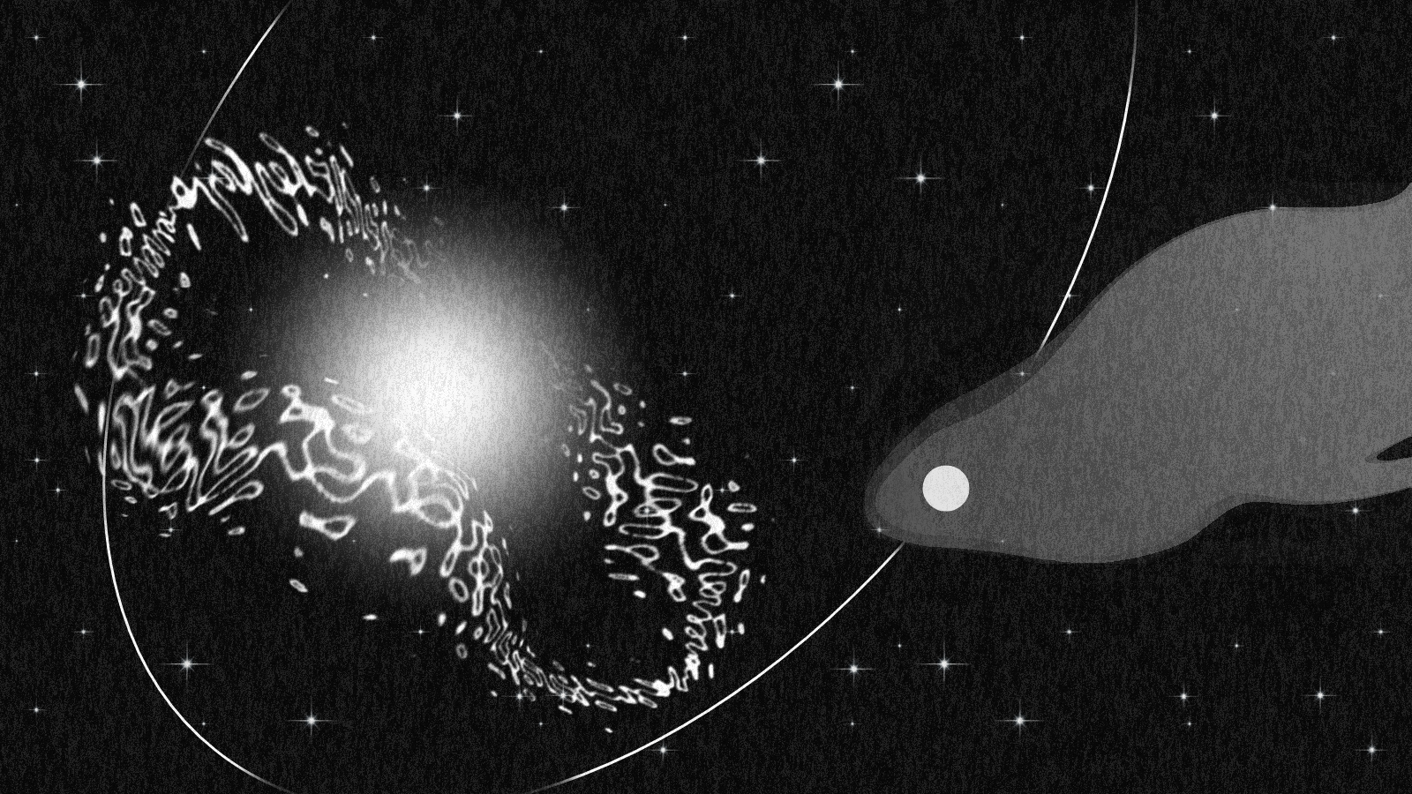

The Missing Lines:
Constraining Disk Parameters in Gamma-Ray Binaries
with NewAthena
Iuliia Shebalkova¹, Maria Chernyakova¹
and Joern Wilms²
NewAthena Rising: SWG4
Barcelona Jun 2 – 5
¹Dublin City University ²Dr. Karl Remeis-Observatory Bamberg​

Slide 2
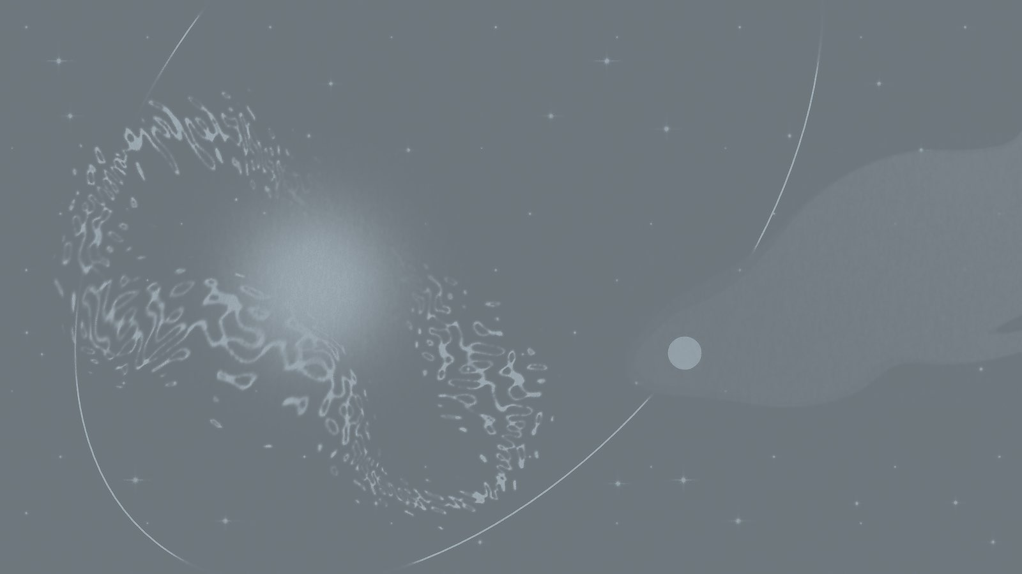

HMXBs vs γ-ray Binaries:
Similar Systems, Different Behavior
Iuliia Shebalkova
The Missing Lines: Constraining Disk Parameters in Gamma-Ray Binaries
NewAthena Rising: SWG4
Barcelona June 2-5

Slide 3
HMXBs vs γ-ray Binaries: Similar Systems, Different Behavior
Сharacteristic | HMXBs | γ- ray Binaries
Components
Iuliia Shebalkova
The Missing Lines: Constraining Disk Parameters in Gamma-Ray Binaries
NewAthena Rising: SWG4
Barcelona June 2-5

Slide 4
HMXBs vs γ-ray Binaries: Similar Systems, Different Behavior
Сharacteristic | HMXBs | γ- ray Binaries
Components | Massive O/B star + compact object | Massive O/B star + compact object
compact object
O/B Star
Iuliia Shebalkova
The Missing Lines: Constraining Disk Parameters in Gamma-Ray Binaries
NewAthena Rising: SWG4
Barcelona June 2-5

Slide 5
HMXBs vs γ-ray Binaries: Similar Systems, Different Behavior
Сharacteristic | HMXBs | γ- ray Binaries
Population Size
Iuliia Shebalkova
The Missing Lines: Constraining Disk Parameters in Gamma-Ray Binaries
NewAthena Rising: SWG4
Barcelona June 2-5

Slide 6
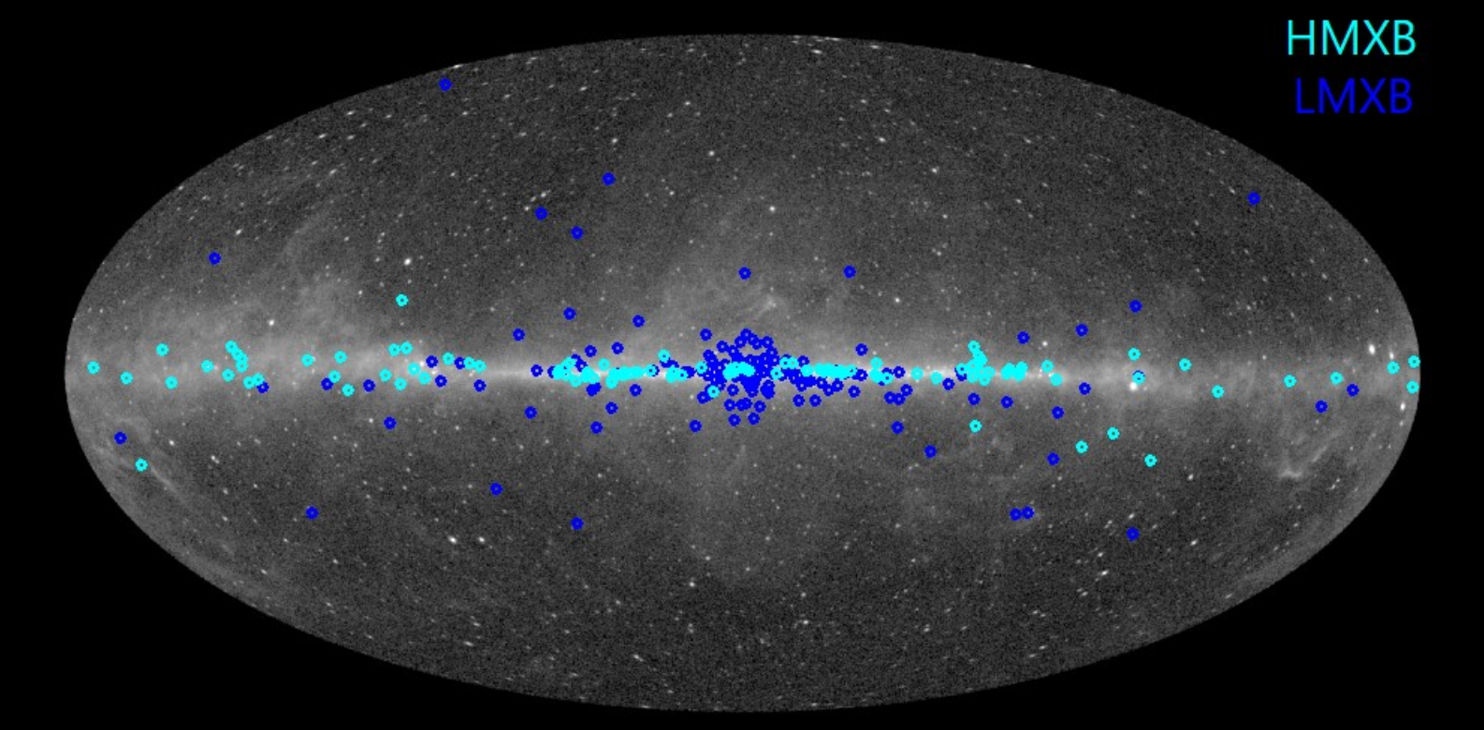
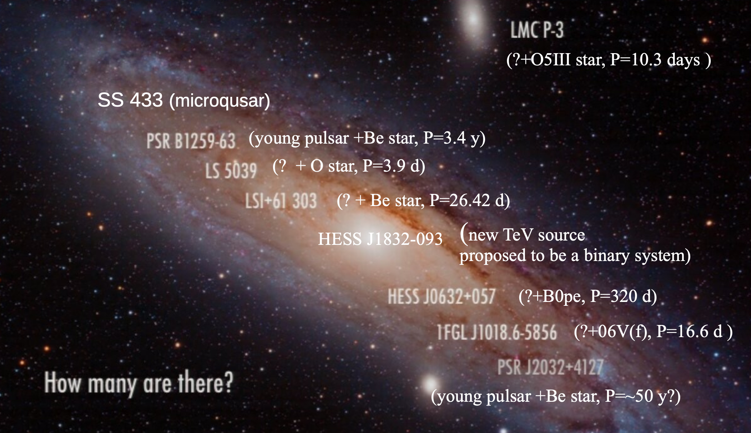
HMXBs vs γ-ray Binaries: Similar Systems, Different Behavior
Сharacteristic | HMXBs | γ- ray Binaries
Population Size | Large population | Rare subclass, only a small number known
Distribution of LMXBs and HMXBs (RXTE)
Distribution of γ-ray Binaries
Iuliia Shebalkova
The Missing Lines: Constraining Disk Parameters in Gamma-Ray Binaries
NewAthena Rising: SWG4
Barcelona June 2-5

Slide 7
HMXBs vs γ-ray Binaries: Similar Systems, Different Behavior
Сharacteristic | HMXBs | γ- ray Binaries
Emission Peak
Iuliia Shebalkova
The Missing Lines: Constraining Disk Parameters in Gamma-Ray Binaries
NewAthena Rising: SWG4
Barcelona June 2-5

Slide 8
HMXBs vs γ-ray Binaries: Similar Systems, Different Behavior
Сharacteristic | HMXBs | γ- ray Binaries
Emission Peak | X-rays | Gamma rays (> 1MeV)
Iuliia Shebalkova
The Missing Lines: Constraining Disk Parameters in Gamma-Ray Binaries
NewAthena Rising: SWG4
Barcelona June 2-5

Slide 9
HMXBs vs γ-ray Binaries: Similar Systems, Different Behavior
Сharacteristic | HMXBs | γ- ray Binaries
Emission Mechanism
Iuliia Shebalkova
The Missing Lines: Constraining Disk Parameters in Gamma-Ray Binaries
NewAthena Rising: SWG4
Barcelona June 2-5

Slide 10
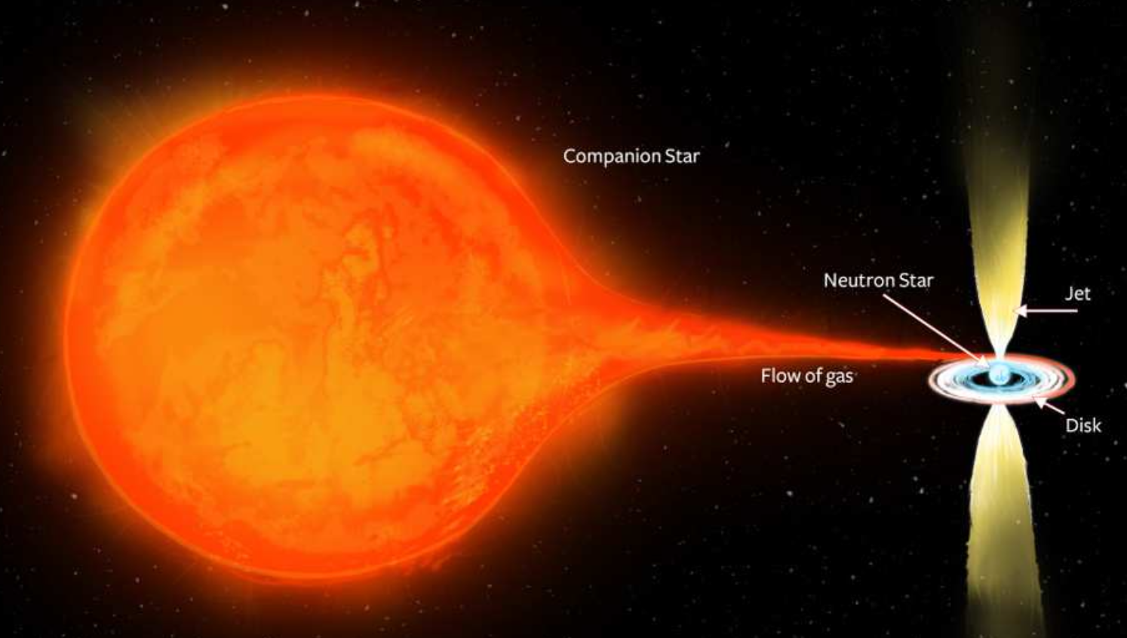
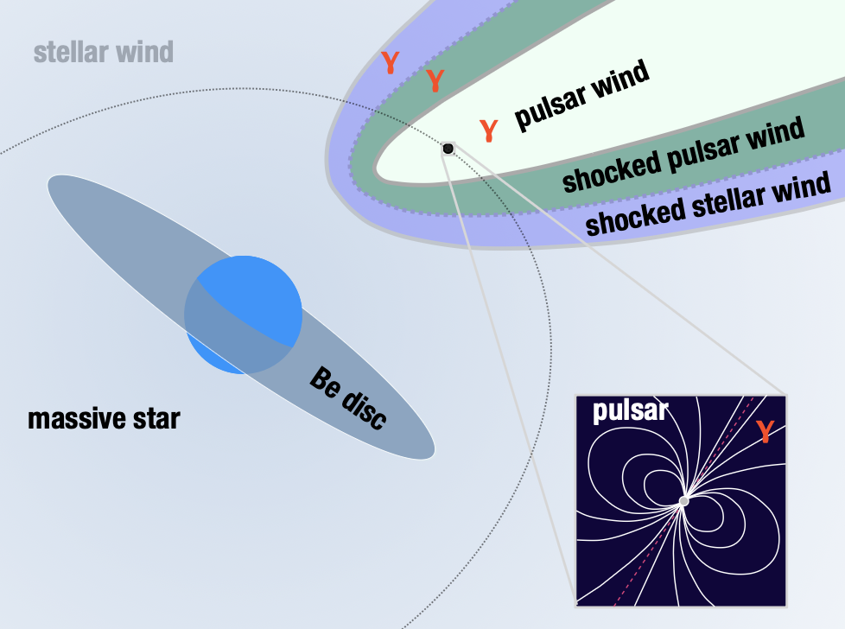
HMXBs vs γ-ray Binaries: Similar Systems, Different Behavior
Сharacteristic | HMXBs | γ- ray Binaries
Emission Mechanism | Accretion-powered emission | Particle acceleration in shocked outflow/pulsar-wind scenario
Credit: ICRAR
Credit: G. Dubus (2006)
Iuliia Shebalkova
The Missing Lines: Constraining Disk Parameters in Gamma-Ray Binaries
NewAthena Rising: SWG4
Barcelona June 2-5

Slide 11
HMXBs vs γ-ray Binaries: Similar Systems, Different Behavior
Сharacteristic | HMXBs | γ- ray Binaries
X-ray Spectrum
Iuliia Shebalkova
The Missing Lines: Constraining Disk Parameters in Gamma-Ray Binaries
NewAthena Rising: SWG4
Barcelona June 2-5

Slide 12
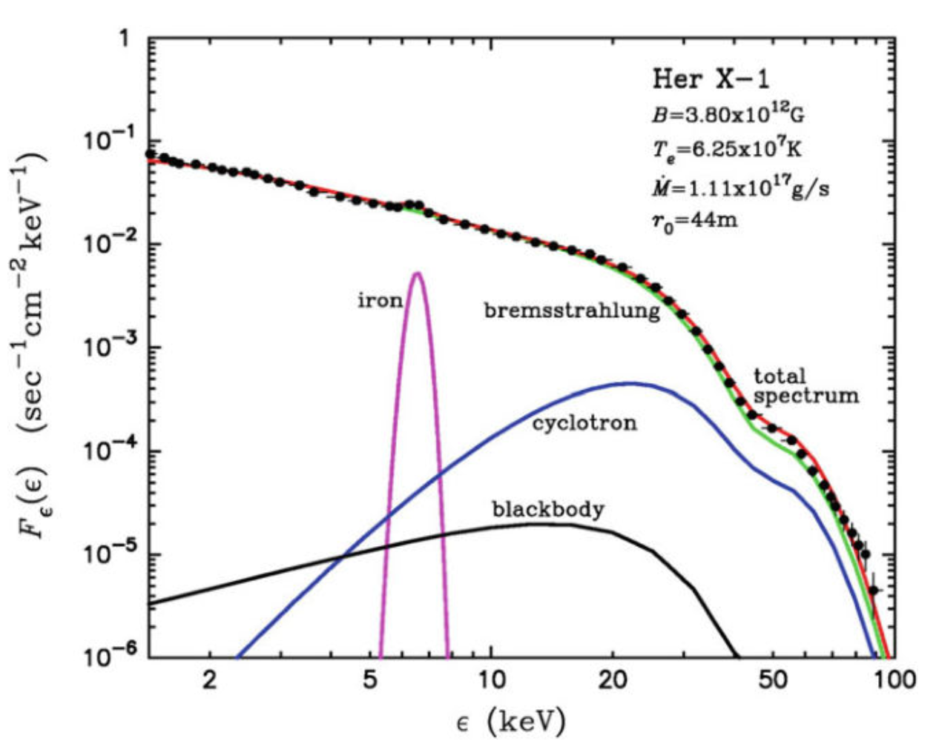
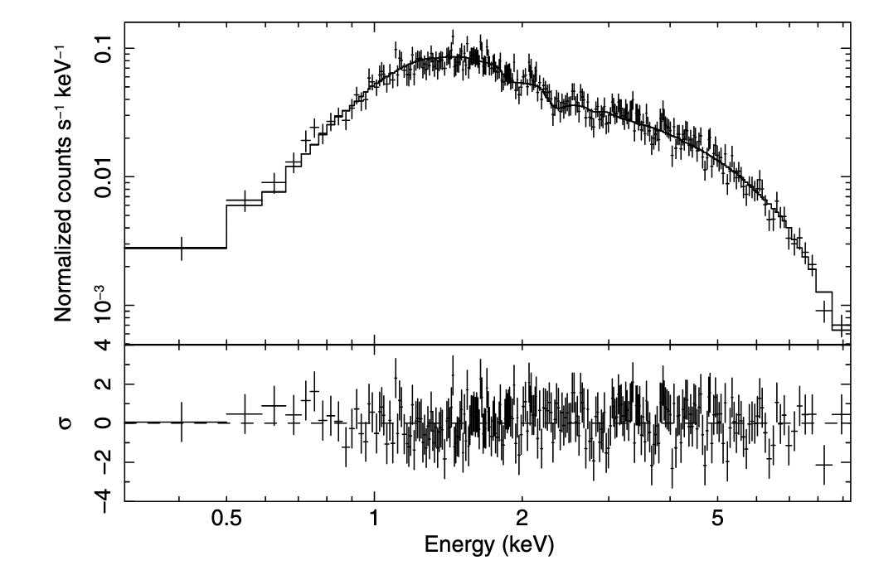
HMXBs vs γ-ray Binaries: Similar Systems, Different Behavior
Сharacteristic | HMXBs | γ- ray Binaries
X-ray Spectrum | Thermal / accretion-related component, rich spectrum | Non-thermal, no spectral features
Credit: Becker and Wolff (2007)
Credit: Esposito et al. (2007)
X-ray spectrum (BeppoSAX) for Her X-1 with best-fit model
Swift/XRT spectrum of LS I +61◦ 303 with best-fit power-law model
Iuliia Shebalkova
The Missing Lines: Constraining Disk Parameters in Gamma-Ray Binaries
NewAthena Rising: SWG4
Barcelona June 2-5

Slide 13
HMXBs vs γ-ray Binaries: Similar Systems, Different Behavior
Сharacteristic | HMXBs | γ- ray Binaries
Components | Massive O/B star + compact object | Massive O/B star + compact object
Emission Mechanism | Accretion-powered emission | Particle acceleration in shocked outflow/pulsar-wind scenario
Emission Peak | X-rays | > 1 MeV
X-ray Spectrum | Thermal / accretion-related component, rich spectrum | Non-thermal, no spectral features
Population Size | Large population | Rare subclass, only a small number known
Iuliia Shebalkova
The Missing Lines: Constraining Disk Parameters in Gamma-Ray Binaries
NewAthena Rising: SWG4
Barcelona June 2-5

Slide 14
X-ray Spectrum of γ-ray Binaries
Iuliia Shebalkova
The Missing Lines: Constraining Disk Parameters in Gamma-Ray Binaries
NewAthena Rising: SWG4
Barcelona June 2-5

Slide 15

X-ray Spectrum of γ-ray Binaries
Spectrum: absorbed power law model
Credit: Esposito et al. (2007)
Swift/XRT spectrum of LS I +61◦ 303 with best-fit power-law model
Iuliia Shebalkova
The Missing Lines: Constraining Disk Parameters in Gamma-Ray Binaries
NewAthena Rising: SWG4
Barcelona June 2-5

Slide 16
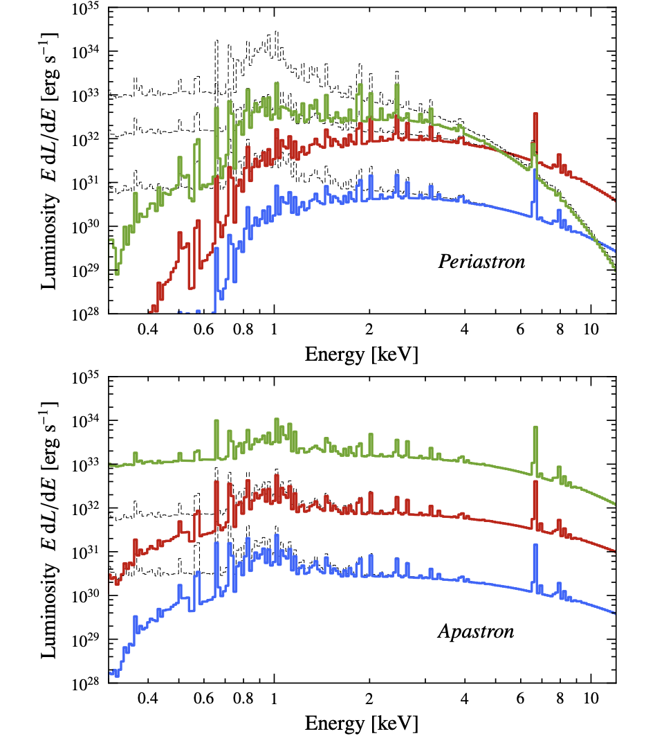
X-ray Spectrum of γ-ray Binaries
Spectrum: absorbed power law model
Motivation from theory: models predict thermal emission from shocked stellar wind
Model X-ray spectra of the shocked stellar wind in LS 5039 at periastron and apastron for different pulsar spin-down luminosities.
Credit:Zabalza et al. (2011)
Iuliia Shebalkova
The Missing Lines: Constraining Disk Parameters in Gamma-Ray Binaries
NewAthena Rising: SWG4
Barcelona June 2-5

Slide 17
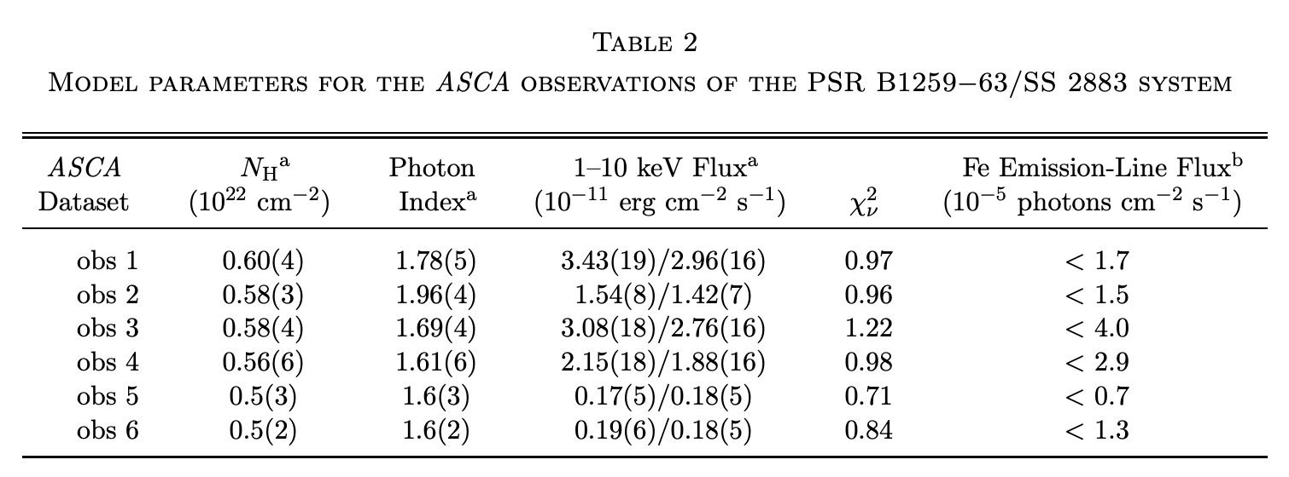
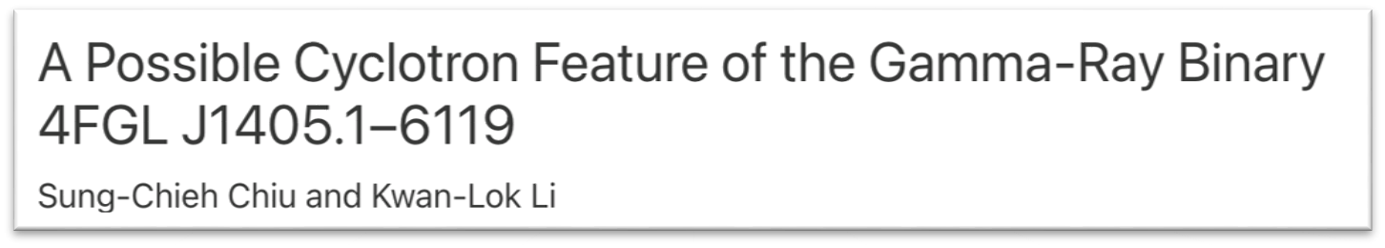
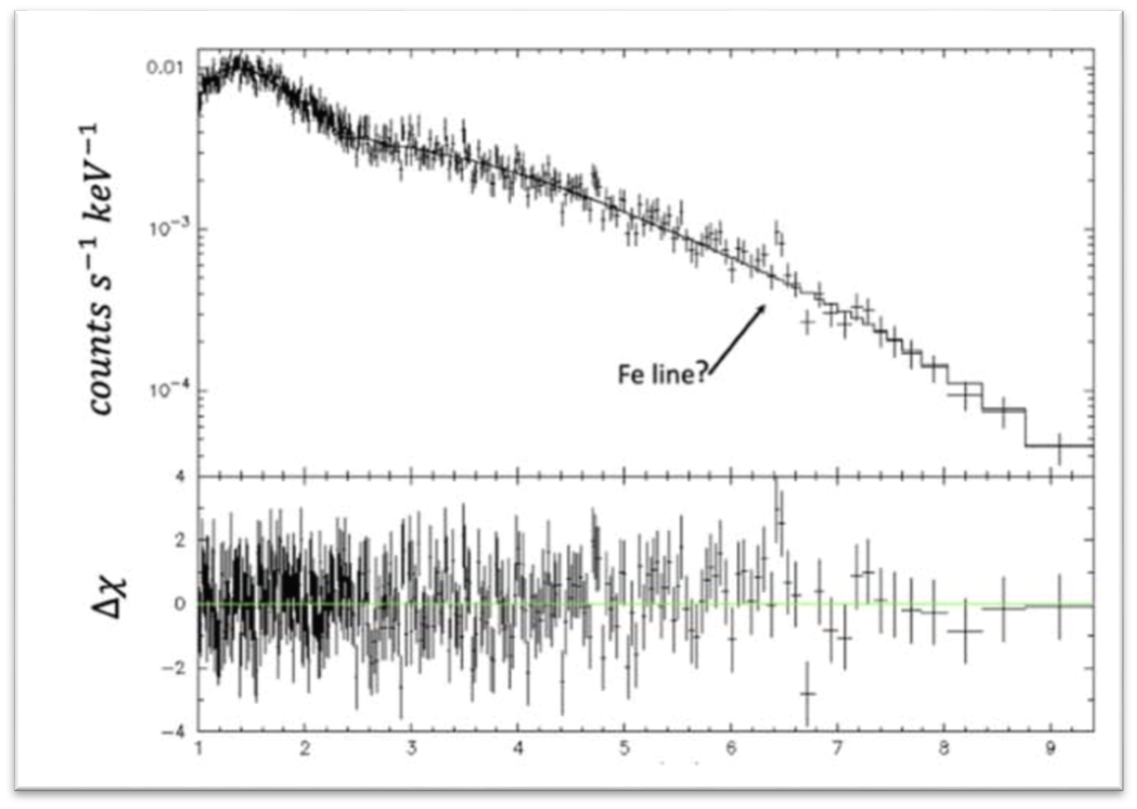
X-ray Spectrum of γ-ray Binaries
Credit: Hirayama, M. et al. (1999)
Spectrum: absorbed power law model
Motivation from theory: models predict thermal emission from shocked stellar wind
Current observational picture:
so far, no convincing detections;
our results are consistent with this
Credit: Kargaltsev et al. (2022)
Iuliia Shebalkova
The Missing Lines: Constraining Disk Parameters in Gamma-Ray Binaries
NewAthena Rising: SWG4
Barcelona June 2-5

Slide 18
X-ray Spectrum of γ-ray Binaries
Spectrum: absorbed power law model
Can we detect thermal X-ray emission?
Motivation from theory: models predict thermal emission from shocked stellar wind
Current observational picture:
so far, no convincing detections;
our results are consistent with this
Yes:
direct plasma and wind diagnostics
No:
upper limits on thermal component, then constraints on $L_{sd}$ and wind properties
Physical interpretation:
both detection and non-detection are informative!
See e.g. Zabalza et al. (2011)
Iuliia Shebalkova
The Missing Lines: Constraining Disk Parameters in Gamma-Ray Binaries
NewAthena Rising: SWG4
Barcelona June 2-5

Slide 19
NewAthena Simulations:
PSR B1259-63
Iuliia Shebalkova
The Missing Lines: Constraining Disk Parameters in Gamma-Ray Binaries
NewAthena Rising: SWG4
Barcelona June 2-5

Slide 20
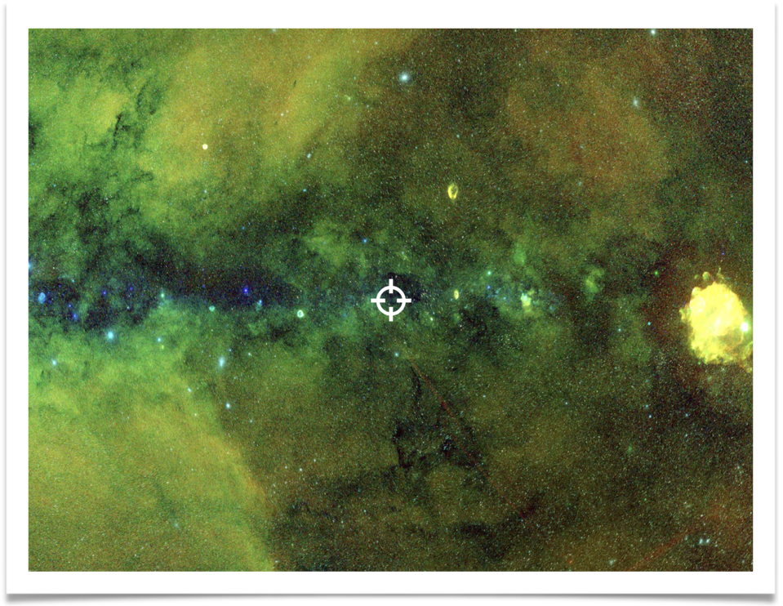
NewAthena Simulations: PSR B1259-63
Why PSR B1259−63?
One of the best-studied gamma-ray binaries
Eccentric orbit: e ≈ 0.87
Orbital period: ∼ 3.7 yr.
Compact object: confirmed millisecond pulsar
Companion: Be star
eROSITA DR1 RGB image of the PSR B1259−63 field; the source is marked on the map.
Iuliia Shebalkova
The Missing Lines: Constraining Disk Parameters in Gamma-Ray Binaries
NewAthena Rising: SWG4
Barcelona June 2-5

Slide 21
NewAthena Simulations: Simulation Framework
Science goal: test detectability of weak thermal X-ray emission / lines /.. in gamma-ray binaries
Baseline case: PSR B1259−63 as the initial target
Strategy: start with minimal simulation setup, then extend to more epochs / parameters / sources
Iuliia Shebalkova
The Missing Lines: Constraining Disk Parameters in Gamma-Ray Binaries
NewAthena Rising: SWG4
Barcelona June 2-5

Slide 22
NewAthena Simulations: Simulation Framework
Source model (.xcm)
tbabs*(PL+apec) or tbabs*(PL+gauss)
SIMPUT generation
input model → SIMPUT source file
SIXTE simulation
X-IFU, infoc optical filter configuration
Spectral extraction
extract spectra for different grating settings
Background options:
          Basic background:
  - NXB (zero-flux source simulation)
  Extended background:
  CXB from AGN-only mock catalogues
  (see http://www.bo.astro.it/~gilli/mock.html)
  ROSAT Soft X-ray Diffuse Background
  (see https://www.sternwarte.uni-erlangen.de/sixte/example-source-files/)
Out of scope (at the moment):
Background time variability
Very bright-source effects: pile-up, crosstalk, defocused mode
Detailed Geant4 background modelling
Full-orbit simulations and full forward modelling
Iuliia Shebalkova
The Missing Lines: Constraining Disk Parameters in Gamma-Ray Binaries
NewAthena Rising: SWG4
Barcelona June 2-5

Slide 23
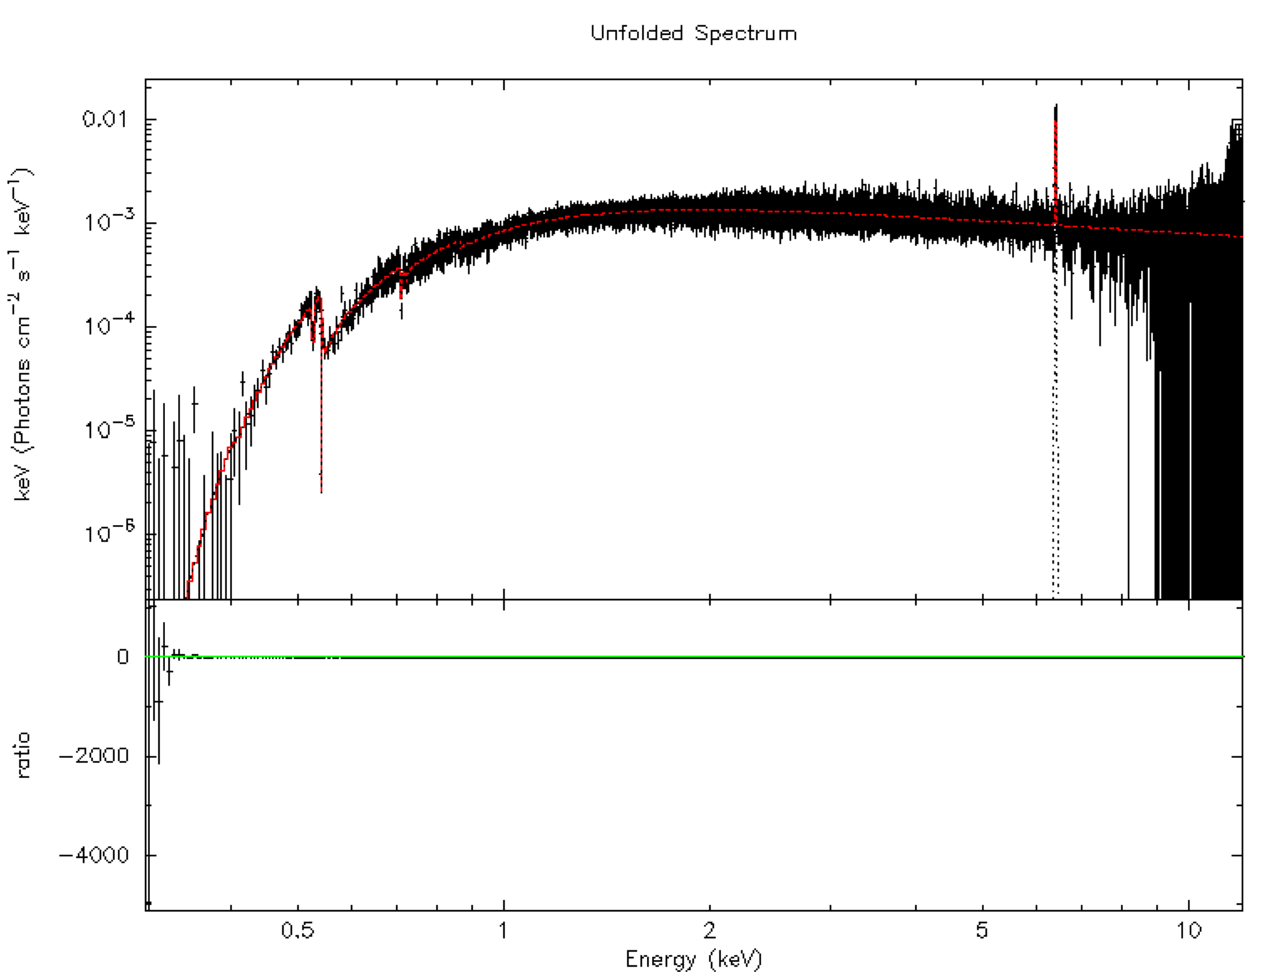
NewAthena Simulations: Example
The X-IFU spectrum was simulated with SIXTE for a
50ks exposure, assuming an in-focus observation with the optical filter and standard NXB background.
PSR B1259−63 was modeled (tbabs*(powerlaw+gauss))
  NH = 0.52
  photon index Gamma = 1.41,
  power-law normalization = 6.13e-4
based on params for ObsID=0881420301 (XMM-Newton).
A weak Fe line at 6.4 keV was added to test whether line emission could be recovered in the normal-resolution (GRADING >= 1) setup.
Software Versions:
SIXTE 3.4.0 | SIMPUT 2.8.0
Iuliia Shebalkova
The Missing Lines: Constraining Disk Parameters in Gamma-Ray Binaries
NewAthena Rising: SWG4
Barcelona June 2-5

Slide 24
NewAthena Simulations: Current Status & Next Steps
Current status:
For the selected observations, line features previously constrained only through upper limits in earlier XMM-Newton analyses for PSR B1259-63 appear detectable at normal X-IFU resolution;
A parameter-grid run is done, but the results are currently under validation.
Next steps:
The present simulations do not yet include the full background treatment → include it;
Validate grid search results;
The validated grid will be used to map detectability to physical constraints, including disk parameters and source luminosity.
Iuliia Shebalkova
The Missing Lines: Constraining Disk Parameters in Gamma-Ray Binaries
NewAthena Rising: SWG4
Barcelona June 2-5

Slide 25
Thank you for your attention!
Iuliia Shebalkova
The Missing Lines: Constraining Disk Parameters in Gamma-Ray Binaries
NewAthena Rising: SWG4
Barcelona June 2-5

Slide 26
Backup Slides
Iuliia Shebalkova
The Missing Lines: Constraining Disk Parameters in Gamma-Ray Binaries
NewAthena Rising: SWG4
Barcelona June 2-5

Slide 27
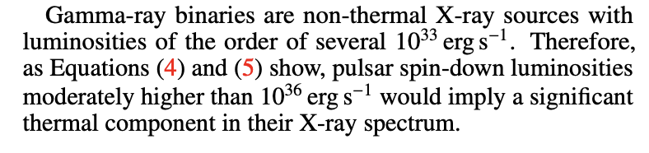
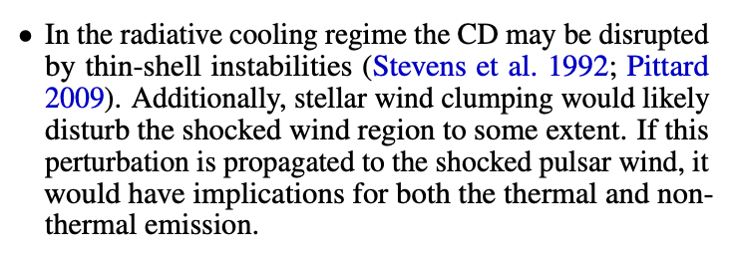
From upper limits to Lsd
See e.g. Zabalza et al. (2011)
Iuliia Shebalkova
The Missing Lines: Constraining Disk Parameters in Gamma-Ray Binaries
NewAthena Rising: SWG4
Barcelona June 2-5

Slide 28
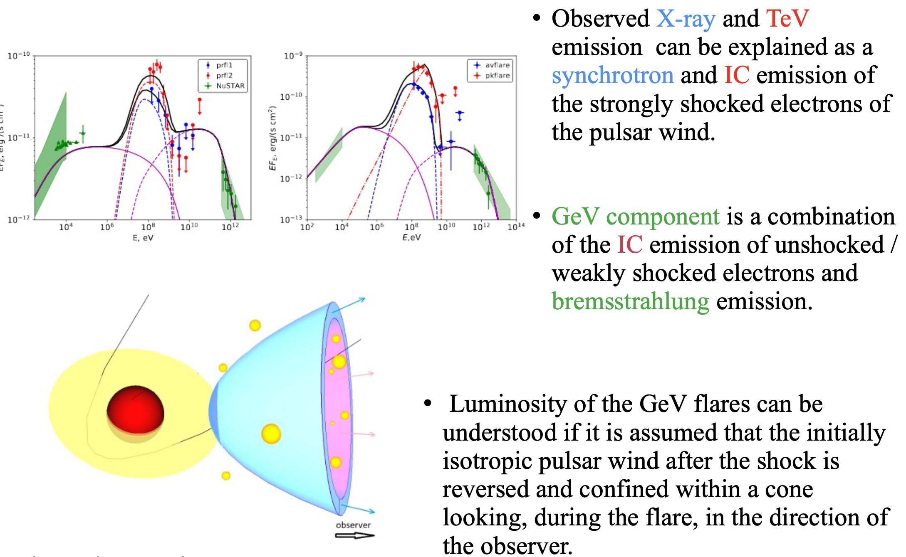
Iuliia Shebalkova
The Missing Lines: Constraining Disk Parameters in Gamma-Ray Binaries
NewAthena Rising: SWG4
Barcelona June 2-5

Slide 29
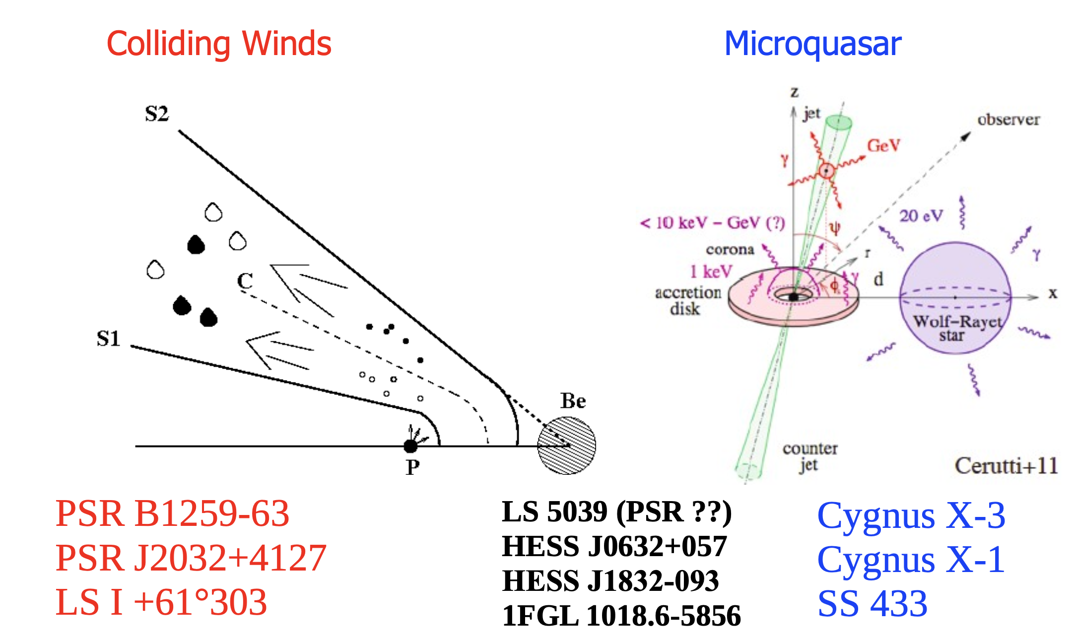
Iuliia Shebalkova
The Missing Lines: Constraining Disk Parameters in Gamma-Ray Binaries
NewAthena Rising: SWG4
Barcelona June 2-5

Slide 30
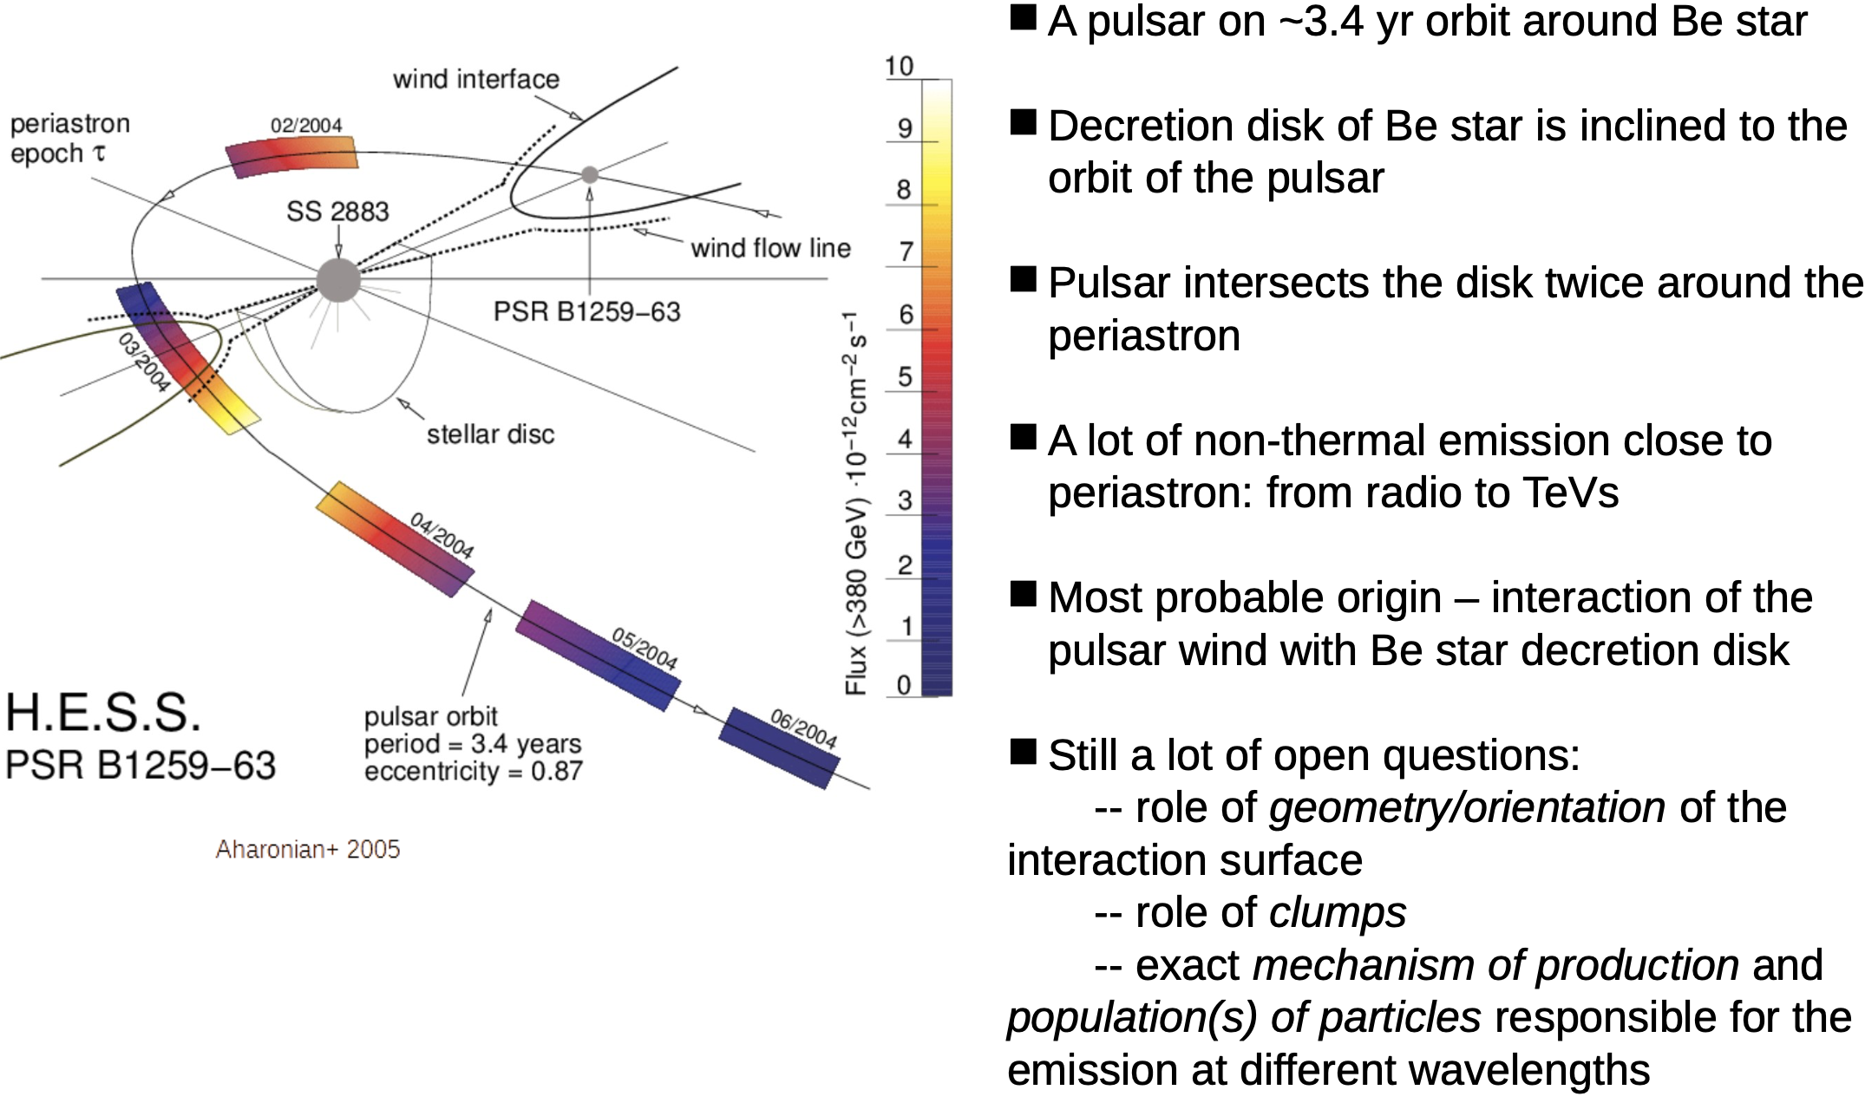
Iuliia Shebalkova
The Missing Lines: Constraining Disk Parameters in Gamma-Ray Binaries
NewAthena Rising: SWG4
Barcelona June 2-5

Slide 31
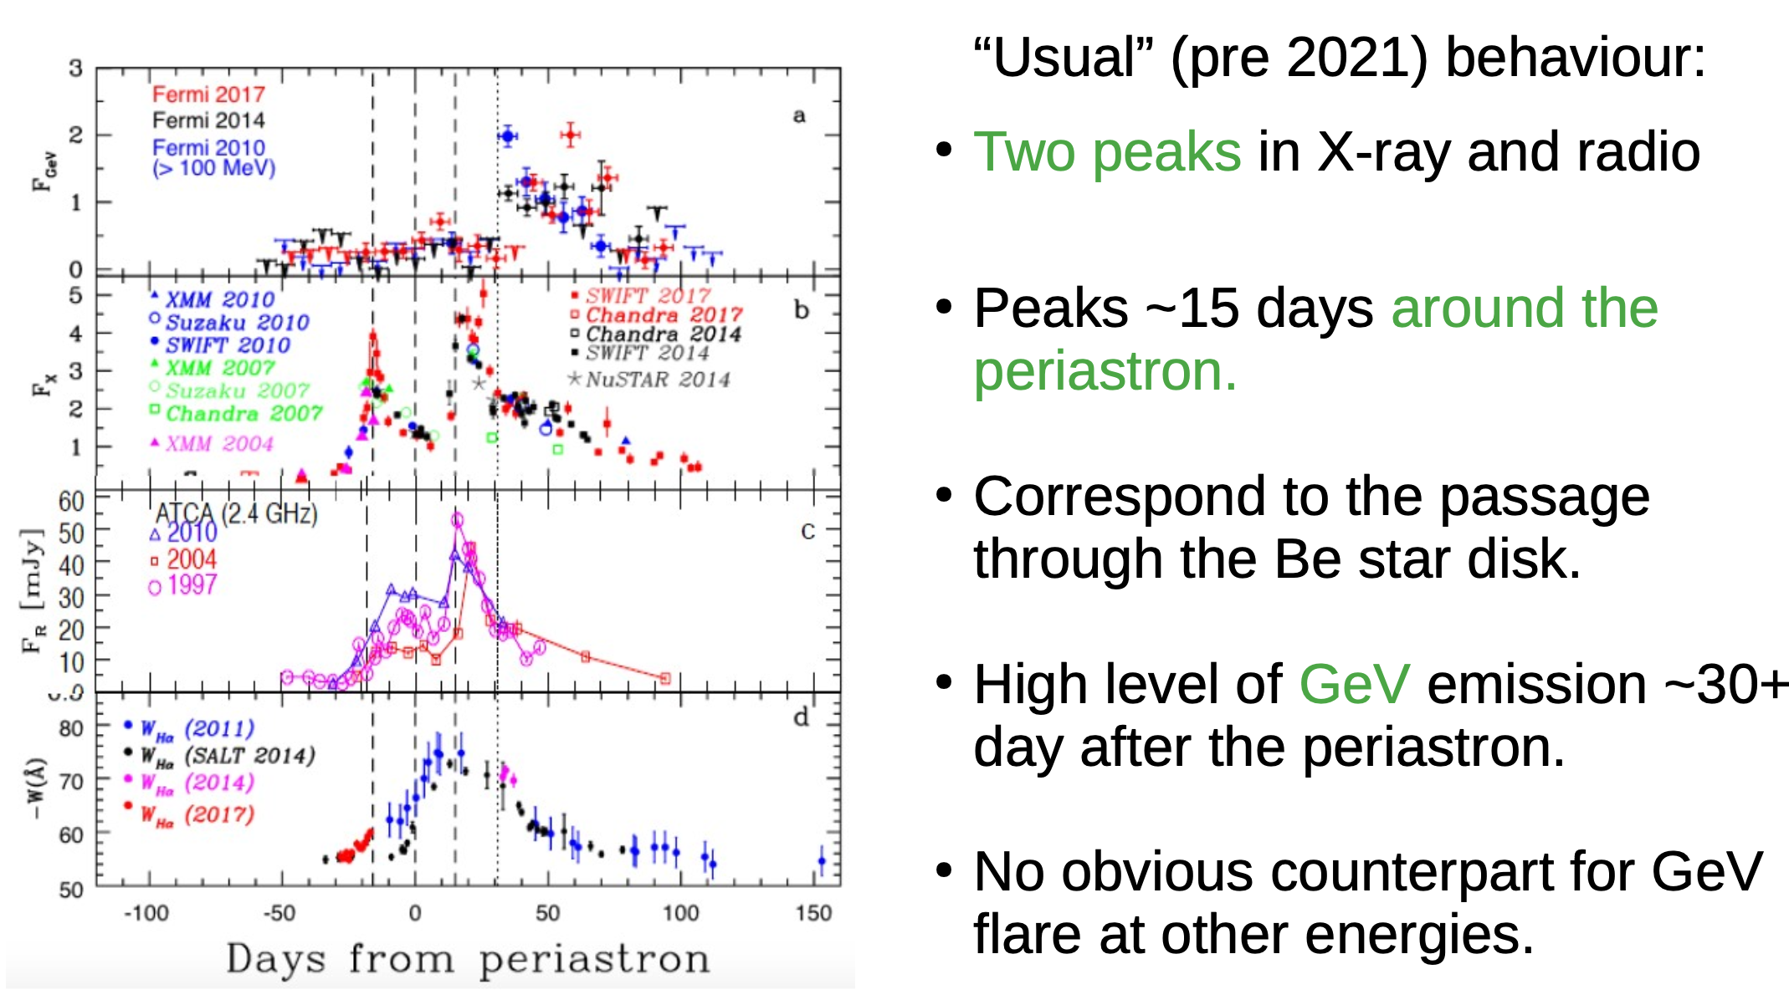
Iuliia Shebalkova
The Missing Lines: Constraining Disk Parameters in Gamma-Ray Binaries
NewAthena Rising: SWG4
Barcelona June 2-5

Slide 32
Iuliia Shebalkova
The Missing Lines: Constraining Disk Parameters in Gamma-Ray Binaries
NewAthena Rising: SWG4
Barcelona June 2-5

