Slide 1

Detection of a 459 Hz X-ray Burst Oscillation in XTE J1810−189 using NICER
M. Varun, Neal Titus Thomas, S. B. Gudennavar* and S. G. Bubbly
*shivappa.b.gudennavar@christuniversity.in
Presented in
NewAthena Rising: SWG4
ICE-CSIC Barcelona
2-5 June 2026
MISSION
CHRIST is a nurturing ground for an individual’s holistic development to make effective contribution to the society in a dynamic environment
VISION
Excellence and Service
CORE VALUES
Faith in God | Moral Uprightness
Love of Fellow Beings
Social Responsibility | Pursuit of Excellence

Slide 2
CHRIST
Deemed to be University
Outline
Introduction
XTE J1810-189
Data
Results
Summary
References
Excellence and Service

Slide 3
CHRIST
Deemed to be University
Introduction
X-ray binary systems → companion star < 1 M⊙ → low mass X-ray binaries (LMXBs) → brightest X-ray point sources in the sky.
High level of accretion onto the compact object → go into outburst → lasts up to weeks to months (Lewin et al. 1995).
Outbursts are separated by long intervals (quiescence) → little or no accretion → lasts months to tens of years.
Up to date → ~349 confirmed and candidate LMXBs → compact object nature not identified for many systems (Fortin et al. 2024).
Based on the nature of the compact object LMXBs are classified as:
  Neutron star - low mass X-ray binaries (NS-LMXBs)
  Black hole - low mass X-ray binaries (BH-LMXBs)
Excellence and Service

Slide 4
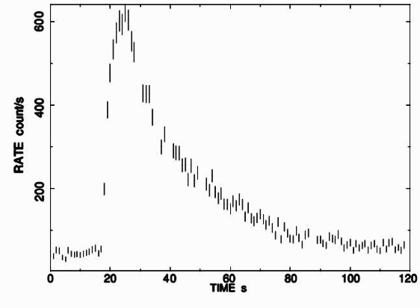
CHRIST
Deemed to be University
NS-LMXBs based on their → spectral and temporal characteristics are further classified into → Atoll and Z sources (Hasinger & van der klis 1989).
NS-LMXBs exhibits phenomena such as X-ray bursts, quasi periodic oscillations, dips, eclipses etc (Van der klis 2006).
Type I X-ray bursts are caused by unstable burning of accreted hydrogen/helium on the neutron star surface (lewin et al. 1993).
Bursts are characterised by:
  Rapid rise (milliseconds–seconds)
  Slower decay (seconds–minutes)
  Thermal (blackbody-like) spectra
(Manca et al. 2023)
Excellence and Service

Slide 5
CHRIST
Deemed to be University
Nuclear burning and burst behaviours mainly depends on the local mass accretion rate (ṁ) (Galloway et al. 2008).
  Bursts usually occurs at sub-Eddington accretion rates, at high ṁ steady burning suppresses the bursts.
When luminosity reaches the Eddington limit, radiation pressure lifts the photosphere → photospheric radius expansion (PRE).
When the photosphere contracts back it is called as “touchdown” → neutron star’s radius.
While PRE probes the spectral response of the neutron star atmosphere → X-ray bursts → exhibit rich timing behaviour → information on surface asymmetries and rotation.
Among timing phenomena → burst oscillations → direct window into thermonuclear burning dynamics → spin of the neutron star.
Excellence and Service

Slide 6
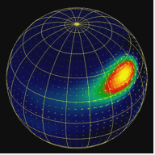
CHRIST
Deemed to be University
Burst oscillations → quasi-coherent brightness modulations → frequencies close to neutron star spin → ~300–600 Hz (Strohmayer et al. 1996).
They are seen in both rise and decay phase of the burst and often a slight frequency drift can be observed.
The asymmetric surface emission responsible for burst oscillations is generally attributed to localized thermonuclear burning regions known as hotspots on the neutron star surface (Watts 2012).
Burst oscillation frequencies are highly stable across multiple bursts from the same source suggesting that burst oscillations could be inferred as the spin frequency of neutron star.
hotspot
Image Credit: Anatoly Spitkovsky
Excellence and Service

Slide 7
CHRIST
Deemed to be University
XTE J1810-189
The source was first discovered on 2008 March 10 during pointed observations with the RXTE (Markwardt et al. 2008).
It is atoll like source and has gone through outburst during 2008, 2013 and 2020.
The first Type I X-ray burst from XTE J1810−189 was detected on 2008 March 26 confirming compact object to be a neutron star.
The burst reached a peak unabsorbed flux of ~2.5 × 10⁻⁸ erg cm⁻² s⁻¹ → distance of ~11.5 kpc was estimated.
The burst showed evidence of PRE → re-analysis constrained the distance in the range ~3.5–8.7 kpc (Weng et al. 2015) .
A total of five Type I X-ray bursts → NICER during its 2020 outburst → No burst oscillations were reported (Manca et al. 2023).
Excellence and Service

Slide 8
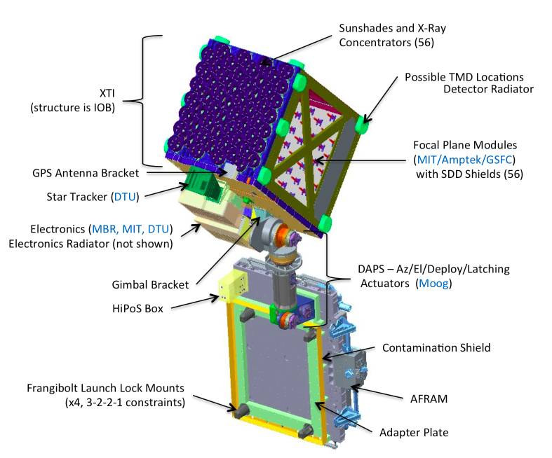
CHRIST
Deemed to be University
Data
Observation ID | Date of observation (dd-mm-yyyy) | Exposure time (ks)
6201750101 | 27-04-2023 | 2.260
6201750102 | 28-04-2023 | 3.642
6201750103 | 30-04-2023 | 0.728
NICER (June 3, 2017 → mounted on ISS) is a non-imaging, focusing X-ray telescope optimized for timing precision → It consists of 56 co-aligned X-ray concentrator optics modules (XRCs) and 56 silicon drift detectors (SDDs).
Image credits: Okajima et al., 2016.
Excellence and Service

Slide 9
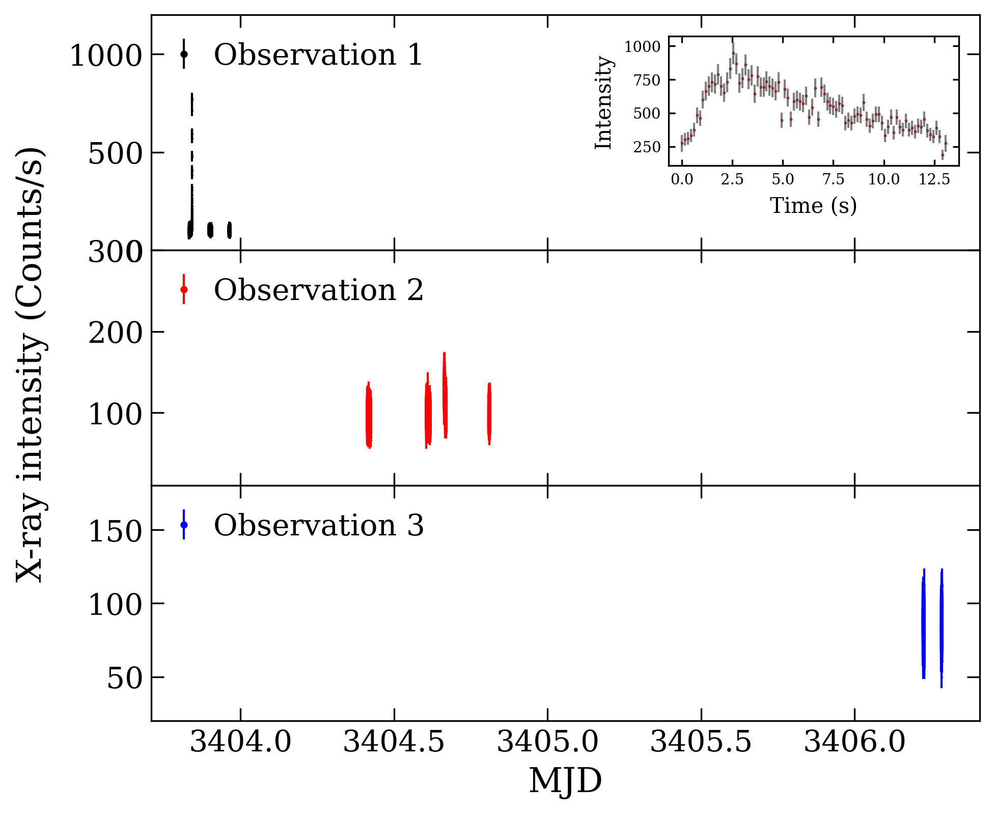
CHRIST
Deemed to be University
Results
Type I X-ray burst exhibited a fast rise time of 2.55 s, an exponential decay time of 7.50 s, and a total duration of ~ 13.05 s.
The bolometric peak flux (F_{peak}) observed during the burst is F_{peak}​=1.93_{−0.37}^{+0.52} ​× 10⁻⁸ erg cm⁻²s⁻¹ in 0.01 - 100 keV
Figure 1. Net light curves from Observations 1, 2, and 3 with a time bin of 1 s in the 0.3−12.0 keV energy range with respect to their modified julian date (MJD). The inset in the top panel displays the X-ray burst.
Excellence and Service

Slide 10
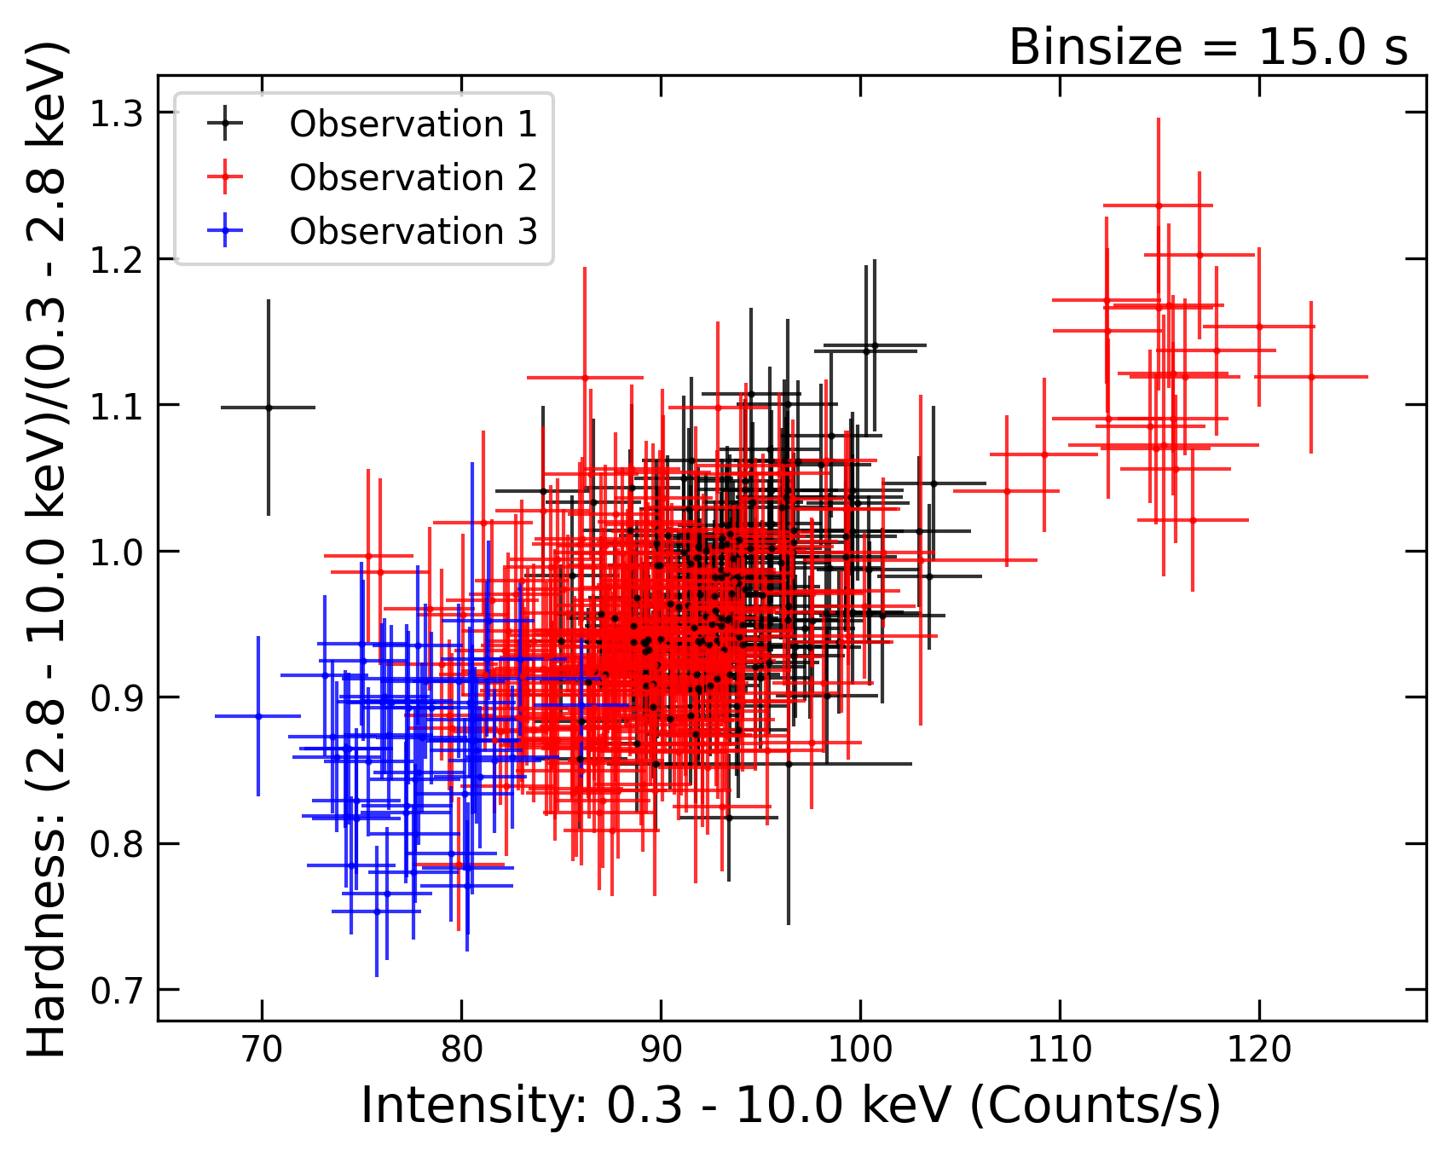
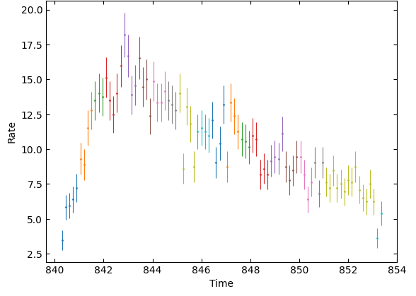
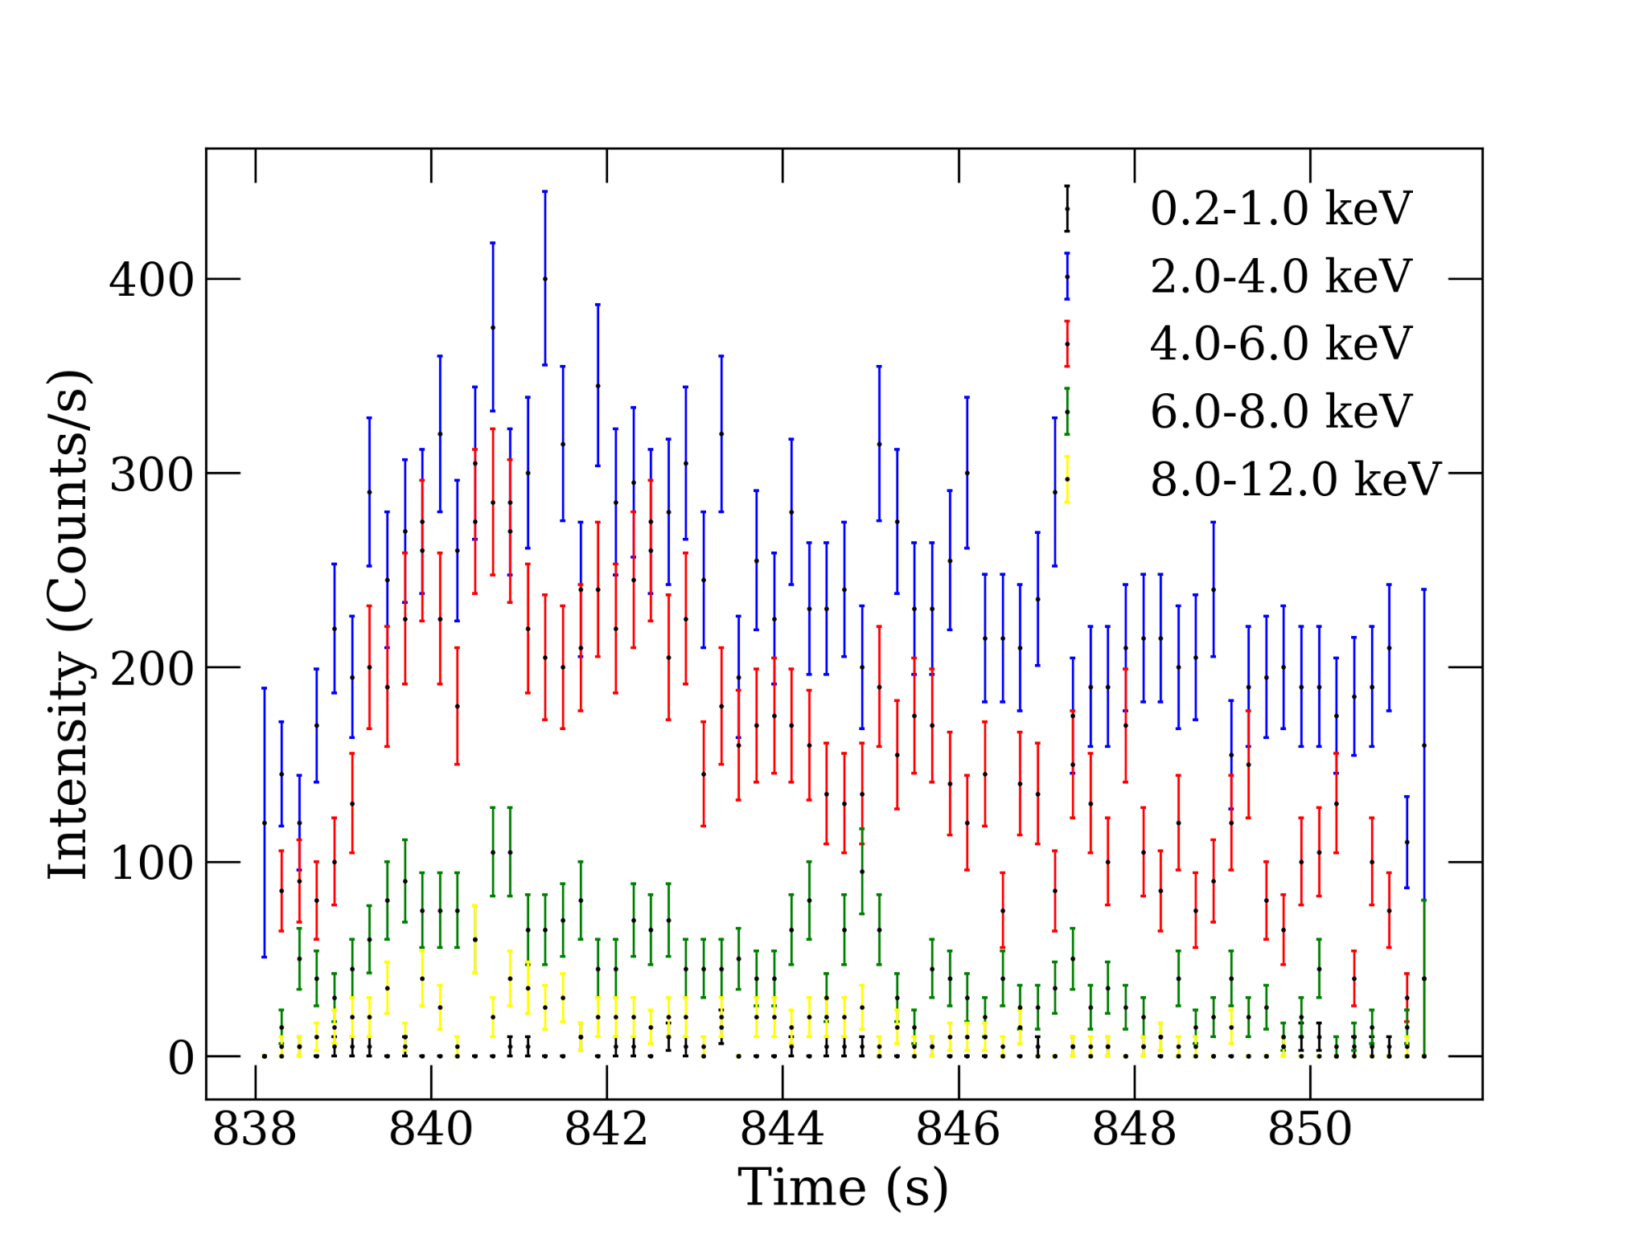
CHRIST
Deemed to be University
Hardness Intensity Diagram (HID)
Burst lightcurve - time resolved
Figure 2. HIDs of Observations 1, 2 and 3.
Figure 3. Time resolved burst lightcurve with a bin time of 1s in 0.2 - 10 keV
Excellence and Service

Slide 11
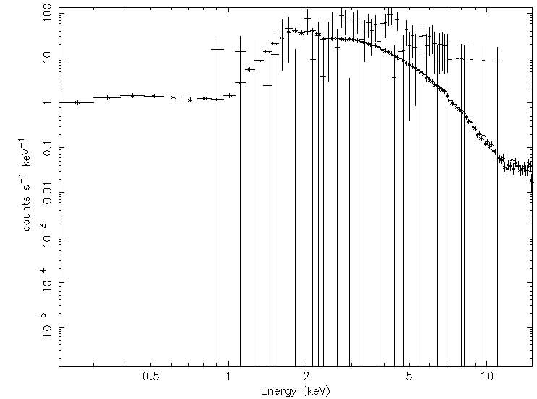
CHRIST
Deemed to be University
X-ray Burst Characteristics
Figure 4. Burst energetics in 0.2-1.0, 2.0-4.0, 4.0-6.0, 6.0-8.0 and 8.0-12.0 keV. The burst is dominant in 2.0-6.0 keV.
Figure 5. Segment 1 of time-resolved burst, where persistent spectrum was taken as background.
Excellence and Service

Slide 12
CHRIST
Deemed to be University
Burst oscillation: Z-square search
Aspect | Z² Search Advantage
Data handling | Works directly on event arrival times (no binning losses)
Pulse shape sensitivity | Highly sensitive to narrow / non-sinusoidal pulses
Short-lived signals | Ideal for burst oscillations and transient periodicities
Data gaps | More robust to uneven sampling and gaps
Frequency resolution | User-defined trial grid, not limited by data length
Long-period signals | Better sensitivity at low frequencies (less red-noise impact)
Statistical significance | Follows known χ² distribution → reliable significance
Excellence and Service

Slide 13
CHRIST
Deemed to be University
Detailed burst oscillation searches
Frequency Range (Hz) | ntrials​ | Search Method | Frequency (Hz) | Max Power | RMS (%) | Probability | Significance (σ)
400 - 500 | 1 | Z_{n}² | 458.96 | 35.74 | 14.84 | 1.73 ✕ 10⁻⁰⁸ | 5.52
 |  | FFT | 458.92 | 35.95 | 14.63 | 1.56 ✕ 10⁻⁰⁸ | 5.53
400 - 500 | all | Z_{n}² | 458.96 | 35.74 | 14.84 | 5.68 ✕ 10⁻⁰⁴ | 3.25
 |  | FFT | 458.92 | 35.95 | 14.63 | 8.41 ✕ 10⁻⁰⁴ | 3.14
10 - 1000 | 1 | Z_{n}² | 458.96 | 35.65 | 14.82 | 1.81 ✕ 10⁻⁰⁸ | 5.51
 |  | FFT | 458.92 | 35.95 | 14.63 | 1.56 ✕ 10⁻⁰⁸ | 5.53
10 - 1000 | all | Z_{n}² | 458.96 | 35.65 | 14.82 | 5.86 ✕ 10⁻⁰³ | 2.52
 |  | FFT | 458.92 | 35.95 | 14.63 | 8.41 ✕ 10⁻⁰⁴ | 3.14
The oscillations were found between 4.2 – 7.2 s from the burst start time.
Excellence and Service

Slide 14
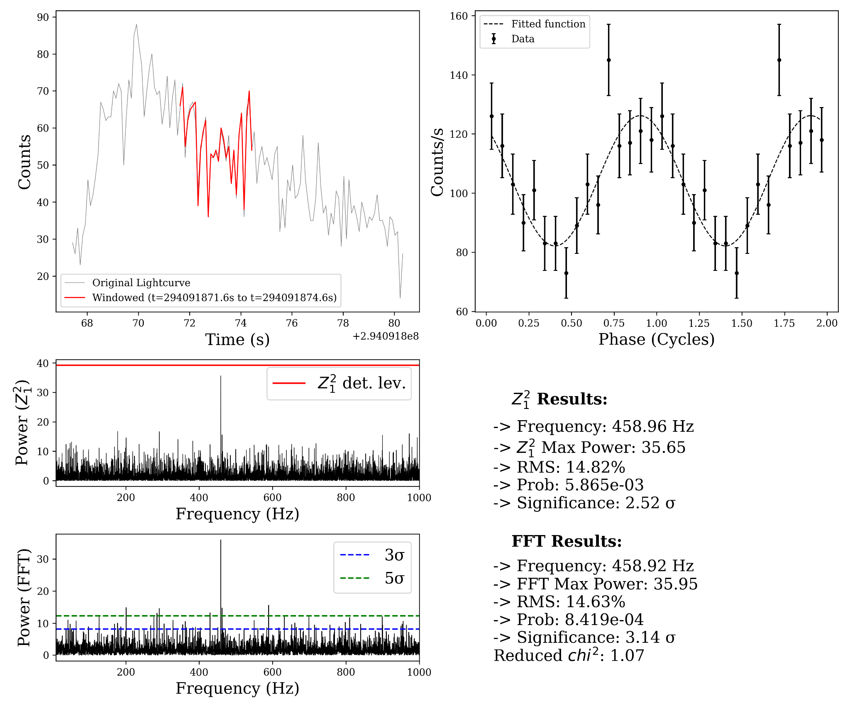
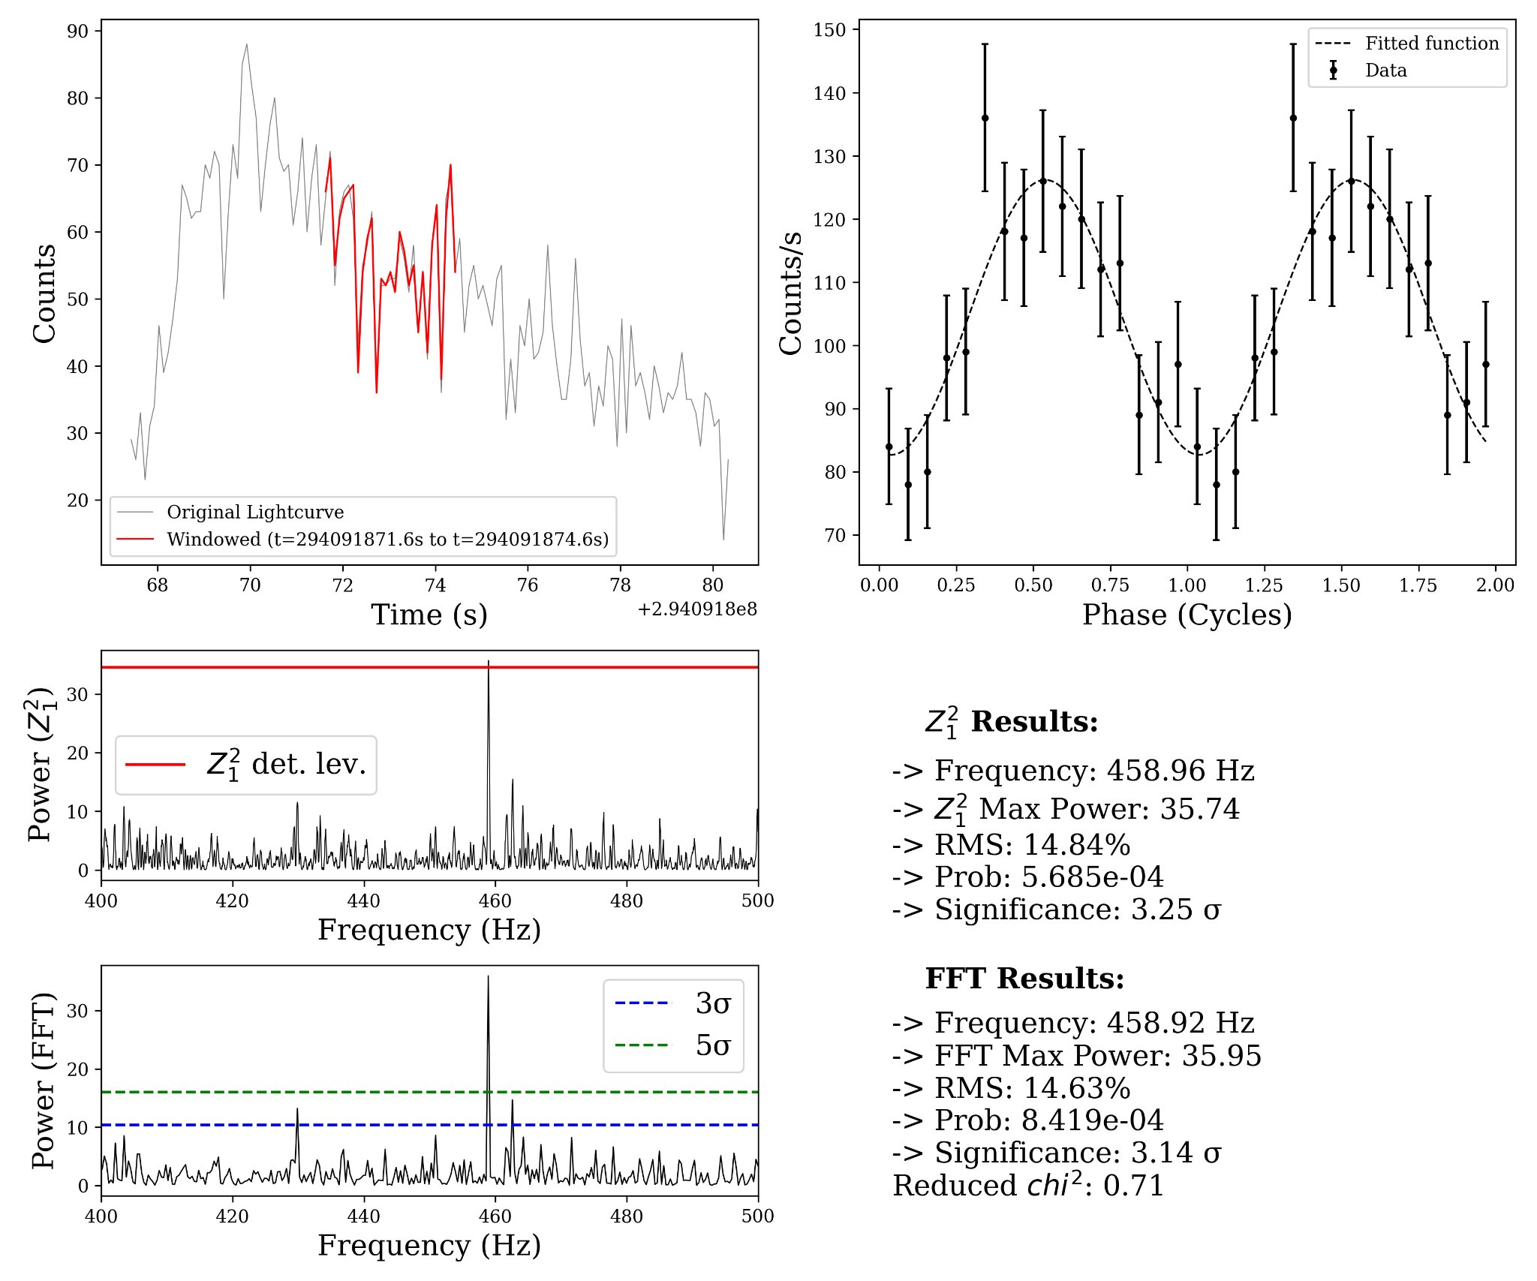
CHRIST
Deemed to be University
Figure 6. Oscillation search from 10 - 1000 Hz for all number of trials
Figure 7. Oscillation search from 400 - 500 Hz for all number of trials
Excellence and Service

Slide 15
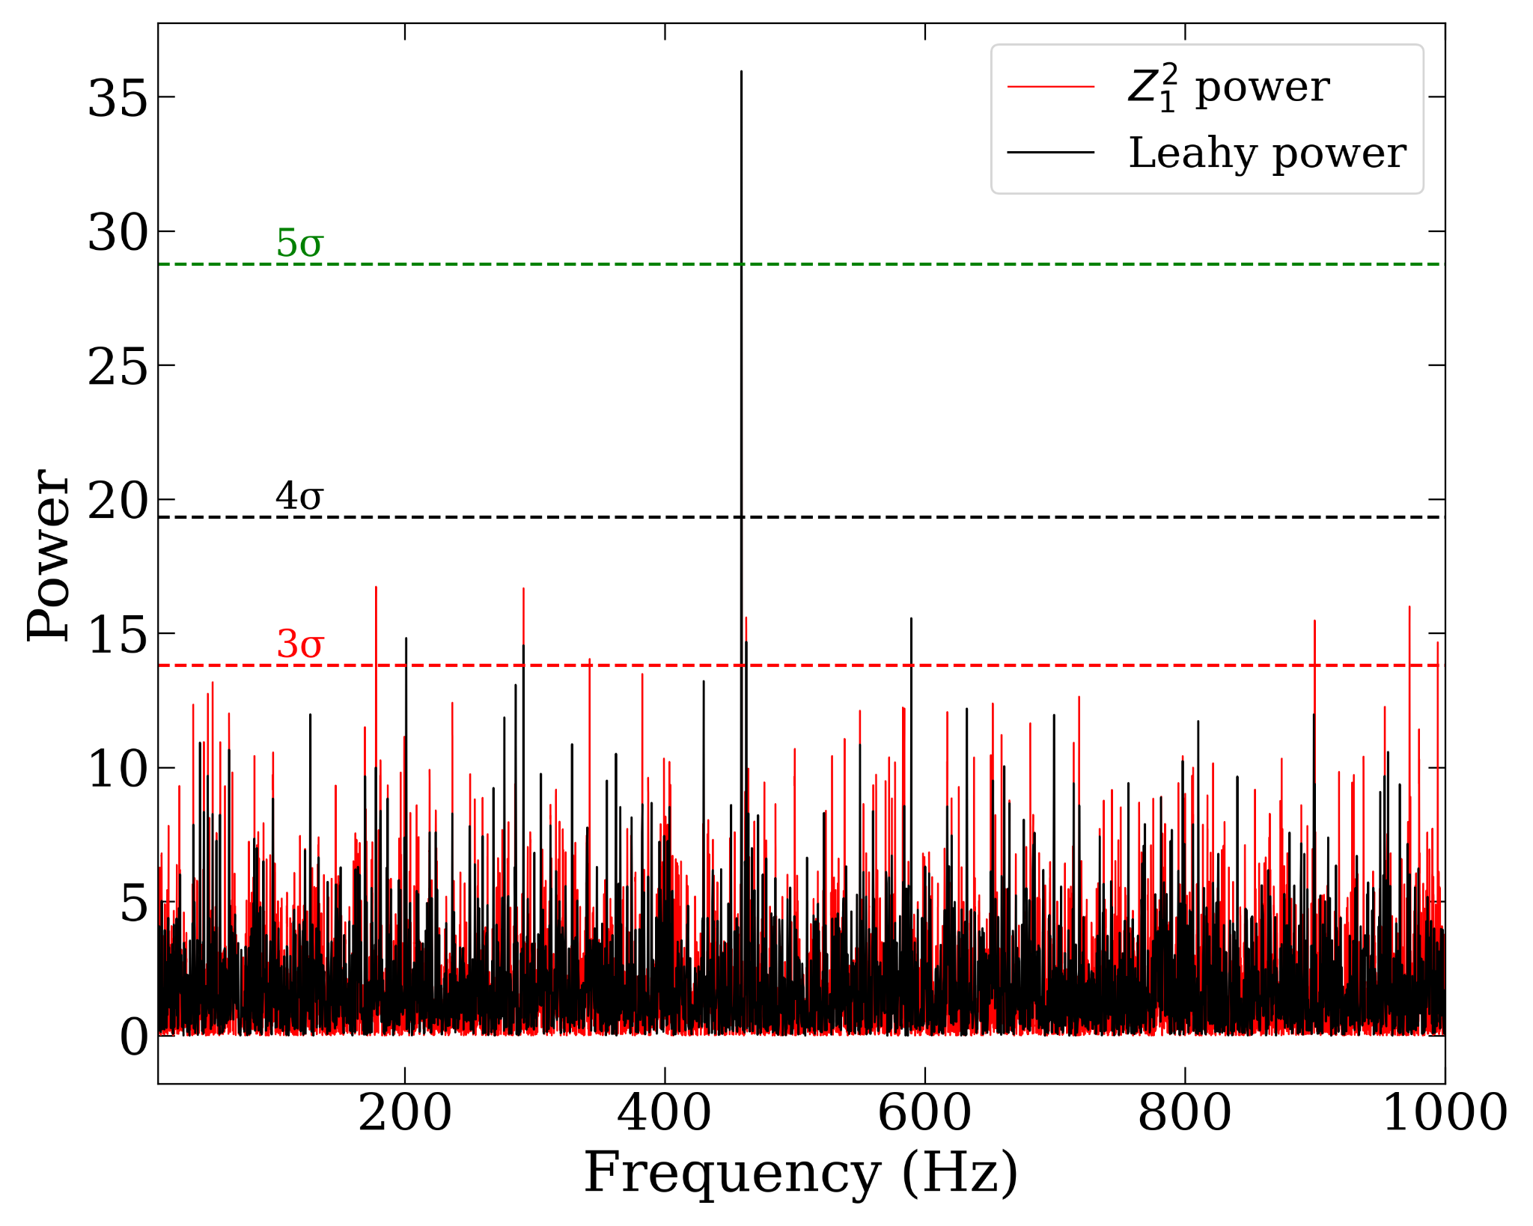
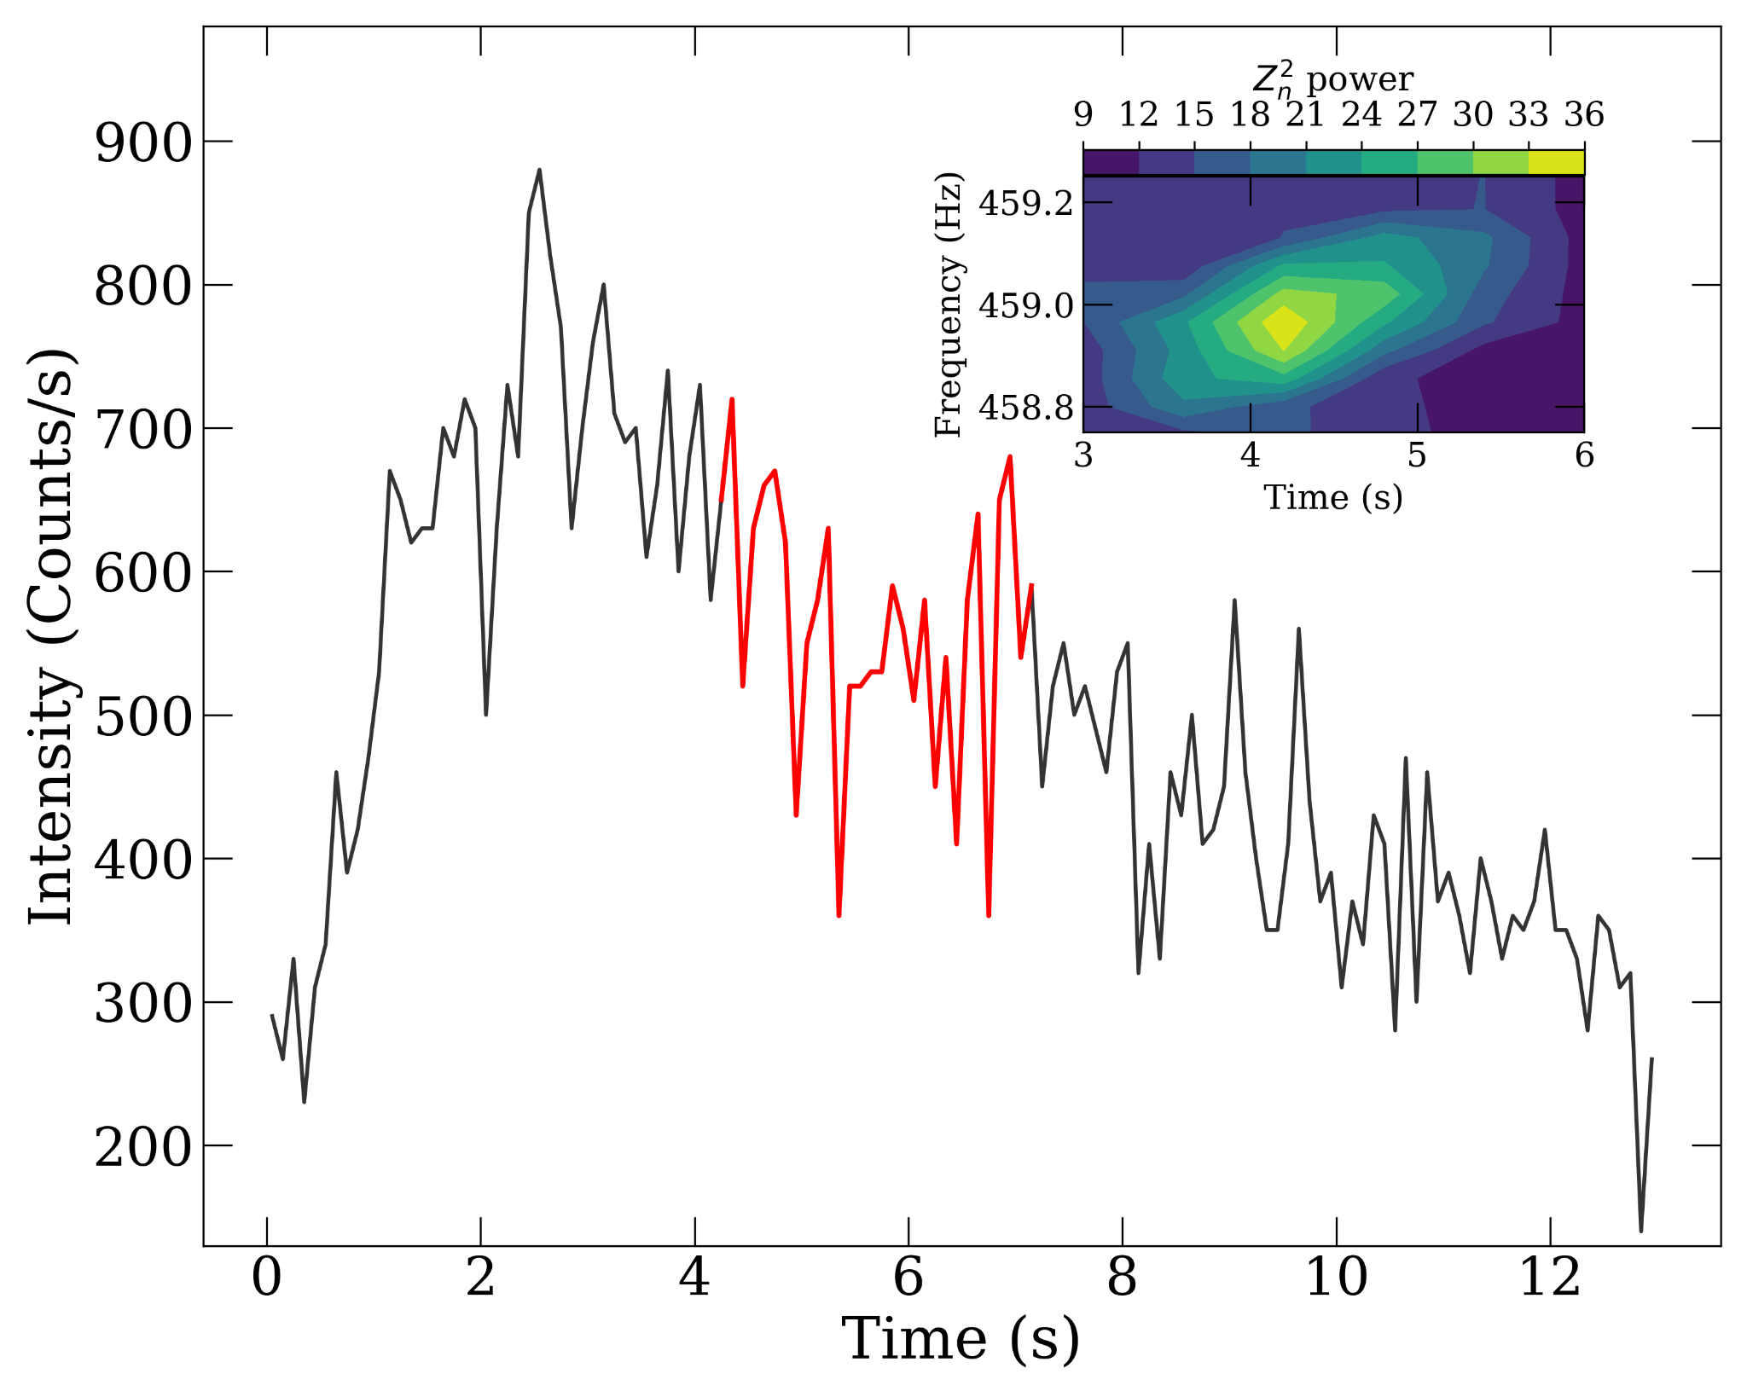
CHRIST
Deemed to be University
Figure 9. The burst light curve, binned at 0.25 s, is shown, with the red-highlighted region indicating the interval during which a strong oscillation signal was detected. The inset displays the corresponding Z_{n}² power spectrum contour plot for this interval.
Figure 8. Burst oscillation detected at ∼ 459 Hz. Dashed lines represent the 3𝜎, 4𝜎 and 5𝜎 confidence levels.
Excellence and Service

Slide 16
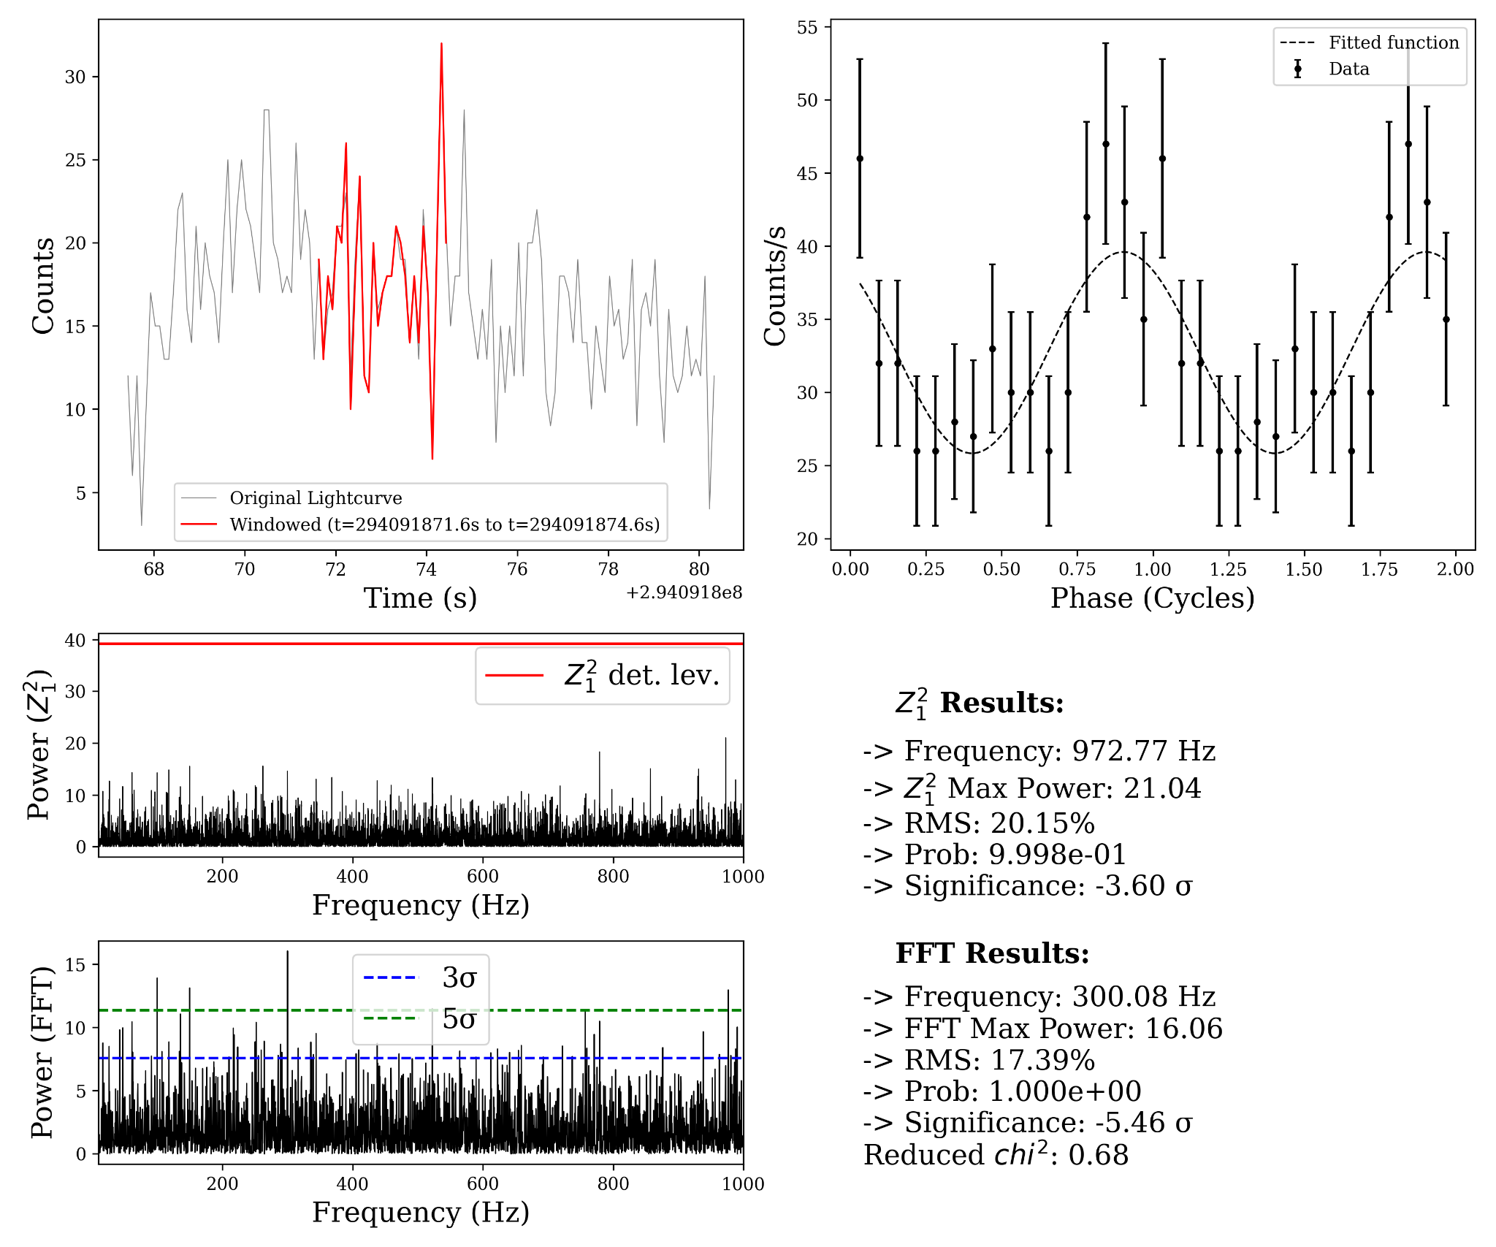
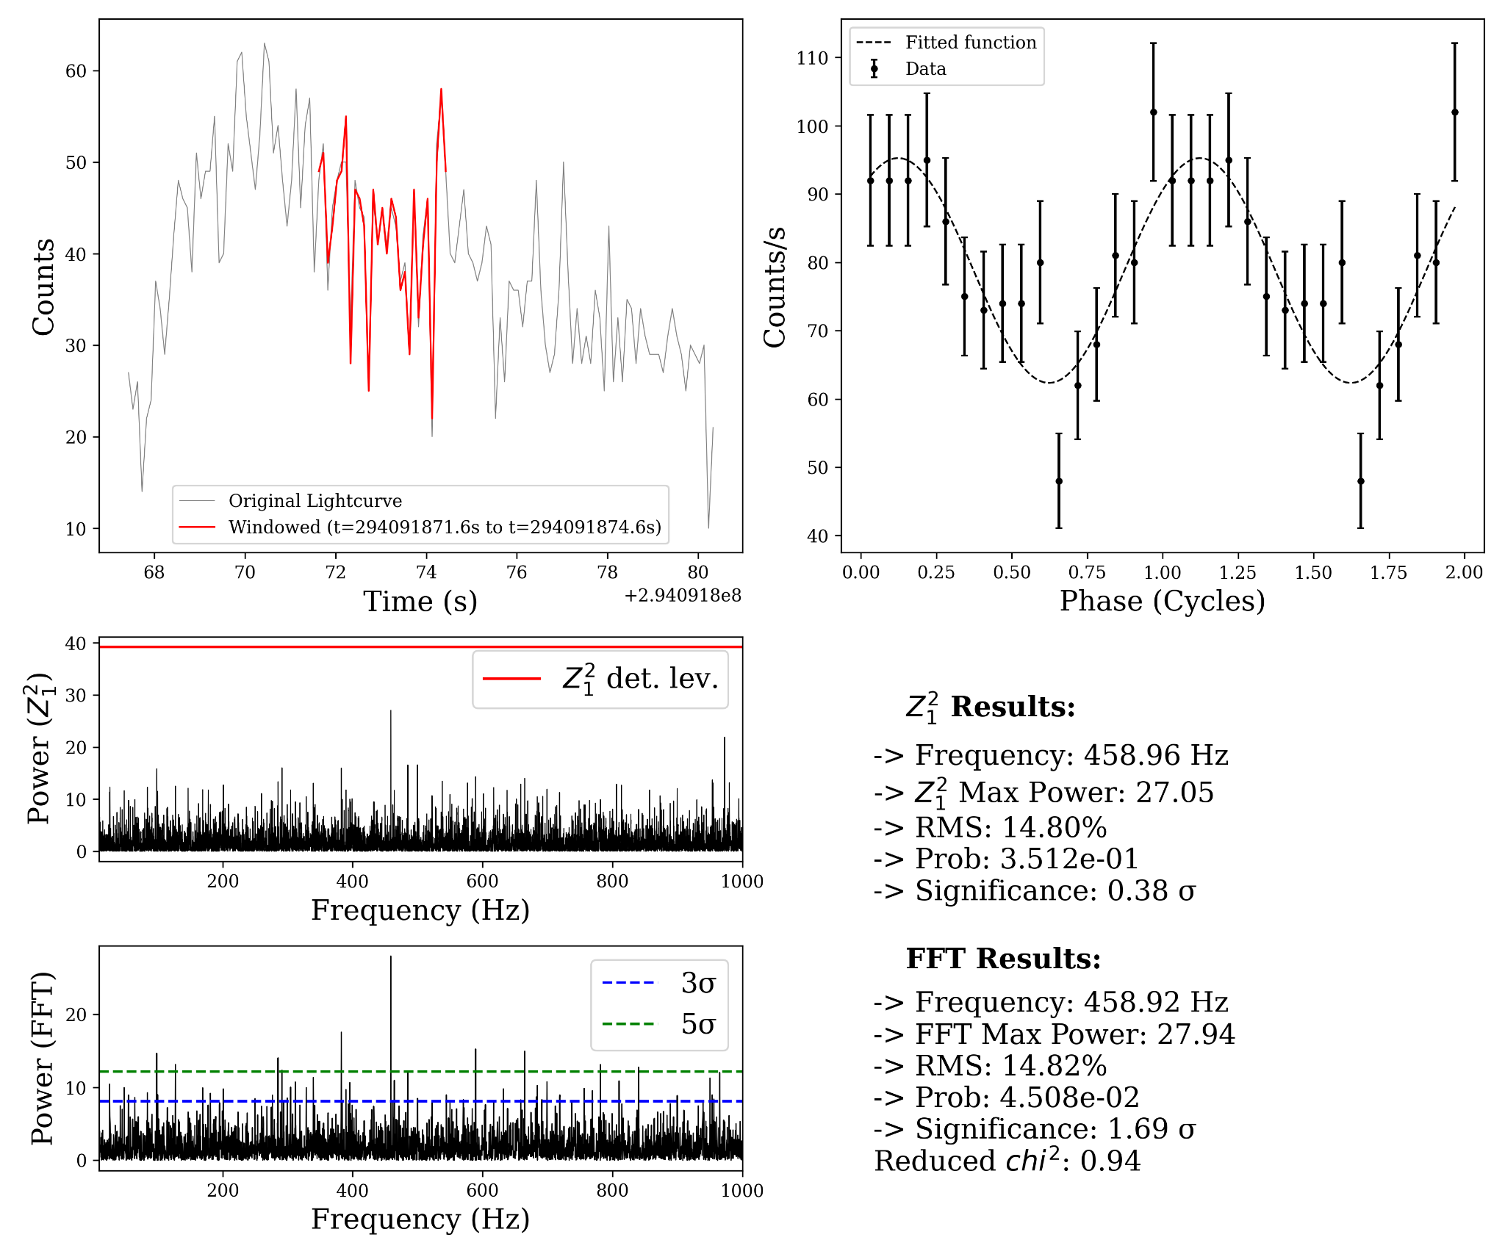
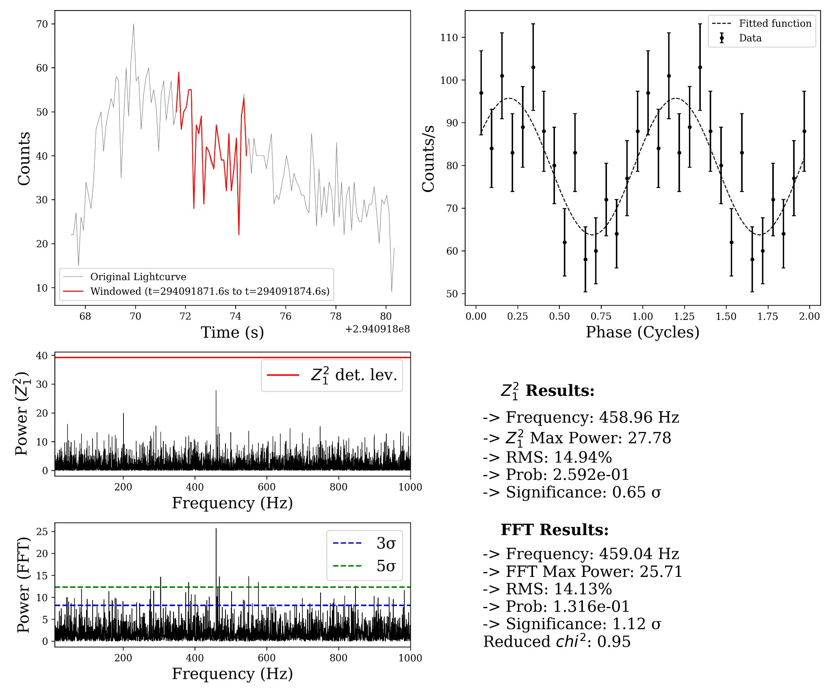
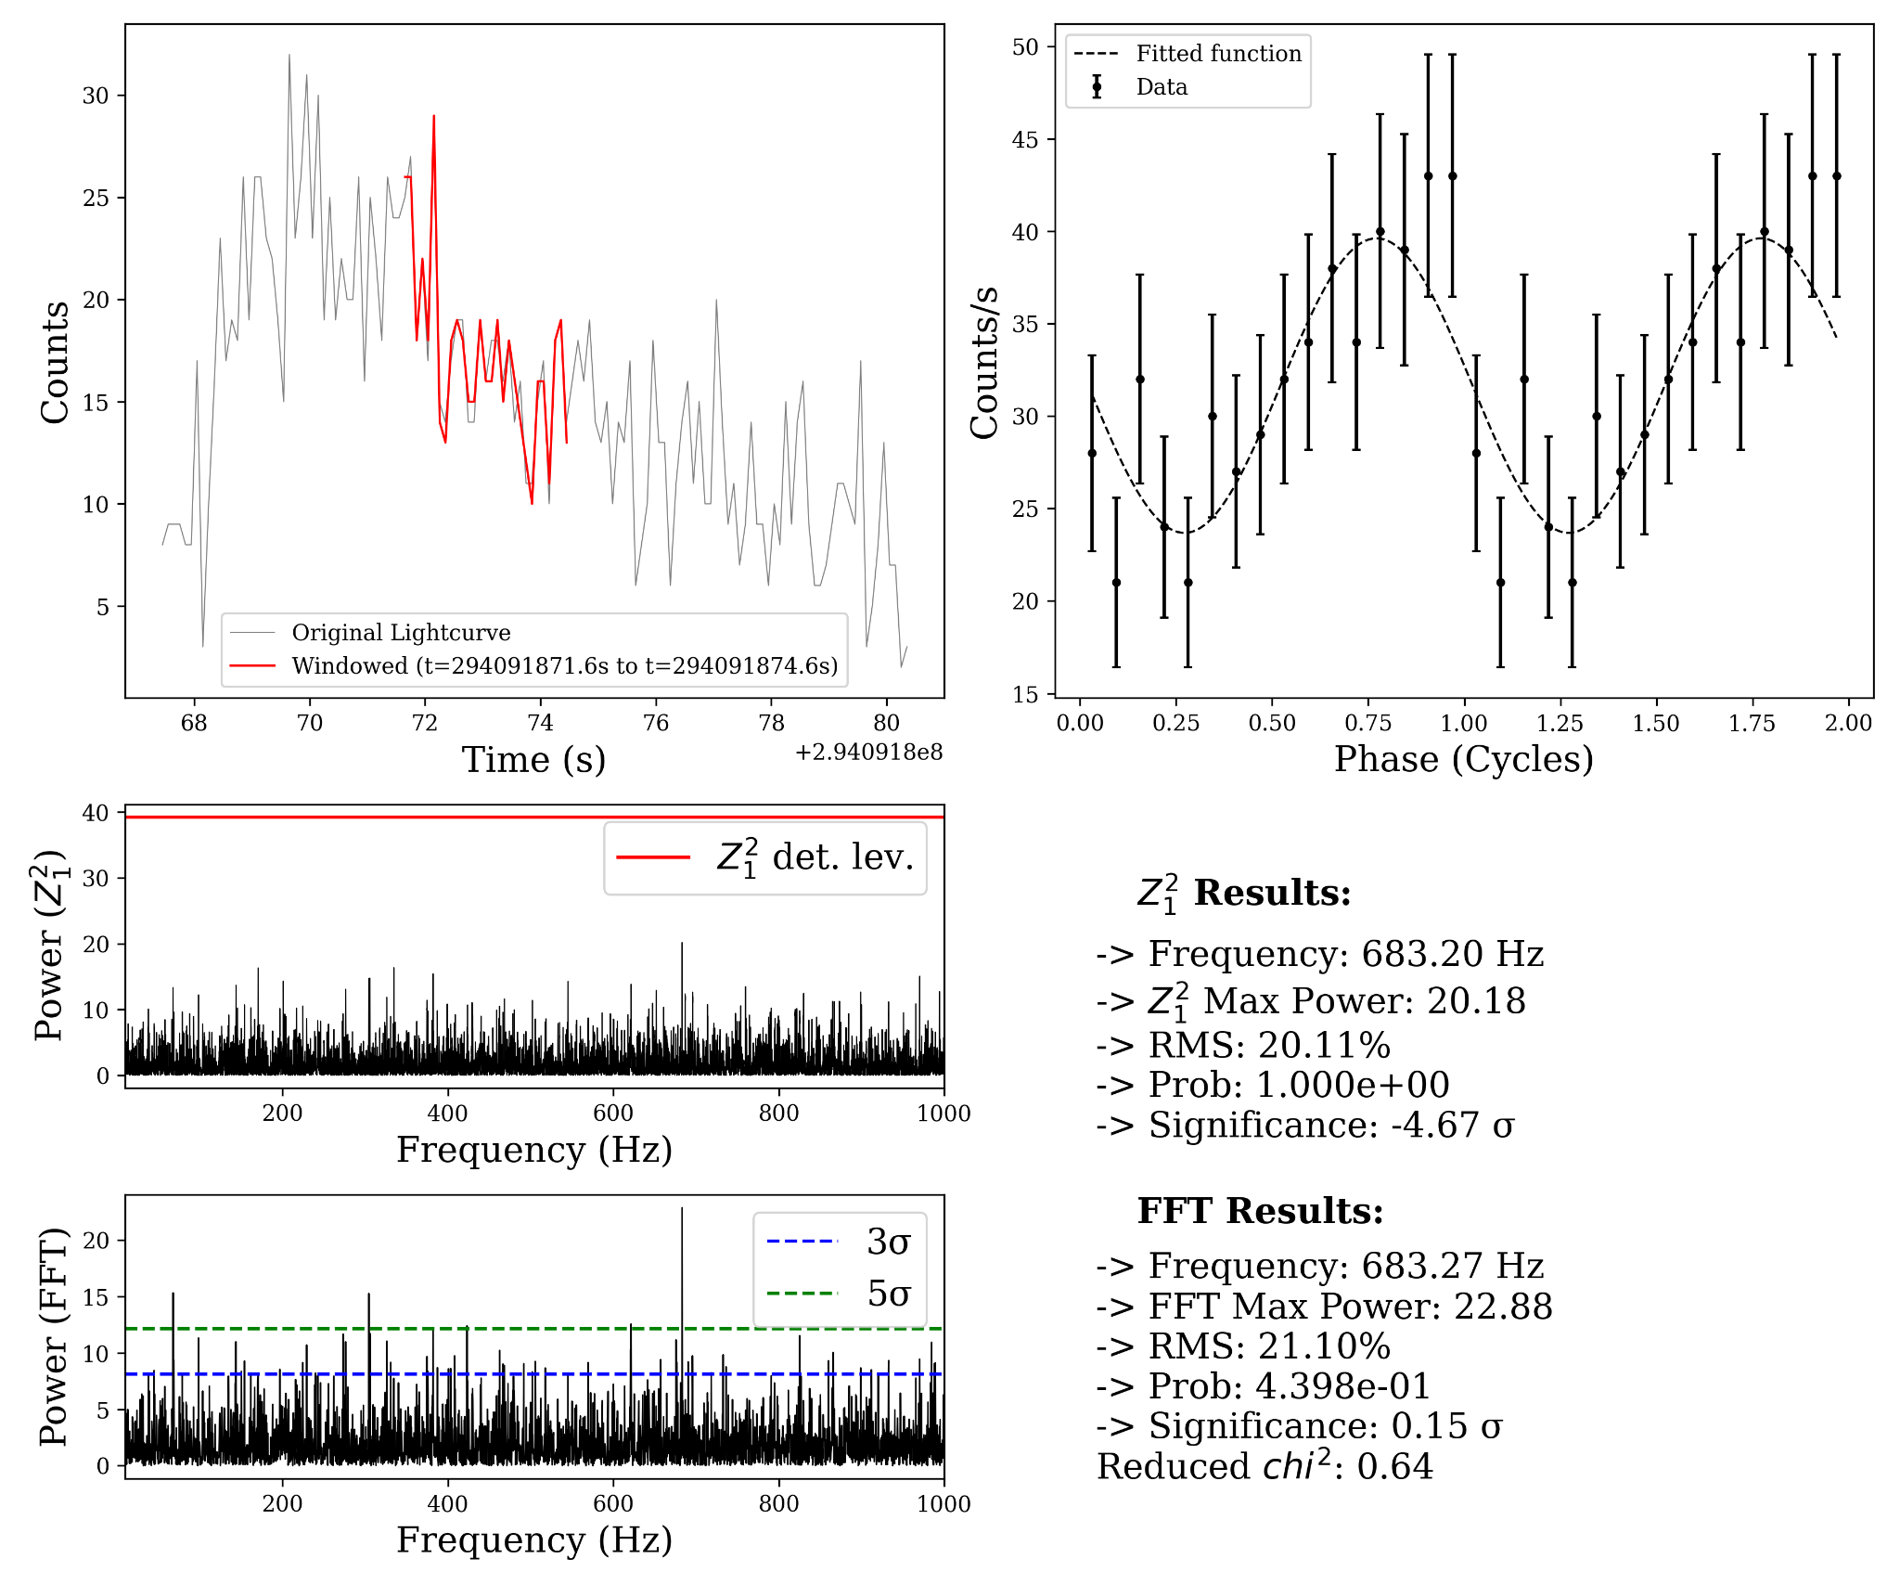
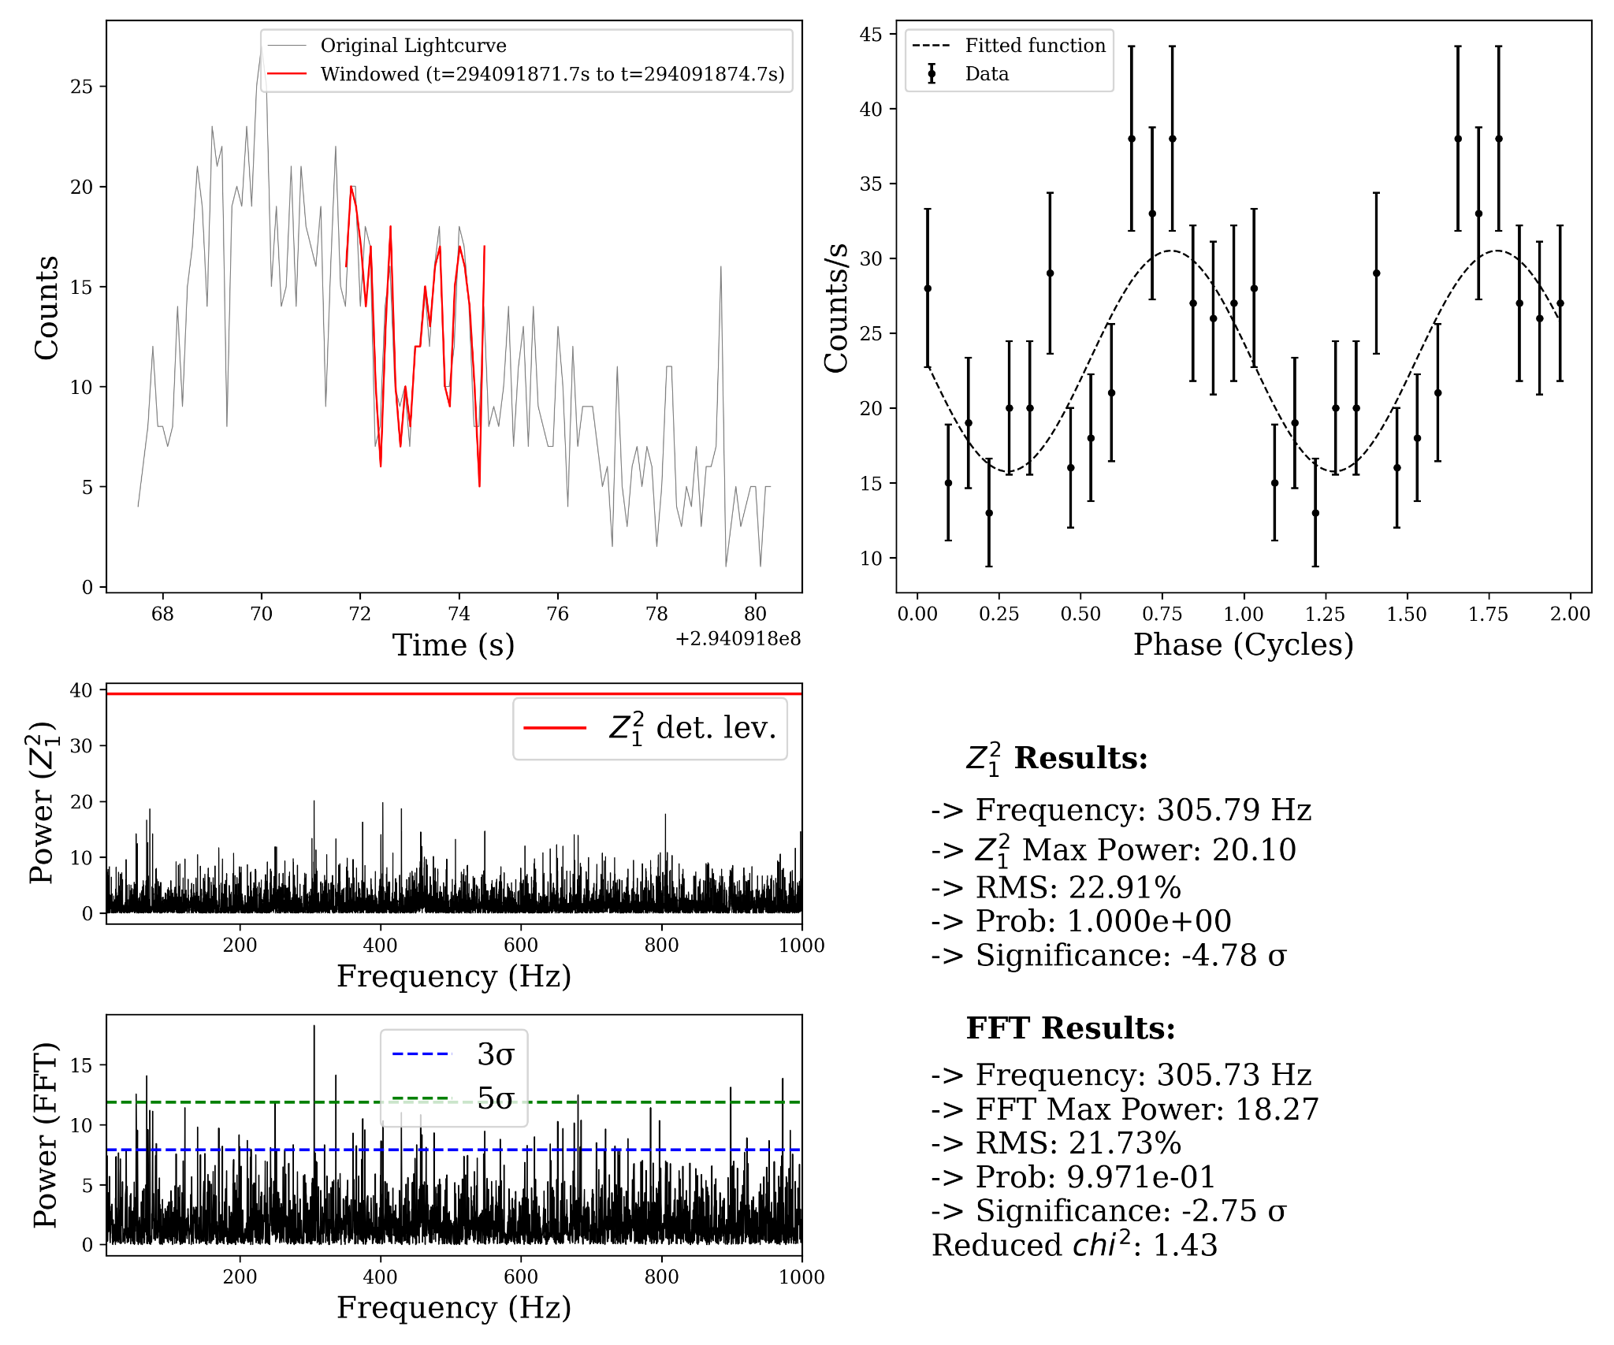
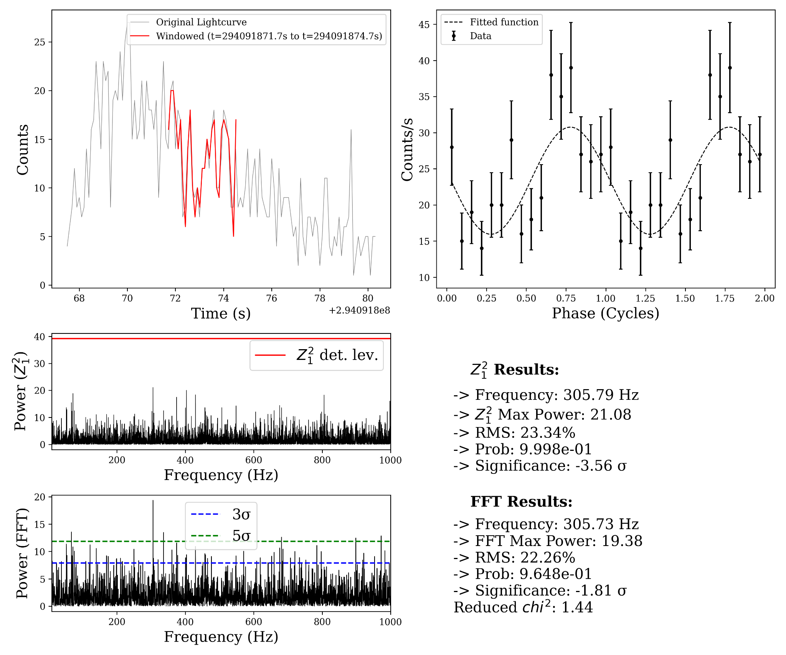
CHRIST
Deemed to be University
0.3 - 2.0 keV
0.3 - 5.0 keV
2.0 - 6.0 keV
4.0 - 6.0 keV
5.0 - 10.0 keV
5.0 - 12.0 keV
Excellence and Service
‹#›

Slide 17
CHRIST
Deemed to be University
Summary
The HID of the source did not show any particular pattern (Figure 1)
Type I burst detection → Identified in Observation 1→ FRED profile → 2.55 s rise, 7.50 s decay, total duration 13.05 s.
The bolometric peak flux observed during the burst is F_{peak}​ ~1.93 ​× 10⁻⁸ erg cm⁻²s⁻¹ in 0.01 - 100 keV
FFT power spectrum → Leahy power = 35.95 → Strong coherent signal at 458.92 Hz → Z²ₙ analysis → power = 35.69 → 458.96 Hz.
Amplitude and pulse profile → Fractional rms = 14.63% → Folded profile was well-fitted by a constant + sinusoidal, confirming stable periodic modulation.
Spin inference → Burst oscillation frequency (~459 Hz) → Implies neutron-star spin period ≈ 2.18 ms.
Excellence and Service

Slide 18
CHRIST
Deemed to be University
Oscillation likely arises from surface brightness asymmetry → surface-mode oscillations or asymmetric cooling wakes model.
Surface-mode oscillations:
  When burst ignites, one part of the surface usually heats up first creating temperature differences across the surface. These temperature differences create waves (modes) on the surface
  As the star rotates, these waves make the X-ray brightness oscillate
Asymmetric cooling wake:
  After the burst, some parts of the neutron star surface cool faster than others. This slower-cooling region lags behind, forming a sort of wave-like a trail-on the surface as temperatures even out. As the star spins, this cool-hot contrast makes the brightness wiggle.
Excellence and Service

Slide 19
CHRIST
Deemed to be University
References
Fortin F., et al., 2024, A\&A, 684, A124
Galloway D. K., et al., 2008, ApJS, 179, 360
Hasinger G., van der Klis M., 1989, A&A, 225, 79
Lewin W. H. G., van Paradijs J., van den Heuvel E. P. J., 1995, xrbi.nasa
Lewin W. H. G., van Paradijs J., Taam R. E., 1993, SSRv, 62, 223
Lewin W. H. G., van der Klis M., 2006, csxs.book, 39
Manca A., et al., 2023, MNRAS, 526, 1154
Markwardt C. B., Swank J. H., 2008, ATel, 1424, 1
Watts A. L., 2012, ARA&A, 50, 609
Weng S. S., et al.,2015, MNRAS, 450, 2915
Excellence and Service

Slide 20
CHRIST
Deemed to be University
Woosley S. E et al., 2004, ApJS, 151, 75.
Strohmayer T. E., et al., 1996, ApJL, 469, L9
Excellence and Service

Slide 21
CHRIST
Deemed to be University
THANK YOU
Excellence and Service
Excellence and Service

Slide 22
CHRIST
Deemed to be University
Hydrogen/Helium serves as the typical fuel in most of the systems but in case of ultra compact X-ray binaries it's mainly helium rich.
The accretted layer would be in hydrostatic equilibrium → as pressure increases with depth, temperature and density rise due to compression.
Thermonuclear ignition typically occurs → column depth is ~10⁸ g cm⁻² → normal bursts and further deeper for intermediate and super bursts.
Nuclear burning during bursts could be of following (Woosley et al. 2004):
  Hydrogen burning due to → hot CNO cycle
  Helium burning due to → triple-α reaction
  Mixed H/He causes rp-process via proton captures and (α,p) reactions and produces long burst tails.
  Carbon burning powers rare super bursts occurs at higher depths.
Excellence and Service

