Slide 1
X-ray Variability of PKS 2155−304
25 years of Chandra + NuSTAR Spectral & Timing Studies
0.4 – 79 keV · 1999 – 2024
Rameshan Thimmappa¹, Joey Neilsen¹, Shivappa B. Gudennavar²
¹Villanova University ²CHRIST University, Bangalore
NewAthena Rising | ICE-CSIC Barcelona | Jun 3, 2026

Slide 2
Why PKS 2155−304 + Why Now?
A benchmark blazar entering the Athena era
PKS 2155−304 at a Glance
Our Work Fills the Gap
Type
HSP BL Lac (z = 0.116)
XMM-Newton (Bhatta+25)
→
0.3–10 keV, 2000–2014 only
Peak
Synchrotron peak in X-ray band
(ν_{peak} > 10¹⁵ Hz); TeV detected
Our work
→
0.4–79 keV, 25-year baseline
X-ray band
Probes high-E synchrotron tail
★
NuSTAR above 10 keV
Variability
Minutes to decades
IC component & hard-X breaks
★
Joint Chandra+NuSTAR
Why now?
IXPE polarisation (22% @ 2–8 keV)
Broadband 0.4–79 keV fits
Athena link
Will be an Athena cornerstone target
★
Thermal component
BR+PL model — coexistence of
thermal & non-thermal emission

Slide 3
Dataset: 25 Years of X-ray Coverage
16 Chandra (1999–2014) + 11 NuSTAR (2012–2024)
27
372.5 ks
~257 ks
0.4–79 keV
Total Observations
Chandra Exposure
NuSTAR Exposure
Energy Coverage
Observational Timeline
1999
2004
2008
2012
2016
2020
2024
Chandra 0.4–8 keV
NuSTAR 3–79 keV
Note:
NuSTAR ObsIDs 11001611002 (Dec 2023) and 11001611004 (Nov 2024) extend coverage into the post-XMM era — the first systematic hard X-ray view of this source after 2015.

Slide 4
Long-term X-ray Light Curve
Count rate , Flux and Hardness Ratio
Key Findings
F_var range
6.6% – 56.9%
Peak flux
Chandra ID 16423
Long-term F_var
~25–30%
Best τ_var
1.15±0.26 ks
NuSTAR F_var
6.6%–48.5%

Slide 5
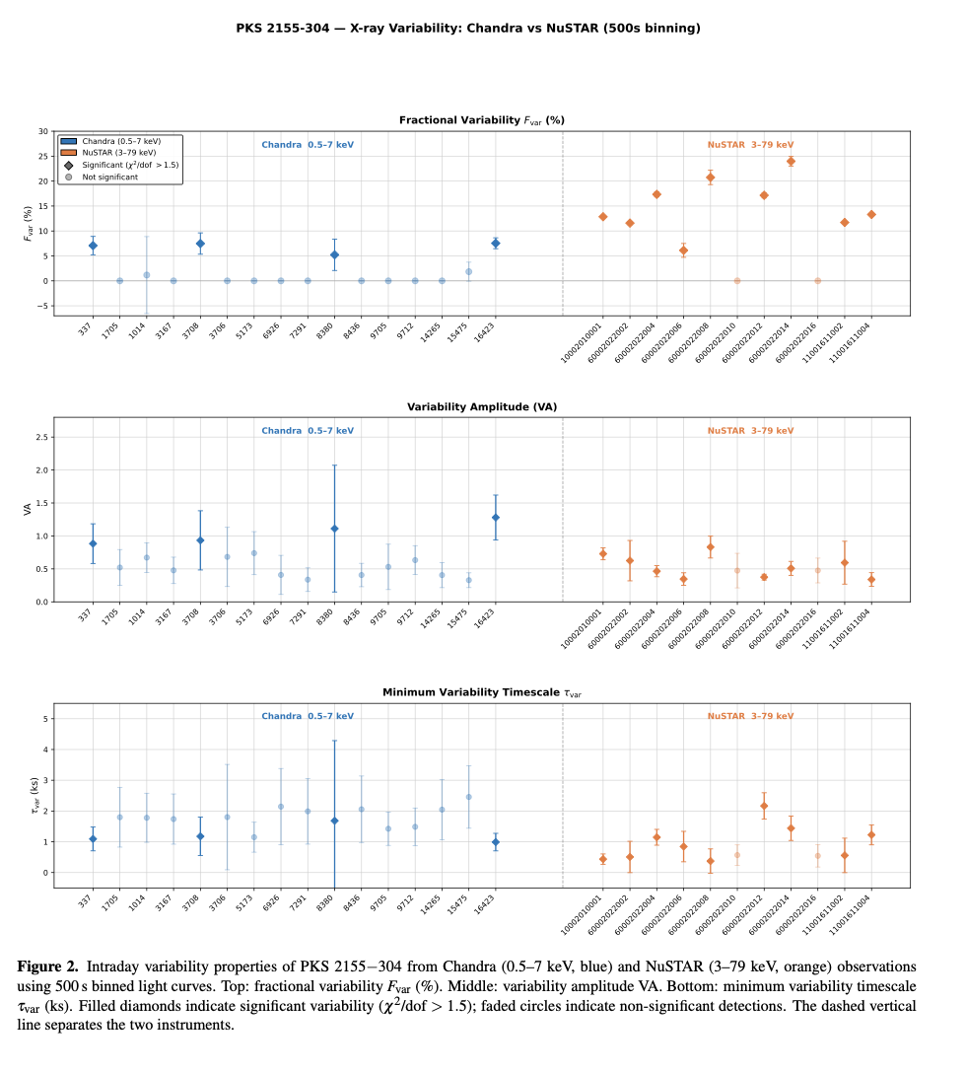
Flux Variability: F_var Results
Chandra vs NuSTAR vs Bhatta+25 (XMM-Newton)
Comparison with Bhatta+25
Metric
Bhatta+25
This work
Instrument
XMM-Newton
Chandra+NuSTAR
F_var min
1.3%
6.6%
F_var max
21.1%
56.9%
F_var mean
~7% (IDV)
~25–30%
Long-term F_var
~40%
~25–30%
Baseline
15 yr
25 yr

Slide 6
Hardness Ratio & Spectral Evolution
Both instruments reveal harder-when-brighter trend
HR Analysis
HR Analysis
Key Results
Chandra: HR = Flux(2–8) / Flux(0.4–2)
NuSTAR: HR = Flux(10–79) / Flux(3–10)
Harder-when-brighter (HWB)
Both Chandra and NuSTAR confirm HWB trend — consistent with efficient particle acceleration extending synchrotron to higher energies during flares
Spectral flux independence
Many observations show significant flux variation without corresponding spectral change — long-term variability is largely achromatic
Complex HR–flux plane
Some observations show neither clear HWB nor SWB — suggests multiple, possibly independent emission regions or turbulent acceleration
Consistent with Bhatta+25
Bhatta+25 found similar behavior in XMM-Newton: HWB in 3/22 obs, SWB in 1/22 obs
HR vs Observation time

Slide 7
X-ray Spectral Analysis: Four Models
PL, BPL, LP, and the novel BR+PL
Power Law (PL)
Log-Parabola (LP)
dN/dE = K·E^{⁻ᴦ}
dN/dE = K·10^(-β(log E/Ep)²)/E²
Γ = 1.88–2.69 (Chandra)
Γ = 2.55–2.97 (NuSTAR)
Chandra: β mostly negative
NuSTAR: β < 0 (all obs)
Baseline — does not fit well alone
Stochastic acceleration signature
Broken Power Law (BPL)
Bremsstrahlung + PL
Two indices + break E_b
dN/dE = K_{BR}·E⁻¹exp(-E/kT) + K_{PL}·E^{⁻ᴦ}
E_b ≈ 4–6 keV (Chandra)
Improves χ²ᵥ significantly
Best fit majority of obs
kT = 0.5–1.7 keV (Chandra)
Better — reveals spectral break
★ KEY RESULT: Thermal + non-thermal
Bhatta+25 (XMM): BPL best in 14/22, LP in 8/22 — simple PL never preferred. Our BR+PL result goes further, suggesting thermal plasma alongside the jet.

Slide 8
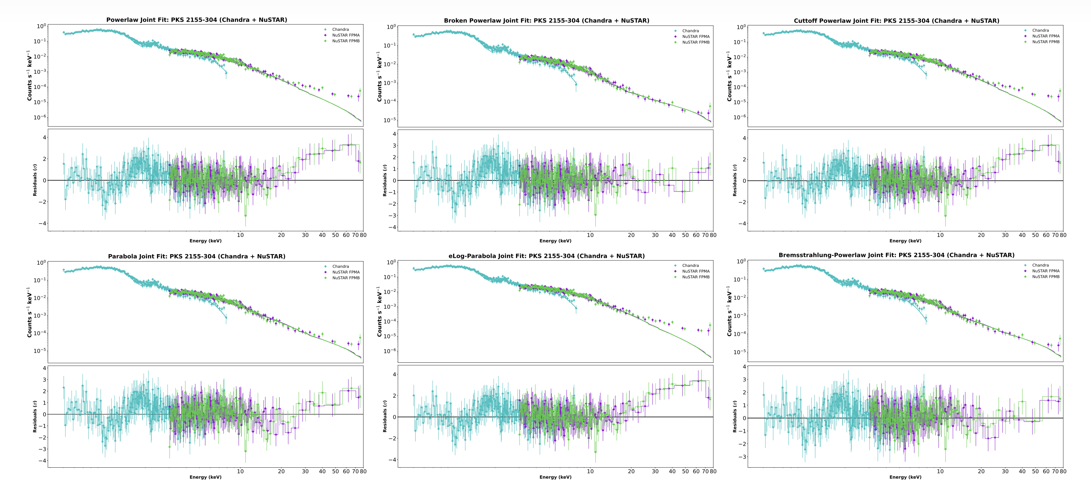
Joint Broadband Spectral Fitting: 0.4–79 keV
Simultaneous Chandra (ID 15475, MJD 56406) + NuSTAR (ID 60002022002, MJD 56406)
Best-fit Parameters
Model
χ²ᵥ (dof)
PL
1.066 (550/516)
[ Figure 3 — Joint spectral fit panels
PL / BPL / CPL / LP / eLP / BR+PL ]
BPL
0.917 (470/512)
CPL
1.051 (540/514)
LP
0.941 (483/514)
eLP
1.059 (544/514)
Chandra (0.4–8 keV) + NuSTAR FPMA/B (3–79 keV)
BR+PL
0.925 (474/512)
BR+PL gives kT = 2.14±0.23 keV (Chandra). BPL finds E_break = 20 keV in NuSTAR — only accessible thanks to the hard X-ray coverage.

Slide 9
Physical Interpretation
Compact jet emission + possible thermal component
Compact Emitting Region
Particle Acceleration
Thermal Component
HWB trend → efficient acceleration extends synchrotron to higher E
τ_var = 1.15±0.26 ks
(well-constrained)
BR+PL best fit (most obs)
R ≤ 7.7×10¹⁵ cm
kT ≈ 0.5–1.7 keV (Chandra)
LP spectra → stochastic acceleration in turbulent jet
(δ = 25, z = 0.116)
Possible origins:
Consistent with synchrotron
from compact jet region
• Accretion disk corona
• Hot ICM plasma
• Jet base emission
Synchrotron cooling constraint: B ≥ 0.35 δ⁻¹/³ ν₁₉⁻¹/³ G → for δ=25: B ≳ 0.12 G | γ ≤ 9×10⁵ ν₁₉¹/² (consistent with SED modeling)

Slide 10
Novel Result: Thermal Component in PKS 2155−304
Bremsstrahlung+PL is the best-fit model for the majority of observations
0.5–1.7 keV
~0.8–3.0 keV
Why Does This Matter?
kT range (Chandra)
kT range (NuSTAR)
Blazars assumed purely non-thermal
Standard picture: jet-dominated, PL spectra. Our result challenges this for PKS 2155−304.
BR+PL outperforms PL, BPL, and LP
Lower χ²ᵥ for majority of both Chandra and NuSTAR observations — statistically significant.
Possible disk-corona origin
kT ~ 0.5–2 keV is characteristic of disk corona or accretion disk soft excess — testable with Athena/XIFU.
Athena relevance
Athena XIFU spectral resolution will definitively resolve thermal vs. non-thermal at these temperatures — this source should be prioritised.
Top: Flux vs kT and Bottom: Γ vs kT [Chandra (left) and NuSTAR (right)]

Slide 11
Connection to NewAthena Science Goals
PKS 2155−304 as a benchmark for the Athena era
X-IFU High-Resolution Spectroscopy
WFI Rapid Timing Variability
Our BR+PL thermal component (kT~0.5–2 keV) will be directly testable with Athena X-IFU's resolving power (ΔE~2.5 eV). It can resolve thermal and non-thermal emission at soft X-ray energies where Chandra/NuSTAR are degenerate.
Our shortest well-constrained τ_var = 1.15±0.26 ks sets a constraint on emitting region size (R ≤ 7.7×10¹⁵ cm). WFI's large collecting area will measure IDV on timescales below our current 500s binning, probing sub-structure of the jet.
Broadband SED in the X-ray Epoch
Constraining Magnetic Field Geometry
Our 25-year Chandra+NuSTAR baseline establishes the spectral state evolution of PKS 2155−304. Athena observations will add a new epoch to this baseline and test whether the thermal component persists or evolves.
Recent IXPE polarisation (22% in 2–8 keV) combined with our spectral curvature results offers a multi-messenger constraint on B-field structure in the blazar jet — synergy with Athena timing.

Slide 12
Summary
1
25-year X-ray baseline
16 Chandra + 11 NuSTAR observations from 1999–2024. F_var spans 6.6%–56.9%. Shortest well-constrained variability timescale τ_var = 1.15±0.26 ks (NuSTAR).
2
Harder-when-brighter confirmed
Both instruments show HWB trend. Many observations show significant flux variation with stable spectral shape — largely achromatic long-term variability.
3
Spectral curvature seen in all observations
Simple PL disfavoured. BPL, LP, and BR+PL all outperform PL. Log-parabola peak energy E_p evolves with flux state.
4
★ Thermal component detected
BR+PL provides best fit in majority of observations. kT ≈ 0.5–1.7 keV — possible disk corona contribution alongside the jet.
5
Joint 0.4–79 keV broadband fit
First joint Chandra+NuSTAR spectral fit for PKS 2155−304. NuSTAR reveals spectral break at ~20 keV invisible to Chandra alone.
→ PKS 2155−304 is an ideal Athena target: thermal component needs XIFU resolution; sub-ks IDV needs WFI collecting area.

Slide 13
Thank You
rameshan.thimmappa@villanova.edu
Thimmappa, Neilsen & Gudennavar (2026, in prep.)
Spectral and Timing Variability Studies of PKS 2155−304
using Chandra and NuSTAR
Collaborators: Joey Neilsen (Villanova) · Shivappa B. Gudennavar (CHRIST University)
Data: Chandra X-ray Center · NuSTAR GOF · NASA HEASARC
NewAthena Rising
ICE-CSIC Barcelona · June 3, 2026

Slide 14
Spectral Curvature: Log-Parabola Parameter Evolution
α, β, E_p correlations reveal particle acceleration history
Physical Insight
β < 0 (Chandra)
May reflect energy-dependent cooling at the synchrotron tail
E_p evolution
Peak energy varies with flux - consistent with shift of synchrotron peak during flares
α–β correlation
Anti-correlation: harder spectra (lower α) show larger curvature — matches particle pile-up
[α vs β vs Flux and Ep panels Chandra (left) and NuSTAR (right) ]

