Slide 1
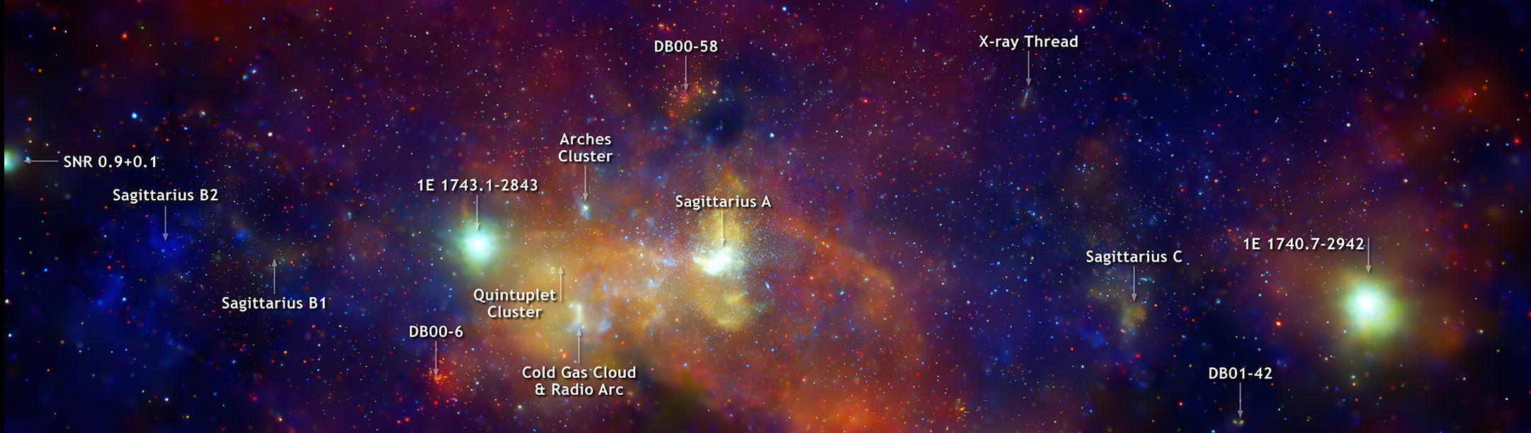


A New Era for Galactic Center Astrophysics: Revealing the X-ray Populations with NewAthena
Credit: NASA/CXC/UMass/D. Wang et al.
Shifra Mandel
Columbia University
June 3, 2026

Slide 2
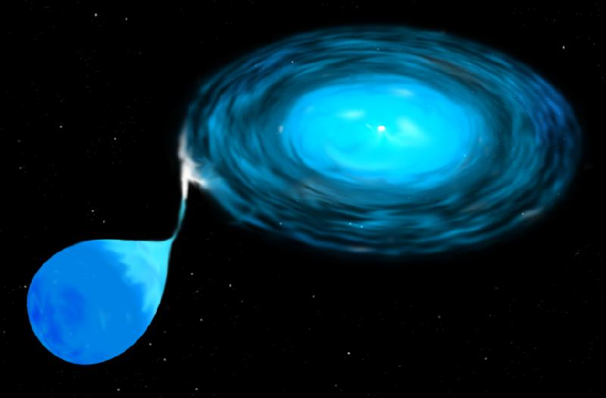
Accreting compact objects are copious X-ray emitters
Compact object
Accretion
disk
Donor
star
Credit: STScI

Slide 3
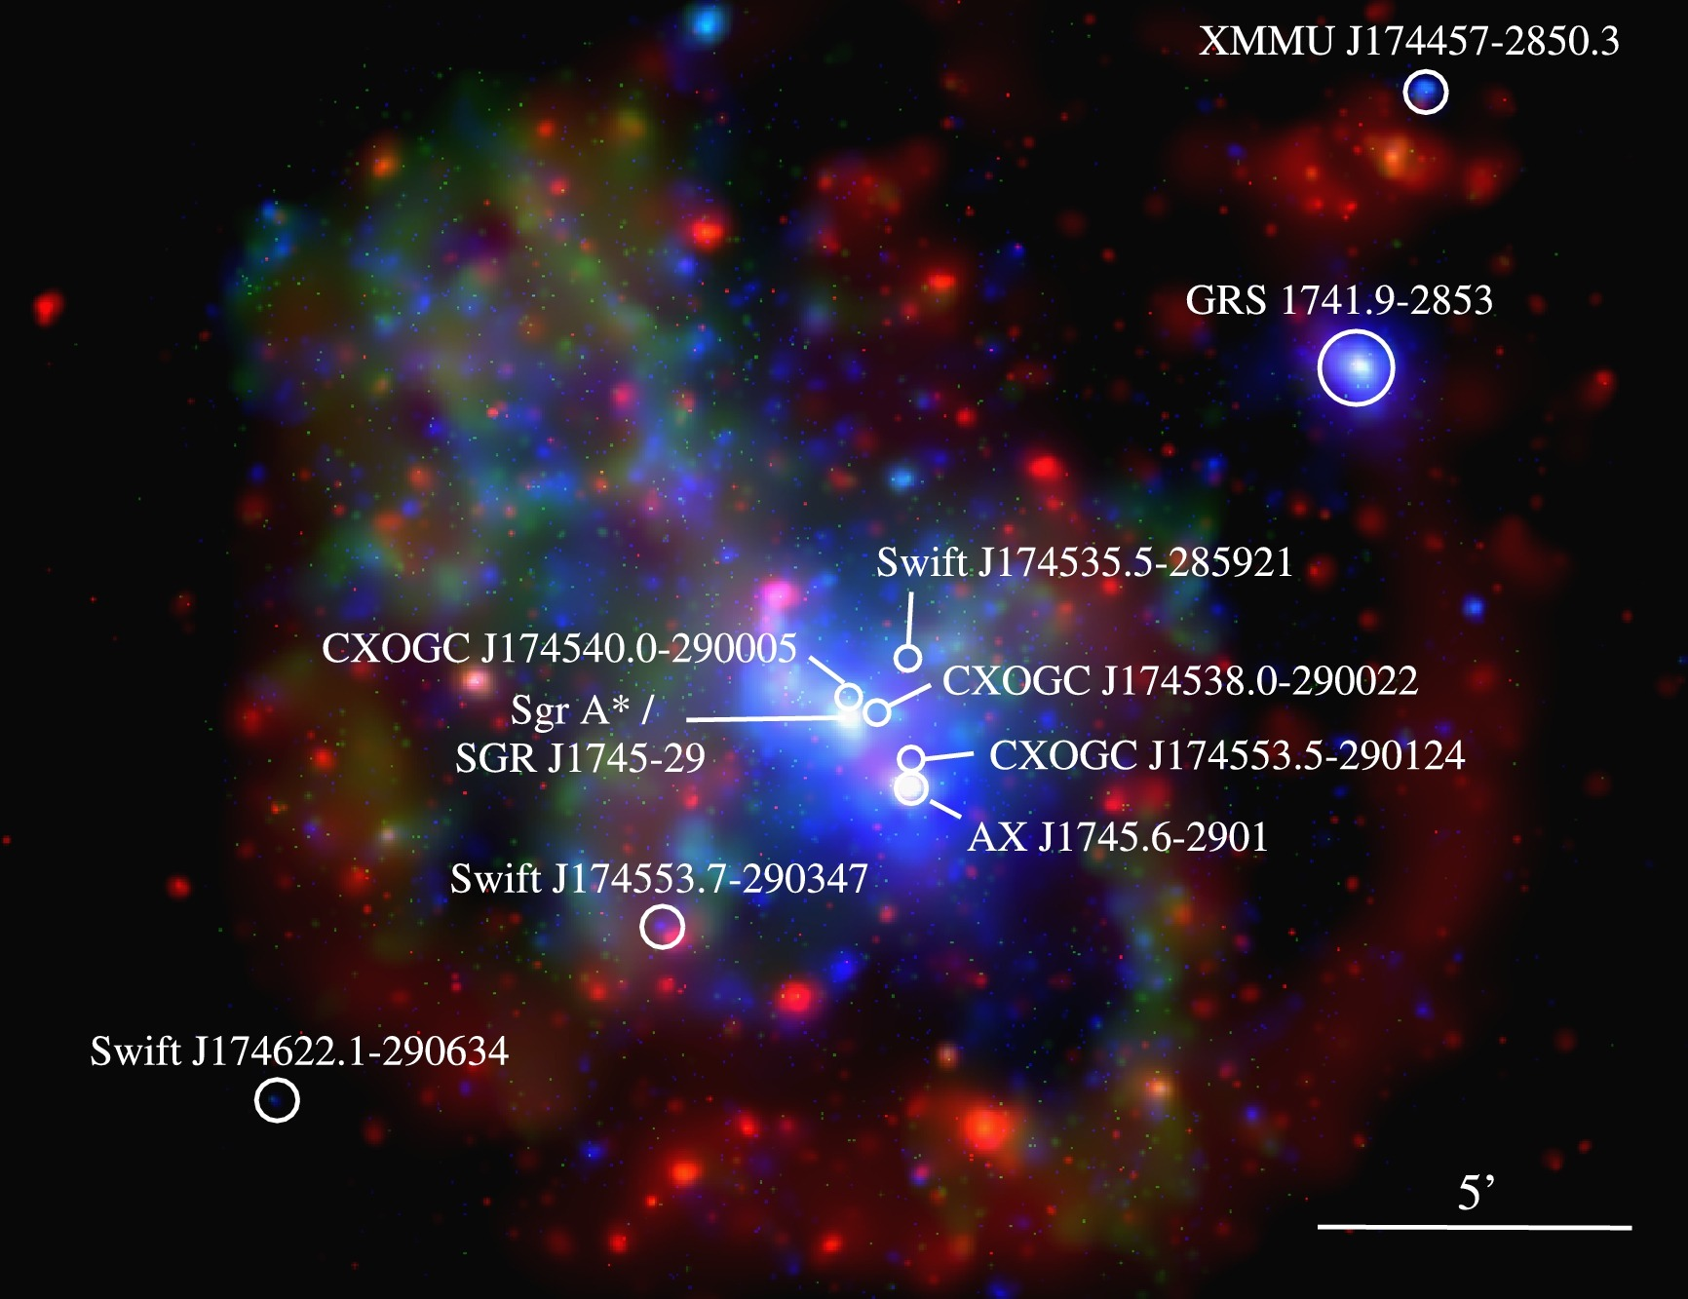
The Galactic center is remarkably rich in X-ray transients
Degenaar et al. (2015)

Slide 4
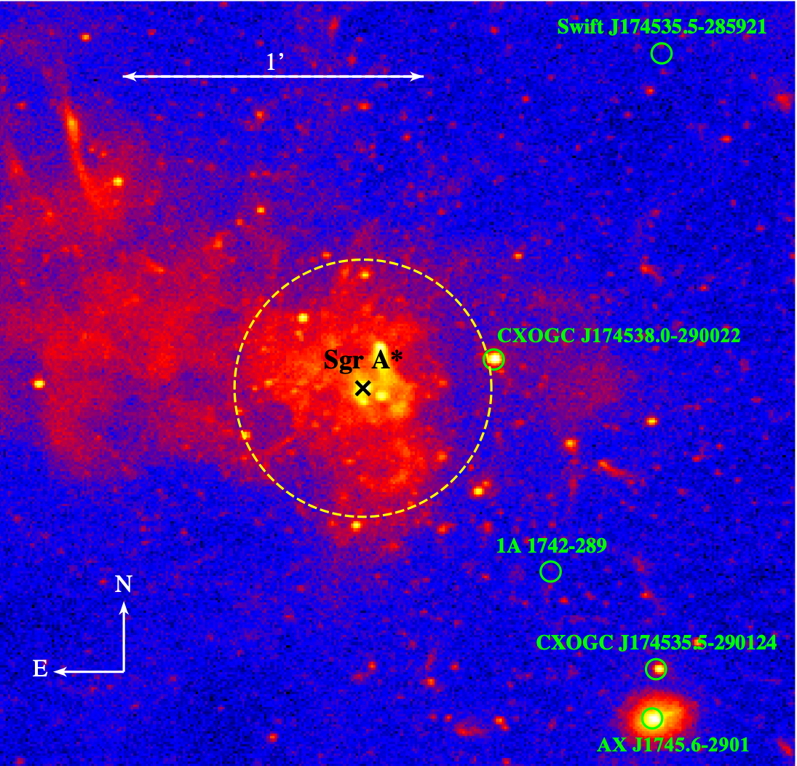
Chandra
Swift/XRT
Degenaar et al. (2015)

Slide 5
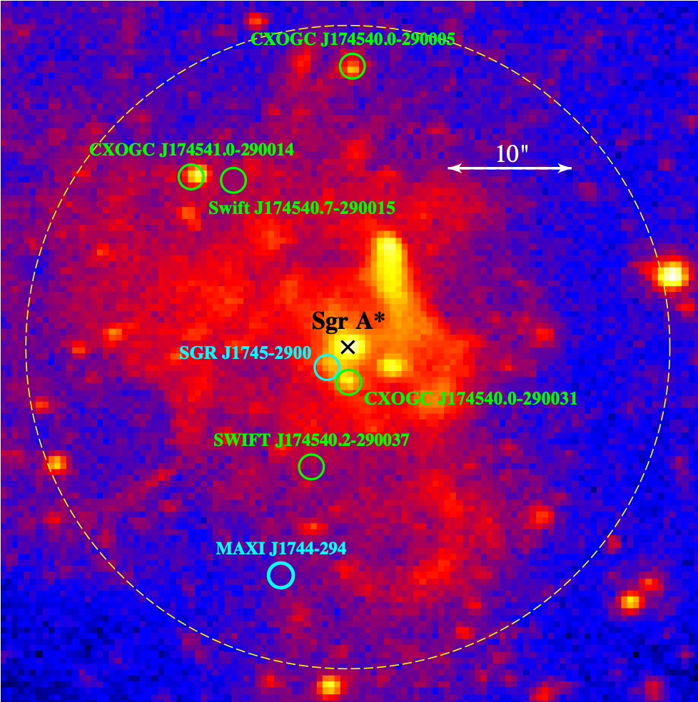
Chandra
PWN G359.95-0.04
CXOGC J174538.0-290022
…Especially in the central pc!

Slide 6
Chandra
CXOGC J174538.0-290022
PWN G359.95-0.04
…Especially in the central pc!

Slide 7
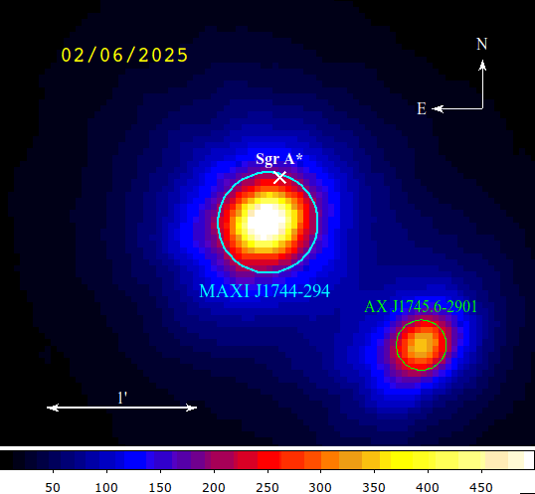
An explosion heard around the world: all X-ray eyes on MAXI J1744-294
X-ray ToO observations:
NuSTAR: 3-79 keV, 18” FWHM → high-energy/broadband spectrum (reflection/spin), timing (QPOs/pulsations/eclipses)
Chandra/ACIS-S: 2-7 keV, 0.5” angular resolution → source localization
XRISM: 2-10 keV, 1.3’ HPD → best X-ray spectral resolution (Fe line complex)
XMM-Newton: 2-10 keV, 4.5” FWHM → Moderate spectral/spatial resolution, soft X-ray coverage
Swift/XRT: weekly observations → long term evolution
NuSTAR
(3-79 keV)
Additional multiwavelength observations: NICER, EP, IXPE, MAXI, Swift/BAT, NinjaSat, (X-ray) MeerKAT, VLA (radio), Keck (NIR)

Slide 9
Swift J174540.7-290015
PWN G359.95-0.04
Sgr A*
SGR J1745-2900
NuSTAR
(3-79 keV)
CXOGC J174540.0-290031
SWIFT J174540.2-290037
MAXI J1744-294
18” FWHM
Chandra
(0.7-7 keV)
1A 1742-289
(58” HPD)
Contamination from
NS AX J1745.6-2901
PWN G359.95-0.04
SNR Sgr A East
}
Accurately modeling the background is a major challenge

Slide 10



Publications in review/press
Mandel et al. A multiwavelength view of the new Galactic center transient MAXI J1744-294 (arXiv:2509.14465; in review)
Marra et al. Exploring MAXI J1744-294: IXPE insights into a Galactic Center X-ray Transient (2026)
Parra, Mandel et al. XRISM view of MAXI J1744-294 (2026; in review)
Mandel et al. (2026)
Marra et al. (2026)
Parra et al. (2026)
10

Slide 11
Spectral signatures of X-ray binaries
Thermal emission from the accretion disk: multi-color blackbody
Compton scattering of thermal disk photons by corona ⇒ non-thermal (power-law)
Reflection of Comptonized photons off the disk ⇒ line emission & Compton hump
COMPTONIZED
DISK
REFLECTED

Slide 12

Spectra: soft thermal (disk blackbody) + hard nonthermal (Comptonization) + reflection components
Absorbed thcomp*diskbb+Gauss (r𝜒²/dof ~1.17/121)
Significant residuals at E > 30 keV ⇒ reflection component (Compton hump)
Flux = 4x10⁻⁹ erg/cm²/s (2-10 keV) ⇒
L_{X} ~3e37 erg/s (for 8 kpc distance)
n_{H} = (1.71$±$0.02)$×$10²³ cm⁻²
kT_{in} = 0.61$±$0.01 keV
𝛤 = 2.62$±$0.16
E_{line} = 6.67$±$0.03 keV
𝜎 = 0.01$±$0.04 keV
+ XMM/EPIC PN
+ NuSTAR/FPMA
+ NuSTAR/FPMB
3/3/25
Compton reflection hump

Slide 13
Spectra: soft thermal (disk blackbody) + hard nonthermal (Comptonization) + reflection components
Absorbed thcomp*diskbb+Gauss (r𝜒²/dof ~1.17/121)
Significant residuals at E > 30 keV ⇒ reflection component (Compton hump)
Flux = 4x10⁻⁹ erg/cm²/s (2-10 keV) ⇒
L_{X} ~3e37 erg/s (for 8 kpc distance)
n_{H} = (1.71$±$0.02)$×$10²³ cm⁻²
kT_{in} = 0.61$±$0.01 keV
𝛤 = 2.62$±$0.16
E_{line} = 6.67$±$0.03 keV
𝜎 = 0.01$±$0.04 keV
+ XMM/EPIC PN
+ NuSTAR/FPMA
+ NuSTAR/FPMB
3/3/25
Compton reflection hump

Slide 14

Zooming in: MAXI J1744-294 Fe lines with XRISM/Resolve
Spectrum rebinned to 20$σ$

Slide 15

+ XMM/EPIC PN
+ NuSTAR/FPMA
+ NuSTAR/FPMB
Maxime Parra

Slide 16
Swift J174540.7-290015
PWN G359.95-0.04
Sgr A*
SGR J1745-2900
NuSTAR
(3-79 keV)
CXOGC J174540.0-290031
SWIFT J174540.2-290037
MAXI J1744-294
18” FWHM
Chandra
(0.7-7 keV)
1A 1742-289
(58” HPD)
Contamination from
NS AX J1745.6-2901
PWN G359.95-0.04
SNR Sgr A East
}
Accurately modeling the background is a major challenge

Slide 17

Contamination in the XRISM FoV (Parra et al. 2026)

Slide 18
Zooming in: MAXI J1744-294 Fe lines with XRISM/Resolve
Spectrum rebinned to 20$σ$

Slide 19
New developments in GC X-ray population studies
Back to the big picture:

Slide 20
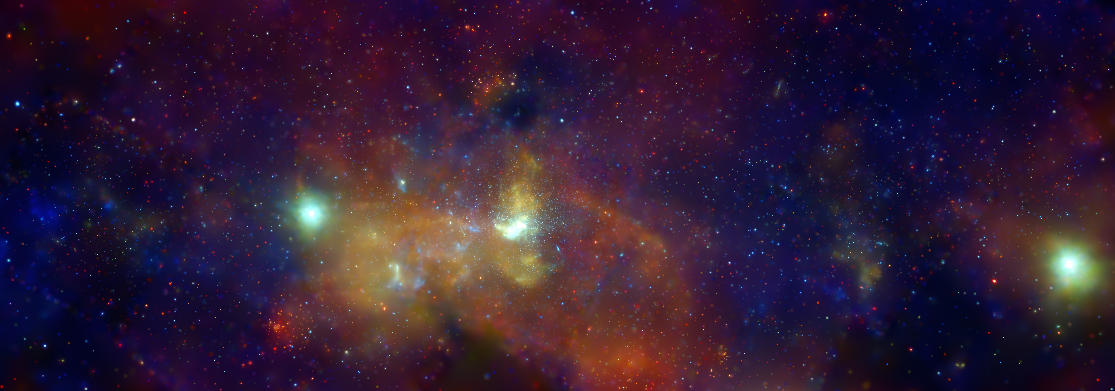
Chandra: nearly 10,000 X-ray point sources in the Galactic Center
Sgr A*
Credit: NASA/CXC/UMass/Q.D. Wang

Slide 21
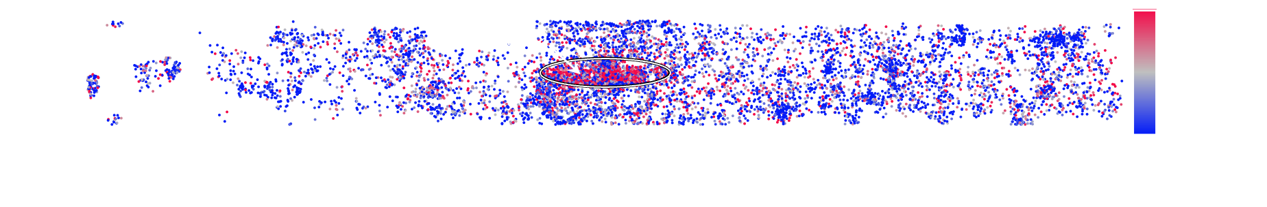

A concentration of hard
X-ray sources in the central region of the Galaxy
(corresponding to the Nuclear Stellar Disc)
Hardness Ratio $=\frac{H−S}{H+S}$
H = 4-12 keV
S = 2-4 keV
Mandel et al. 2026 (in prep)

Slide 22
The Spatial Distributions of X-ray Sources

Slide 23
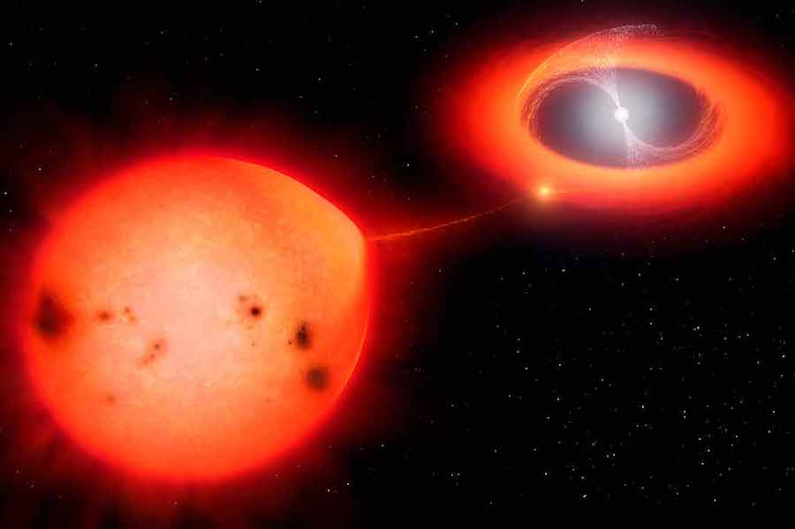
Intermediate Polars
(IPs)
Credit: Mark Garlick

Slide 24
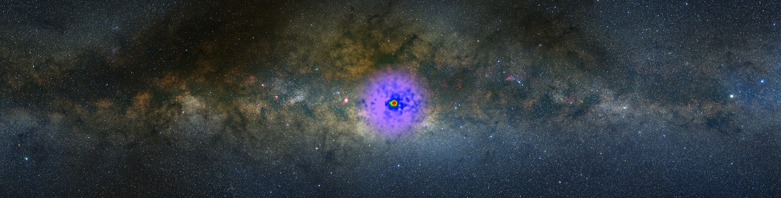
A concentration of MSPs in the Galactic center?
Fermi GeV excess: the missing pulsar problem
Credit: NASA Goddard/A. Mellinger (Central Michigan Univ.) and T. Linden (Univ. of Chicago)

Slide 25
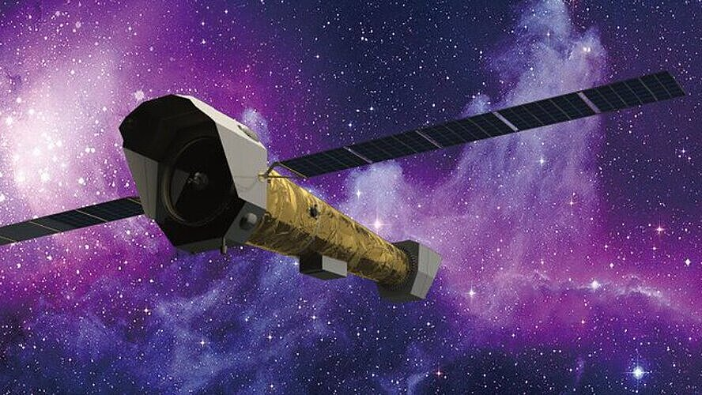
Requirements for Galactic center population studies:
Angular resolution
Spectral resolution
Sensitivity

Slide 26








Acknowledgements
Columbia Team:
Chuck Hailey
Kaya Mori
Benjamin Levin
Eric Miao
Harry Cato Van Der Ark
Maxime Parra
(Ehime University)
Paul Draghis
(MIT)
Gabriele Ponti
(INAF)
Mimi
(unaffiliated)

Slide 27

Key Takeaways:
An “excess” concentration of hard X-ray sources has been discovered in the central region of the Galaxy
The Galactic center hosts the highest concentration of exotic X-ray sources in the sky, including X-ray transients
For Galactic center X-ray astrophysics, we require an observatory with
  High angular resolution (to mitigate source confusion/contamination),
  High spectral resolution (to resolve and accurately measure the Fe line complex), and
  High sensitivity (to detect faint point sources)
ss5018@columbia.edu
27

